Slide 1
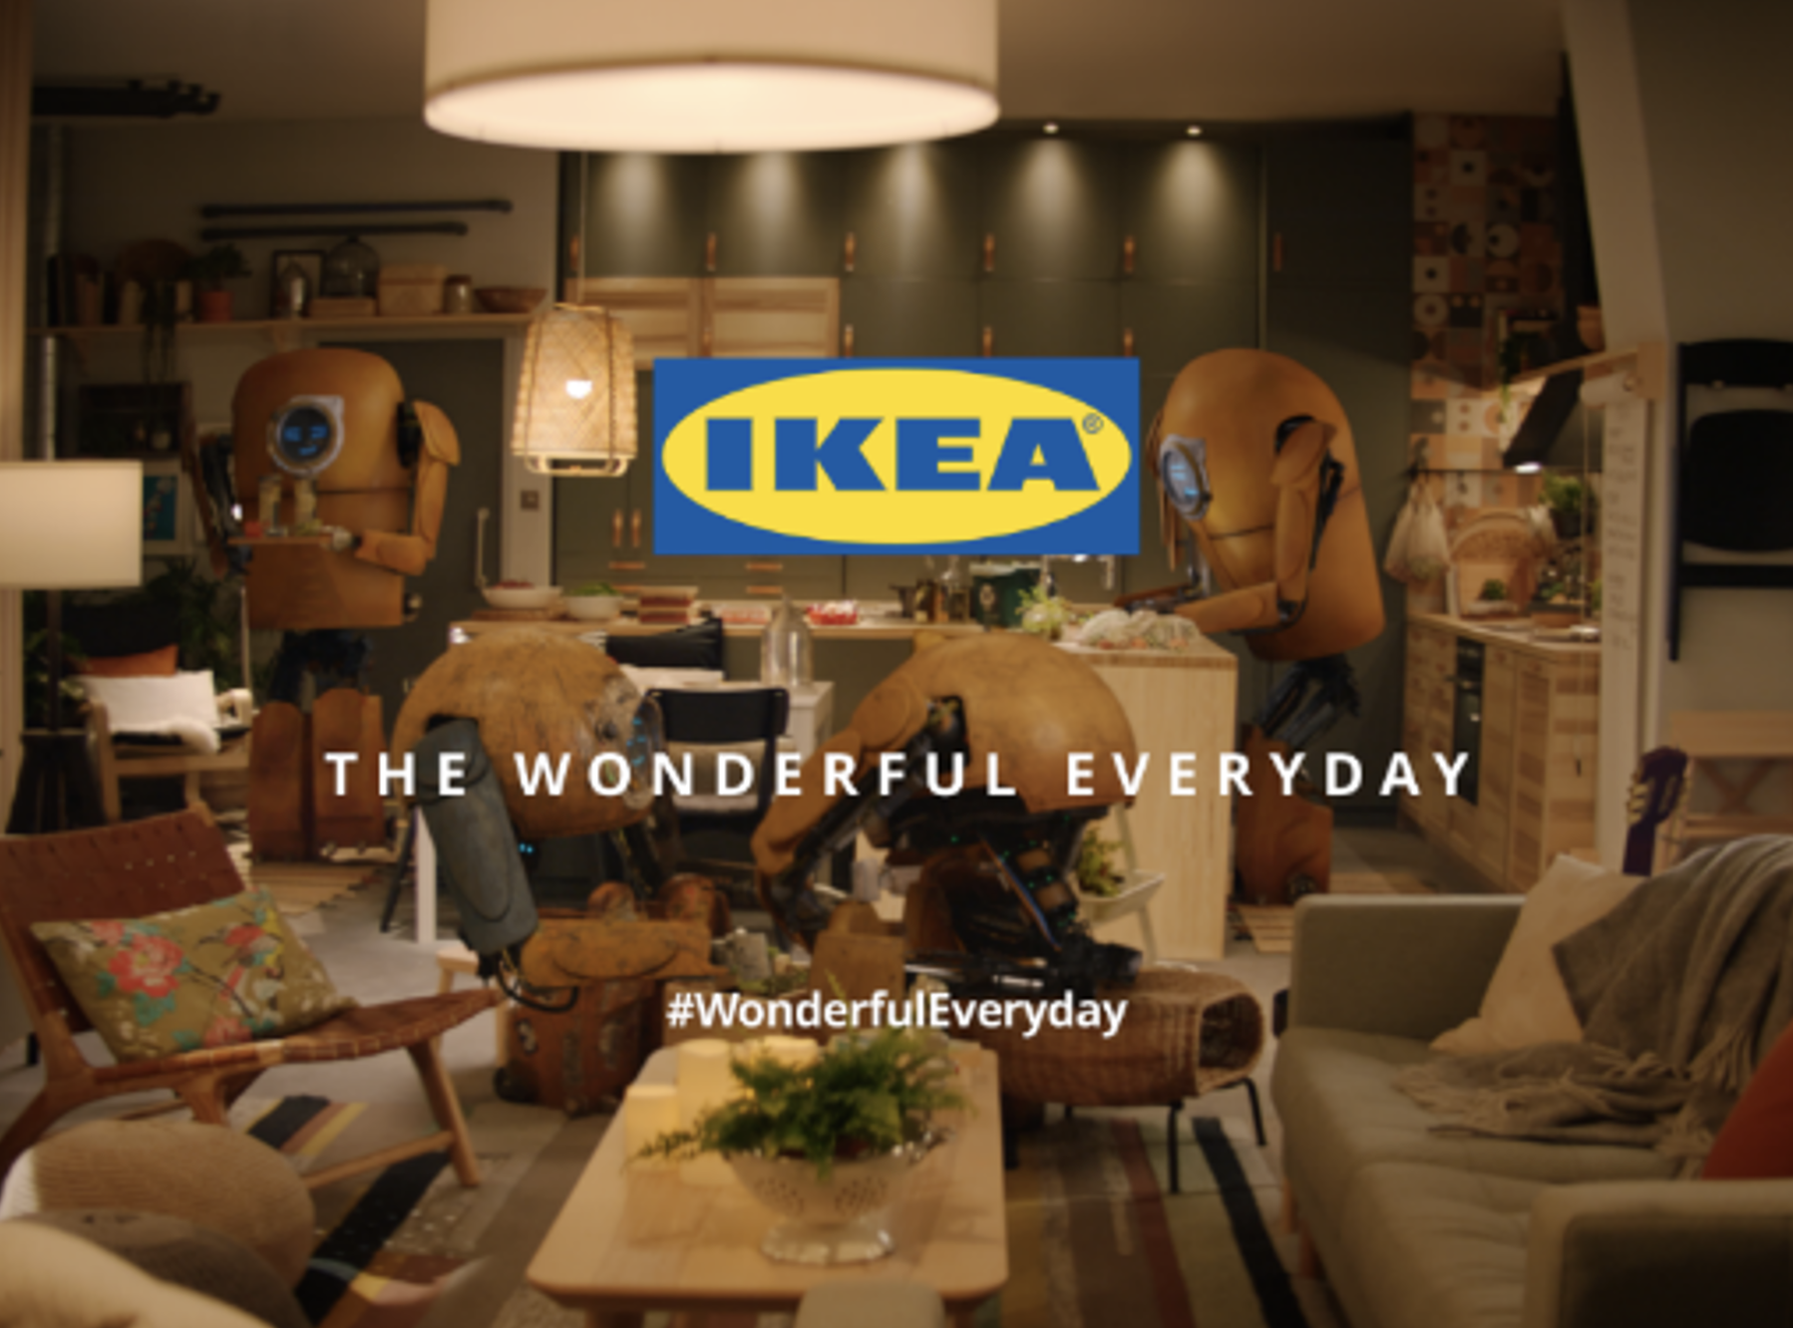


Ikea
Background
2021 was IKEA’s ‘Leap Year of Sustainability’ making it the singular central message across all brand activity during the year. IKEA wanted to demonstrate that living sustainably was achievable by showcasing solutions for the masses.
Plan
The campaign’s longest Little Robot 60” asset ran in cinema as part of a broad AGP buy and across Family AGP titles to upweight engagement with families. IKEA made sure that all the campaigns were certified as ‘green’, meaning that electricity at the sites was 100% renewable and the campaign had to be shown at chains with digital-only film.
Results
The ‘Leap Year of Sustainability’ brand campaign delivered over £180m incremental revenue to IKEA.
Cinema delivered a 7% contribution to ‘brand desire’, despite accounting for only 1% of the overall media spend.
Source: IKEA DCM Awards Entry
Notes:
Source: IKEA DCM Awards Entry

Slide 2
Ikea
‘Leap Year of Sustainability’
Media agency | Target | Buying route | Copy length
iProspect | Adults | AGP | 60”
Background
2021 was IKEA’s ‘Leap Year of Sustainability’ making it the brand’s core focus and singular central message across all brand activity across the year. IKEA needed to demonstrate that living more sustainably was achievable for ‘the many’ by showcasing solutions that were accessible to people regardless of circumstances and across the household income spectrum.
Plan
The campaign’s longest Little Robot 60” asset ran in cinema as part of a broad AGP buy and across Family AGP titles to upweight engagement with families. Working closely with DCM, IKEA made sure that all the campaigns were certified as ‘green’. This meant that electricity at the sites used had to be 100% renewable and the campaign had to be shown at chains that no longer used physical film reels, instead delivering films digitally, reducing their carbon footprint.
Results
The ‘Leap Year of Sustainability’ brand campaign delivered positive results across brand KPIs.
Delivered successful ROI
The campaign delivered over £180m incremental revenue to IKEA and an exceptional ROI that was significantly ahead of figures from the previous two years.
‘Brand desire’ contribution
Cinema delivered a 7% contribution to ‘brand desire’, despite accounting for only 1.2% of the overall media spend, four times more effective than the next best channel.
Source: IKEA DCM Awards Entry
Notes:
Source: IKEA DCM Awards Entry

