Slide 1
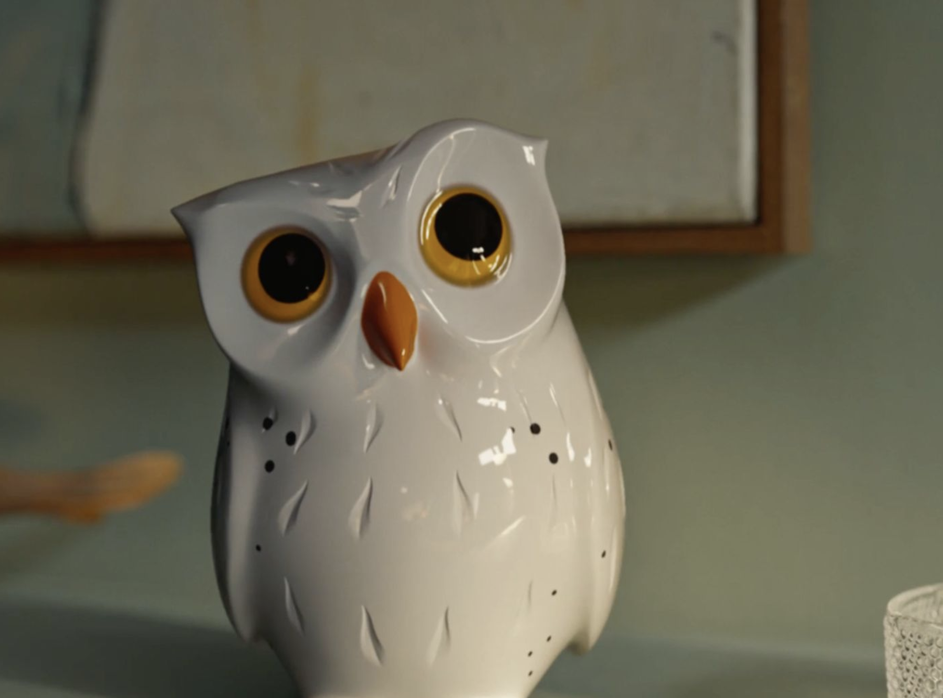
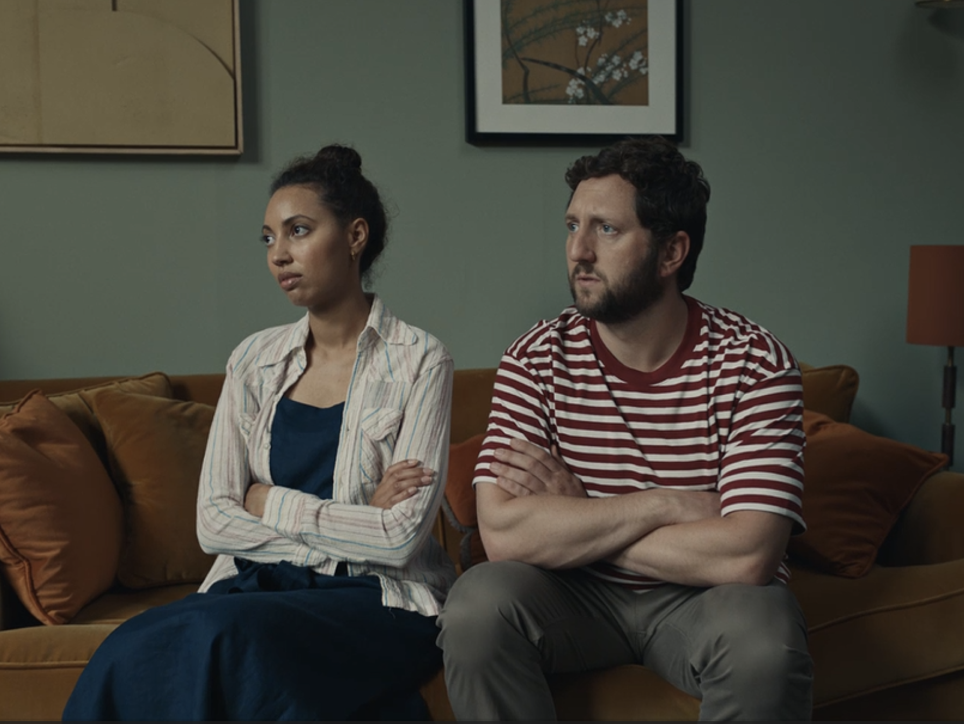

Hillarys
Background
Hillarys launched a brand-new campaign to highlight the importance of expert advice and service when it comes to window dressing.
Plan
Hillarys set out to maximise ABC1 Adult campaign reach by adding cinema to the plan, with the campaign running in Premium AGP titles including Bob Marley: One Love, The Iron Claw & Wicked Little Letters, and Dune: Part 2.
Results
Awareness (+21%) and Consideration (+41%) KPIs were significantly higher amongst those exposed via cinema.
Brand comprehension: ‘Hillarys is well known for doing what it does’, +16% higher vs. control sample.
Notes:
No source on previous presentation

Slide 2
Hillarys
Media agency | Target | Buying route | Copy length
EssenceMediacom | ABC1 Women | Prem AGP & Film Pack | 30”
‘For the Window Wise’
Background
Hillarys, the UK’s leading supplier and manufacturer of bespoke window dressings, launched an innovative brand campaign to highlight the importance of expert advice and service when it comes to window dressing. Their creative copy followed the story of a delightful owl character, whimsically guiding viewers to the benefits of tailored expertise. Voiced by Jennifer Saunders, the campaign was set to charm audiences across various media platforms.
Plan
In an effort to extend & maximise incremental reach during the campaign, Hillarys leveraged the power of cinema to enhance attention and engagement. The brand wanted to feature alongside films that aligned with their target audience as well as attracting new audiences to the brand who in the past might’ve disregarded the in-home service. Hillarys bought into a Premium AGP across Feb – Mar 24, giving them access to films such as Bob Marley: One Love, The Iron Claw & Wicked Little Letters, in addition to a film pack in Dune: Part 2, a film that was predominantly ABC1 (c.70%).
Results
Exposure to the ad in the cinema significantly enhanced Hillarys’ KPIs.
Awareness and consideration
Awareness (+21%) and Consideration (+41%) KPIs were significantly higher amongst those exposed via cinema.
Brand comprehension
The perception ‘is well known for doing what it does’ was +16% higher amongst those exposed vs. control sample.
Brand trust
Test respondents were significantly more likely to trust (+45%) Hillarys after exposure to the ad in the cinema.
Notes:
No source on previous presentation

