Slide 1
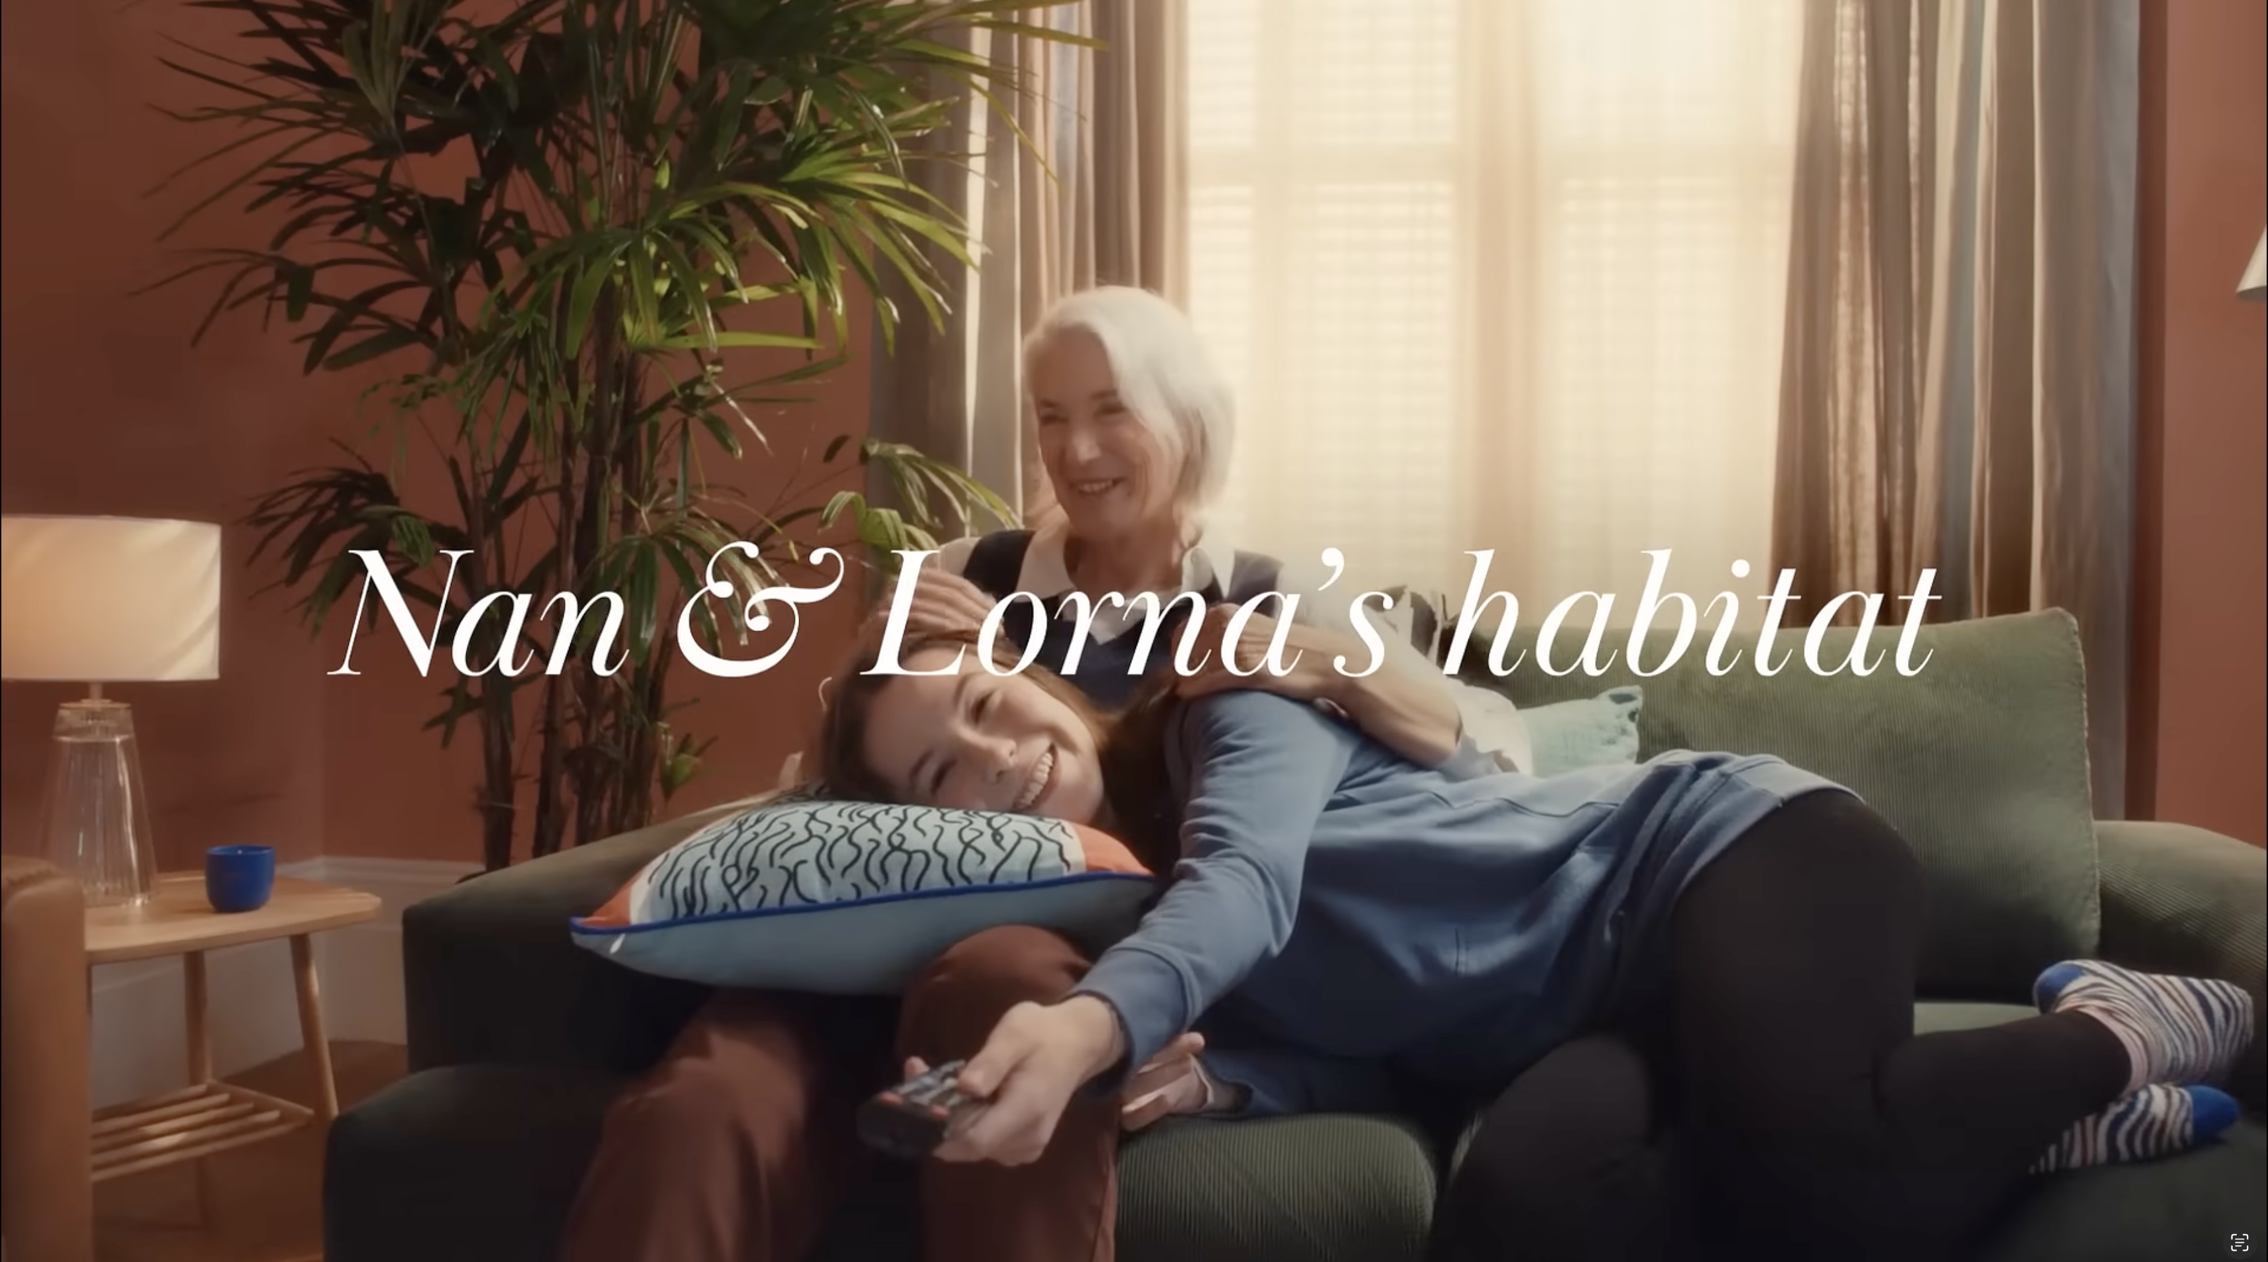
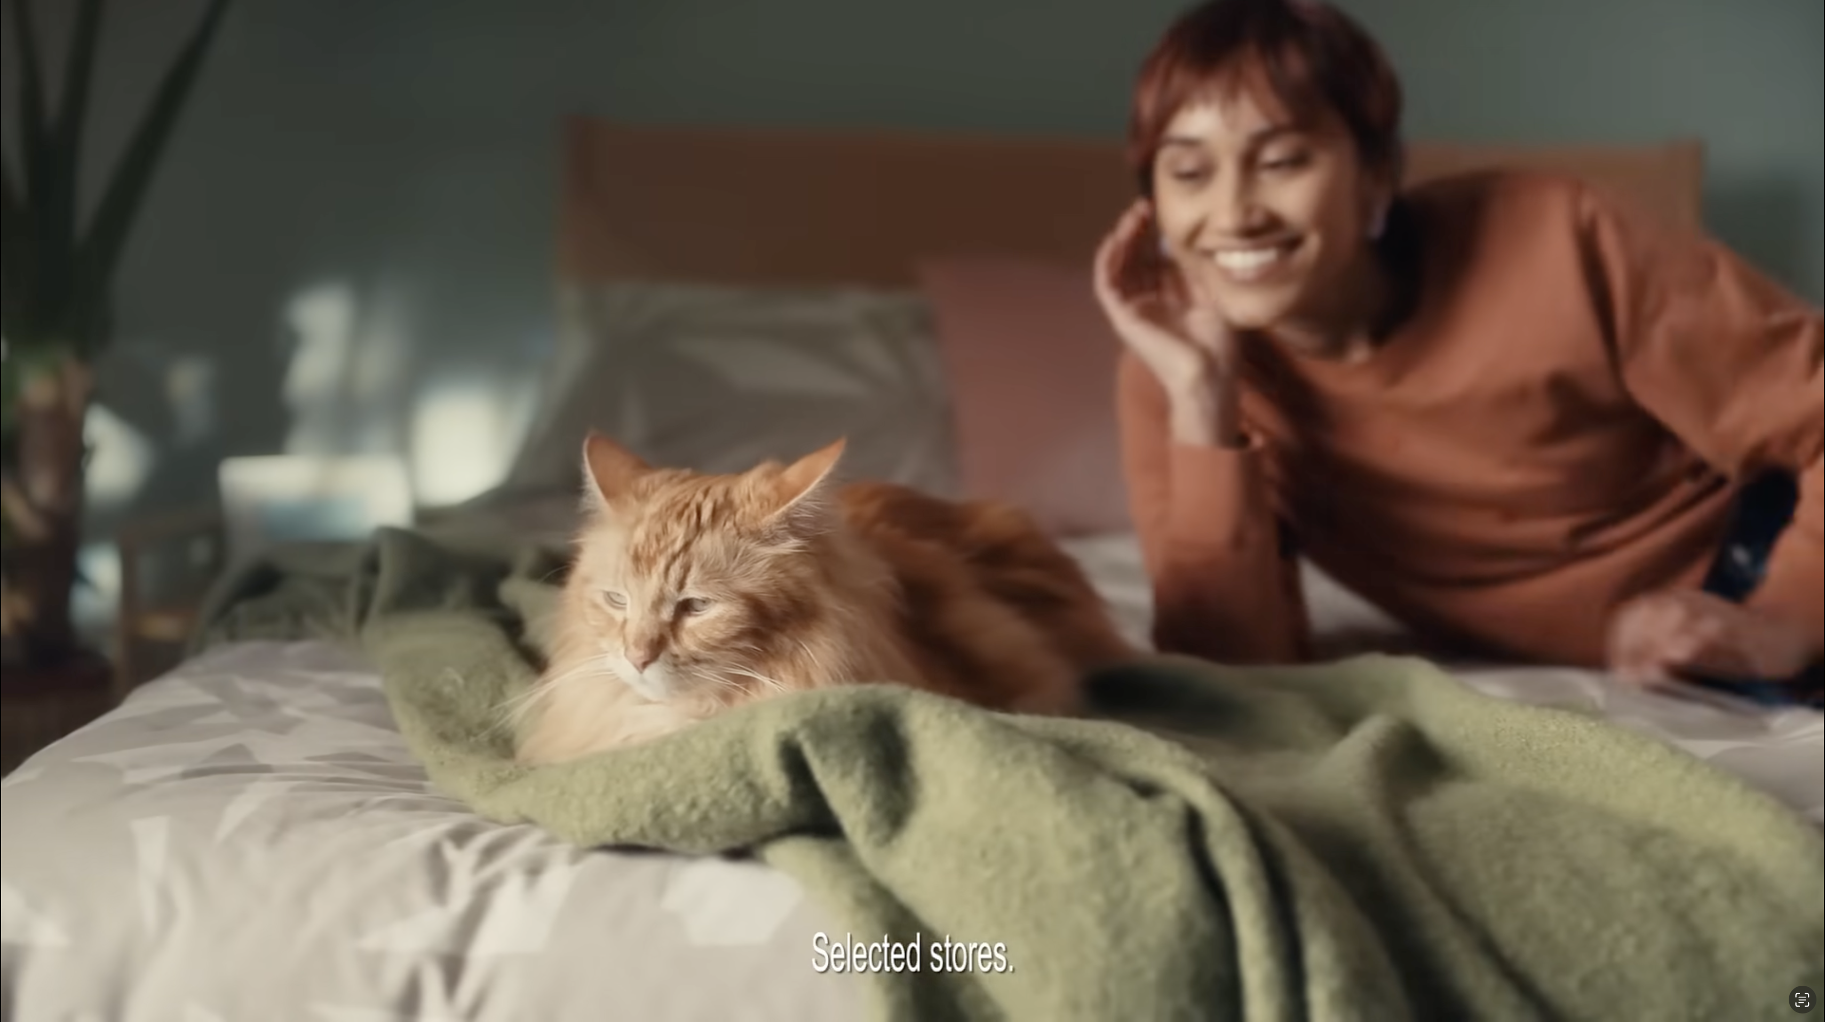

Habitat
Background
The aim of the ‘Happy Habitat’ campaign was to raise the brand’s profile and by showing Habitat has ‘something for everyone’ drive consideration across its product range.
Plan
With a goal to drive impact, capture attention and push likeability amongst the target audience, Habitat selected an ABC1 Adult AGP giving the campaign access to titles including Doctor Strange in the Multiverse of Madness, Top Gun: Maverick and Jurassic World Dominion.
Results
Cinemagoers exposed to the ad on the big screen were 23% more aware of recent Habitat advertising.
Just under 60% said they would consider shopping at Habitat – with cinemagoers 42% more likely to be ‘extremely likely’ to consider vs. control.
Source: DCM / Habitat. Conducted by; Differentology, June 2022.
Notes:
Source: DCM / Habitat. Conducted by; Differentology, June 2022.
Results base: 25-54s. Uplifts are test (exposed to ad in cinema) vs control (not exposed to ad in cinema)

Slide 2
Habitat
Media agency | Target | Buying route | Copy length
PHD | 25-54s | ABC1 Ads AGP | 30”
‘Happy Habitat’
Background
The aim of the ‘Happy Habitat’ campaign was to raise the brand’s profile and consideration of its product range. The campaign looked to inspire customers in the process of either updating a whole room or adding touches of seasonal style with the breadth of Habitat’s range to create their own personal “habitat”. Demonstrating its wide-ranging product offering, Habitat wanted to show that they have something for every home.
Plan
With the aims of driving direct impact, capturing attention and pushing likeability amongst the target audience, Habitat selected an ABC1 Adult AGP giving the campaign access to titles including Doctor Strange in the Multiverse of Madness, Top Gun: Maverick and Jurassic World Dominion.
Results
Cinema was crucial in enhancing the campaign’s overall impact, helping to maximise impact across the KPIs.
Improving recall
Cinemagoers exposed to the ad on the big screen were +23% more aware of recent advertising by
the brand.
Key perceptions
Cinema delivered uplifts on key brand perceptions - ‘Habitat is good value for money’ (+43%) and ‘Habitat has quality products and great design’ (+22%).
Driving consideration
Just under 60% said they would consider shopping at Habitat – with cinemagoers +42% more likely to be ‘extremely likely’ to consider vs. control.
Source: DCM / Habitat. Conducted by; Differentology, June 2022.
Notes:
Source: DCM / Habitat. Conducted by; Differentology, June 2022.
Results base: 25-54s. Uplifts are test (exposed to ad in cinema) vs control (not exposed to ad in cinema)

