Slide 1

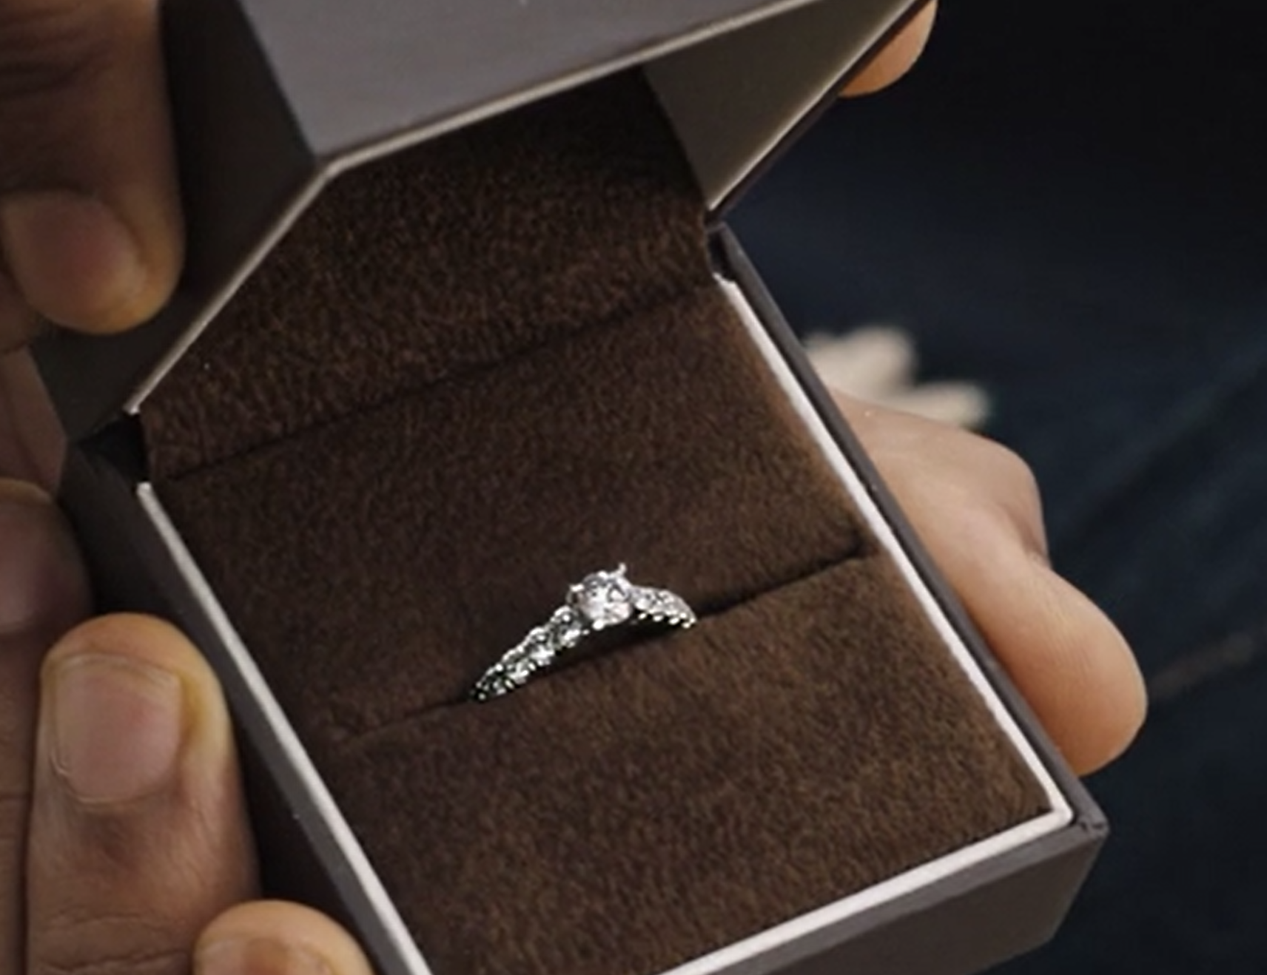

Ernest Jones
DCM Awards Winner:
Best Use of Cinema (Small)
Background
Ernest Jones wanted to promote its luxury associations on a wider national level, looking at driving mass reach but with a proximity focus to support its key outlets.
Plan
Using DCM’s Cinemapper planning tool, Ernest Jones’ 30” copy ran in cinemas within a 20-minute drive of a store. In cinemas within outlets that also had an Ernest Jones, a bespoke 5” end-frame was used to highlight the stores’ close proximity, with the aim of driving footfall.
Results
+39% uplift in those who said they would consider shopping at Ernest Jones.
The selected stores saw a 9% increase in attributed sales vs. 2019, outperforming other Ernest Jones’ outlets by 3%.
Source: Ernest Jones DCM Awards Entry
Notes:
Source: Ernest Jones DCM Awards Entry

Slide 2
Ernest Jones
DCM Awards Winner:
Best Use of Cinema (Small)
Celebrate Your Story
Media agency | Target | Buying route | Copy length
Bountiful Cow | ABC1 35-54 | ABC1 Ads AGP + House of Gucci | 30” + 5”
Background
Ernest Jones wanted to promote its luxury associations on a wider national level, looking at driving mass reach but with a proximity focus to support its key outlets. Ernest Jones chose cinema as they wanted to prioritise targeting in a premium environment that provides content that influences and creates emotional connections.
Plan
Using DCM’s Cinemapper planning tool, Ernest Jones’ 30” copy ran in cinemas within a 20-minute drive of a store. In cinemas within outlets that also had an Ernest Jones, a bespoke 5” end-frame was used to highlight the stores’ close proximity, with the aim of driving footfall.
The campaign ran across House of Gucci and wider ABC1 Adults AGP titles. Beyond cinema, the campaign also ran across TV, BVOD and YouTube & Print.
Results
Selecting cinema locations near Ernest Jones stores delivered an exceptional uplift in sales performance, demonstrating the power of cinema as both a brand-building and sales-driving platform.
Improving consideration
+39% uplift in those who said they would consider shopping at Ernest Jones.
Boosting sales in targeted stores
The selected stores saw a 9% increase in attributed sales vs. 2019, outperforming other Ernest Jones’ outlets by 3%.
Source: Ernest Jones DCM Awards Entry
Notes:
Source: Ernest Jones DCM Awards Entry

