Slide 1
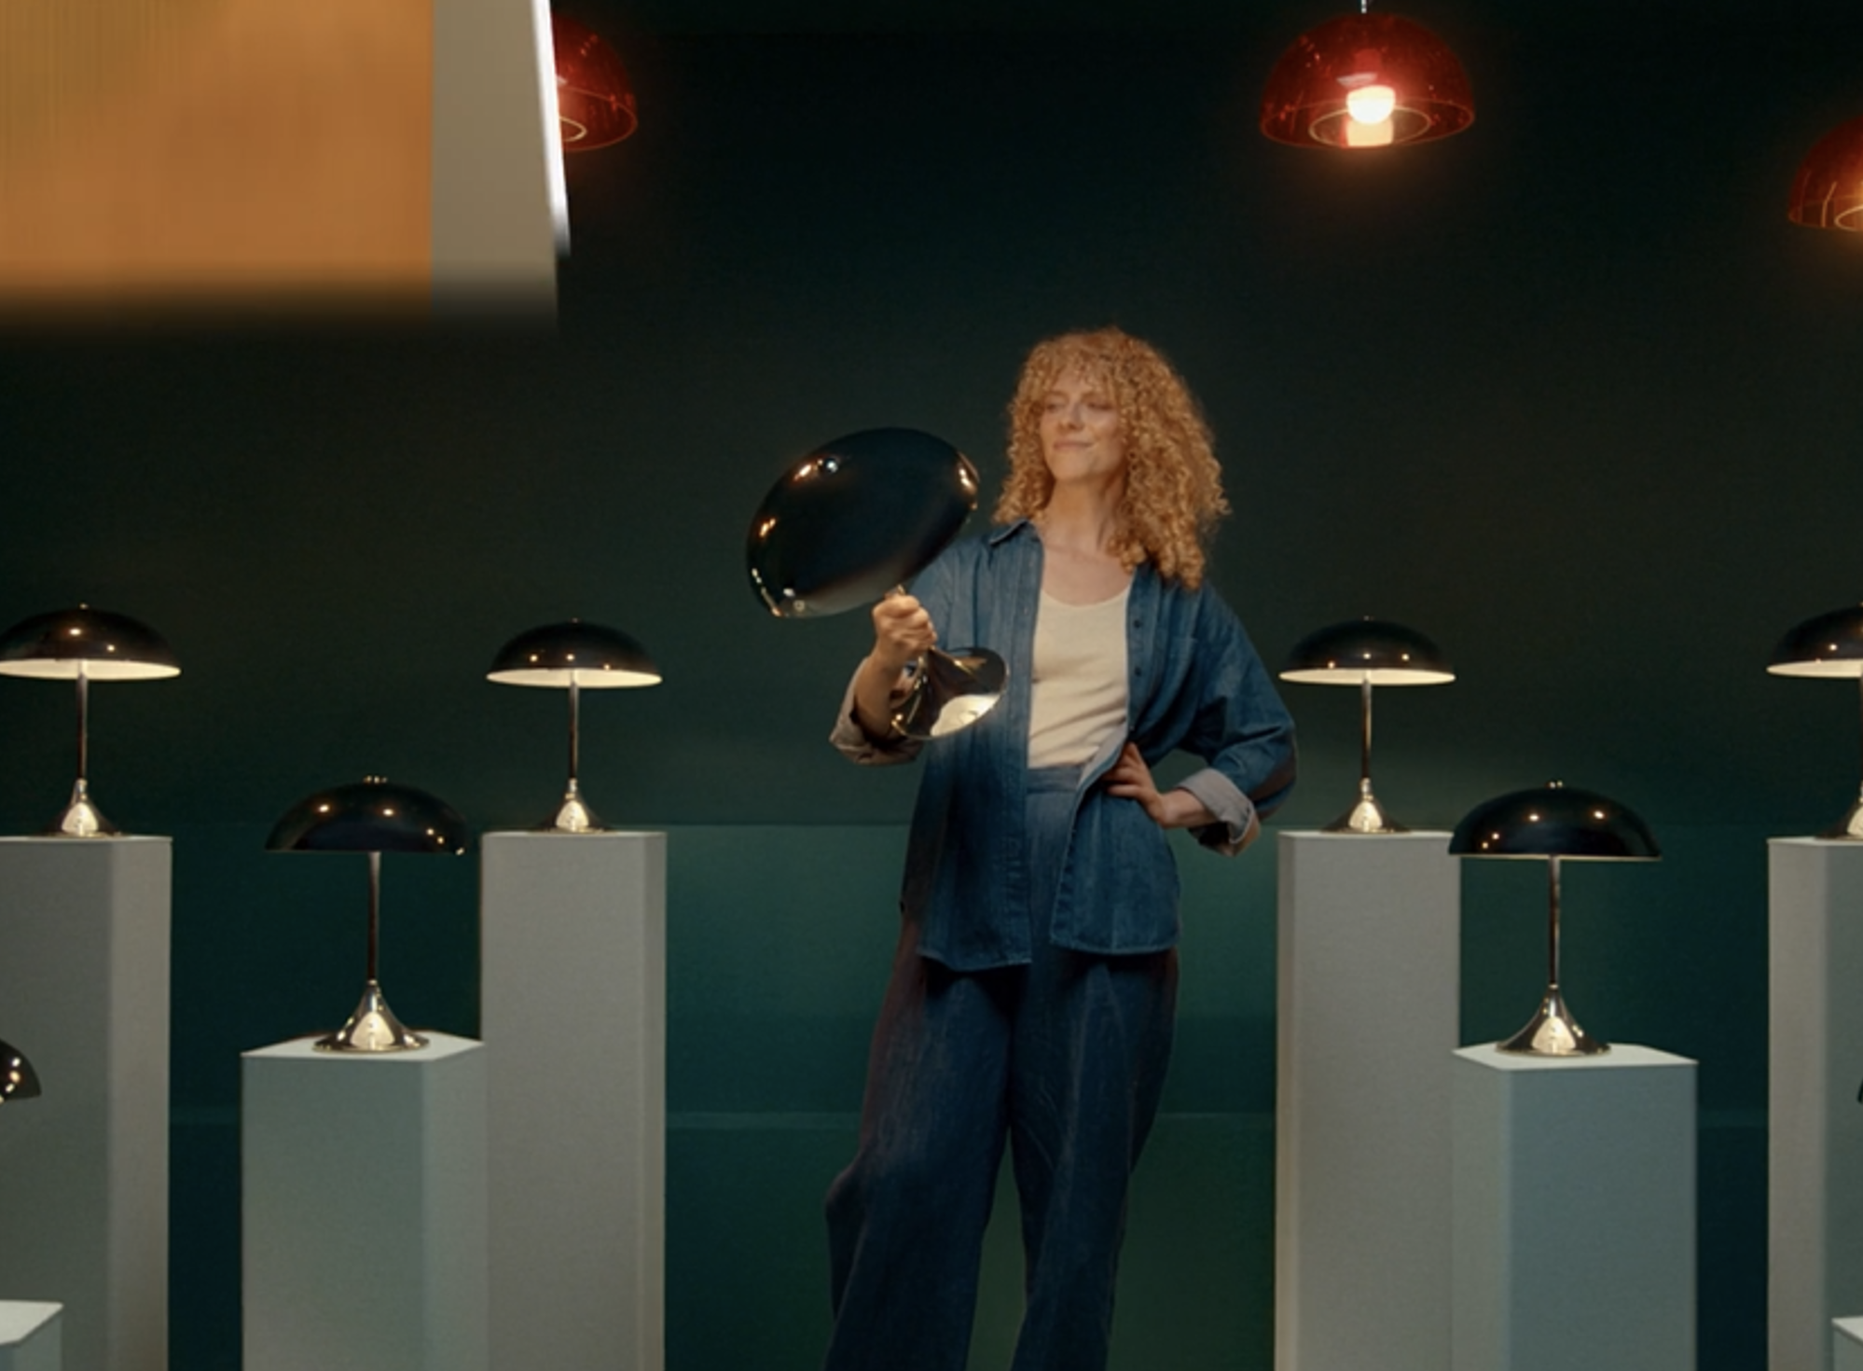
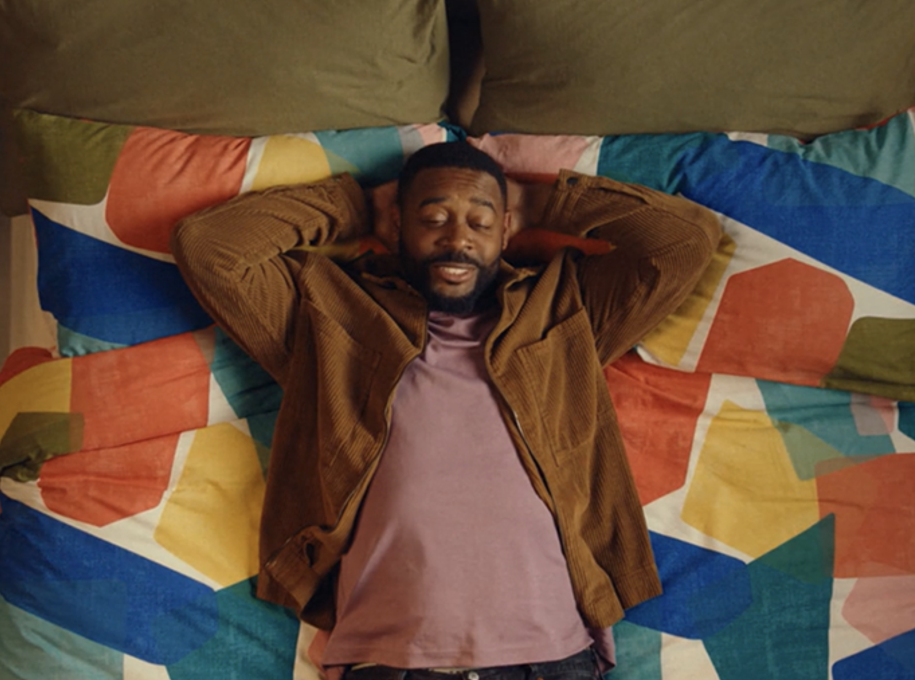

Dunelm
Background
Dunelm wanted to increase cut through with affluent 25-54s and boost brand value perceptions and ultimately increase consideration and conversions.
Plan
Dunelm showcased its 30” ad across cinema for the first time reaching its core demographic through an AGP buy. The campaign also ran the 30” and additional shorter copies across TV, BVOD, YouTube, and Radio.
Results
Brand awareness was high at 80% with cinema delivering +9% uplift.
Perceptions of Dunelm offering ‘good value for money’ were up 25% and action intent was up +19% amongst those exposed to the ad in cinema.
Source: DCM / Dunelm. Conducted by; Differentology, Sept 2024.
Notes:
Source: DCM / Dunelm. Conducted by; Differentology, Sept 2024.
Results base: 25+. Uplifts are test (exposed to ad) vs control (unexposed to ad)

Slide 2
Dunelm
‘You’re the One That I Want’
Media agency | Target | Buying route | Copy length
Goodstuff | 25+ ABC1 | AGP | 30”
Background
Whilst already owning the title of being the UK’s leading home furnishing retailer, Dunelm wanted to cut through to affluent 25-54s who were interested in homeware and décor in order to boost product sales. In the last 5 years, Dunelm used AV mediums like TV and VOD to boost awareness & saliency of their brand but struggled to see any conversion across the core target audience. The new campaign therefore aimed to increase aggregate awareness of the brand, boost value brand perceptions and increase consideration.
Plan
Wanting to access a wide array of films that appealed to an ABC1 audience, Dunelm showcased their 30” across cinema for the first time, accessing a full weight AGP to give them access to titles including Beetlejuice Beetlejuice, The Substance, Smile 2, The Wild Robot & Anora. Expanding across other platforms, the campaign also ran the 30” and an additional 10” copy across TV, BVOD, YouTube, Press and Radio.
Results
Cinema was crucial in enhancing the campaign’s overall impact, helping to maximise impact across the KPIs.
Awareness
Brand awareness was high at 80% with exposure in cinema delivering +9% uplift.
Messaging & action
Perceptions of Dunelm offering ‘good value for money’ were up 25% and action intent was up +19% amongst those exposed to the ad in cinema.
Source: DCM / Dunelm. Conducted by; Differentology, Sept 2024.
Notes:
Source: DCM / Dunelm. Conducted by; Differentology, Sept 2024.
Results base: 25+. Uplifts are test (exposed to ad) vs control (unexposed to ad)

