Slide 1
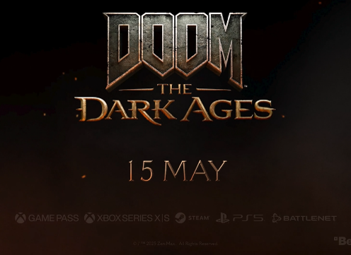


Doom
DCM Awards nominee:
Best Use of Cinema (Small)
The Dark Ages – Stand & Fight
Background
As the next chapter in the iconic Doom franchise, the game needed a legendary launch. Whilst it was key to drive reach, on a tight budget, there was also a focus on maximising attention to deliver the biggest impact.
Plan
The centrepiece for the campaign was a 60” Silver Spot in Final Destination: Bloodlines, although a 30” creative also played in-reel for Until Dawn and Thunderbolts* - all titles chosen because they over-indexed for gaming adjacent audiences.
Results
Doom: The Dark Ages debuted at #1 in the charts on release and received huge accolades
Key uplifts across a range of metrics, particularly driven by positive increases in both consideration and purchase intent.

Slide 2

Doom
DCM Awards nominee:
Best Use of Cinema (Small)
Media Agency | Target | Buying Route | Copy length
Arena Media | Adults | Silver spot and Film Packs | 30” & 60”
The Dark Ages – Stand & Fight
Background
As the next chapter in the iconic Doom franchise, the game needed a legendary launch. Whilst it was key to drive reach, on a tight budget, there was also a focus on maximising attention to deliver the biggest impact. Cinema’s role was to better target gaming-interested audiences in an attentive environment, with the intention of driving consideration.
Plan
The centrepiece for the campaign was a 60” Silver Spot in Final Destination: Bloodline, although a 30” creative also played in-reel for Until Dawn and Thunderbolts* which were all titles that over-indexed for gaming adjacent audiences. The creative was crafted to ensure that the games’ themes were displayed whilst also celebrating the games’ iconic music and visual spectacle – perfect for the cinema environment.
Results
The campaign was a huge success, with Doom: The Dark Ages performing well commercially.
Results – cont.
Topping The Charts
Doom: The Dark Ages debuted at #1 in the charts on release and received huge accolades
Boosting KPIs
Key uplifts across a range of metrics, particularly driven by positive increases for both consideration and purchase intent.

