Slide 1
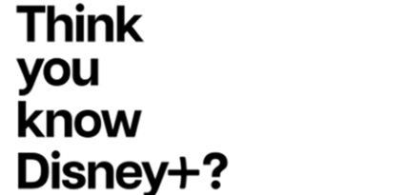
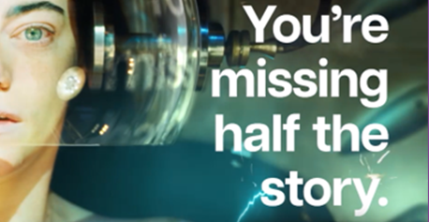

Disney+
Background
Wanting to reach more mature audiences to emphasise the plethora of content available to stream, Disney+ aimed to drive a change in perception, boost sales and improve the brand’s position in the SVOD market.
Plan
Disney+ disrupted the cinema ad reel, running Blipverts to showcase the juxtaposition and range of Disney+ titles e.g. Ratatouille and The Bear, to ultimately land the campaign’s core message - “If you’re only seeing half the story, you don’t know what you’re missing”.
Results
Cinema was integral in effectively engaging with hard-to-reach audiences, with their ‘content for adults’ brand health metrics significantly increasing.

Slide 2
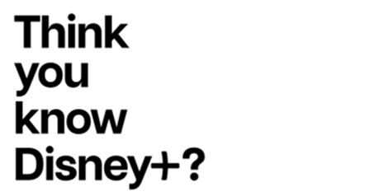


Disney+
Media Agency | Target | Buying Route | Copy length
Publicis | ABC1 Adults | Film Packs/Blipverts | 10”, 30”
Think You Know Disney+?
Background
Whilst being synonymous with family friendly entertainment, Disney+ struggled to break away from the perception that the streaming service is solely for children’s content. Wanting to reach more mature audiences to emphasise the plethora of mature content available to stream, Disney+ aimed to drive a change in perception, boost sales and improve the brands position in the SVOD market.
Plan
Wanting to primarily associate themselves with non-family titles to help challenge the existing perception, Disney+ creatively ran Blipverts across a range of films to reach parents and older audiences.
The Blipverts alternated between juxtaposing Disney+ titles e.g. Ratatouille and The Bear to show the variety of their content, emphasising the campaigns slogan “If you’re only seeing half the story, you don’t know what you’re missing”. The copy also aimed to provide shock value by playing the iconic Disney audio intro sound adjacent to crude and graphic lines from adult films, such as Poor Things when Emma Stone states, “I must go punch that baby!”, building on the perceptions of the departure from only family friendly entertainment.
Results
The campaign was a phenomenal success, especially in disrupting perceptions of the streaming service. Cinema was integral in effectively engaging with hard-to-reach audiences, with their ‘content for adults’ brand health metrics significantly increasing before the end of the final quarter of Disney's financial year.
“Our cinema presence across the Easter period was key to the success of the campaign and has aided the job we need to do to tell people that we have content for them (and not just their kids!)”
- Nicole Evangeli, Brand Marketing Manager Disney+

