Slide 1
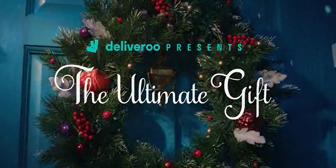
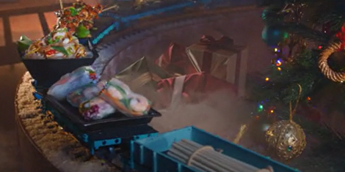

Deliveroo
DCM Awards nominee:
Best Use of Cinema (Small) + Best Use of Innovation
Background
With a goal to land what Deliveroo’s role at Christmas can be, the key for this campaign was to drive awareness, and ultimately create impact that would lead to increased consideration.
Plan
Deliveroo combined its 30” on-screen spots - running in cherry picked films including Encanto, Spider-Man No Way Home and The Matrix Resurrections - with in foyer digital panels. This primed audiences to Deliveroo prior to seeing the movie and then provided them with a timely reminder post-film, closer to the point they might be considering a takeaway.
Results
Over a third of those exposed said they were ‘extremely likely’ to consider Deliveroo, a +55% uplift vs. Control
An +80% uplift for perception that ‘Deliveroo food is exciting as a gift at Christmas’’ amongst those exposed.

Slide 2
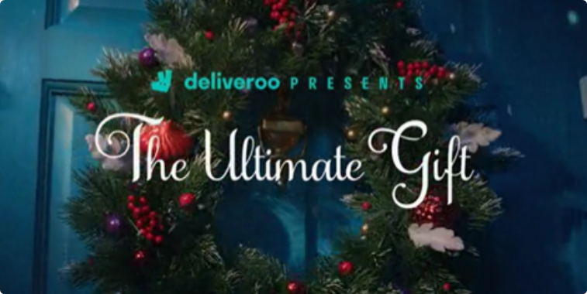
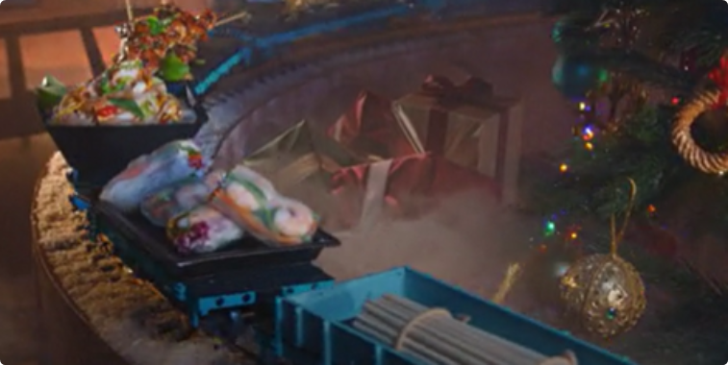

Deliveroo
DCM Awards nominee:
Best Use of Cinema (Small) + Best Use of Innovation
Media Agency | Target | Buying Route | Copy length
Initiative | 16-34 Adults | HFSS AGP + Film Packs | 30”
The Ultimate Gift
Background
Deliveroo exists understood its position in a highly competitive category and knew that Christmas has also always been a threat for food delivery brands. Therefore, their campaign's goal was to land what Deliveroo’s role at Christmas can be, wanting to also to drive awareness, improve perceptions and ultimately create an impact that would lead to increased consideration and action.
Plan
Deliveroo combined its 30” on-screen spots - running in cherry picked films including Encanto, Spider-Man No Way Home and The Matrix Resurrections - with in foyer digital panels. This primed audiences to Deliveroo prior to seeing the movie and then provided them with a timelier reminder post-film, closer to the point they might be considering a takeaway.
Taking this one step further, Deliveroo worked with Mobsta to leverage mobile re-targeting – targeting devices that had visited the geofenced DCM cinemas, to reinforce the messaging and close the Deliveroo consumer journey, in turn driving post-film takeaway orders.
Results
The results highlight how maximising the full cinema experience can deliver on key campaign metrics.
Driving Perceptions & Consideration
Over a third of those exposed said they were ‘extremely likely’ to consider Deliveroo, a +55% uplift vs. Control. An +80% uplift for perception that ‘Deliveroo food is exciting as a gift at Christmas’, amongst those exposed.
Consumer Journey
Over 2 in 5 Vue cinemagoers were also able to recall the in-foyer digital screen ads, and Mobsta’s research showed that the re-targeting drove additional uplifts in spontaneous (+4%) and prompted (+8%) awareness.

