Slide 1
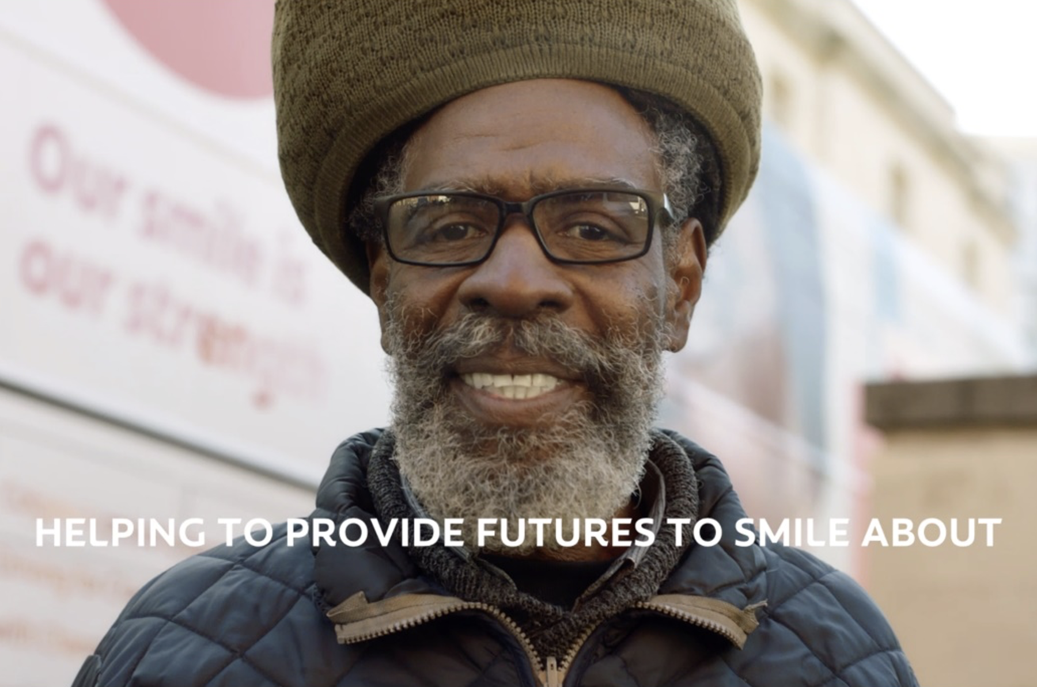
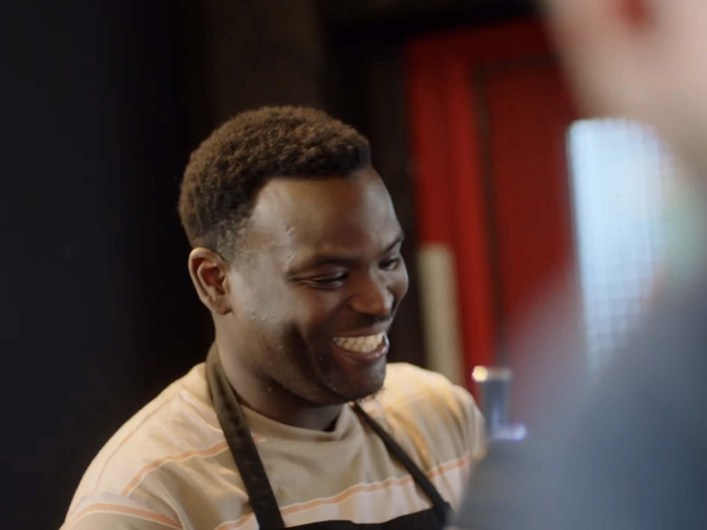

Colgate
Background
Colgate wanted to go beyond its standard product advertising and deliver an important message as part of its partnership with award-winning social enterprise Change Please whose mission is to improve oral care amongst the homeless.
Plan
A 30” film was created focusing on Raphael, who experienced homelessness when he was 17 but was helped by Change Please three years ago. Colgate bought into film packs running across 8 key films that aligned with optimistic sentiment.
Results
Successfully drove higher awareness of the ‘Futures to Smile About’ initiative with 433 patients in 2024.
Helped to boost associations that Colgate is a caring brand amongst those exposed (+13%).
Source: DCM Awards: Colgate Case Study 2024.
Notes:
Source: DCM Awards: Colgate Case Study 2024.

Slide 2
Colgate
Media agency | Target | Buying route | Copy length
Wavemaker | ABC1 Adults | Film Packs | 30”
‘Futures to Smile About’
Background
When we think of the issues facing the homeless, we may think of drugs, crime, hunger, the cold but the startling reality is that without access to oral hygiene, the majority of rough-sleepers experience mouth pain. This major issue led Colgate to partner with the Change Please, an award-winning social enterprise to improve the oral care for the homeless. Historically, Colgate’s focus has been communicating product efficacy and value, designed to drive awareness and effective conversion to sales. That was not the aim of this campaign, this activity had an arguably much deeper and more important message to convey.
Plan
To cement this partnership, a 30” emotionally charged film was created focusing on the plight of Raphael, who experienced homelessness when he was 17 but was helped by Change Please three years ago. Whilst a previously untapped channel for Colgate, they utilised cinema to reach the emotive side of their target audience, using the shared collective experience, relaxed environment, and immersive viewing that cinema offers. Colgate bought into film packs themed full of family moments and positivity, running across 8 key films that aligned with optimistic sentiment.
Results
Cinema was pivotal in helping to raise awareness of the ‘Futures to Smile About’ initiative, in addition to boosting positive associations with Colgate as a brand. But the real success is helping those in need, who, without Futures to Smile About would be living day to day in excruciating pain.
Societal impact
Already this year, Colgate and Change Please have seen 433 patients, with 191 needing specific dental help in the mobile dental service bus.
Brand perception
Helped to boost associations that Colgate is a caring brand amongst those exposed (+13%).
Source: DCM Awards: Colgate Case Study 2024.
Notes:
Source: DCM Awards: Colgate Case Study 2024.
Films: Trolls Band Together, The Marvels, Aquaman and the Lost Kingdom, Bob Marley: One Love and Wish.

