Slide 1
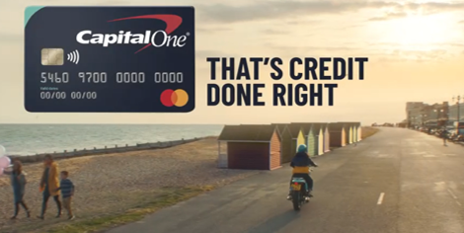
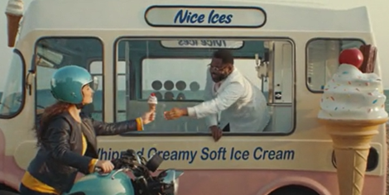

Capital One
Background
Capital One wanted to leverage its 40” creative in a high impact environment to maximise effectiveness and drive cut through of its new ‘that’s credit done right’ positioning.
Plan
Capital One bought an AGP to maximise reach of its target audience as part of a multi-media mix. The ad featured in the reel ahead of titles including Shang Chi And The Legend Of The Ten Rings, Candyman, Free Guy, and Jungle Cruise.
Results
Uplift for perceptions that Capital One are ‘trustworthy’ (+30%) and ‘do credit the right way’ (+32%) vs. control
Those exposed in cinema were almost 3x more likely to consider Capital One as ‘first choice’ for a new credit card.
Source: Differentology campaign effectiveness project, September 2021

Slide 2
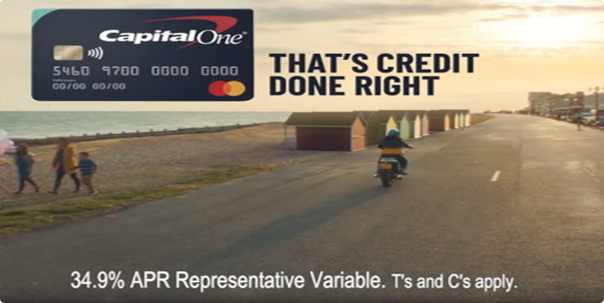


Capital One
Media Agency | Target | Buying Route | Copy length
the7stars | 20-54 Adults | AGP | 40”
Credit Done Right
Background
Capital One wanted to leverage its 40” creative in a high impact environment to maximise its impact on key brand metrics and drive cut through of its new ‘that’s credit done right’ positioning. Cinema was also included on the plan to help drive quality and trustworthiness perceptions of the brand; with research having shown that the audience perception of cinema as a premium environment can transfer to the brands advertising on the big screen
Plan
With a strong slate of titles releasing in cinemas across the summer, Capital One bought an AGP to maximise reach of its target audience as part of a multi-media mix alongside BVOD, social, online video, outdoor and radio. Capital One’s ad featured in the reel ahead of titles including Shang Chi And The Legend Of The Ten Rings, Candyman, Free Guy, Jungle Cruise and Space Jam: A New Legacy.
Results
Capital One’s cinema campaign was a success with exposure to the ad on the big screen delivering significant uplifts across a range of metrics.
Increased Cut-Through
Awareness of recent advertising from Capital One was up +129% amongst those who were exposed to the campaign via cinema.
Delivering on Key Campaign Messaging
Uplift for perceptions that Capital One are ‘trustworthy’ (+30%) and ‘do credit the right way’ (+32%) vs. control.
Improving Consideration VS Competitors
Those exposed in cinema were almost 3x more likely to consider Capital One as ‘first choice’ for a new credit card.
Source: Differentology campaign effectiveness project, September 2021

