Slide 1
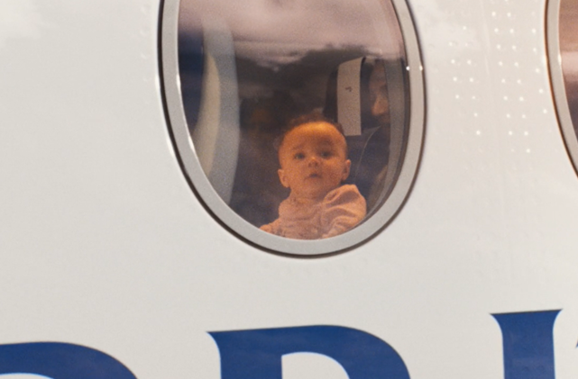
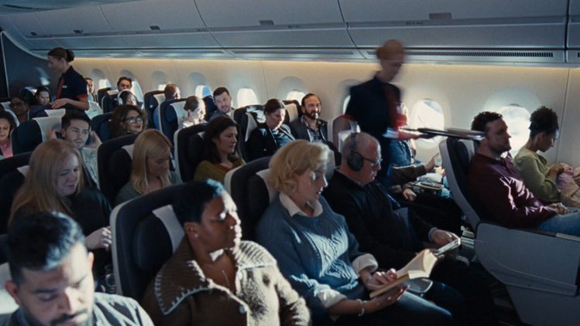
British Airways
‘Everywhere we go, make us everything we are’
Background
British Airways launched 'Everywhere we go, make us everything we are’ with the intention of highlighting how British Airways is integral to helping individuals develop our own unique originality.
Plan
Showcasing its 60” in cinema, BA accessed a film pack in Bridget Jones: Mad About The Boy and an AGP.
Results
Cinema played a vital role in helping British Airways land the campaign, helping drive incremental reach.
Ultimately, it significantly improve impressions (+20%) and recall (+41%).
Source: DCM / British Airways. Differentology Feb 2025
Results base: 18-44. Uplifts are test (exposed to ad) vs control (unexposed to ad)
Notes:
Source: DCM / British Airways. Differentology Feb 2025
Results base: 18-44. Uplifts are test (exposed to ad) vs control (unexposed to ad)

Slide 2
British Airways
Media agency | Target | Buying route | Copy length
MGOMD | ABC1 Adults | Film pack & AGP | 60”
‘Everywhere we go, make us everything we are’
Results
Cinema played a vital role in helping British Airways land the campaign, helping drive incremental reach.
Ultimately, it significantly improve impressions (+20%) and recall (+41%).
Background
British Airways launched the third burst of activity for its campaign, titled 'Everywhere we go, make us everything we are’ with the intention of highlighting how British Airways is integral to helping individuals develop our own unique originality.
Plan
Looking to add incremental reach on top of their existing AV plan, British Airways showcased their 60” in cinema, accessing a film pack in Bridget Jones: Mad About The Boy and an AGP. Expanding across other platforms, the campaign also ran the 60” and an additional 30” copy across TV, BVOD, Social, YouTube, Online and Radio.
Source: DCM / British Airways. Differentology Feb 2025
Results base: 18-44. Uplifts are test (exposed to ad) vs control (unexposed to ad)
Notes:
Source: DCM / British Airways. Differentology Feb 2025
Results base: 18-44. Uplifts are test (exposed to ad) vs control (unexposed to ad)

