Slide 1
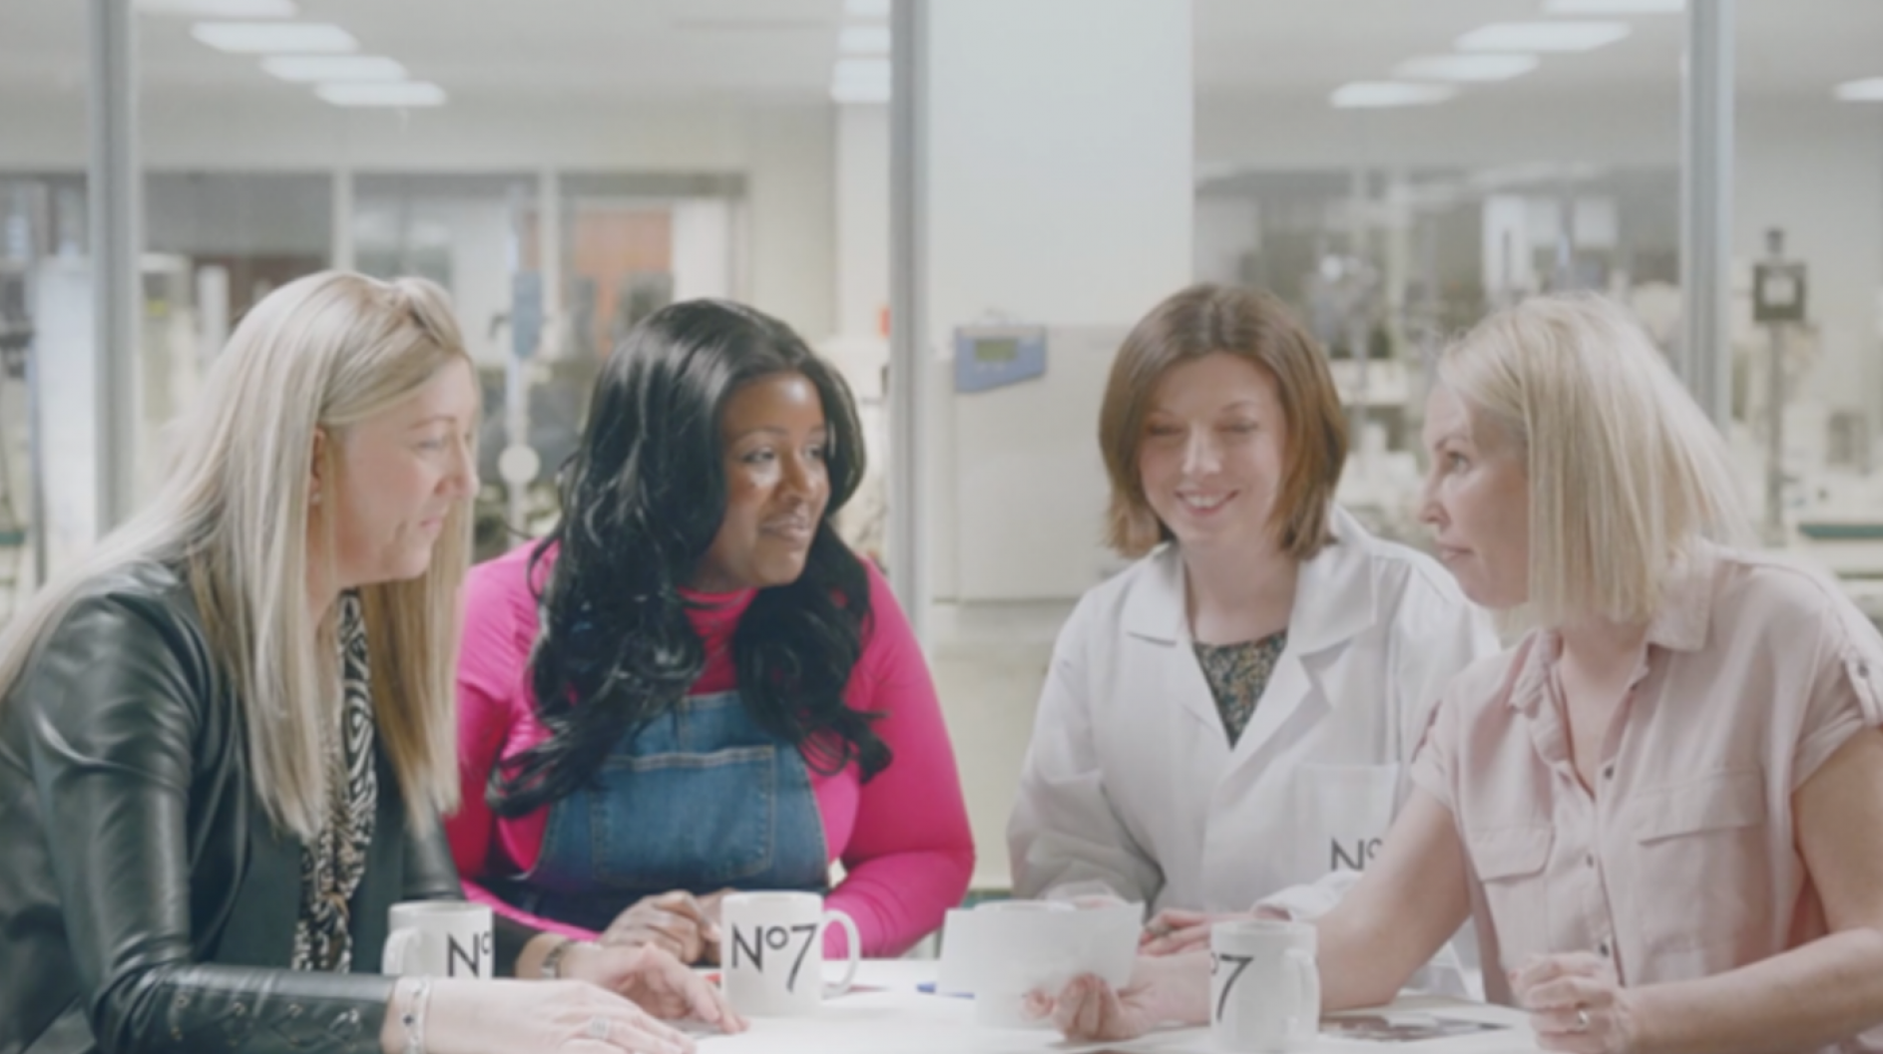
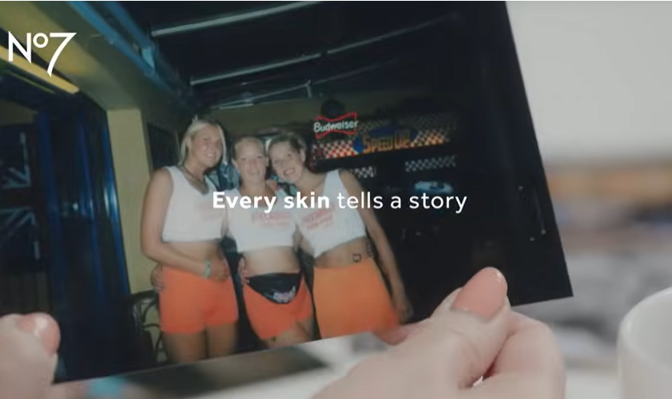

Boots No.7
DCM Awards nominee:
Best Use of Cinema (Large)
Background
No.7 had a new product range and needed to showcase the proof behind the claim that it reverses the visible signs of skin damage whilst staying true to the relatability of the brand.
Idea
No.7 showcased a 170” short film across a 2-month period, buying into a Female AGP that gave them access to an array of films that indexed well for their target audience of 45+ women. Alongside this a 60” asset was showcased in the Gold Spot of The Unlikely Pilgrimage of Harold Fry.
Results
Ad awareness rose by 5% during the time cinema was live
Future Renew was the biggest ever product launch for No7 in terms of revenue generated and delivered over 18 weeks of target sales in just the first 25 days of launch.
Source: Boots No.7 DCM Awards Entry
Notes:
Source: Boots No.7 DCM Awards Entry

Slide 2
Boots No.7
DCM Awards nominee:
Best Use of Cinema (Large)
Media agency | Target | Buying route | Copy length
Essence Mediacom | 45+ Women | Female AGP | 170”, 60”
Future Renew Range
Background
Boots No.7 has long been leading the industry as the No.1 brand in the cosmetic category but noticed that growth had been stagnant since 2019 due to competition from the likes of L'Oréal & Olay.
No.7 wanted to showcase its new product range whilst staying true to the relatability of the brand. No7 had a new product range - that reverses the visible signs of skin damage – and needed to showcase the proof behind this big claim but while staying true to the relatability of the brand.
Plan
Launching with an unmissable campaign across-media (AV, Print OOH, Social, Digital Audio), No7 wanted to stand out and elevate the campaign as much as possible, seeing cinema as a space to bring forth its authenticity in a fully immersive and engaged medium.
No.7 showcased a 170” short film across a 2-month period, buying into a female AGP that gave them access to an array of films that indexed well for their target audience of 45+ women. Alongside this a 60” asset was showcased in the Gold Spot of The Unlikely Pilgrimage of Harold Fry.
Results
The campaign was a roaring success, with people queuing to purchase the product in-store and the website crashing at launch. Cinema was fundamental in driving these results, helping to secure target audience engagement with the ad and boost key brand metrics.
Awareness
Ad awareness rose by 5% during the time cinema was live.
Impact on sales
Future Renew was the biggest ever product launch for No7 in terms of revenue generated, with one product sold every two seconds. No7 had delivered over 18 weeks of target sales in just the first 25 days of launch.
Source: Boots No.7 DCM Awards Entry
Notes:
Source: Boots No.7 DCM Awards Entry

