Slide 1
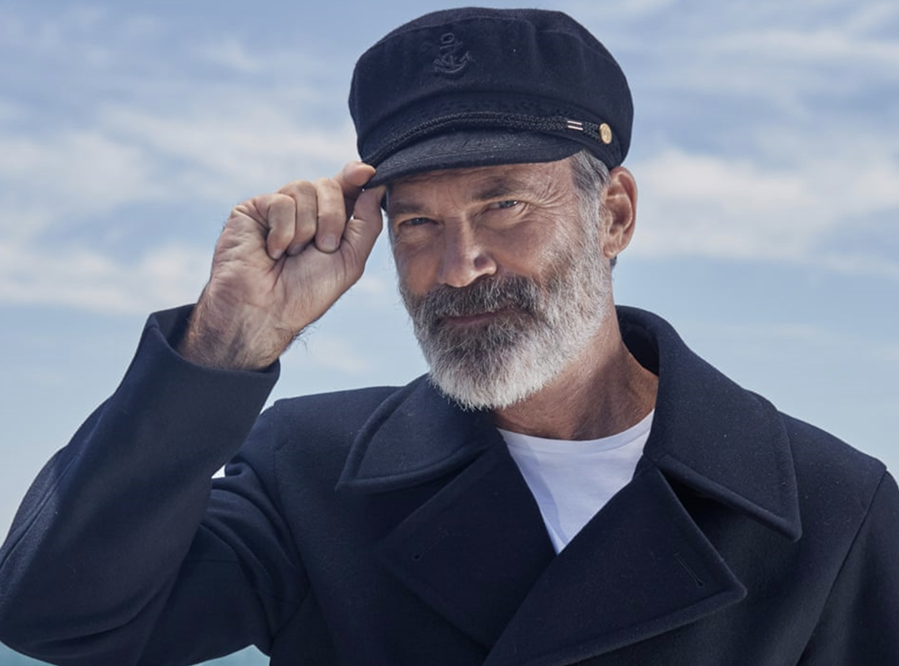
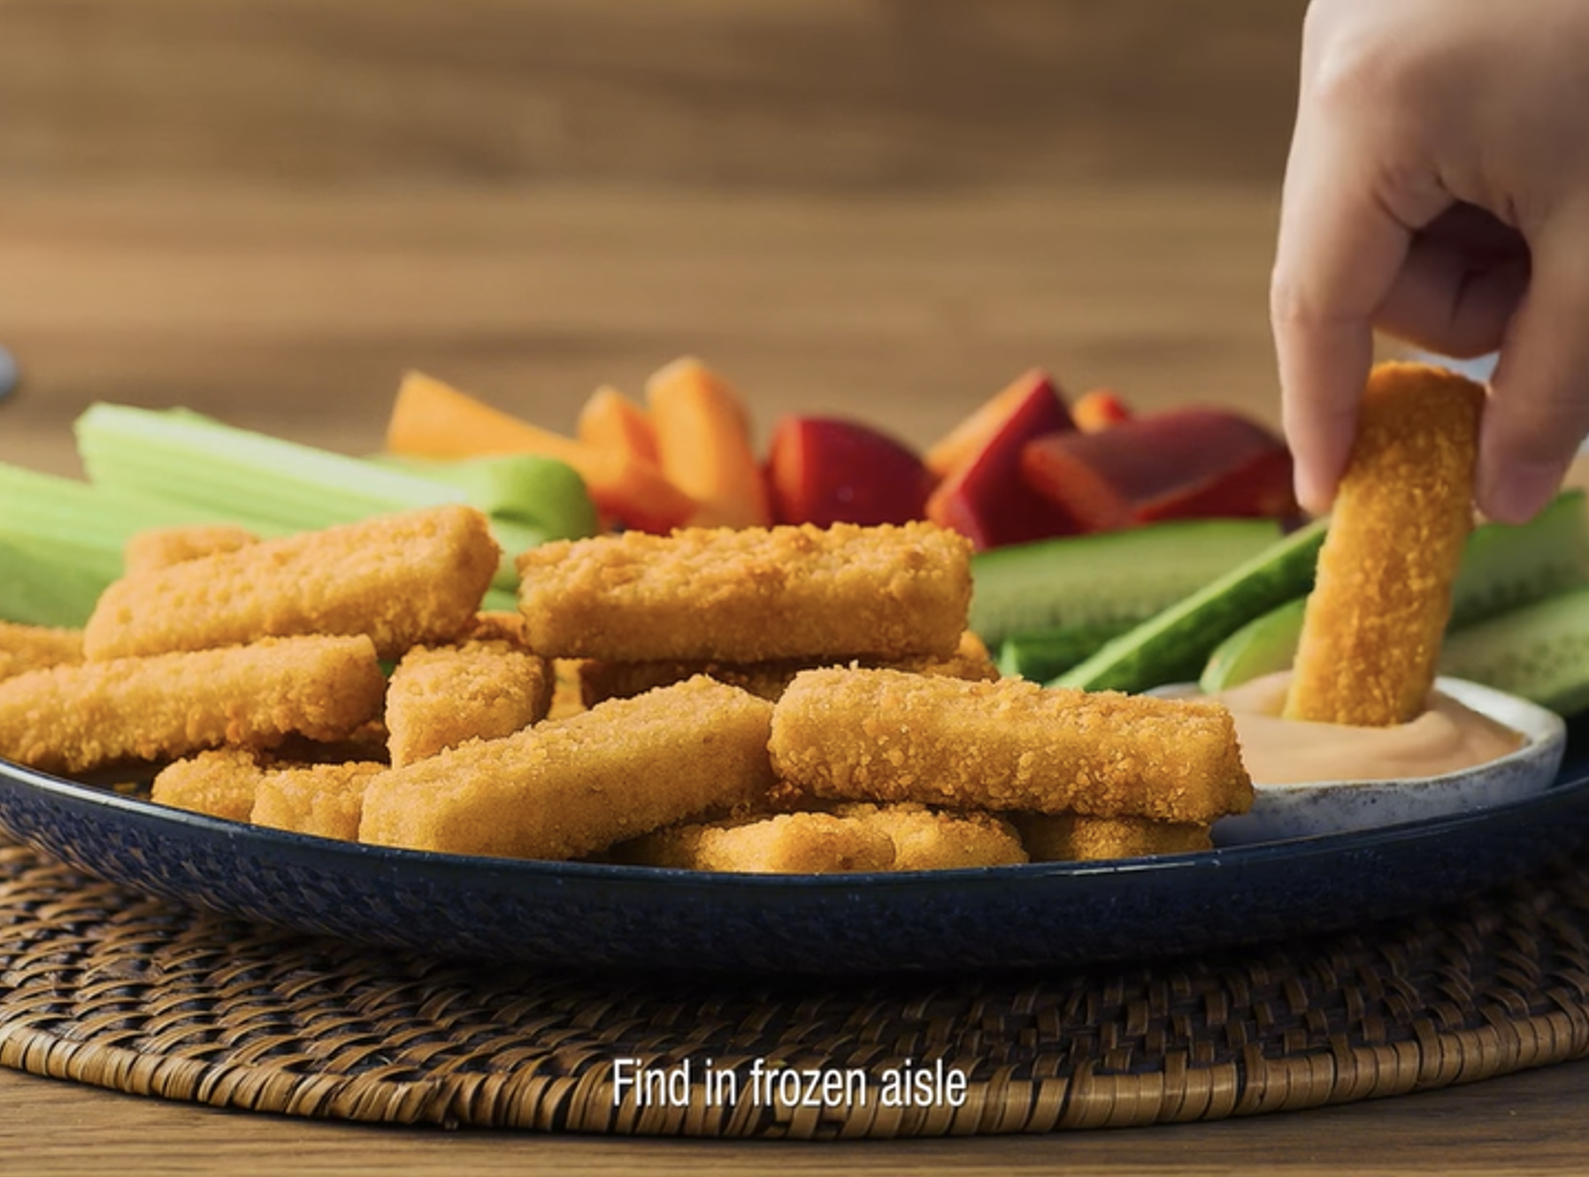

Birds Eye
Background
Birds Eye wanted to drive reach among families to promote a new product and enhance perceptions of product quality and brand worth.
Plan
Running the new 20” creative in HP+CH AGP titles, the brand could maximise reach and emotional response to the reintroduction of the beloved ‘The Captain’ character and the new mini fish finger product.
Results
Cinema delivered significant uplifts across Recall (+24%) and Recommendation (+17%) metrics.
Cinema also helped enhance key brand perceptions including ‘…provides food which is sourced responsibly’ (+27%) and ‘…is a brand worth paying more for’ (+46%).
Notes:
No source on previous presentation

Slide 2
Birds Eye
‘Get On Board!’
Media agency | Target | Buying route | Copy length
Zenith | HP+CH | HP+CH AGP | 20”
Background
Whilst already being a highly salient brand, Birds Eye wanted to maximise reach among families to promote a new product and enhance perceptions of product quality and brand worth.
With a new 20” creative, Birds Eye reintroduced the beloved character ‘The Captain’ to engage their audiences, connect emotionally and promote their mini fish finger product.
Plan
Running across HP+CH AGP titles, cinema was able to maximise reach among the key family audience and associate the brand with quality family offering across the summer months with titles including Migration, Kung Fu Panda 4, and The Garfield Movie. The campaign also extended across TV, BVOD, Social Media, YouTube, and content creators.
Results
Cinema helped drive significant uplifts across key metrics for Birds Eye:
Recall (+24%) and recommendation (+17%) was significantly higher amongst those had been exposed to the ad in cinema.
Cinema also helped enhance key brand perceptions including ‘…provides food which is sourced responsibly’ (+27%) and ‘…is a brand worth paying more for’ (+46%).
Notes:
No source on previous presentation

