Slide 1

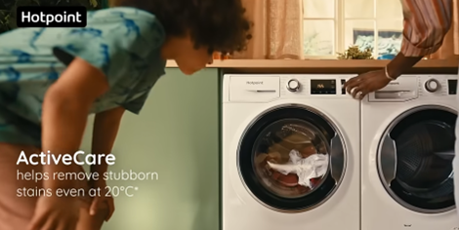

Beko Hotpoint
DCM Awards nominee:
Best Use of Cinema (Large)
Background
Hotpoint wanted to establish the brand as synonymous with reliability & care to better convert its strong brand awareness into consideration & preference.
Plan
Hotpoint ran a 30” version of its new copy across an AGP buy to maximise reach, while the hero 60” version ran in the Silver Spot (Furiosa) & Gold Spot (IF) to maximise emotional engagement with the new narrative.
Results
Those exposed to the ad in cinema were 64% more likely to recall seeing the ad vs. those not exposed to cinema
The campaign drove key messaging - ‘is the UK's most trusted major domestic appliance supplier’ (+86%) – and ultimately over half of those exposed to the ad in cinema said they were very likely to consider Hotpoint.

Slide 2

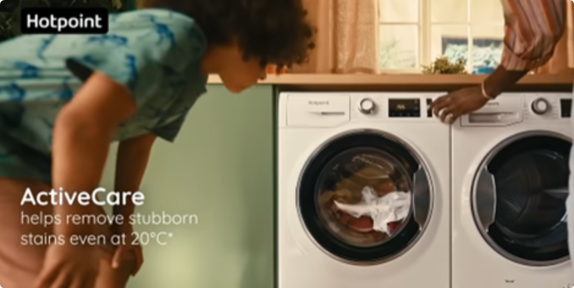

Beko Hotpoint
DCM Awards nominee:
Best Use of Cinema (Large)
Media Agency | Target | Buying Route | Copy length
T&P | ABC1 Adults | Gold + Silver Spots & AGP | 60”, 30”
‘The Feeling of Home Since 1911’
Background
Despite being an already salient brand within its own market, Hotpoint struggled to convert its strong brand awareness into consideration and preference. Knowing that consumers are increasingly prioritising value for money, innovative home improvements and energy efficiency due to the cost-of-living crisis, Hotpoint was presented with a unique opportunity to resonate emotionally with its audience – aiming to establish the brand as synonymous with reliability & care to ultimately drive consideration & preference.
Plan
Creatively, Hotpoint wanted to illustrate 'The Feeling of Home' by telling the story of a mischief maker, symbolising household mishaps, and showcasing Hotpoint as the reliable partner that ensures everything runs smoothly. Knowing that cinema offers an immersive environment that delivers impactful attention, Hotpoint introduced cinema within the wider AV media plan for the first time to maximise the emotional impact of the new narrative among the target ABC1 audience. Hotpoint ran a 30” version of the copy across AGP titles, while the full 60” version ran in the Silver Spot (Furiosa) & Gold Spot (IF) to maximise engagement.
Results
Cinema helped to significantly improve several of Hotpoint’s core brand metrics:
Those exposed to the ad in cinema were 64% more likely to recall seeing the ad vs. those not exposed to cinema
Over 50% of those exposed to the ad in cinema said they were very likely to consider Hotpoint (60% for exposure via the Gold Spot). Intent to act having seen the ad in cinema reached around 80%.
Uplifts in key perceptions including ‘is the UK's most trusted major domestic appliance supplier’ (+86%).

