Slide 1
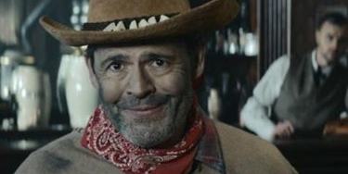
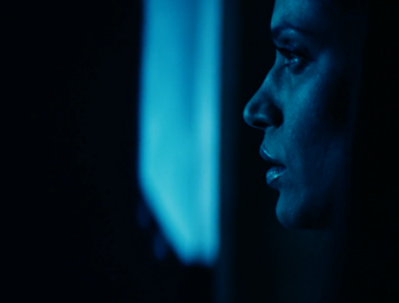

BT
Flexible BT TV Launch
Background
BT was launching the UK’s first range of flexible TV packages that would offer customers the freedom to choose what they wanted to have switched on every month. BT needed to launch with impact but also clearly communicate the uniqueness of the new offering.
Plan
With DCM Studios, BT created two bespoke 60” copies intended to trick the audience into thinking they had gone to the wrong screening. These ran in the Gold Spots ahead of Military Wives and Onward as well as being live with posters on OOH Screens in cinema foyers.
Results
Consideration was up +26% amongst those exposed to the ad in cinema vs. control
+19% uplift for the perception that BT ‘is first with new ideas’.

Slide 2
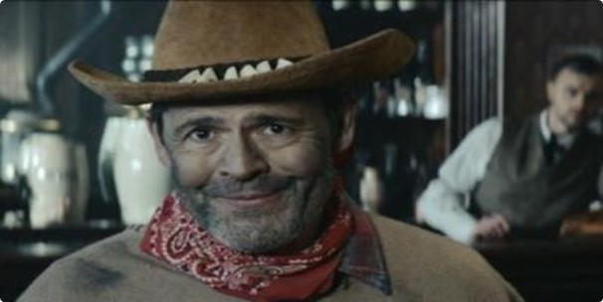
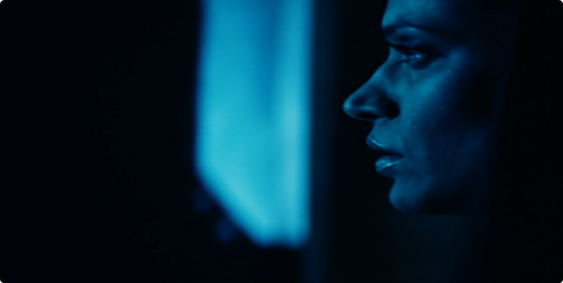

BT
Media Agency | Target | Buying Route | Copy length
EssenceMediacom | TV Viewers | Gold Spots | 60”
Flexible BT TV Launch
Background
BT was launching the UK’s first range of flexible TV packages that would offer customers the freedom to choose what they wanted to have switched on every month. BT needed to clearly communicate the uniqueness of the new offering, whilst ensuring an impactful and memorable launch.
Plan
BT teamed up with DCM Studios to create two 60” fake film openings, deliberately designed to look and feel like the start of a real movie that was very different to the one customers had actually paid to see. These played in the Gold Spot ahead of Military Wives and Onward.
Having lulled cinemagoers into thinking that they might be about to watch the wrong film, the actors broke the fourth wall to reveal to cinemagoers the ruse, proclaiming ‘You wouldn’t pay for something you don’t want to watch at the cinema, so don’t put up with it at home’ and revealing BT’s new flexible package.
Digital OOH posters for the two spoof films were displayed on digital OOH screens in the foyers to further embed the prank with cinemagoers.
Results
Working in collaboration with DCM Studios, BT created a hugely successful launch for the new product:
Driving Consideration
Consideration was up +26% amongst those exposed to the ad in cinema vs. the control sample.
Landing Key Campaign Perceptions
Almost 7 in 10 cinemagoers who saw the contextual copy in cinema reported being left with a better impression of BT TV
+19% uplift for the perception that BT ‘is first with new ideas’ vs. control sample.

