Slide 1
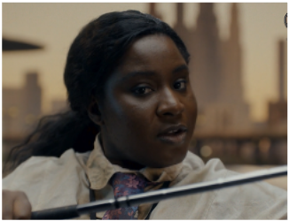
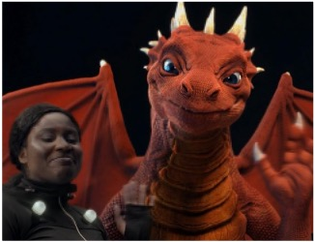

BAFTA
DCM Awards nominee:
Best Use of Cinema (Large)
Background
BAFTA partnered with DCM Studios to promote the gaming industry with a campaign celebrating video games as an artform that changes lives.
Plan
The 105” ad launched in cinemas alongside the release of A Minecraft Movie. In addition, the creative was presented at the London Game Awards during the New Game Plus B2C event at the London Museum, targeting industry panels and big screens at the festival’s Trafalgar Square takeover.
Results
BAFTA saw significant uplifts in association with gaming (+42%) for those who saw the ad in cinema
75% of those who saw the ad in cinema agreed ‘Video games tell great stories’
Source: DCM / BAFTA. Conducted by; Differentology, October 2022
Notes:
Source: DCM / BAFTA. Conducted by; Differentology, October 2022.
Results base: 16-34s. Uplifts are test (exposed to ad in cinema) vs control (not exposed to ad in cinema)

Slide 2
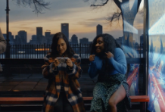
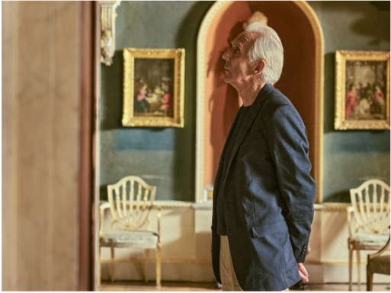
BAFTA
DCM Awards nominee:
Best Use of Cinema (Large)
Target | Buying route | Copy length
16-34s | AGP | 105”
Celebrating the Art of Storytelling
Results
Cinema demonstrated its value as an effective medium for storytelling and driving uplifts in engagement.
Increase in website traffic
Ad awareness rose by 5% during the time cinema was live.
Gaming associations
Future Renew was the biggest ever product launch for No7 in terms of revenue generated, with one product sold every two seconds. No7 had delivered over 18 weeks of target sales in just the first 25 days of launch.
Message takeout
75% of those who saw the ad in cinema agreed ‘Video games tell great stories’
Background
BAFTA partnered with DCM Studios designed to promote the gaming industry, an area which is typically overlooked after Film and TV. The campaign aimed to celebrate video games as an artform that changes lives.
Plan
DCM Studios and Common People Films produced a 105” ad which explored the connectivity between film, games and TV, highlighting the depth of video game storytelling that captivates audiences worldwide. To ensure contextual relevance & maximum impact with 16-34-year-olds ahead of the Game Awards, the trailer was launched in cinemas alongside the release of A Minecraft Movie. In addition, the creative was presented at the London Game Awards during the New Game Plus B2C event at the London Museum, targeting industry panels and big screens at the festival’s Trafalgar Square takeover.
Source: DCM / BAFTA. Conducted by; Differentology, October 2022
Notes:
Source: DCM / BAFTA. Conducted by; Differentology, October 2022.
Results base: 16-34s. Uplifts are test (exposed to ad in cinema) vs control (not exposed to ad in cinema)
Client direct
16-34 ADS
16-34 AGP
60”

