Slide 1

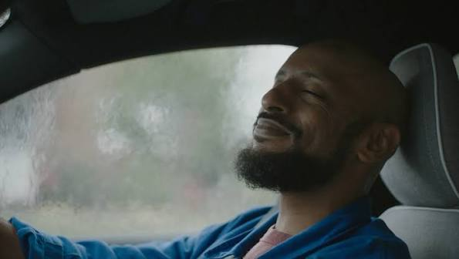

Autotrader
Background
AutoTrader wanted to improve consumer understanding that you can buy brand new cars on AutoTrader and ultimately boost conversion.
Plan
AutoTrader showcased the new 30” copy across the big screen, buying into blockbuster film packs including Gladiator II. The campaign also ran across TV, Social, YouTube, Online, Radio, and OOH.
Results
Awareness saw a 41% uplift, and there was further impact across Consideration (+18%) and Recommendation (+16%) among those exposed to the ad in cinema.
The ad succeeded in driving it’s intended message with the perception ‘I can find new cars on Autotrader’ significantly higher (+41%) amongst those exposed in cinema.
Notes:
No source included in previous presentation

Slide 2
Autotrader
Media agency | Target | Buying route | Copy length
The Specialist Works | 18+ | Film packs | 30”
‘Brand new cars found at AutoTrader’
Background
AutoTrader wanted to improve consumer understanding that you can buy brand new cars on AutoTrader and ultimately boost conversion.
Looking to target all UK car buyers and ‘new car considerers’, Autotrader knew that their campaign had to run in an impactful environment that would help maximise awareness, strengthen brand impressions, and increase brand consideration among its target audience.
Plan
Knowing the benefit of cinema as a medium that not only maximises reach, but also provides an attentive environment, AutoTrader showcased the hero 30” copy across showings of films including Gladiator II and Beetlejuice Beetlejuice.
The campaign also ran with additional 20” and 15” copy across TV, BVOD, Social, YouTube, Online, Radio and Outdoor.
Results
Cinema was successful in helping AutoTrader launch the new creative and deliver significant uplifts across numerous key metrics.
Ad impact
Awareness increased +41% amongst those exposed, whilst there were further uplifts across consideration (+18%) and recommendation (+16%) respectively.
Perceptions
‘I can find new cars on Autotrader’ came out significantly higher (+41%) amongst those exposed in cinema, demonstrating successful cut through of the new messaging.
Notes:
No source included in previous presentation

