Slide 1
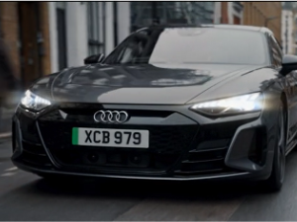
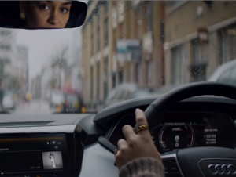

Audi
Background
Audi wanted to test out the incremental impact of converting an ad into full Screen X format.
DCM undertook research to compare those who saw the standard version of ad of in the Wonka Gold Spot and those who saw the Screen X version of the ad in Screen X showings of The Marvels.
Results
75% of Screen X cinemagoers were able to recall seeing the ad (+9% vs. those exposed in a standard screening)
Key perception ‘is a prestige brand’ saw significant improvement (+15%) after exposure to the Screen X ad
56% agreed that seeing the bespoke Screen X ad made it more impactful, easier to remember, and/or enjoyable
Source: DCM / Audi. Conducted by; Differentology, Nov 2023.
Notes:
Source: DCM / Audi. Conducted by; Differentology, Nov 2023.
Results base: 16+, Uplifts are control (unexposed to ad) vs test 1 (exposed to gold spot ad) vs test 2 (exposed to Screen X ad)

Slide 2
Audi
Media agency | Target | Buying route | Copy length
PHD | ABC1 Adults | Screen X | 60”
Life is a Work in Progress
Background
Audi has long used cinema due to its capacity to reach the target affluent audience within a high-attention environment. Cinema also helps to affirm the brand’s premium and prestige perceptions that Audi drives through their campaigns.
Idea
In 2023, as well as continuing to invest in premium positions across cherry-picked relevant titles, Audi wanted to test out the incremental impact that the ad could have if converted into full Screen X format. The cinema campaign was running alongside a wider AV campaign that included BVOD, Social, Online, and Outdoor.
Plan
DCM undertook research across those unexposed to the ad in cinema (Control), those who saw the standard ad of in the Wonka Gold Spot (Test 1) and those who saw the Screen X version of the ad in Screen X showings of The Marvels (Test 2), to see the overall impact across levels of exposure.
Results
Audi benefitted from using the immersive Screen X format to maximise impact:
75% of Screen X cinemagoers were able to recall seeing the ad (+9% vs. those exposed via normal screen)
Audi’s key perception ‘is a prestige brand’ saw significant improvement (+15%) after exposure to the Screen X ad
56% agreed that seeing the bespoke Screen X ad made it more impactful, easier to remember, and/or enjoyable
Source: DCM / Audi. Conducted by; Differentology, Nov 2023.
Notes:
Source: DCM / Audi. Conducted by; Differentology, Nov 2023.
Results base: 16+, Uplifts are control (unexposed to ad) vs test 1 (exposed to gold spot ad) vs test 2 (exposed to Screen X ad)

