Slide 1
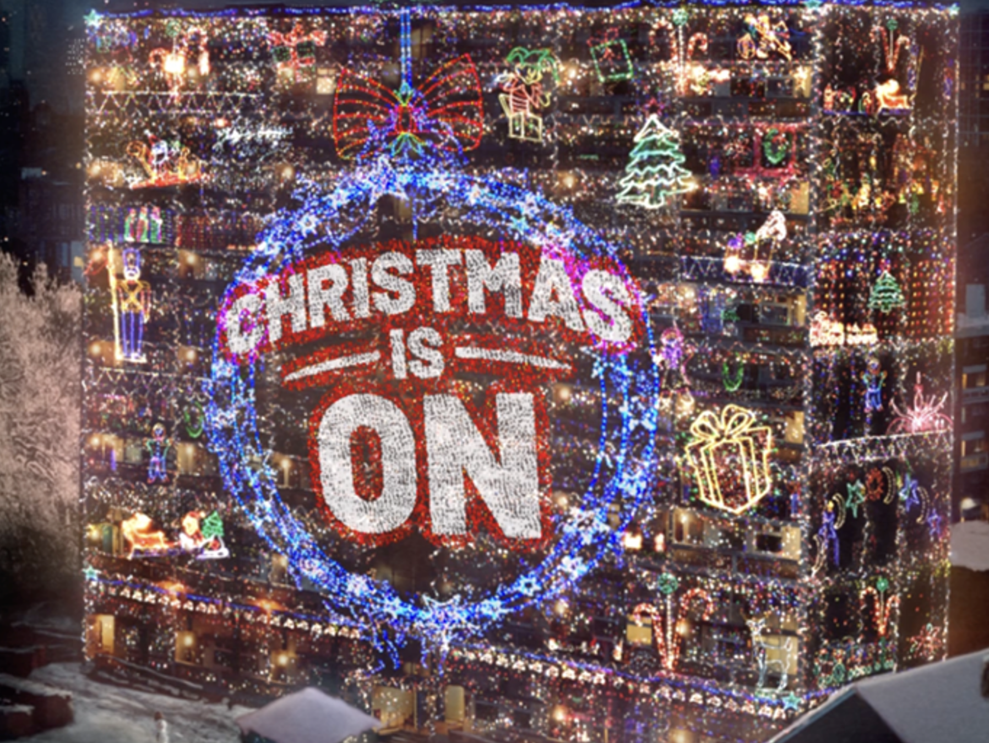
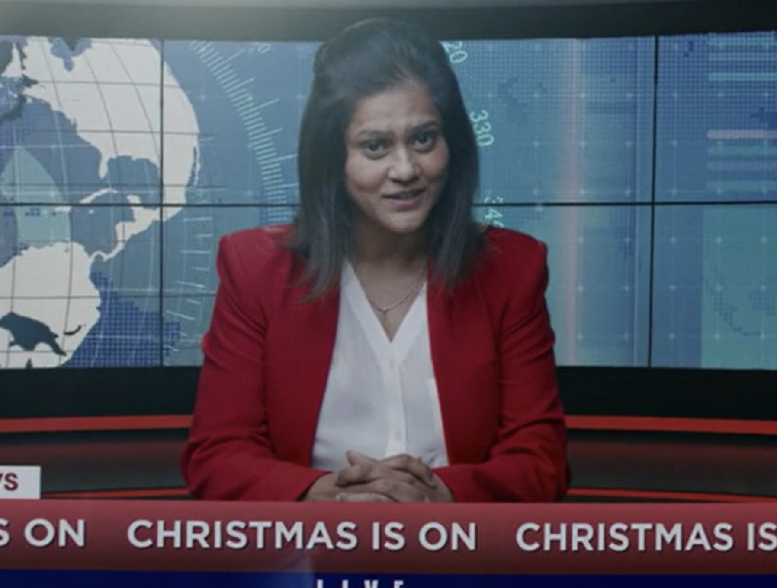

Argos
Background
Argos wanted to focus on helping its customers have the best Christmas and its ‘Baubles to Last Year, Christmas is On!’ ad showcased the pure jubilation of the season and the ways families can celebrate together.
Plan
Running from mid-November to Christmas Eve in cinemas, Argos bought a ABC1 Adults and Family AGP running in reel across a range of films including Encanto, Ghostbusters: Afterlife, and House of Gucci, successfully achieving reach to key audiences, including co-viewing families.
Results
Cinemagoers were +50% more likely to be ‘extremely likely’ to consider shopping at Argos vs. control.
Test sample respondents were +37% more likely to agree that ‘Argos is a retailer I feel close to’ compared to control.
Source: DCM / Argos. Conducted by: Differentology, Dec 2021
Notes:
Source: DCM / Argos
Conducted by: Differentology, Dec 2021
Base: 18-54 adults

Slide 2
Argos
Media agency | Target | Buying route | Copy length
PHD | Adults Young Families | Family & ABC1 Ads AGP | 60”
Christmas Is On
Background
After a disrupted Christmas in 2020, the brand wanted to focus on helping its customers have the best Christmas. The ‘Baubles to Last Year, Christmas is On!’ ad showcases the pure jubilation of Christmas and all the ways families across the country can celebrate together. Appealing to Christmas enthusiasts across the UK, Argos wanted the campaign to reach as many shoppers and families as possible so planned a broad media mix that included TV, BVOD/Online video, social, outdoor and press.
Plan
Cinema was added to the mix to help diversify the AV campaign and with a strong family profile was particularly key in broadening reach amongst the key audience in the run up to Christmas during an occasion of parent/child co-viewing. Running from mid-November to Christmas Eve in cinemas, Argos bought a ABC1 Adults and Family AGP running in reel across a range of films including Encanto, Ghostbusters: Afterlife, House of Gucci, Clifford The Big Red Dog and West Side Story.
Results
Adding cinema to the AV mix for the Christmas campaign worked well for Argos – driving cut through, resonance and consideration.
High level of recall
71% of cinemagoers recalled seeing the ‘Christmas Is On’ ad (vs. 44% benchmark).
Increasing brand ‘closeness’
Test sample respondents were +37% more likely to agree that ‘Argos is a retailer I feel close to’ compared to control.
Driving consideration
Cinemagoers were +50% more likely to be ‘extremely likely’ to consider shopping at Argos vs. control.
Source: DCM / Argos. Conducted by: Differentology, Dec 2021
Notes:
Source: DCM / Argos
Conducted by: Differentology, Dec 2021
Base: 18-54 adults

