Slide 1
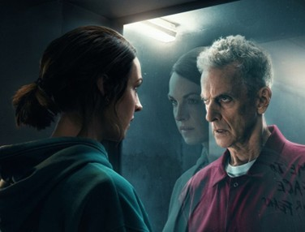
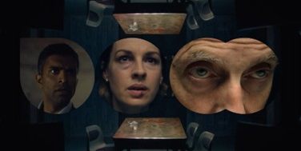

Amazon Prime Video
Background
Ahead of the launch of its new psychological thriller series The Devil’s Hour, Amazon Prime Video collaborated with DCM Studios to create bespoke content that would deliver impact and cut through amongst an entertainment-loving audience.
Plan
Content was created to disrupt the pre-show experience - with 3 bespoke 10” blipverts, the main 30” ad, and also a ‘take over’ of the DCM closing ident. The campaign ran across the DCM estate in titles including Black Adam, Watcher, The Banshees Of Inisherin and Halloween Ends.
Results
‘Very likely’ to consider watching the show experienced a +105% uplift amongst the exposed via cinema.
+120% uplift vs. control for having a ‘Much better’ impression of Amazon Prime Video.

Slide 2
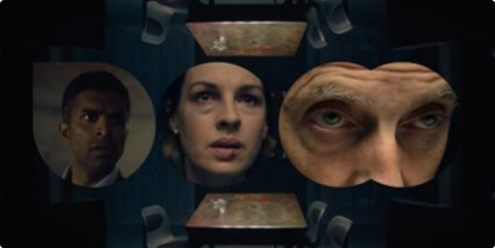

Amazon Prime Video
Media Agency | Target | Buying Route | Copy length
Initiative | 18-54 | Film Packs | Blipverts, 30” & DCM Ident Takeover
The Devil’s Hour
Background
Ahead of the launch of its new psychological thriller series The Devil’s Hour, Amazon Prime Video collaborated with DCM Studios to create bespoke content that would deliver impact and cut through amongst an entertainment-loving audience.
Plan
Knowing that using cinema would provide them with a platform to engage a broad entertainment-loving audience, Amazon Prime Video wanted to supercharge this to ensure the show stood out in the run up to its release date.
To create a suspenseful experience for the audience, The Devil’s Hour would disrupt the reel – with 3 bespoke 10” blipverts, the main 30” ad, and then a final reminder with the show ‘taking over’ the DCM closing ident.
The campaign ran across the DCM estate, running in titles including Black Adam, Watcher, Prey For The Devil, The Banshees Of Inisherin and Halloween Ends.
Results
The repetition of activity within the reel helped to increase cut-through and drive key campaign and brand metrics.
Increased Awareness of The Devil’s Hour
+56% uplift in awareness of The Devil’s Hour amongst exposed audience.
Heightened Consideration
‘Very likely’ to consider watching the show experienced a +105% uplift amongst the exposed via cinema.
Improved Impressions of Prime Video
+120% uplift vs. control for having a ‘Much better’ impression of Amazon Prime Video.

Slide 3
The appeal of blipverts
Audience reaction to blipverts are very positive with cinemagoers rating them as more memorable and something they’re even more likely to pay attention to and act on.
68% agree
Advertising in this format is more memorable than a typical cinema ad
73% agree
Advertising in this format is more engaging than a typical cinema ad
67% agree
I pay more attention to cinema advertising in this format
62% agree
Advertising in this format would make me more likely to consider the brand or product being advertised than typical cinema ads
Blipverts statements – top 3 ‘Strongly agree’ scores
Source: DCM / Amazon Prime Video. Conducted by; Differentology, October 2022.
Results base: 18-54s. To what extent do you agree or disagree with these statements about ads shown in the blipvert format? (10-point scale).

