Slide 1

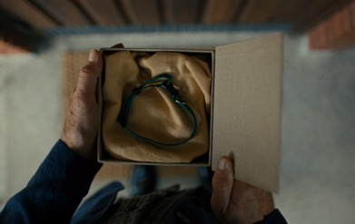

Agria
DCM Awards nominee:
Best Use of Cinema (Small)
Background
Agria aimed to increase brand awareness, so bought into cinema for the first time, capitalising on its engaging and quality environment to showcase the new Agria copy.
Plan
Agria bought into numerous film packs, giving them access to films like The Salt Path and Downton Abbey: The Grand Finale, knowing they would index strongly towards a slightly older affluent audience.
Results
Agria benefitted after showcasing its ad in the cinema, seeing significant uplifts across brand awareness (+38%), and consideration (+21%), significantly jumping up across ABC1 35+ adults (51% all adults vs 62% ABC1 35+).

Slide 2


Agria
Media Agency | Target | Buying Route | Copy length
Carat Manchester | ABC1 35+ | Film Packs | 60” & 30”
Background
Agria had previously bought into traditional media only, but with a new goal of increasing brand awareness and attention levels, it wanted to branch out to more high impact channels. Cinema was therefore considered, with the intention of capitalising on its engaging and quality environment to showcase the new Agria creative copy in both long and short form lengths.
Plan
Agria bought into numerous film packs, giving them access to films like The Penguin Lessons, Caught Stealing, The Salt Path, A Big Bold Beautiful Journey and Downton Abbey: The Grand Finale, knowing they would index strongly towards a slightly older affluent audience. This ran alongside a wider campaign that included BVOD & Radio.
Results
Agria hugely benefitted from the attention-grabbing medium of cinema, where those exposed to the cinema ad saw improvement in prompted awareness of Agria vs those who we’re unexposed (+38%). Brand salience also improved as a result of the campaign, with consideration not only improving significantly vs unexposed, but also jumping up across ABC1 35+ adults (51% all adults vs 62% ABC1 35+).
Source: DCM / Agria Conducted by: Differentology July 2025. Results base 18+. Uplifts are test (exposed to ad) vs control (unexposed to ad.

