Slide 1
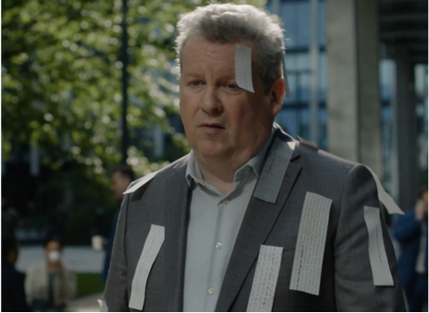


Abbott
Background
Abbott Laboratories launched ‘Above the Bias’, a global multi-year initiative aimed at exposing the negative stigma that people with diabetes face everyday. Cinema was chosen as a premium environment in the aim to evoke a strong impact, and ultimately lead to positive change.
Plan
Abbott bought the Gold Spot in James Gunn’s Superman, one of the summer’s biggest releases, in order to maximise potential reach. By accessing the Gold Spot, Abbott ran the creative when anticipation and attention is at its highest pre-film, unlocking the benefits of heightened attention.
Results
90% of those exposed claimed to have better understanding of the challenges faced by those with diabetes.
Test sample were significantly more likely (+48%), to have talked to friends/family about the video vs. control.
Notes:
No source included in previous presentation

Slide 2
Abbott
Media agency | Target | Buying route | Copy length
Mediaplus UK | Adults 25+ | Gold Spot | 80”
Above the Bias
Background
Abbott Laboratories launched ‘Above the Bias’, a global multi-year initiative aimed at exposing the negative stigma that people with diabetes face everyday. Cinema was chosen as a premium environment for Abbott to show it’s highly emotive 80” copy, in the aim to evoke a strong impact, and ultimately lead to positive change.
Plan
Abbott bought the Gold Spot in James Gunn’s Superman, one of the summer’s biggest releases, in order to maximise potential reach. By accessing the Gold Spot, Abbott ran the creative when anticipation and attention is at its highest pre-film, unlocking the benefits of heightened attention.
Results
The campaign succeeded in delivering a lasting emotive impact that resulted in aiding positive change.
Deepening Understanding
90% of those exposed in cinema claimed to have a better understanding of the challenges faced by those with diabetes.
Sparking Conversation
Test respondents were significantly more likely (+48%), to have talked to friends/family about the video than control sample.
Notes:
No source included in previous presentation

