Slide 1
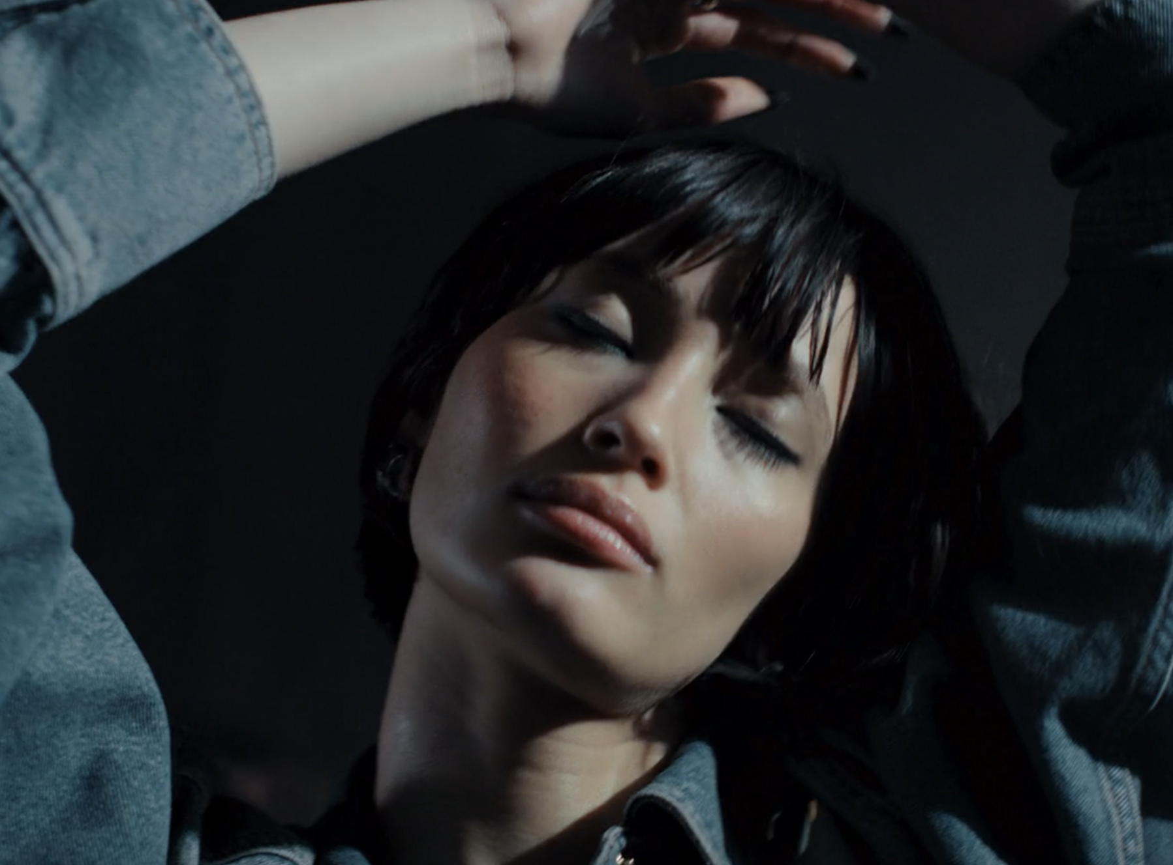
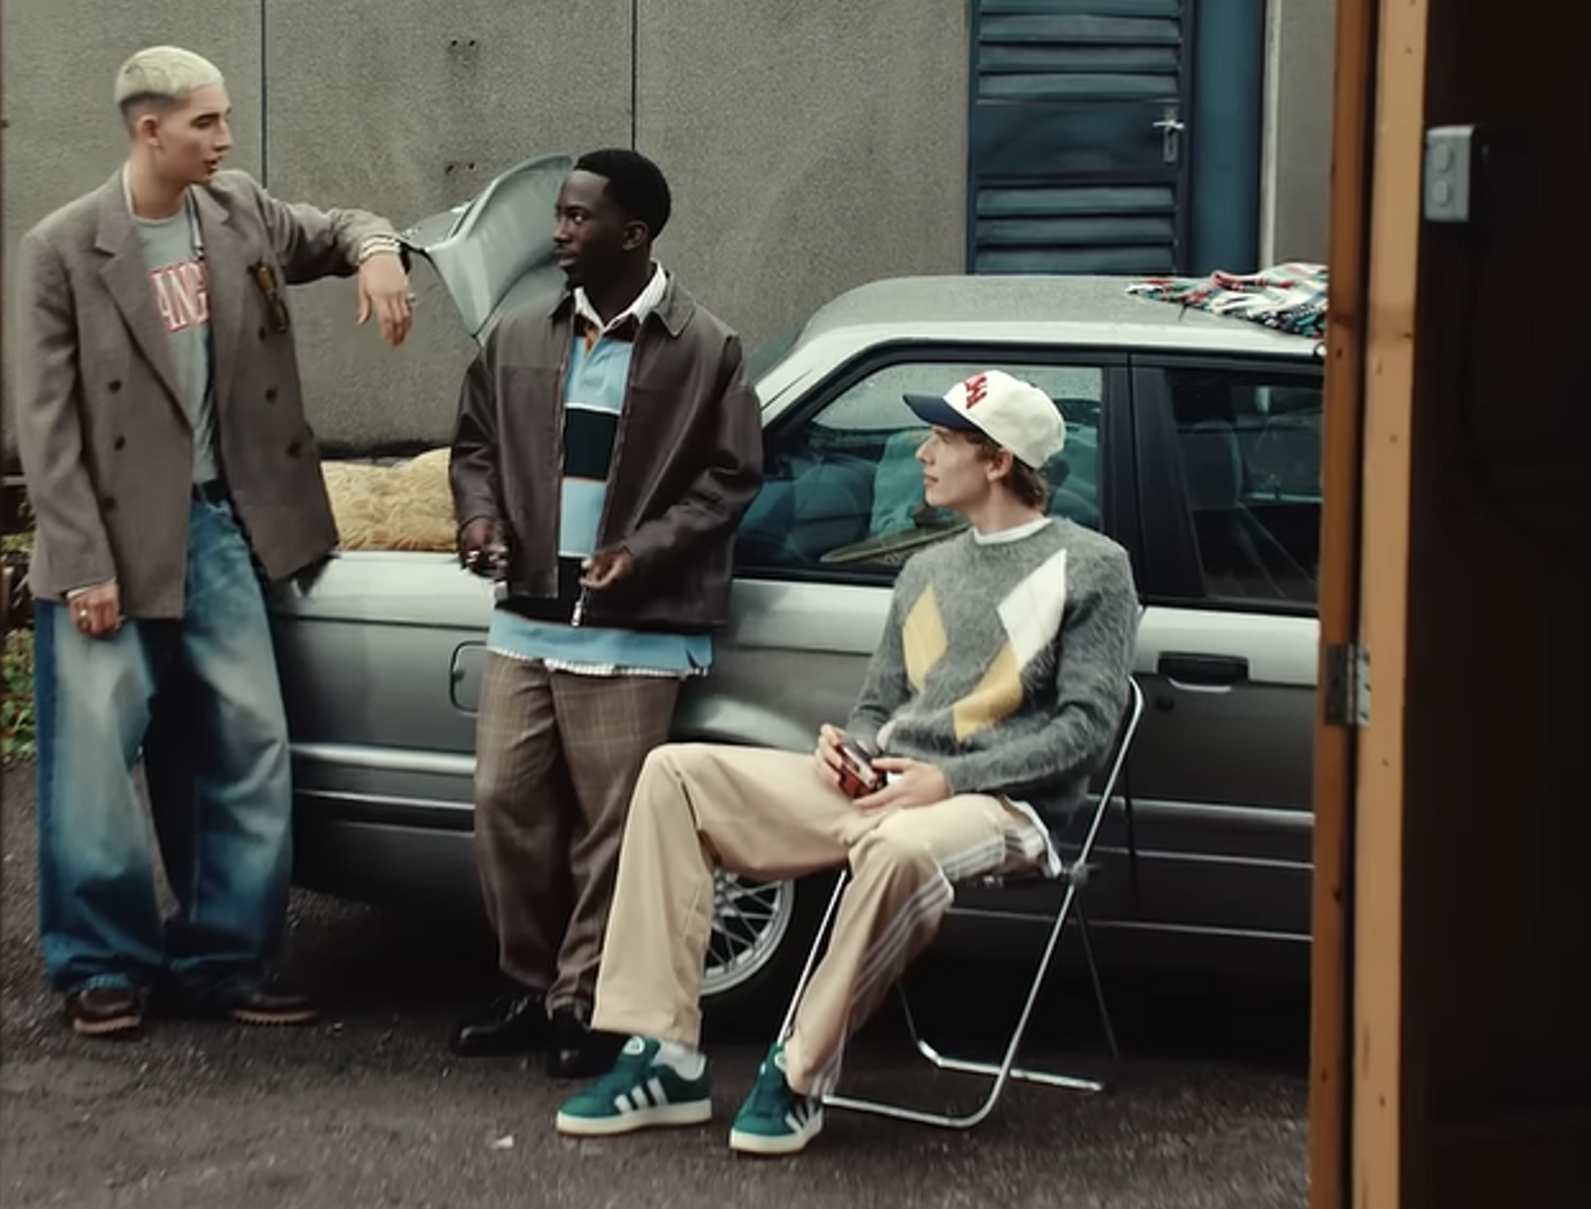

ASOS
DCM Awards Nominee:
Best Use of Cinema (Large)
Background
ASOS launched its first brand campaign aimed at positioning itself as a platform where people can find inspiration and originality in fashion and ultimately increasing brand consideration.
Plan
Buying the Silver Spot in Venom: The Last Dance, ASOS showcased the 60” ad in cinema to its target young adult audience, as part of a wider mix including BVOD, SVOD, YouTube and Social.
Results
Ad awareness increased by +20% among those exposed via cinema.
Significant increases across key campaign perceptions included ‘is a brand that inspires my fashion’ (+35%).
Source: DCM / ASOS. Conducted by; Differentology Oct 2024.
Notes:
Source: DCM / ASOS. Conducted by; Differentology Oct 2024.
Results base: 18-44. Uplifts are test (exposed to ad) vs control (unexposed to ad)

Slide 2
ASOS
DCM Awards Nominee:
Best Use of Cinema (Large)
‘Inspired By’
Media agency | Target | Buying route | Copy length
Goodstuff | 18-44 | Silver Spot | 60”
Background
ASOS launched its first brand campaign aimed at positioning itself as a platform where people can find inspiration and originality in fashion – rather than just an online marketplace for items you’ve already decided to purchase. ASOS aimed to use this new campaign to drive awareness, strengthen key brand perceptions, and increase brand consideration among its target audience.
Plan
Wanting to launch the new brand ad to a younger audience who are also lighter TV viewers, ASOS showcased the 60” in cinema as part of its media mix, understanding its role in driving key metrics.
ASOS bought into the Silver Spot of Venom: The Last Dance, giving them access to an engaged younger skewing audience. Expanding across other platforms, the campaign also ran the 60” and an additional 20” copy across SVOD, BVOD, Social, YouTube, Online
and Outdoor.
Results
Cinema played a vital role in helping ASOS launch the new campaign.
Awareness
Ad awareness increased by +20% uplift for those exposed via cinema.
Perceptions
Exposure to the ad in cinema delivered significant increases across key perception statements including ‘is a brand that inspires my fashion’ (+35%) and ‘is a brand I trust’ (+19%).
Source: DCM / ASOS. Conducted by; Differentology Oct 2024.
Notes:
Source: DCM / ASOS. Conducted by; Differentology Oct 2024.
Results base: 18-44. Uplifts are test (exposed to ad) vs control (unexposed to ad)

