Slide 1


Maximising price:
The role of media
Digital Cinema Media x everyday people
Notes:
Maximising price: the role of media is our new research project in collaboration with insight consultancy everday people.
So why are we interested in the topic of how media can help brands maximise price?

Slide 2
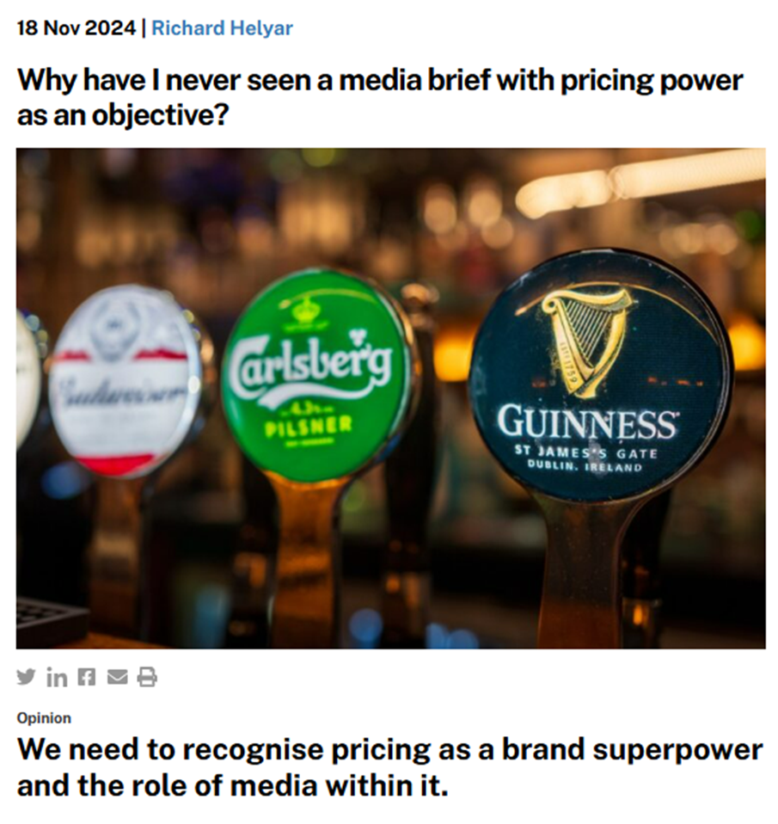
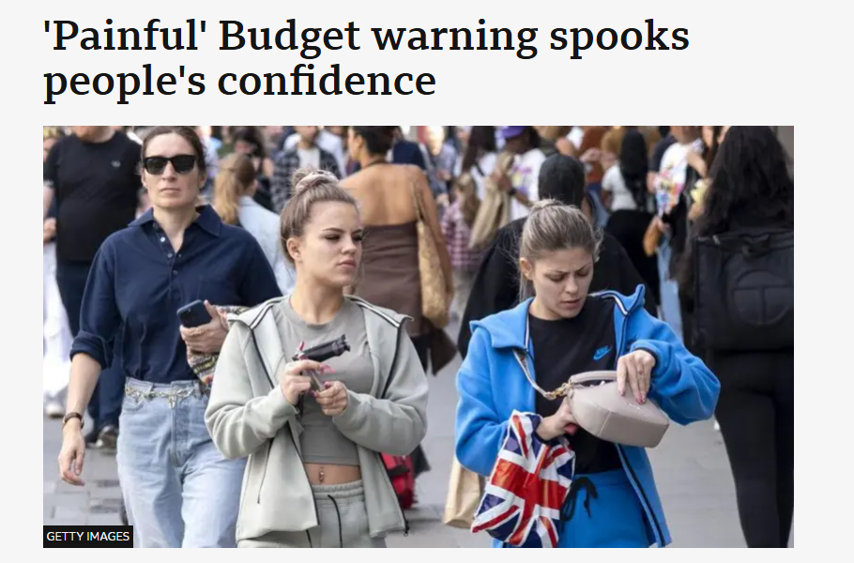
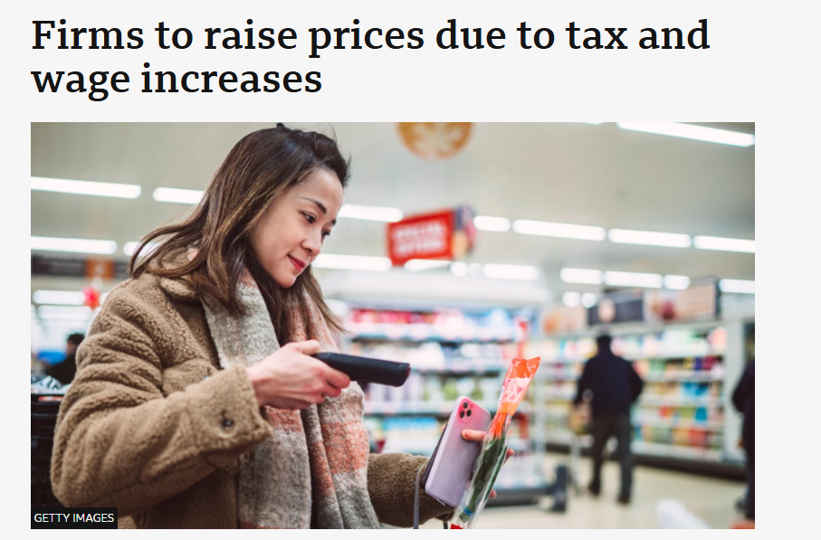
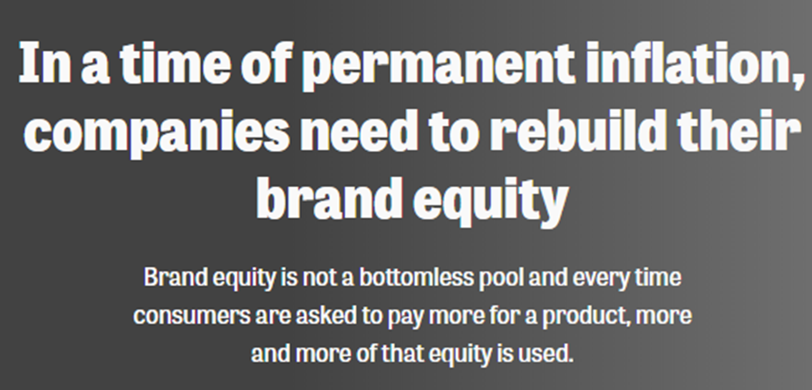
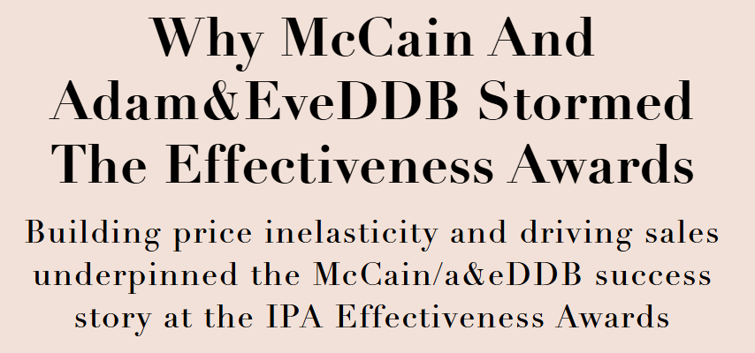

Maximising price: context
Backdrop of economic uncertainty causing issues for consumers and brands alike
Notes:
We’re launching this research in the wake of a budget that spooked both ordinary people and business. Costs are rising, and businesses need to raise prices to counter this. But at the same time consumer confidence remains very fragile so there’s a clear challenge for advertisers here.
We have begun to see signs within the industry of this topic being discussed – recent thought leadership articles, industry papers and award-winning IPA case studies are beginning to talk about the clear impact advertising can – and should be – having on improving price perceptions and reducing price elasticity.

Slide 3
People want to maintain their spend and look for value
Consumers don’t want to spend more, but top buying priorities remain value for money and quality over the lowest price
61%
Spend the same
27%
Spend less
11%
Spend more
Source: DCM/everyday people 2025. Base: UK Adults (n=2,700). Spend this year vs last year. Priorities for buying brands, % - top 2.
Notes:
Our research confirms it is a challenging outlook for brands. Consumers don’t want to spend any more – we found that 88% of people want to maintain or reduce spend this year across 10 major product categories – so there’s a clear widening gap between the commercial necessities for brands and consumer sentiment.
This current economic climate just highlights the need to engage with people’s everyday motivations and priorities, and the chart on the right highlights that buying priorities remain about value and quality (over lowest price) so how can brands communicate this explicitly and implicitly through advertising and media choice?

Slide 4


“To economists, price is a number; to consumers, it’s a feeling”
Rory Sutherland
Vice Chairman, Ogilvy UK
Notes:
When we talk about price, it can often be in the context of economists and the boardroom where price is seen as ‘a number’, an economic lever for driving profitable growth.
However, in the real world to ordinary people, price is a feeling, it’s a psychological experience that can be positive or negative.
And the same can be said for how people encounter advertising in different environments.

Slide 5

Proving the role of media in driving price perceptions
Notes:
And that’s what we were interested in investigating with this new research project.
The work we’ve done previously with everyday people has demonstrated that the role of channel choice alone can communicate important positive signals about a brand – with TV and Cinema particularly strong at signalling fame and fitness signals.
We wanted to see if this went further and can the media channel a brand is seen in alone increase people’s willingness to pay for a brand?

Slide 6
An experimental approach
We used a fictional new brand
TIXE
We create product descriptions
for 2 categories
Mobile network
Laundry detergent
Nationally representative sample of 2,700 UK Adults
Channel description varied across the 9 media cells
150 respondents per cell
TV
Cinema
Video Sharing Sites (e.g. YouTube)
TV
Cinema
Video Sharing Sites (e.g. YouTube)
Social media
Content creators
Outdoor
Social media
Content creators
Outdoor
Radio
Podcasts
New brands
Radio
Podcasts
New brands
Notes:
For our experiment designed to isolate the impact of different media channels on people’s willingness to pay for brands we introduced a tried and tested fictional brand – TIXE – that everyday people have used in previous research.
We created two product description – one being a mobile network, and one a laundry detergent.
A nationally representative sample of 2,700 UK adults were then split evenly across 18 demographically matched media cells. Nine cells see the mobile network category, and 9 in the laundry detergent one.

Slide 7
Scenarios isolate the effect of media placement
Every respondent sees the same product description, but the advertising channel will vary
Product Proposition
(constant within category)
Advertising Description
(varies within category)
TIXE is the new flexible mobile and broadband provider dedicated to making it easier for you to stay in touch
No one cares more about their customers than TIXE. Our fully flexible mobile plans put you in control. Choose from pay as you go, monthly, or fully flexible contracts – just pick one that’s right for you.
TIXE: the no limits mobile and broadband
TIXE must decide where to advertise. The advertising campaign will run for 3 months.
TIXE will launch with an advertising campaign that will appear exclusively in cinema.
Notes:
Each cell is given a synopsis of the product information – this product description is exactly the same for everyone.
The only difference is which media channel the brand is said to be launching on – the example here shows what those in the cinema cell would be shown – that Tixe will launching an advertising campaign exclusively in the cinema. And if you were in the TV cell, respondents would be told that Tixe was launching on TV and so on.

Slide 8
Four straightforward questions
Each respondent is then asked the same four questions…
  1. Good value
  At what price would you consider Tixe to be a reasonable price – a great buy for the money?
  2. Too cheap
  At what price would Tixe be too cheap and you would feel the quality couldn’t be very good?
  3. Expensive
  At what price is Tixe starting to get expensive, so you would have to give some thought to buying it?
  4. Too expensive
  At what price would you consider Tixe too expensive to buy?
Notes:
We then asked four very straightforward questions about their willingness to pay for TIXE – what would be a price that seems too cheap, a good value price, and when would it start to get expensive and be too expensive etc.
So what did we find? Well, I’m going to talk through two different ways we can interpret the results.

Slide 9
Cinema drives higher ‘good value’ price
Compared to all other channels, being told the brand will launch its advertising in cinema delivers the highest ‘good value’ price perceptions.
Outdoor | Social | Content creators | Podcasts | Radio | News brands | Video sharing sites | TV | Cinema
£13.30 | £14.40 | £15.00 | £15.60 | £15.80 | £16.00 | £16.70 | £17.40 | £17.80*
Source: DCM/everyday people 2025. Base: 150 UK adults per media cell.
*Statistically significant difference vs. all media except for TV and Video Sharing at 95% confidence interval.
Notes:
As hypothesised, at a very basic level, if we just focus on answers to the question of ‘good value’, we see a strong correlation between media channel and willingness to pay.
There are a wide range of prices across the media channels, and people are willing to pay substantially more for TIXE if they believe the brand will be launching its advertising in cinema.

Slide 10
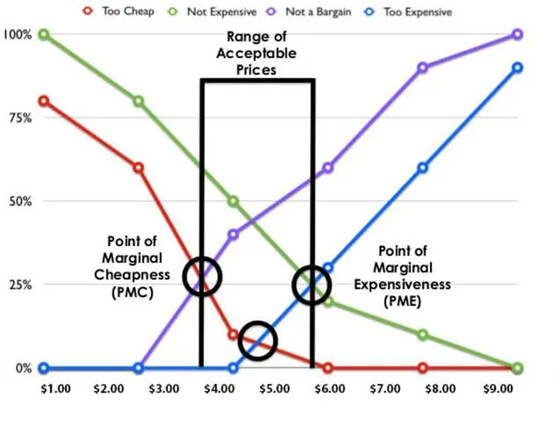
The Van Westendorp Price Sensitivity Meter
Price Sensitivity Meter output
The model is typically used in new product development where there are no pre-existing parameters for price perceptions. This makes it particularly well suited to the ‘Tixe’ fictional brand
The model helps brands identify the “optimal price” specifically focused on finding an acceptable price as a quality indicator
Notes:
The second way we can interpret willingness to pay is to model optimal price for TIXE using a widely-used pricing model called the Van Westerndorp Price Sensitivity Meter. The Meter provides a measure of “psychological price”, with price framed as a quality indicator.
So we took all the price point data we had from the four questions and input into the model to identify the optimal price for the product.

Slide 11
We created a benchmark model for all media
Tixe: Mobile Network - Price sensitivity meter output - all channel average:
Optimal price point £14.30
Notes:
By putting the four price points from all 1,350 people into the model – regardless of media channel they were told the brand was launching on – helped us identify what’s the Optimal Price Point for the product.
The Van Westendorp model is essentially looking to identify the intersection between Too Cheap and Too Expensive and that is the optimal price point, in this case £14.30.
We then re-ran the model 9 times to identify the optimal price point based on each of the 9 media cells, to see if the optimal price varied significantly depending on which media channel people were told the brand would be launching…

Slide 12
Cinema delivers highest price perceptions
Price sensitivity meter output Mobile network brand
Average optimal price point £14.30
Cinema delivers price premium +10% above the average
Source: DCM/everyday people 2025. Base: 150 UK adults per media cell.
*Statistically significant difference vs. all media except for TV and Video Sharing at 95% confidence interval.
Notes:
Once again you can see there’s a big spread in optimal price points across the 9 media channels – from £11.80 for those told the brand would be launching its advertising with outdoor up to Cinema coming out top with an optimal price point of £15.79.
Cinema delivers a 10% higher price premium than the all-channel average, and is statistically significantly higher than all channels from Social Media and below.
The results highlight the benefit of quality AV environments – with a top 3 of TV, Video Sharing Sites (YouTube) and Cinema – in signalling brand quality and ultimately driving willingness to pay more.

Slide 13
Stress-test findings with a lower price category
Product Proposition
(constant within category)
Advertising Description
(varies within category)
TIXE is the new laundry detergent that makes it easy to be green and clean
TIXE removes stubborn stains and freshens your clothes even at the lowest temperatures and uses 50% less packaging than other liquids meaning it’s also good for the environment.
TIXE: the greener and cleaner way to do your washing
TIXE must decide where to advertise. The advertising campaign will run for 3 months.
TIXE will launch with an advertising campaign that will appear exclusively in cinema.
Notes:
While mobile is quite a high interest category, we felt it was important to also test the hypotheses on a slightly lower interest (and lower price) category. That’s why we selected laundry detergent as our other TIXE product.

Slide 14
Cinema again delivers highest price premium
Price sensitivity meter output Laundry detergent brand
Cinema delivers price premium +14% above the average
Average optimal price point £6.71
Source: DCM/everyday people 2025. Base: 150 UK adults per media cell.
*Statistically significant difference vs. all media except for TV and Video Sharing at 95% confidence interval.
Notes:
We re-ran the exact same process for all the data from the laundry category respondents and found a very similar set of results.
Even at a lower price point, there is still quite a range of prices delivered by the individual media channels from £6.14 in Outdoor, to an average of £6.71, and up again to Cinema at the top delivering £7.67, the highest optimal price of any of the channels.
That’s a 14% increase vs. the overall average optimal price point for the laundry detergent brand.
And again, we see the quality AV channels leading the way in terms of their ability to drive price perceptions higher.
So what does this all mean for brands?

Slide 15
Implications for brands
Cinema has a key role to play in maximising business success
Context is key
Where your brand/ad
is seen matters
Premium signals
Cinema infers quality
Notes:
In summary…
Context is key - not all channels are created equally, and the media mix you choose has a clear role to play in influencing quality and price perceptions and therefore long- and short-term profitability.
Quality media and especially the premium nature of cinema sets it apart from other media channels in being able to signal quality and good value.
And we’ve just not seen that in this experiment using a fictional brand, we have also seen in real world practice with existing brands.

Slide 16
Brands appearing in cinema have seen increases in ‘good value’ and ‘quality’ metrics
+21%
+22%
‘Quality’ perceptions
‘Value for money’ perceptions
Source: DCM Ad Effectiveness Databank. Uplift of those exposed to ad in cinema vs. not exposed to the ad in cinema.
Notes:
Digging into our Ad Effectiveness Databank, we can see where brands wanted to measure perceptions relating to Quality and ‘Value For Money’ people being exposed to the brand’s ad in cinema had significantly higher levels of agreement with these perceptions versus those not exposed to the ad in cinema.

Slide 17

Implications for brands
Cinema has a key role to play in maximising business success
Context is key
Where your brand/ad
is seen matters
Premium signals
Cinema infers quality
Price is right
Cinema delivers highest
price perceptions
Notes:
To conclude, Cinema should be a key part of the media mix for brands looking to maintain or increase price and quality perceptions, land ‘good value for money’ messaging and it can also play a role for new or challenger brands in categories looking to elevate their brands.

Slide 18
Cinema enhances price perceptions and perceived brand value
Results from an experiment run by everyday people and DCM found that when people believe a brand is launching with advertising in cinema, price perceptions for the brand significantly increase..
+10%
+14%
Source: DCM/everyday people 2025. Van Westendorp Price Sensitivity Meter Output.
Notes:
And we now know from this experiment, that this can go one further with Cinema ultimately able to drive higher price perceptions for brands than any other channel.

Slide 19

Maximise with cinema

