Slide 1

Centre of Attention
DCM x Lumen
Notes:
The role cinema can play within the AV mix to maximise outcomes

Slide 2
We know people claim to pay attention to cinema ads
However, we know there can be a big difference between what people claim they do and what they actually do
Those rating 4 or 5 out of 5. Base: All adults. Source: Magnetic, “Pay Attention”
Notes:
We’ve got a lot of claimed data that suggests people pay more attention to ads in cinema than other channels – as shown here from a survey a few years back run by the old magazine trade body Magnetic – however there can of course be a difference between what people claim they do and what they actually do.
This is why Lumen and DCM came together to design, execute and analyse a piece of research that could deliver real-world empirical evidence about how much attention cinema advertising actually gets.

Slide 3














Working with Lumen
Attention specialists who have worked with many major media clients to help them better understand attention to advertising
Li
Lumen uses eye tracking to
help brands and media owners measure (and buy) attention.
The aim of this project was to investigate how much attention cinema ads generate relative to other media
Lumen in-context setting
Creative and media optimisation clients
Awards & nominations
Notes:
As established market leaders in this space, Lumen use eye tracking to help brands and media owners measure attention.
Lumen have worked with a variety of media, measuring attention in different contexts (from TV, to OOH, to gaming and digital display) - this has allowed them to build a comprehensive databank of attention data that we have been able to tap into as part of this project that was aiming to understand how much attention cinema ads generate relative to other media.

Slide 4


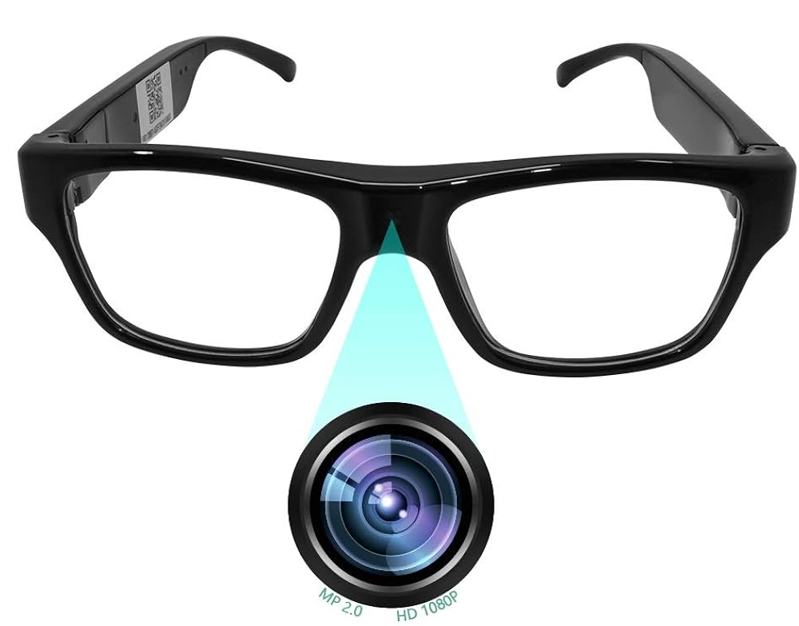
Methodology
Participants (all aged 16-34) were pre-recruited to ensure a balanced mix of gender, social class and cinemagoing frequency
Notes:
To fill in the missing attention knowledge gap, Lumen and DCM came together to design, execute and analyse a piece of research to answer: how much attention does cinema advertising get?
To do this we pre-recruited respondents to come and watch a showing of The Batman, and throughout the time they were in the cinema screen we asked them to wear a special pair of video glasses that were recording everything they could see in front of them. They were instructed that we wanted to get a picture of their typical behaviour in the cinema and so to act as they normally would, whether that was taking to their friends, eating popcorn or watching the ads!
Afterwards they answered a brief quantitative questionnaire to assess the impact of attention to the advertising on brand outcomes, like recall.
Post data collection, Lumen analysts then began coding the videos to itemise whether each respondent was viewing vs. not viewing the screen during the ad.

Slide 5


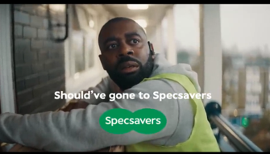
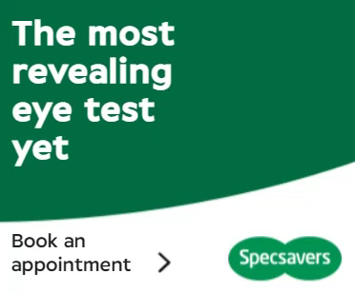
“Viewable” vs viewed
100% viewable
100% viewable
95% Viewed
15% Viewed
Notes:
Measuring attention helps us all better understand the quality of exposure in different media environments.
Based on just viewability standards alone we could assign the same value to both of these Specsavers ads. As these ads currently appear, in cinema this brand ad could be classed as 100% viewable and online this MPU could also be classed 100% viewable.
But when we overlay attention data we reveal that there can be a big difference between how much attention these ads are likely to generate and therefore, their value. A viewable ad in cinema is expected to be viewed by 95% of people in the room, whereas an MPU on desktop is only expected to be viewed by 15% of people.
And so attention metrics can act as a valuable unifying measure of effectiveness across both online & offline channels. Obviously it’s also important to then consider how long those are viewing the ad are actually viewing for…

Slide 6
Maximise attention with cinema
A far greater proportion of your ad – 24 seconds of a 30” and 48 seconds of a 60” - will be watched in cinema
Lumen norms
Source: Lumen Attention Research Channel Benchmarks
Notes:
As you can see Cinema is really the stand out media when it comes to driving engagement – on average 24 seconds of a 30” ad are watched, and 48 seconds of a 60”. The level of attention provided by exposure to the ad in cinema far surpasses what is achievable in other formats and really allows for deep engagement with the brand and the message.
By comparison TV on average delivers a solid 15.5 seconds attention to a 30” ad, and there’s a decreasing tail of attention available across other formats e.g. 4 seconds of a 15-20” bumper on YouTube and 1-1..5 seconds attention paid to Facebook and Instagram Infeed advertising.

Slide 7
Depth of attention paid to cinema ads is unmatched
Cinema delivers significantly longer cumulative viewership vs other AV formats
Cinema ads
75% of cinema ads are watched for over 20 seconds
TV 30”
YouTube Non-Skippable 15/20”
YouTube 6s Bumper
FB Infeed
Source: Lumen Attention Research Project April 2022. Onscreen Ad Impressions: Cinema Ads = 1,347 | Norms Source: TV data = Tvision / YouTube, Facebook, OOH, Display data = Lumen Research
Notes:
Another way of understanding how attention differs across media is to look at the distribution of the total attention given to an ad.
Some people will just glance briefly at an ad, whereas others will engage more deeply – and this varies a lot across media. This chart here shows the % of ad impressions that viewed for five, ten, fifteen seconds and so on – in total. They may not be watching from the start of the ad, and they may not be watching consecutive seconds. It is very likely that they may look at the screen, look away, and then look back. So this is charting cumulative attention, not continuous.
If we take a look at some of these trends we see that typically less than 10% of ads are on Facebook are looked at for more than 2s in total. Interestingly, when we compare YouTube and TV, YouTube initially looks better with a much higher starting point of viewing, but very few ads get past 5 seconds, while TV gets about 25% of ads past the 15 second mark.
Cinema, meanwhile, is really a cut above the rest – achieving both high levels of viewership and keeping viewers engaged for substantially more of the ad.

Slide 8

Cinema delivers significant brand metric uplifts
The benefit of high levels of attention in cinema is that it will deliver significant uplifts across key ad and brand metrics
Ad Awareness
+18%
Brand perception statements
+24%
Consideration
+17%
Recall
+43%
Better brand impression
+16%
Intention to act
+15%
Source: Differentology, databank of 100+ cinema campaign effectiveness studies . Relative uplifts between those exposed to the ad in cinema vs. those not exposed to ad in cinema (Demographically matched groups). Top 3 agree scores reported for perceptions, consideration and brand impression
Notes:
Since 2015 DCM have been working with Differentology to measure the effectiveness of cinema advertising for brands, and they have now built up a databank of 60+ campaigns from across 18 different product categories that we can tap into to understand the impact cinema can have as part of the media mix.
Comparing the results of those exposed to the cinema ad vs. those not exposed to the ad in cinema we can see that a highly attentive view of your ad in cinema delivers significant uplifts across important metrics including recall, awareness, brand perceptions, consideration and intention to act.

