Slide 1

Building Box Office Brands:
Cultural Relevance
Notes:
We are excited to launch the latest chapter of our Building Box Office Brands research programme – this time focusing on Cultural Relevance. Having previously investigated young audiences, attention, shared viewing, and media’s influence on price perceptions - why this topic now?

Slide 2

Be in culture. Cultural moments.
Cultural visibility. Culturally relevant.
Notes:
Well, it’ll be no surprise to those of you who write and send us briefs but we’ve seen a notable increase in the number of briefs we’ve been receiving recently where the challenge is some variation on brands wanting to “be in culture” or “cultural moments” or looking to increase “cultural visibility and relevance”. Why does culture remain such hot property? Well the evidence is clear…

Slide 3
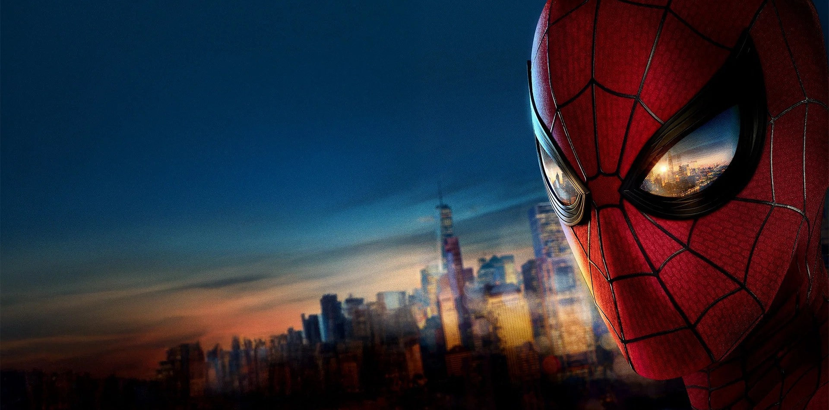
Brands with
high cultural relevance
grow nearly
6X more
than brands
with low levels
Source: Kantar
Notes:
Kantar’s Brand Z data highlights how brands with high cultural relevance grow nearly 6x more than brands with low levels – a compelling argument for cultural relevance as a growth lever in a competitive and ongoing economically challenging context for many advertisers. However, where can brands find culture that they can put on the media plan that can help them drive their own relevance?

Slide 4
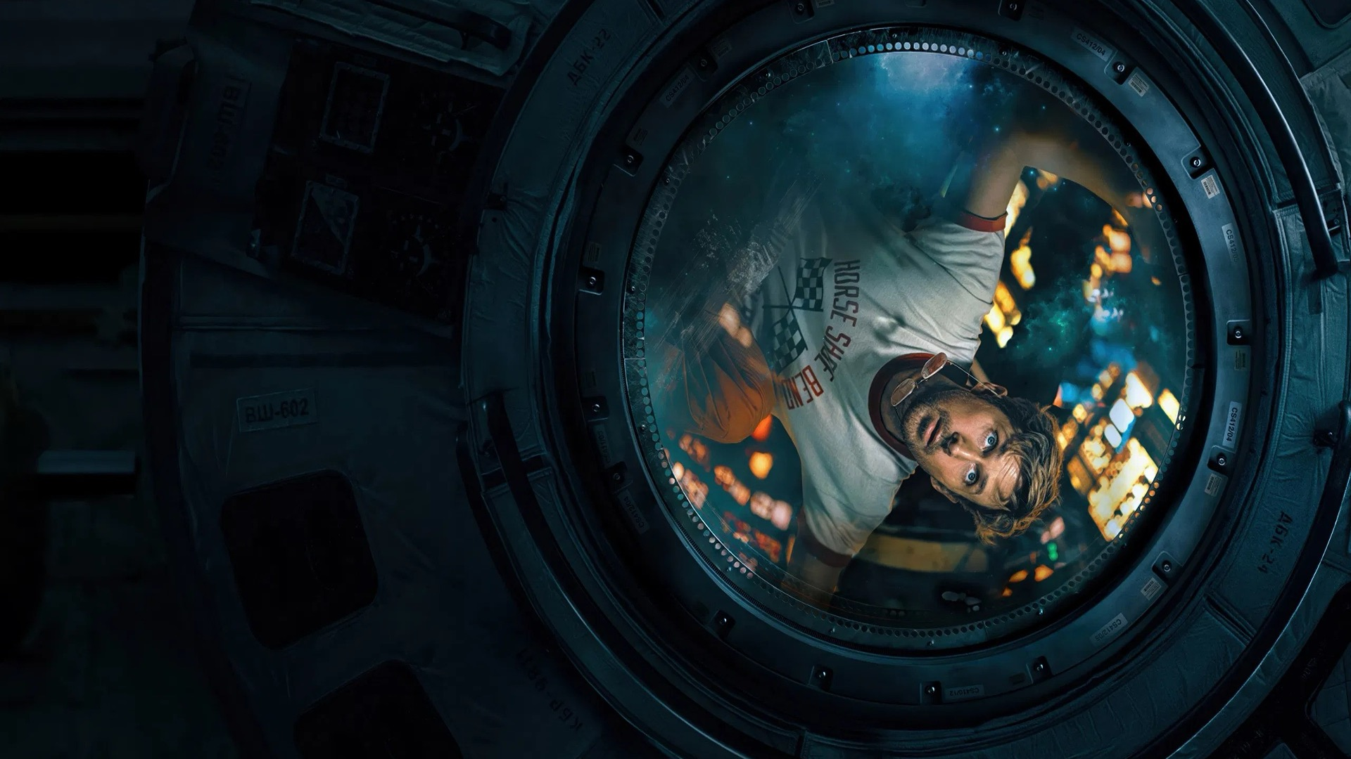
What resonates
and delivers
relevance?
Notes:
At a time when TouchPoints data tells us we’re spending more time on our phones than watching TV and the way we consume entertainment and news has dramatically shifted. In this context, what counts as culture worth being interested in if you’re a brand – and what is its ability to drive relevance?
This is why we wanted to explore this topic further - what are the moments that actually resonate, what underpins these moments, and specifically what is cinema’s role in driving cultural relevance for brands?

Slide 5
Behind the Scenes: Methodology
Experts
Audience
10 interviews with senior media planners,
film academics, and cultural strategists
30-min AI-moderated interviews with 75 cinemagoers
1500 adults (UK nat-rep, 16-64) completed 15min survey
Notes:
Working with respected research agency MTM we took a two-stage approach to the research including both qual and quant that would give us a 360 view on the topic.
For qual ‘expert’ stage we spoke to film & media academics, cultural strategists, and senior media strategists and planners to understand the current state of play and opportunities for brands. We also conducted interviews with 75 cinemagoers to dig into the cinemagoing experience and film’s role in culture.
For the quant stage – we conducted a robust Nat-rep survey among 1,500 people to allow us to understand how cinema shaped up against everything else. The majority of the deck you’ll see today is rooted in findings from this quant stage.

Slide 6

Defining
‘Cultural Moments’
Cultural moments are collective moments that shape societal conversation.
Shared: A defined event or piece of content that a lot of people engage with together (in-person or online)
Discursive: Causes audiences to engage with others’ experiences of the moment and it transcends through the created discourse
Time-bound: Has a defined peak where audiences engage with the content or event concurrently
Notes:
We started out through the qualitative stage wanting to build a definition of ‘cultural moments’ that we could use throughout the research – as this is a phrase that we use in the industry but not widely used by others
At its core we’ve defined ‘cultural moments’ as a “Collective experience with scale across society”
It has to be ‘shared’ – be that online or in person
Discursive: it has to be sufficiently absorbing, moving, important that the occasion transcends its original experience to become bigger
Cultural moments also have a time-bound collective peak of interest where reverberation is loudest

Slide 7
They can vary in scale, predictability and endurance
These characteristics are not mutually exclusive. For example, cultural moments can be mass, spontaneous and fleeting; or niche, planned and long-lasting
Niche
Mass
Spontaneous
Planned
Fleeting
Long-lasting
Notes:
What makes it tricker for brands is that cultural moments can take different forms – because they can vary in scale, predictability and endurance – and they can be a combination of these different elements.
(ANIMATION) Mass: high salience & attention at scale (World Cup) / Niche: only specific fandoms (e.g. anime, K-Pop)
(ANIMATION) Planned: Taylor Swift Eras tour, Spider-Man film / Spontaneous: kiss-cam couple from Coldplay gig
(ANIMATION) Fleeting: Labubus / Long-lasting: watching a TV show every week, or seeing a film that becomes something you love for the rest of your life
In this context, we were interested to understand what culture resonates for the long-term, when you ask people to look back what do they remember?

Slide 8
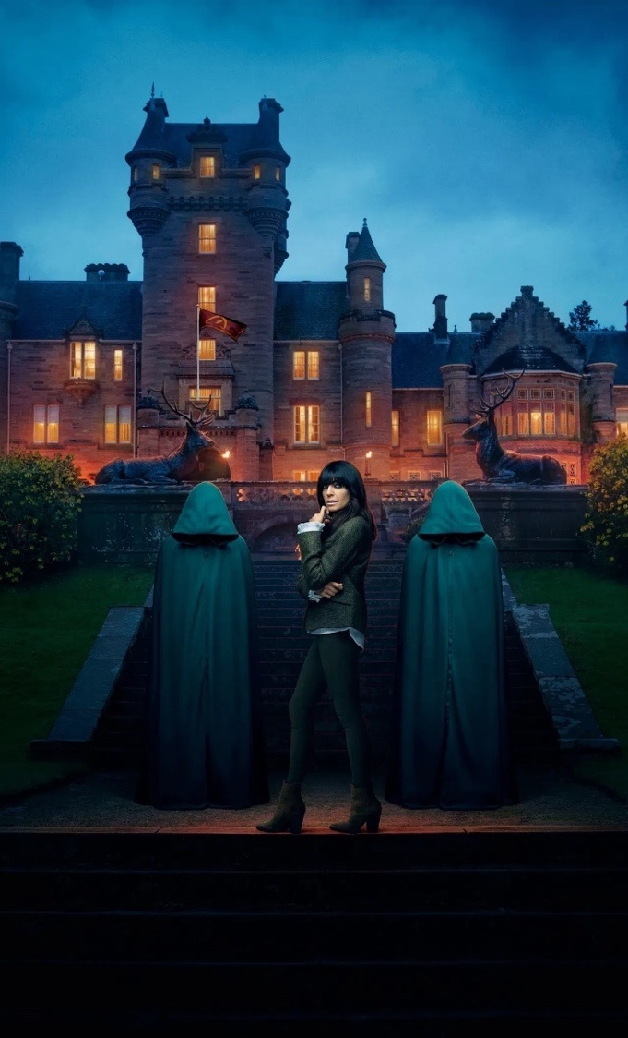
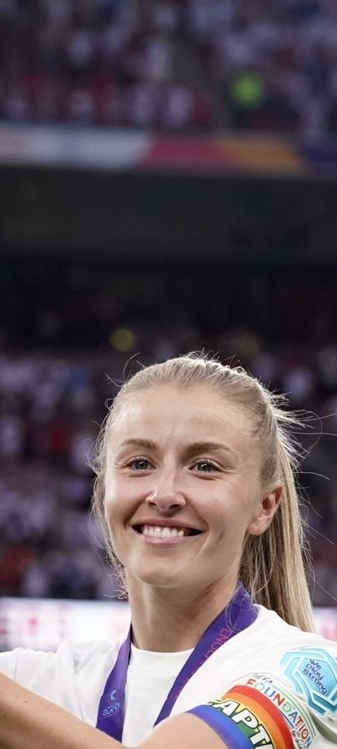

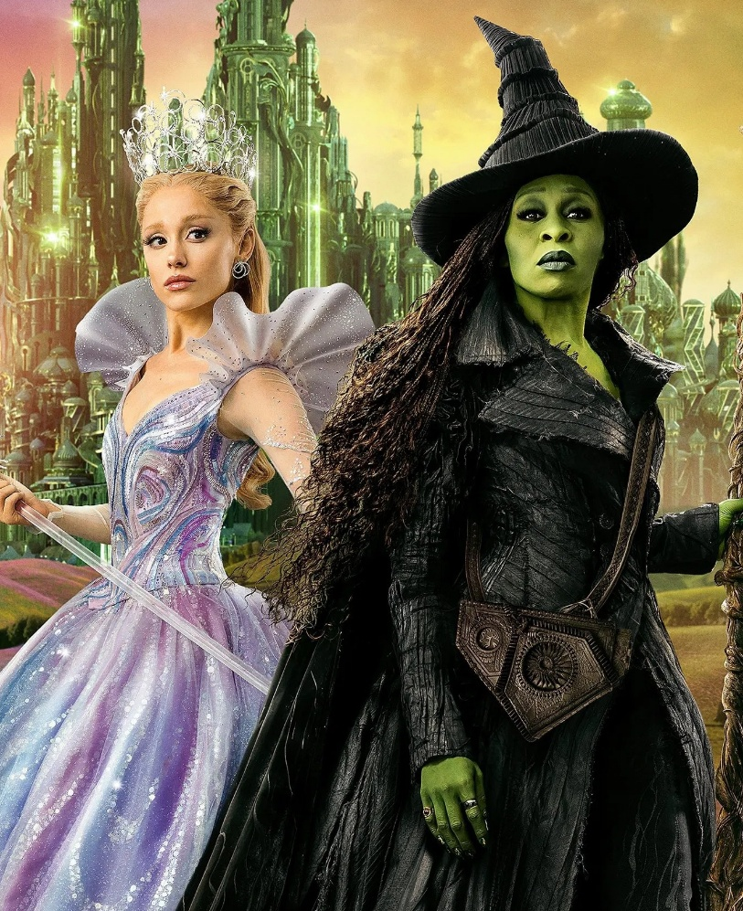
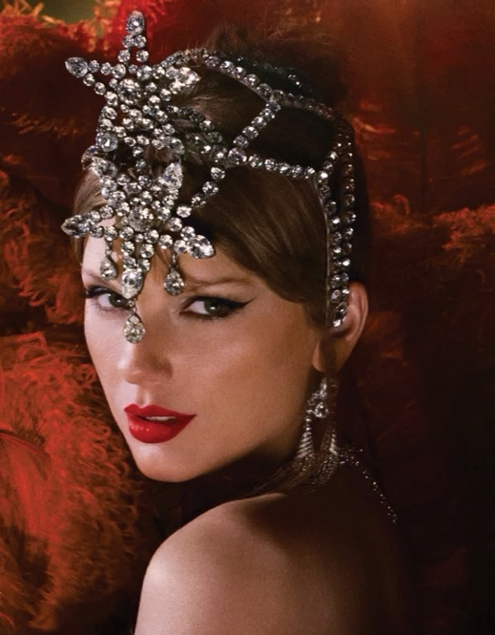
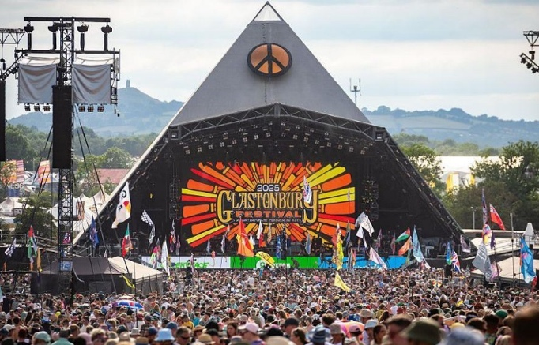
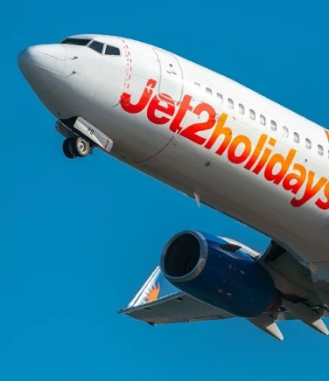
Audiences engage with a wide range of culture
Cinema, 10%
Other, 10%
Social Media Trends, 5%
TV, 23%
Sport, 21%
News, 20%
Cultural Events, 11%
Source: DCM x MTM: Cultural Moments, Treemap based on % of Spontaneously Recalled Events
Notes:
We conducted the survey for this in February and we simply asked people to look back on the last 12 months and recall up to 10 things they would consider to be ‘cultural moments’ that got lots of people talking.
We then categorised these up:
TV came out top (Traitors, Stranger Things, Adolescence)
Sport (Lionesses victory, Lando winning F1)
News (Peter Mandelson/Andrew Mountbatten were in the news at time of fieldwork),
Cultural Events (Glasto, Notting Hill Carnival)
Cinema (lead by mentions of Wicked)
Other: Oasis reunion, Taylor Swift, Gaming releases
Social media: Only a handful of mentions of Jet2 memes, 6/7, Labubus
However, when it comes to being able to buy in cultural moments – and put your 30” ad (for example) before or during it – obviously not all of these moments are commercially available. And so we took all the mentioned moments and have made a commercially available version too…

Slide 9

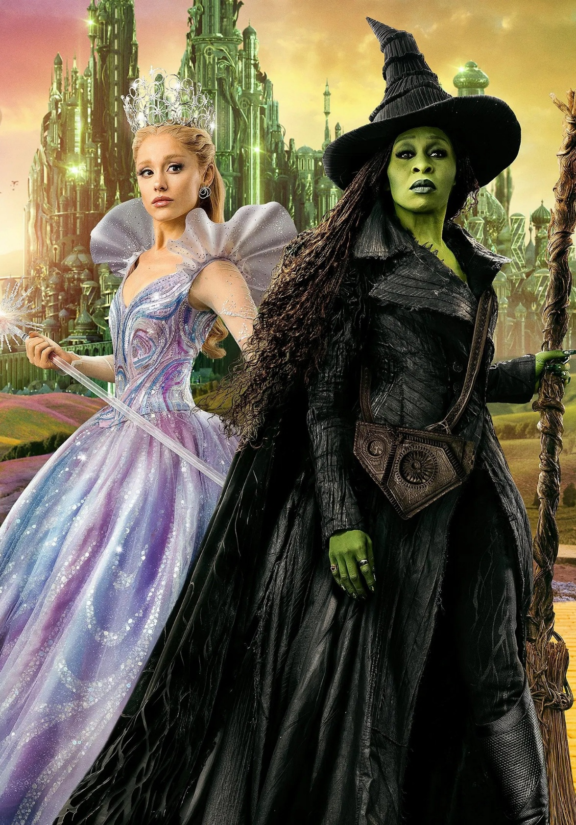
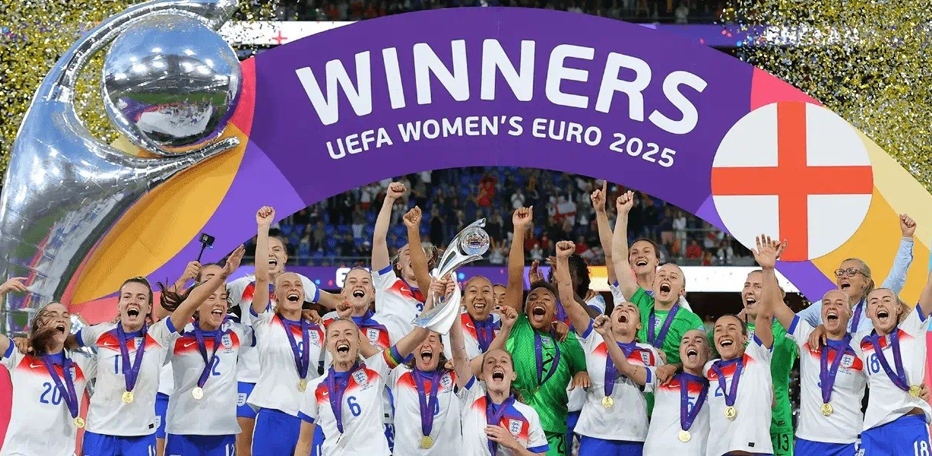
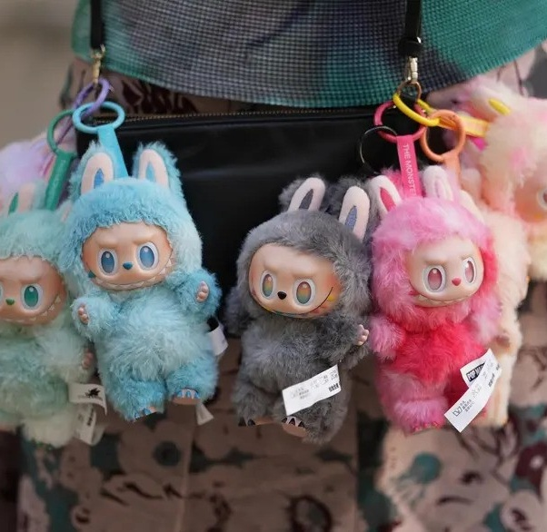
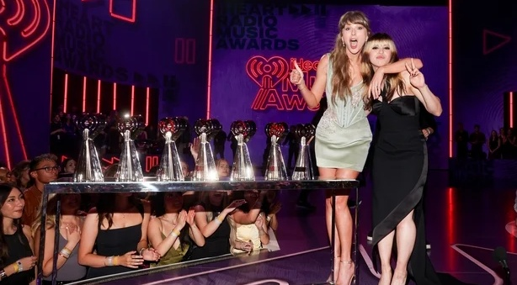
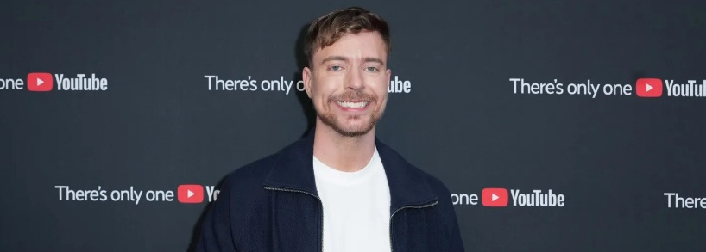
TV and Cinema deliver 85% of commercially available entertainment that resonates
TV-Sport, 23%
Cultural, 3%
TV-Entertainment, 34%
Cinema, 28%
Social Media, 12%
Other, 1%
Source: DCM x MTM: Cultural Moments, Treemap based on % of Spontaneously Recalled Events factored for commercial availability
Notes:
Having stripped out moments that brands can’t buy (e.g. BBC TV shows, factored Netflix shows for ad-tier viewership) it becomes clear that the 2 strongest routes advertisers have into cultural moments that resonate are TV (through entertainment and sport) and Cinema.
While we’re in a time where many briefs are ‘social first’ and in our own bubbles viral moments can feel massive, when people reflect on the moments that mattered or resonated most it’s clear that TV and Cinema deliver the majority of commercially available culture that brands can put on the media plan.

Slide 10
Cinema delivers disproportionate cultural impact
Cinema outperforms it small share of ‘video time’ delivering significant, long-lasting cultural impact
28%
recalled cultural moments
1%
total video
viewing time
vs
Sources: DCM x MTM: Cultural Moments / Thinkbox . Based on commercial viewing and cultural moments
Notes:
And this is even more impressive if you place the resonance of cinema in the context of time spent. Unlike all the other video channels, cinema isn’t an everyday activity – if you average out the handful of visits people make - as per the Thinkbox Total Video Viewing Time charts – cinema accounts for less than 1% of total video viewing time but we all know that’s not telling the full picture about the value of cinema. Not all forms of video are equal.
Cinema is not a volume channel in terms of providing endless scale and high frequency, but what we offer is being an incredibly high value channel that’s going to punch above our weight on the media plan in more ways than one. And on this topic, cinema delivers a disproportionate impact vs time spent because cinema remains a powerfully relevant cultural force.

Slide 11
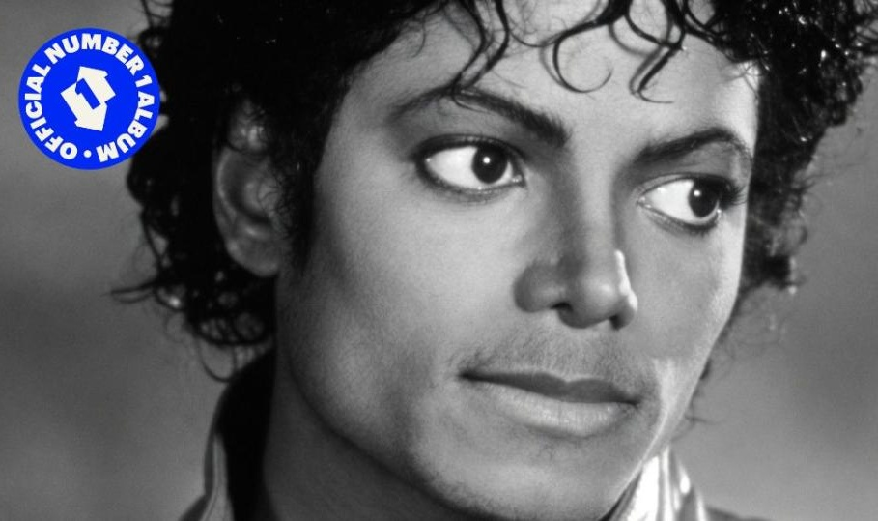
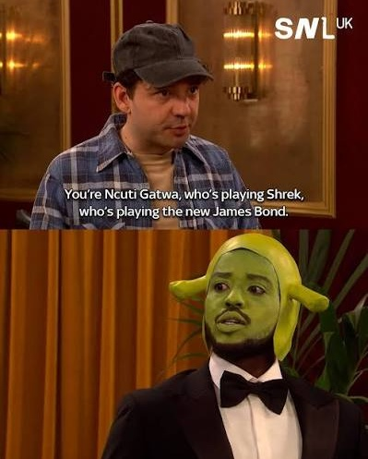

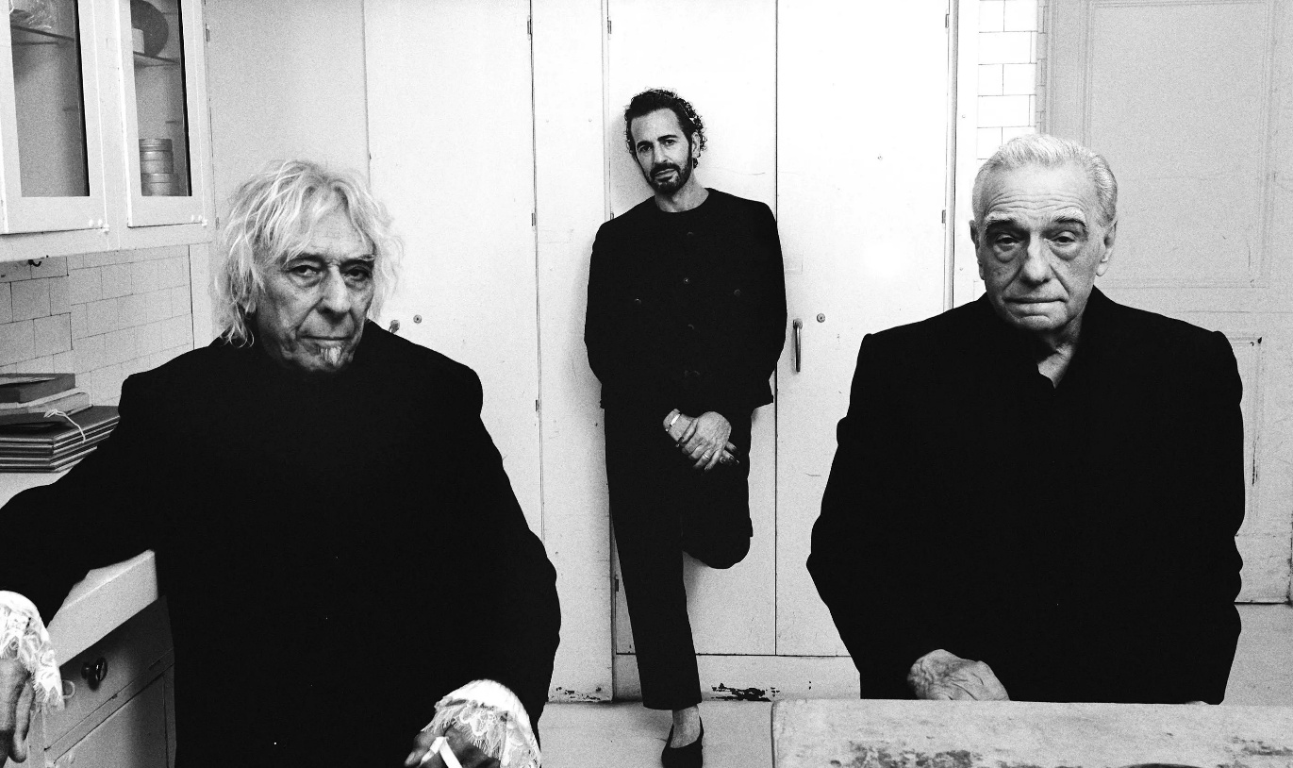

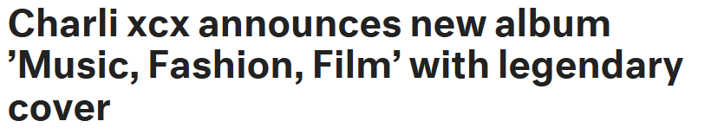
Cinema remains a culturally relevant force
Notes:
Just a few recent examples of this include the Michael Jackson biopic creating a resurgence in his music and driving his Greatest Hits to #1.
Charli XCX, one of the defining cultural figures of her generation has in the last 12 months released a soundtrack, her own movie, and film is one of the core cultural pillars referenced in her upcoming album.
SNL UK launched earlier this year, a show designed to satirise and spoof popular culture and not an episode went by without multiple film and cinema references. From Hamnet to Super Mario, film junkets to Ncuti Gatwa playing Shrek playing James Bond – it’s proof of the continued cut through of cinema.
And that’s before we get to the conveyor belt of GIFs and memes that new releases create that appear online and permeate the group chats.

Slide 12








Channels deliver culture in different ways
Cinema and the SVOD players are differentiated by their ability to deliver high talkability “must see” moments
Social media platforms & creators are known for creating trendy, hyper-personalised, relatable moments.
Traditional broadcasters are seen to create quintessential, timeless moments that feel distinctly British.
CINEMA
SVOD & Cinema create
buzzworthy moments that define
the wider cultural zeitgeist.
For each of the following statements about culture, which, if any, of the following media providers do you associate with it? Base: UK 16–64-year-olds (1507)
Notes:
These days are a lot of different channels that can provide a route into culture – but we were interested to understanding more about what audiences think about the type of culture being delivered by these, and what channels are most similar to each other.
We asked people a series of statements – you can see these floating on the chart map now – and asked them how much they associated those statements with a list of channels
What you’ll see as the chart builds is which channels align closest to which statements
(ANIMATION BUILD) On the left we see Social &video are associated most with defining what’s trendy and popular, and championing everyday & alternative views. No surprise for trending and algorithm based services.
(ANIMATION BUILD) In the top right, we see the traditional broadcasters more defined by their ability to deliver distinctly British programming and being as the heart of culture
(ANIMATION BUILD) Cinema & SVOD are grouped together in the bottom right: most associated with delivering must-see, buzzworthy, zeitgeist moments

Slide 13
The trajectory of a cultural moment
Cultural moments aren’t just about the moment and the resonance
Salient moment
Resonance
The point at which audiences collectively engage with the event
The ripple effect of discourse, wider event coverage, and the enduring memories
Sources: DCM x MTM: Cultural Moments / Thinkbox
Notes:
When it comes to ‘cultural moments’, it’s easy to perhaps think (especially in the context of social) that these moments happen and then there’s the resonance
But what was interesting, if we think back to the moments that resonated the most, that these (TV shows, sport, cinema) have an important additional element in their trajectory – and that’s Anticipation (MORPH TRANSITION TO NEXT SLIDE)

Slide 14
The trajectory of a cultural moment
Cultural moments aren’t just about the moment and the resonance – planned moments deliver a key ‘build up’ stage
Anticipation
Salient moment
Resonance
Planned moments only
Notes:
This is what differentiates these moments from what happens online, because there is a ‘build up’ and anticipation to these moments.

Slide 15
Cinema is unparalleled for being highly anticipated
Cinema has an inherent ‘event’ status and a whole ecosystem that drives anticipation for months that separates it from other video channels/programming.
Cultural Moments Associations – Gap between left [0-3] & right side [8-10] (All respondents)
Low Anticipation
High Anticipation
Social media
Sport
TV
Cinema
For each media format, please select the point on the scale that best describes the nature of that cultural moment.
Gap between left [0-3] & right side [8-10] (All respondents). Note: Scale From 20% to -20% not shown for presentation purposes. Base: UK 16–64-year-olds (1507)
Notes:
And when it comes to Anticipation, Cinema wins outright.
We asked survey respondents to rate each type of media you see here on the scale from Low to High Anticipation – and you can see cinema is a clear winner in delivering anticipation.
It’s no surprise given the ‘Event’-status that films have and the whole marketing machine that is engaged to generate interest and excitement over weeks and months.
No other cultural phenomenon, perhaps outside of a World Cup, builds anticipation quite like cinema

Slide 16
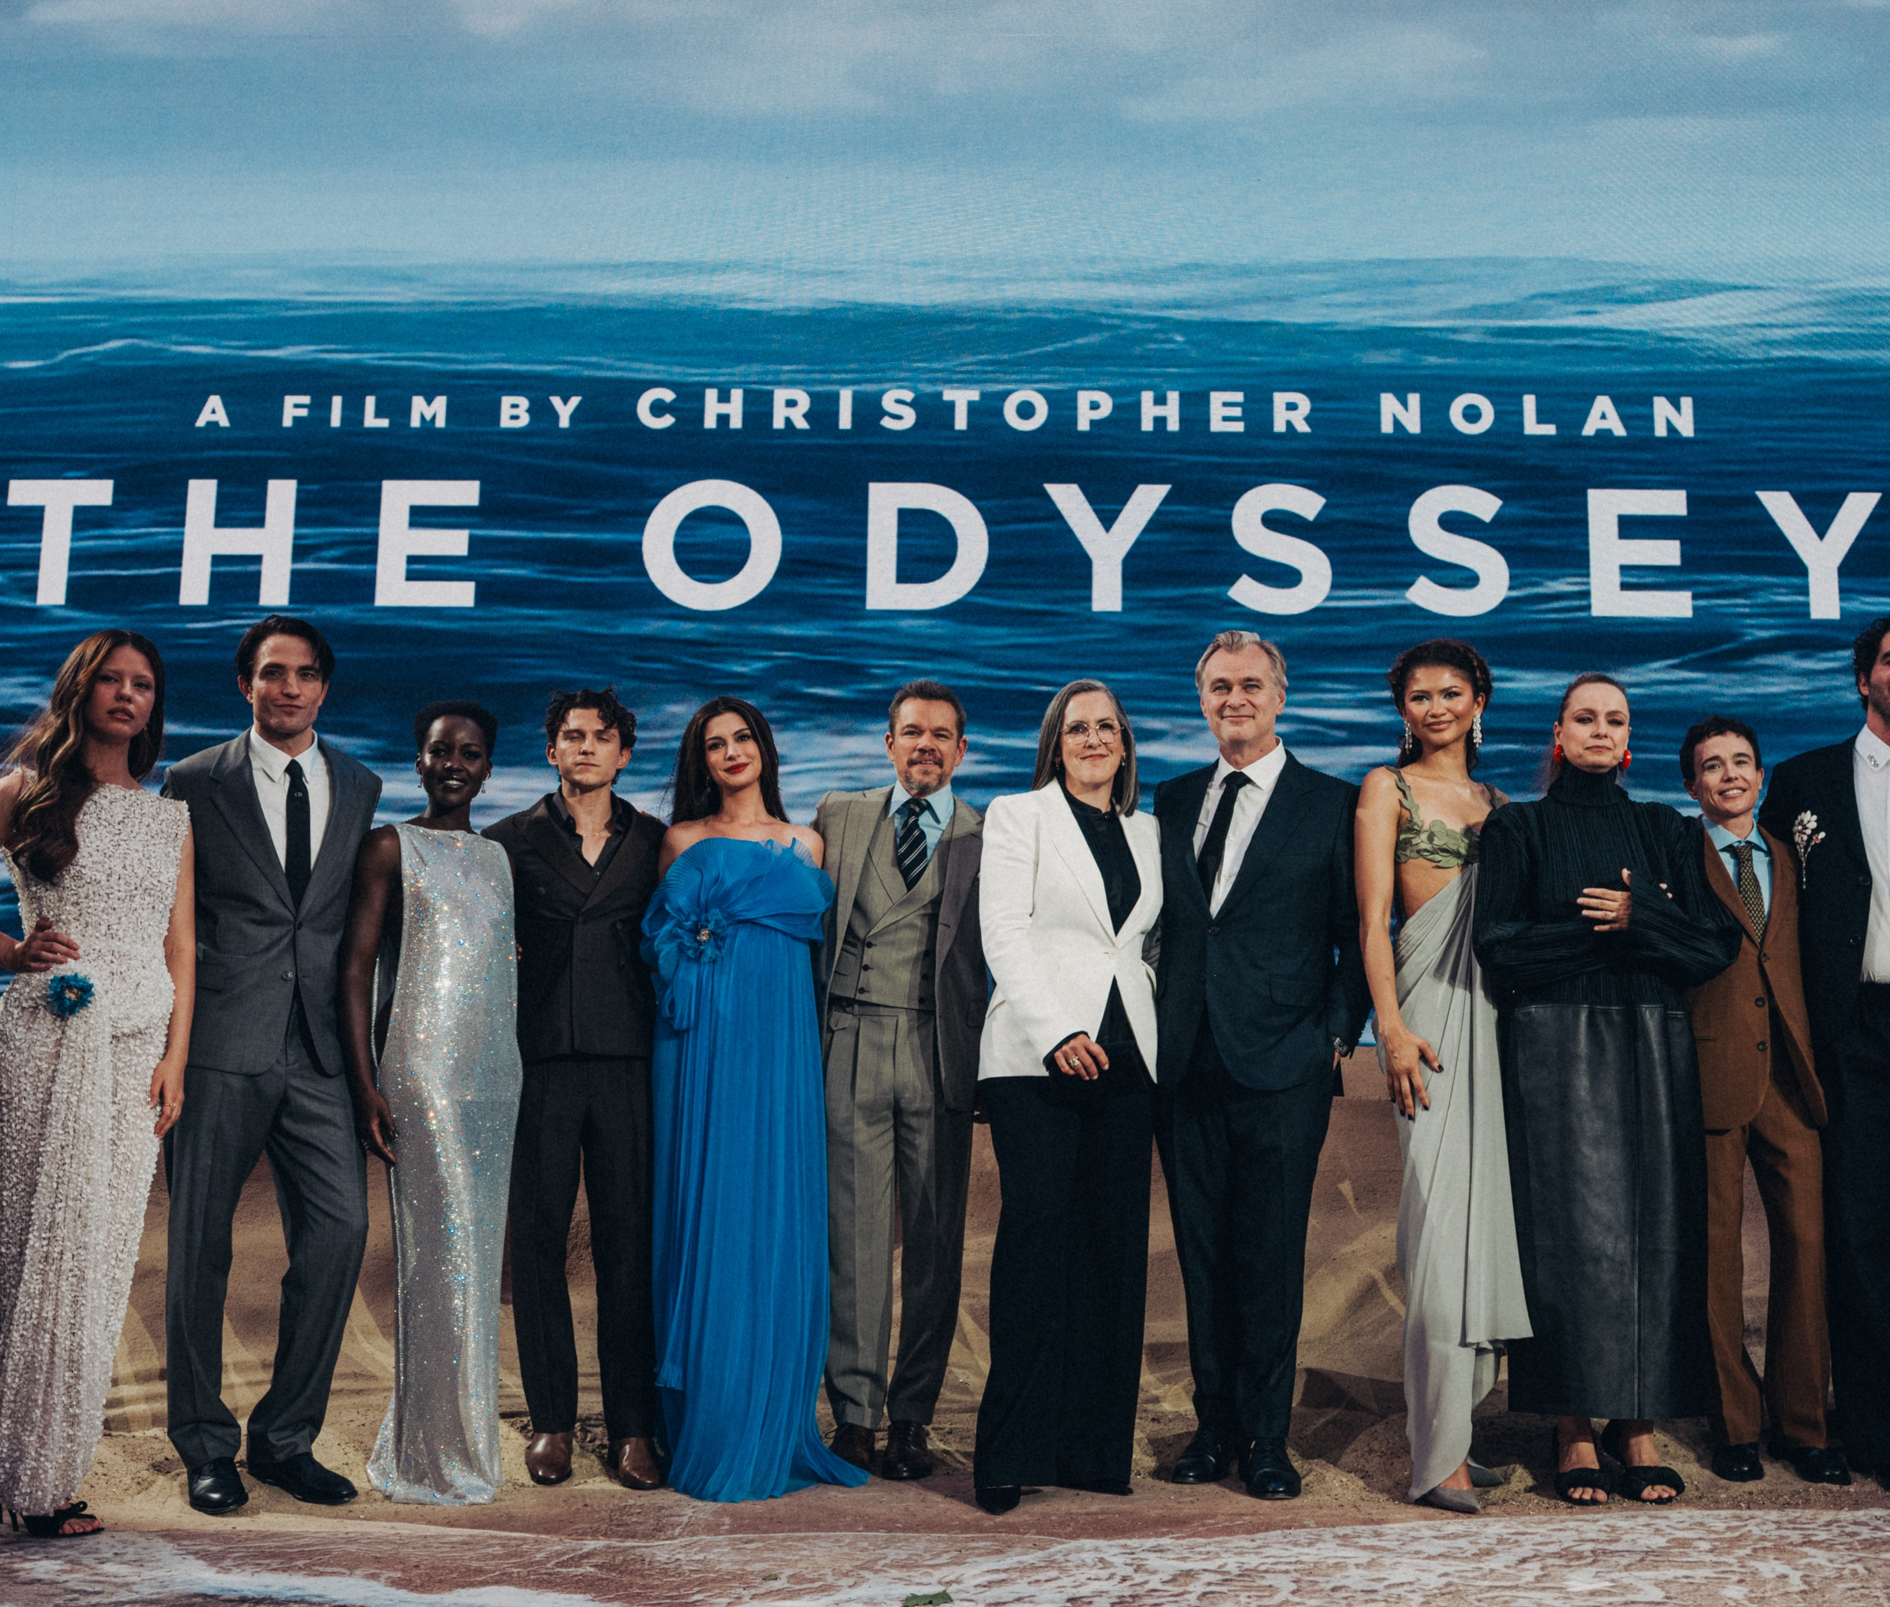
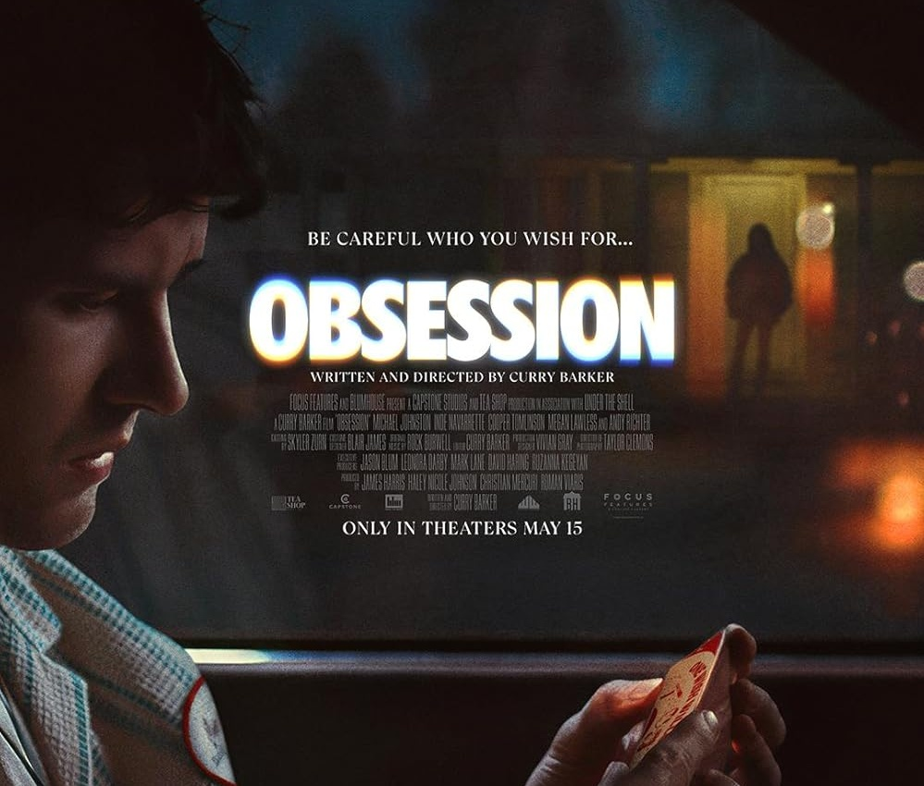
2.5M
weekly cinema admissions
Every ticket sold is a ‘high anticipation’ moment that is a high value opportunity
for brands to harness
Source: Rentrak. Average weekly industry admissions, H1 2026
Notes:
Anticipation is obvious when it’s something like The Odyssey coming this Friday, but don’t think of cinema just as something to cherrypick.
Week in week out in H1 cinema is delivering significant scale with a weekly average of 2.5m admissions in UK cinemas and every ticket sold is a ‘high anticipation’ moment that people have left their home for.
It’s not just all about big franchises and known IP that drive anticipation, it can be a buzzworthy original title that captures the zeitgeist – like Obsession (ANIMATION BUILD), the recent horror film you might have heard about.

Slide 17
Cinema isn’t just about IP and franchises
When a new film strikes the zeitgeist, cinema is the only place they can see it – as seen with Obsession’s remarkable box office performance
Obsession
Source: DCM Admissions for Obsession and average burn rate
Source: DCM 2026. Weekly admission avg. based on all releases from 2022 - 2026
Notes:
The benefit of the exclusive theatrical windows that have remained and are being extended is that when something pops off, cinema is the only place people can see it.
Obsession is a remarkable example of this – a film that generated huge word of mouth that has sustained its box office performance.
Unlike the average ‘burn rate’ of a film (the black line here) you can see Obsession delivered more admissions in Week 4 of its release than its opening week.
A reminder that it doesn’t matter when someone sees a film in its run, it’s still something virtually everyone is coming to see for the very first time.

Slide 18


With cinema, brands always enter the scene just as excitement is peaking
Excitement Curve:
Feel excited (6-10) at each moment
Peak excitement:
sitting down to watch the film
For each stage, how would you rate your excitement while experiencing the film. Base: UK 16–64-year-olds who saw a film in the past 12 months)
Notes:
In the survey, we asked people about the last film they had been to see and how excited they were at each point in time – from first time seeing the trailer, to planning the visit, to sitting down to watch the film
As you’d expect Excitement climbs through the build-up
Its peak is when people sit down at the cinema – exactly when the brand ads will be part of the experience

Slide 19
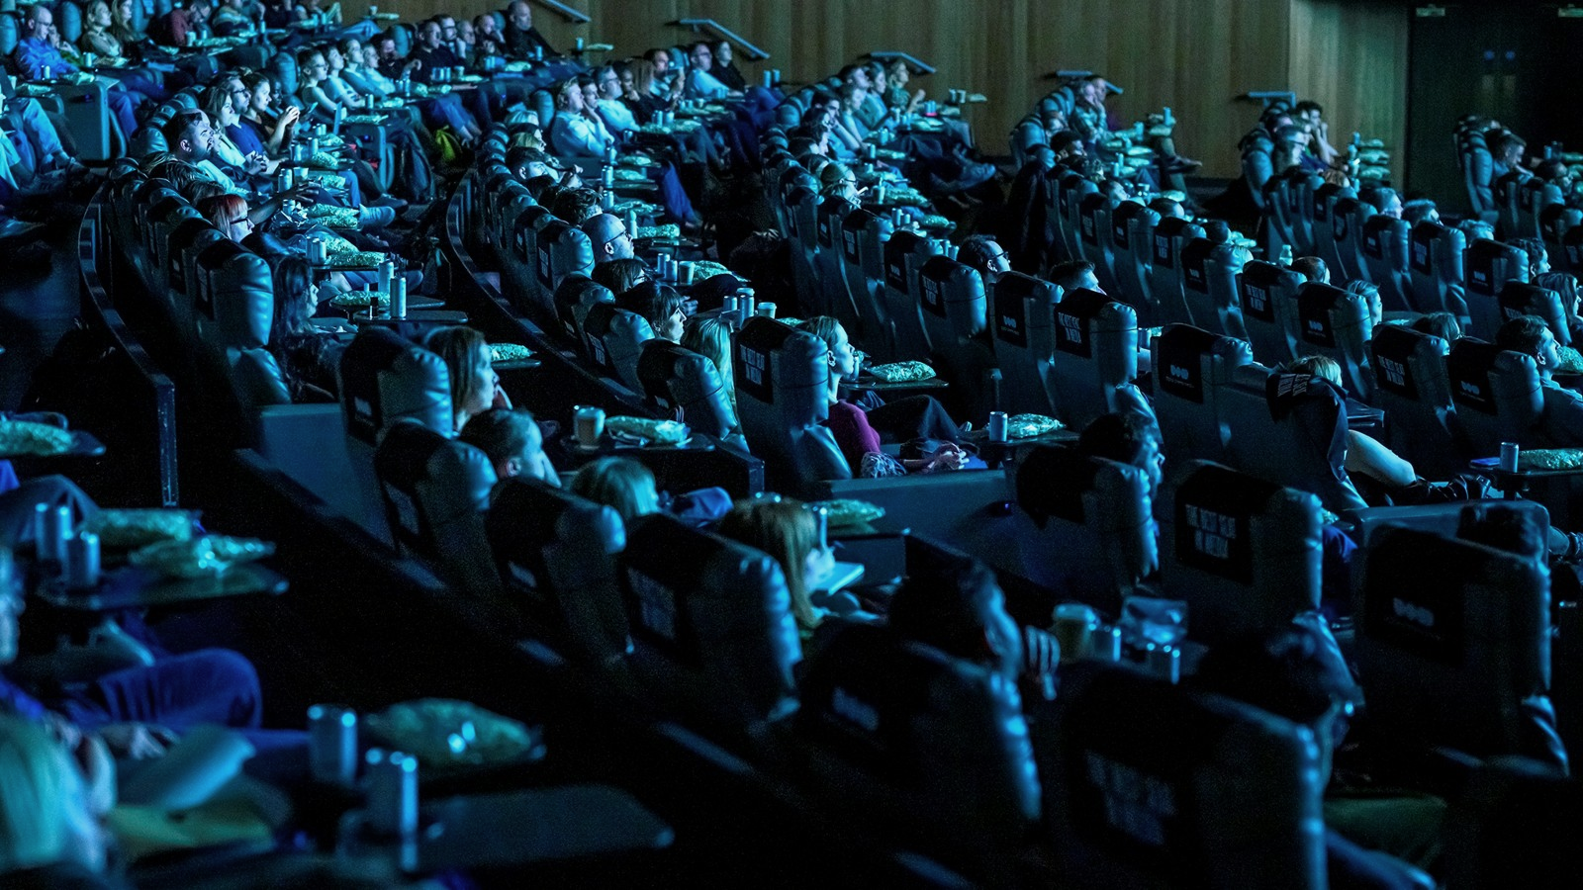
Cinema’s build up creates an emotional high no other channel can match
Emotions before watching something new at the cinema
Amazed
17%*
Focused
31%*
Excited
47%*
"The lights go down, the screen's really big, everyone's quiet in
anticipation, and no one checks
their phones. It just feels more exciting"
Female cinemagoer, London
Happy
39%*
Nostalgic
13%*
*Cinema significantly higher than all other channels
For each type of media, please select all the emotions you typically feel just before viewing something new. Base: UK 16–64-year-olds (1507)
Notes:
And the benefit to brands having your ads placed in this context of excitement is that it creates an emotional high that no other channel matches
When we asked people about emotions felt while watching something new in different channels, we found people were significantly more likely to say they were Excited, Happy, Focused in cinema

Slide 20
Emotional resonance is cinema’s strength
Cinema cultural moments are felt to be the longest lasting, while by comparison social media moments are more fleeting and forgettable
Cultural Moments Associations – Gap between left [0-3] & right side [8-10] (All respondents)
Fleeting
Long-lasting
Social media
Sport
TV
Cinema
Forgettable
Memorable
Social media
Sport
TV
Cinema
For each media format, please select the point on the scale that best describes the nature of that cultural moment.
Gap between left [0-3] & right side [8-10] (All respondents). Note: Scale From 20% to -20% not shown for presentation purposes. Base: UK 16–64-year-olds (1507)
Notes:
The emotional resonance that people feel isn’t fleeting either!
When we asked people to place the moments on scales of fleeting to long-lasting and forgettable to memorable – we again see the Cinema experience resonating as the longest-lasting & most memorable
Cultural moments from social media can cut through, but by comparison are likely fleeting & forgettable
The build-up to cinema forges strong memory – for example, you can probably still vividly recall a cinema trip from your youth
And tapping into a high emotionally resonant moment like cinema is important because…

Slide 21

Brands can ride the wave of emotional intensity to long-term memory
Cinema’s unparalleled emotional resonance drives stronger memory encoding. The brain also builds associations between these positive emotions and the advertiser brands.
”I think if you are seeing [ads] before something you’re very excited about, it is naturally going to create a positive association.” Female cinemagoer, London
[1] Tyng CM, Amin HU, Saad MNM, Malik AS (2017) The Influences of Emotion on Learning and Memory
Spotify Advertising & Neuro-Insight (2021): Sonic Science: Understanding your brain on sound
Notes:
It’s been known since 70s in neuroscience research that high-emotion is fast-pass to long-term memory
Emotional intensity is a signal to the brain that this is something worth encoding – aka if it’s important enough to feel, its important enough to remember
Positive associations then drive System 1 thinking that will then be used in future when making decisions about what brands to buy/use

Slide 22
The nature of cinema makes audiences more open to advertising
#1
The high anticipation moment, the focused setting, the well-established ad experience positioned before the main event (as opposed to during) help make audiences more positive to ads in cinema.
Cinema scores highest vs
TV, Streaming, Social & Online Video
Ads do not interrupt my experience
Openness to ads shown
Memorable ads
63%
of cinemagoers agree that ‘advertising is an expected part of the build up to cultural moments’
For each type of media, please select the point on the scale that best describes how you feel about the advertising that appears on it. .Base: UK 16–64-year-olds (1507)
Notes:
Importantly the nature of cinema advertising also creates a context where audiences expect – and are open to – advertising in the build up to cultural moments
Cinema = more than other media we tested – people rate themselves as being open to seeing ads, that the ads are not an interruption to the main experience, and the ads are more likely to be memorable
We believe this is because advertising has been a well-established part of cinema experience and hasn’t changed over time so audiences know exactly what to expect

Slide 23
Cinema stands out from other channels for its ability to deliver a ‘big brand energy’ halo
% agree ‘more likely to associate attribute with brand’
when they’ve advertised before a cinema cultural moment
Cinema vs.
all channel average
High quality
67%
+16%
Relevant to me
65%
+13%
Established
63%
+15%
Category leading
61%
+14%
Please tell us whether you are more or less likely to associate the phrase with a brand if you saw their ad right before/during watching this [CHANNEL] cultural moment.
Base: Users of each channel: Cinema at least once a year (1134); Watches sport (1112); Watches TV/streaming (1430); Social media at least once a day (1391)
Notes:
In the survey we then wanted to understand what the benefit to brands might be from being seen advertising before a big film at the cinema.
We gave people a list of 12 different brand attributes and asked them to pick which ones they would be ‘more likely’ to associate with brands they see advertising before a cultural moment in cinema
We found that the top attributes people would most associate are high quality, relevant, established, and category leading. And people were more likely to select these attributes, than for advertising before/during cultural moments on other channels.
Cinema helps leave advertisers a ‘bigger brand’ than before they walked in – and this can work for challenger brands who want to build ‘big brand energy’, as well as brands that are already category leaders who want to be seen in spaces that continue to give off that stature to audiences.

Slide 24

Cinema enhances quality perceptions and perceived brand value
Results from our research last year showed that when people believe a brand is launching with advertising in cinema, price perceptions for the brand significantly increase.
+10%
Mobile network brand
Optimal monthly cost
Source: DCM/everyday people 2025. Van Westendorp Price Sensitivity Meter Output.
Notes:
These results support what we found in last year’s research with everyday people. Where your brand and its advertising shows up matters and impacts perceptions of its quality and value.
Using a fictional new telecoms brand, we found that when telling people it would launch with advertising in cinema they were significantly more likely to place higher value on the product – creating an optimal monthly cost in this case 10% higher than the average seen across all 9 media that we analysed as part of the experiment.
Being seen in this context, alongside high quality programming helps drive your own perceived brand value and what people are willing to pay for your products.

Slide 25
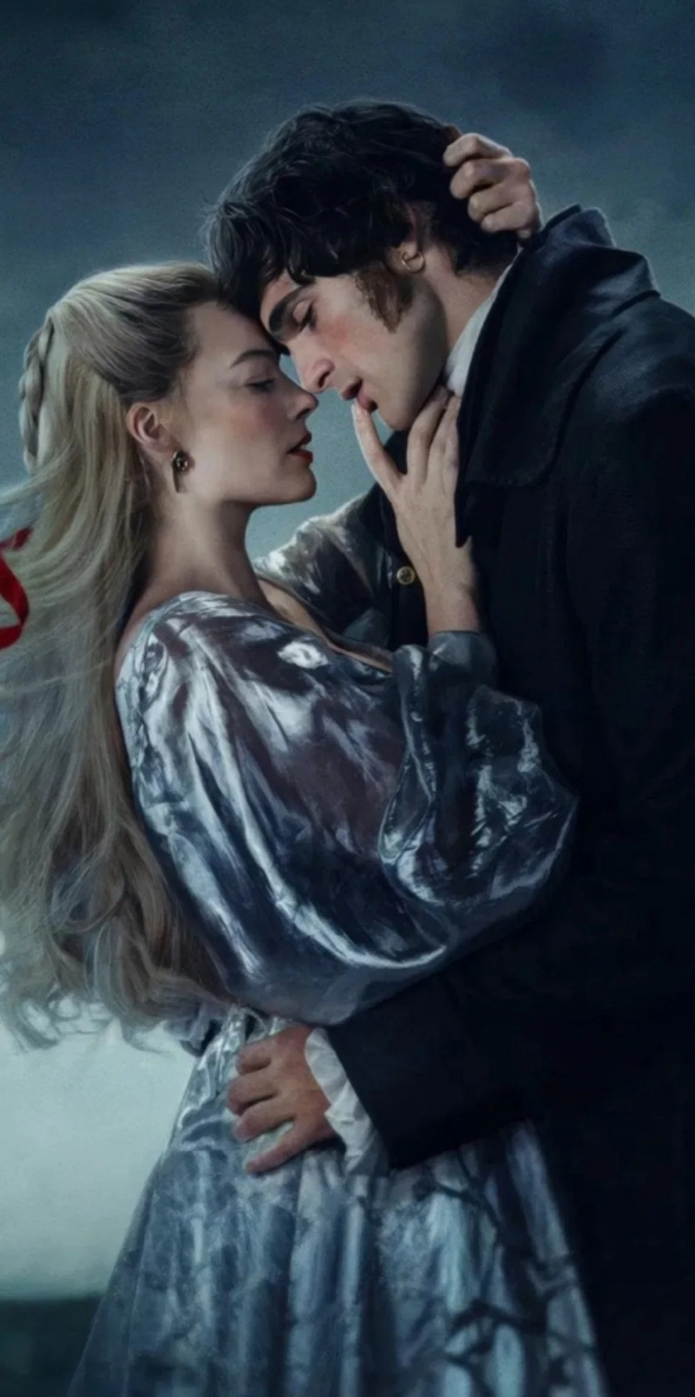
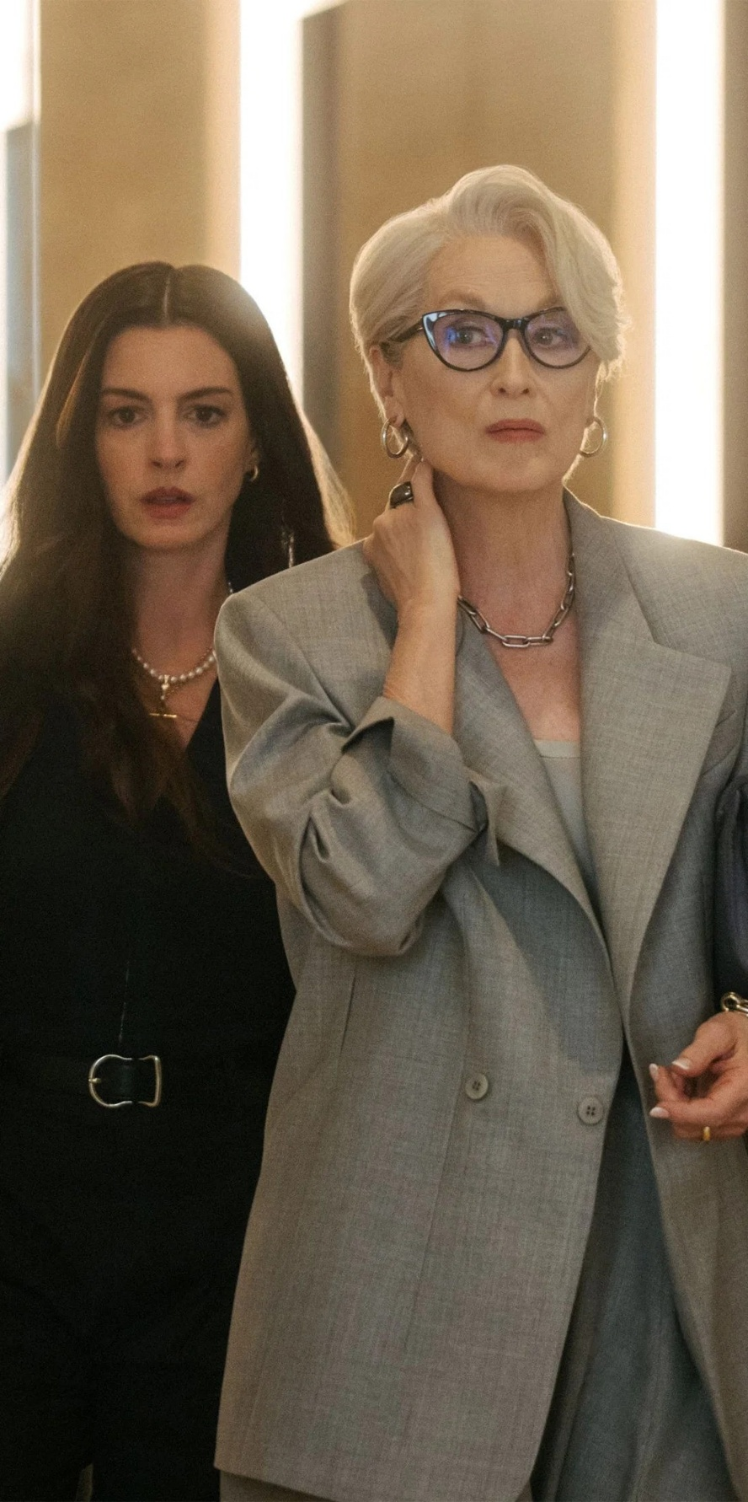


Maximising cultural relevance with cinema
Wuthering Heights, The Devil Wears Prada 2, The Mandalorian & Grogu, Toy Story 5
Notes:
We’ve seen how hypothetically in the survey people say advertising before a cinema cultural moment would drive relevance of a brand, but we wanted to take this one step further.
So, since February we have been looking at proving this rooted in real world campaigns.
On the opening weekends of these 4 films we asked an in-foyer data partner to ask cinemagoers if the brands running in the premium positions (bronze, silver, gold) were a ‘relevant brand in British culture’.
This question was asked of people before they saw the film, and then a matched group of people coming out of the film hours later.

Slide 26

Running in the premium positions of cinema’s
biggest blockbusters maximises cultural
relevance +55%
Source: DCM 2026. Research conducted on 9 brands running in the premium positions of Wuthering Heights, The Devil Wears Prada 2, The Mandalorian & Grogu, Toy Story 5. Uplift: Exposed to the ad in cinema vs. those not exposed to the ad in cinema. ‘…is a relevant brand in British culture’ (Top 2 Box)
Notes:
We found that across the 9 brands that ran in the premium positions, seeing their ad before a highly anticipated title drove cultural relevance by a huge 55%.
Demonstrating that simply placing your ad in the preshow of the most anticipated entertainment produces a halo effect that makes your own brand feel more culturally relevant too
And as Kantar proved this can be incredibly valuable for growth.

Slide 27
Summary
Cinema remains a powerful cultural force
Anticipation + Context = high value advertising opportunity
Cinema maximises cultural relevance for brands
Notes:
Hopefully, we’ve given you more compelling evidence that can help sell in and reinforce cinema’s role in the AV and to summarise:
Cinema remains a powerful and influential cultural force
High anticipation and the physical and emotional context that cinema is viewed in combine together to create an incredibly high value advertising opportunity for brands
Being seen on the big screen ahead of culturally relevant films that people are excited about has been proven to drive brand’s own cultural relevance too

