Slide 1


The cultural currency of cinema at Christmas
How brands can drive cultural connection and relevance with cinema this Q4

Slide 2
Fragmented viewing habits mean that people are spending more time alone, over half agree that “there is no sense of community anymore”¹
How can I reach co-viewing audiences?
Brands with high cultural relevance grow early 6x more than brands with low levels²
How can my brand be across the biggest cultural moments?
Around 40 advertisers across Nov-Dec are spending >£5m, making it a struggle to be heard over the festive period.³
How can I avoid being lost amongst other brands in the festive period?
72% of GB consumers agree that they spend money more carefully than they used to⁴
How can I reach more affluent audiences willing to spend more?
Source: 1. The Cultural Power of Cinema DCM x everydaypeople (2024). 2. eWorks (2026) 3 Nielsen Ad Intel 2025. 4. TGI GB June 2026 All respondents

Slide 3
How can I reach co-viewing audiences?
Dial up social connection with cinema
How can my brand be across the biggest cultural moments?
Access cinematic cultural moments
How can I avoid being lost amongst other brands in the festive period?
Cut-through the festive clutter with cinema
How can I reach more affluent audiences willing to spend more?
Leverage cinemagoers spending power

Slide 4


01.
Dial up social connection with cinema

Slide 5
Cinema is Christmas
The cinema boosts mood and encourages co-viewing, showing us that it can act as a respite to the chaos of Christmas – making them more receptive to ads.
90%
More likely to go to the cinema with 3 or more people
% either excited or happy using the media
+40%
Typically go with their family or friends
Source: FAME 2025. Target: Those who visit the cinema during Christmas time who have been to the cinema in the last week. Social media ‘watching Adverts on Social Media’ ‘

Slide 6

Cinema brings families together…
Families love the nostalgia and shared family moments that cinema gives them.
“The cinema is a great way to spend quality time with family and friends”
80% agree
Cinema gives people space & time to spend time with family
% who see aspect of Christmas as Important (NET)
Source: FAME (2025) Target: Those with children in the household who typically go to the cinema at Christmas time. / YouGov Dec 2024. 06/12/2024 - How stressful, if at all, do you normally find Christmas to be? - Very / fairly / not very / not at all, Target: Parents, Control: Nationally representative

Slide 7
…Whilst giving young adults the escape and entertainment they need during Christmas
“Films are an essential part of my cultural life”
70% AGREE / INDEX: 121
“I enjoy seeing films at the cinema more than on TV”
80% AGREE / INDEX: 220
“A trip to the cinema lets me escape from everyday life”
68% AGREE / INDEX: 110
“An IMAX cinema is the best place to watch films”
53% AGREE / INDEX: 170
Source: FAME (2025) Target: 16-34s who typically go to the cinema at Christmas time. Index vs avg. GB adult

Slide 8
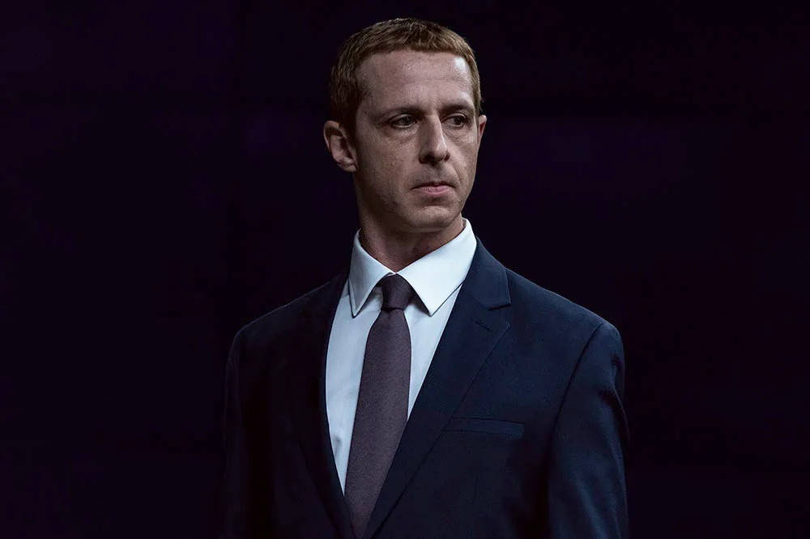

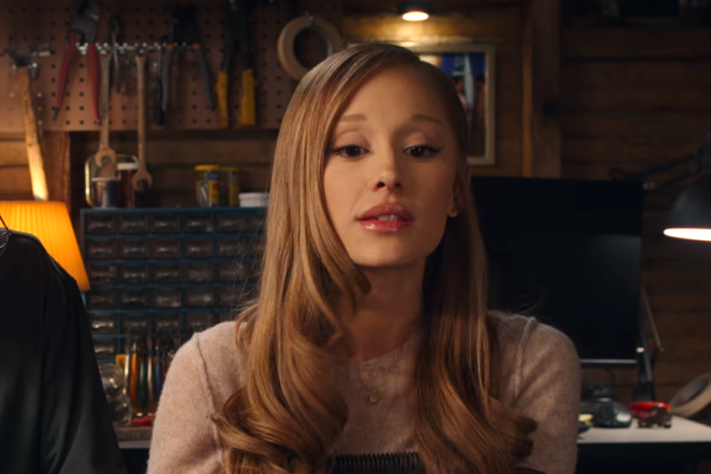

Nostalgia is a powerful tool in film that connects audiences
Sequels bridge the gap between generations, creating a novel shared cultural moment for kids and adults with the opportunity to indulge in the sentimental value it provides.
The Social Reckoning
9 Oct
603k admissions
The Hunger Games
20 Nov
2.3m admissions
81% AGREE
‘I enjoy sharing films/franchises from my youth with the younger people in my life’
Focker-In-Law
25 Nov
1.6m admissions
Jumanji: Open World
23 Dec
3.1m admissions
‘I enjoy seeing nostalgic films in the cinema’
Source: TGI GB June 2026. Target: Cinemagoers who have children in the household who have been to the cinema in the last week and typically go to the cinema at Christmas time. Statement 1 = Index 146, Statement 2 = Index 141. Index vs avg. GB adult

Slide 9
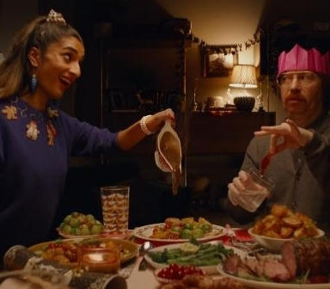
Dial up social connection
Sainsbury’s case study
Intending to show people the excitement of Christmas, Sainsbury’s wanted to dial up “togetherness” and “indulgence”, with cinema the perfect fit.
Running from mid-November to Christmas Eve in cinemas, it bought a HFSS AGP running in reel across a range of films
Cinema delivered uplifts on Sainsbury’s “have everything you need for Christmas” (+36%) and “makes me look forward to Christmas” (+58%)
65% of those exposed in cinema agree the campaign had a positive impact on their opinion of Sainsbury’s.
Source: Sainsbury’s Campaign Effectiveness Study (2021)

Slide 10

02.
Access cinematic cultural moments

Slide 11

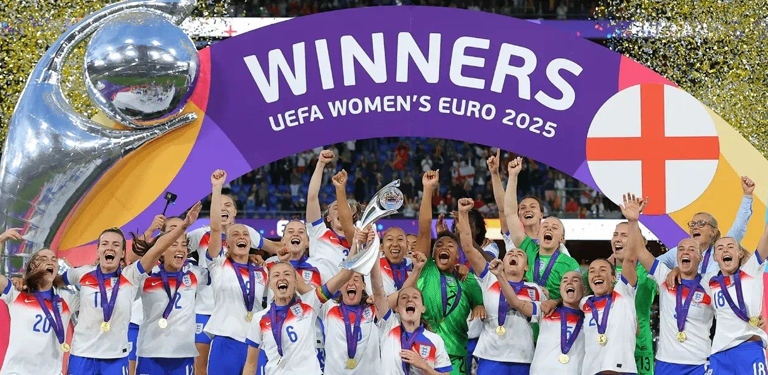
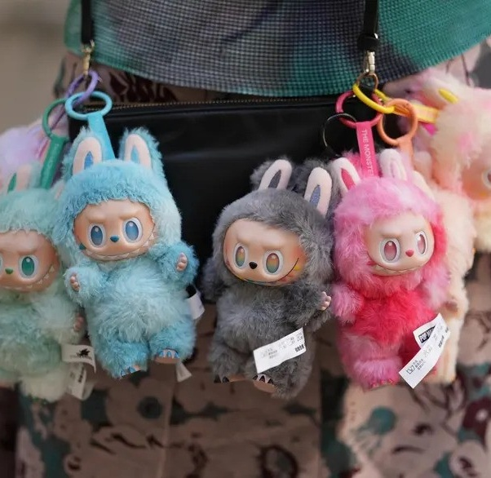
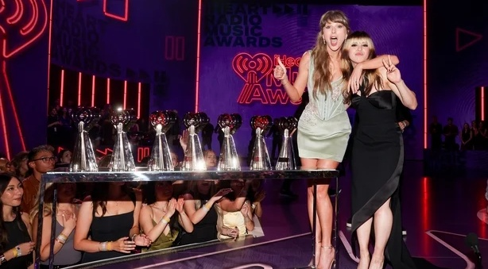
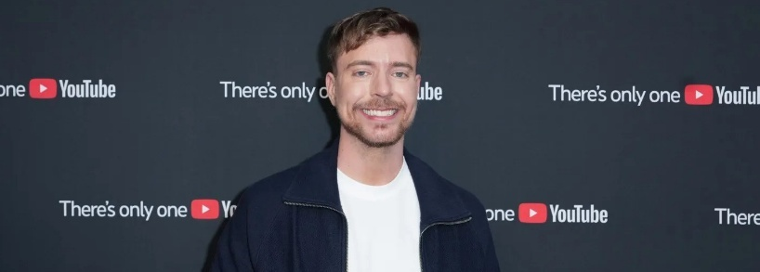
TV and Cinema deliver 85% of commercially available entertainment that resonates
TV-Sport, 23%
Cultural, 3%
TV-Entertainment, 34%
Cinema, 28%
Social Media, 12%
Other, 1%
Source: DCM x MTM: Cultural Moments
Treemap based on % of Spontaneously Recalled Events of 2025 factored for commercial availability
Notes:
Having stripped out moments that brands can’t buy (e.g. BBC TV shows, factored Netflix shows for ad-tier viewership) it becomes clear that the 2 strongest routes advertisers have into cultural moments that resonate are TV (through entertainment and sport) and Cinema.
While we’re in a time where many briefs are ‘social first’ and in our own bubbles viral moments can feel massive, when people reflect on the moments that mattered or resonated most it’s clear that TV and Cinema deliver the majority of commercially available culture that brands can put on the media plan.

Slide 12

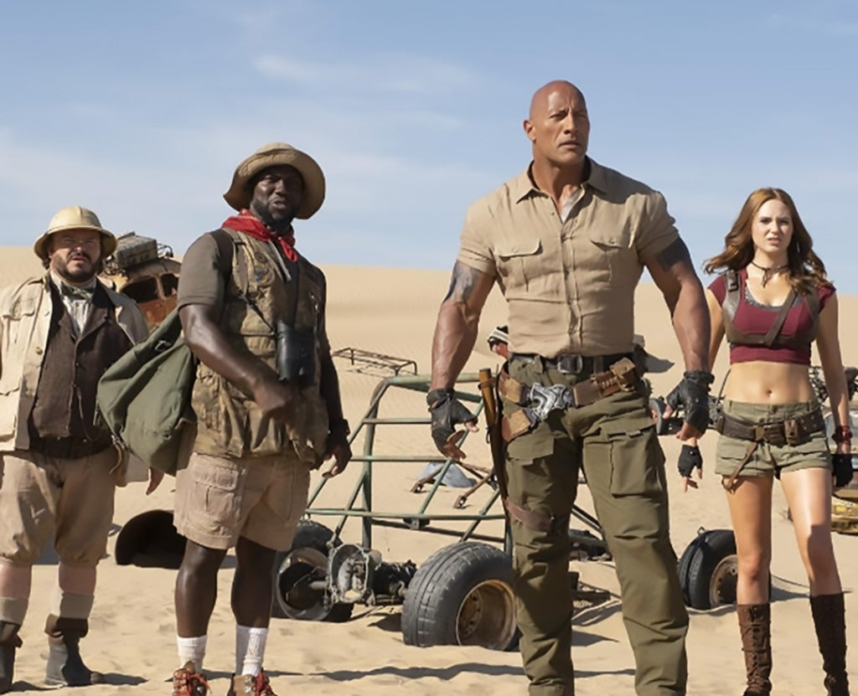



Cinema delivered more TVRs than the top TV & SVOD shows last year, with an even stronger forecast for 2026
18
TVRS
12
TVRS
Avengers: Doomsday
Jumanji Open World
16-34 TVRS 2025
10
TVRS
8
TVRS
Dune Part 3
Sunrise on the Reaping
Source: Adwanted Audience Comparison Report Nov – Dec 2025. TV shows based on 7 day run. Cinema TVRs based on 28 day run for 16-34s

Slide 13
Research shows that anticipation is as important as the afterglow
It’s not just all about the post-moment discussion, people enjoy the build-up and anticipation to something they’re looking forward to, with cinema brands always enter the scene just as excitement is peaking
66%
I enjoy the build-up leading up to a
TV/film release or sport event
Excitement Curve:
Feel excited (6-10) at each moment
Peak excitement:
sitting down to watch the film
Source: DCM x MTM: Cultural Moments

Slide 14
When looking at planning against highly anticipated moments, cinema offers the most plannable route
In a world of declining shared culture, cinema’s highly planned nature helps lend its inherent ‘event’ status and for brands, offers an easy plannable route to likely cultural moments
Cultural Moments Associations – Gap between left [0-3] & right side [8-10] (All respondents)
Spontaneous
Planned
Social media
Sport
TV
Cinema
For each media format, please select the point on the scale that best describes the nature of that cultural moment. Gap between left [0-3] & right side [8-10] (All respondents). Note: Scale From 20% to -20% not shown for presentation purposes. Base: UK 16–64-year-olds (1507)

Slide 15
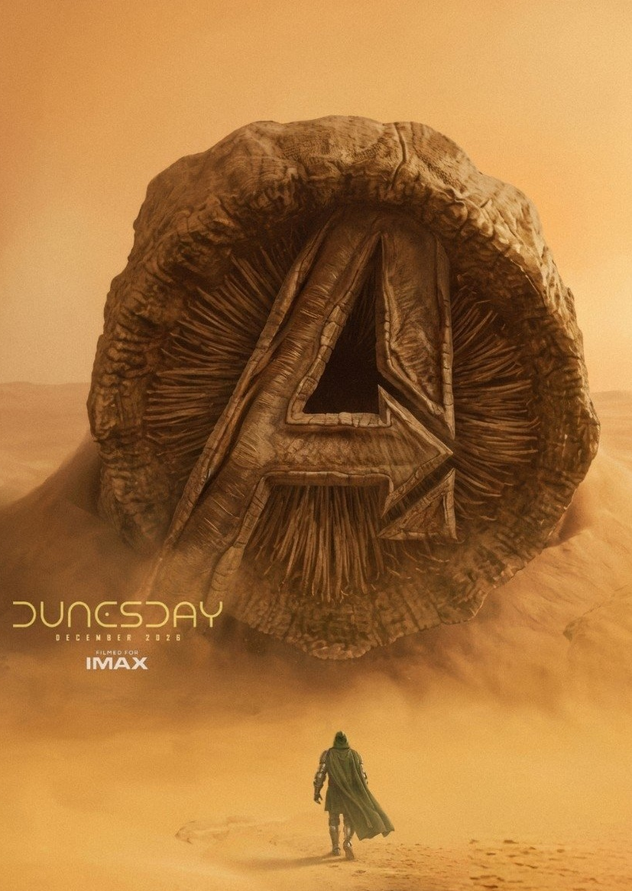
The next planned cultural moment: ‘DunesDay’
In a special screening of Marty Supreme, Chalamet was joined on stage by Avengers frontman Robert Downey Jr, who first proclaimed the monicker ‘Dunesday’, given the two major blockbusters are set to have the same release date. The gag picked up traction online, with a fan-generated image superimposing the Avengers logo on the iconic Dune sandworm being reposted by Avengers front-man Robert Downey Jr on Instagram. Hoping to replicate the ‘film rivalry’ effect that ‘Barbenheimer’ had in 2023, with both films combining to gross $2.5bn worldwide.
2.8m
OPENING WEEK
DCM ADMISSIONS
60%
ADMISSIONS POST XMAS

Slide 16

Brands appearing in cinema have seen increases in key brand metrics
% uplifts after exposure to ads on the big screen
+38%
Recall
+25%
Brand comprehension
+55%
Running in the premium positions of cinema’s biggest blockbusters maximises cultural relevance
+25%
All perceptions
+35%
Consideration
Source: DCM Ad Effectiveness Databank. Uplift of those exposed to ad in cinema vs. not exposed to the ad in cinema. DCM 2026. Research conducted on the brands running in the 3 premium positions across the film’s opening weekend.
Uplift: Exposed to the ad in cinema vs. those not exposed to the ad in cinema

Slide 17
03.
Cut-through the Christmas clutter

Slide 18
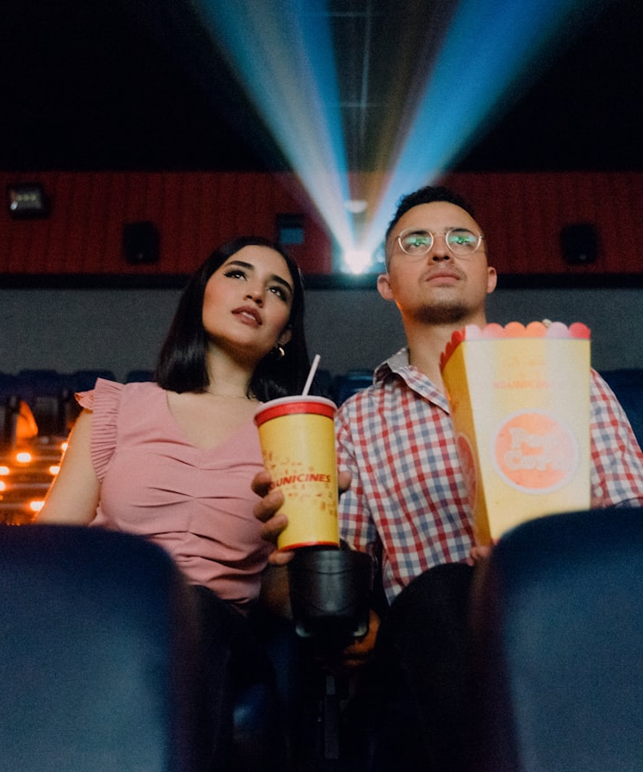
Cinema offers a less congested advertising space, helping brands to grab attention through SOV
OVER 1 IN 2 AGREE
“I enjoy Christmas adverts”
In the pursuit of owning Christmas, brands across categories are increasing investment across AV channels resulting in a squeeze in overall share of voice, but TV delivers nearly 2x more advertising time compared to cinema, meaning there’s less ad clutter to cut-through in the cinema
Minutes of advertising allowed per 2.5h
Source: Nielsen Ad Intel 2024, Ad Volumes by Platform – IPA 2023
TGI GB June 2026. Target: 16-34 Cinemagoers who have been to the cinema in the last week

Slide 19
December 2026 is set to deliver a higher level of admissions than the rest of the year
Brands should make the most of the increased appetite to visit the cinema at the end of the year
9m avg. monthly admissions YTD 2026
Source: CAA Industry Admissions + DCM Industry Admission Forecasts

Slide 20




Helping you maximise your campaigns through some key titles to finish the year
18 December
23 December
3.4m Admissions
11
16-34 Men
TVRS
4.8m Admissions
22
16-24
TVRS
3.1m Admissions
16
16-24
TVRS
904k Admissions
3
HP+CH
TVRS
Dune Part 3
Avengers: Doomsday
Jumanji: Open World
Angry Birds 3
Source: DCM, based on forecast industry admissions and comparative film profile. TVRs: based on 16-34

Slide 21
The weeks around Christmas are the perfect opportunity to maximise reach via cinema
Both the lead up to Xmas and the week of Twixmas present prime opportunities for brands to maximise reach as the cultural power of cinema at Christmas drives more people to the big screen at these times.
Post-Christmas Admission Share
Avengers: Doomsday
58% of admissions
2.3m TOTAL
Dune: Part Three
62% of admissions
1.8m TOTAL
92% of admissions
Jumanji: Open World
2.4m
TOTAL
Source: Comscore 2026 & DCM Forecasted 2026 Industry Admissions

Slide 22
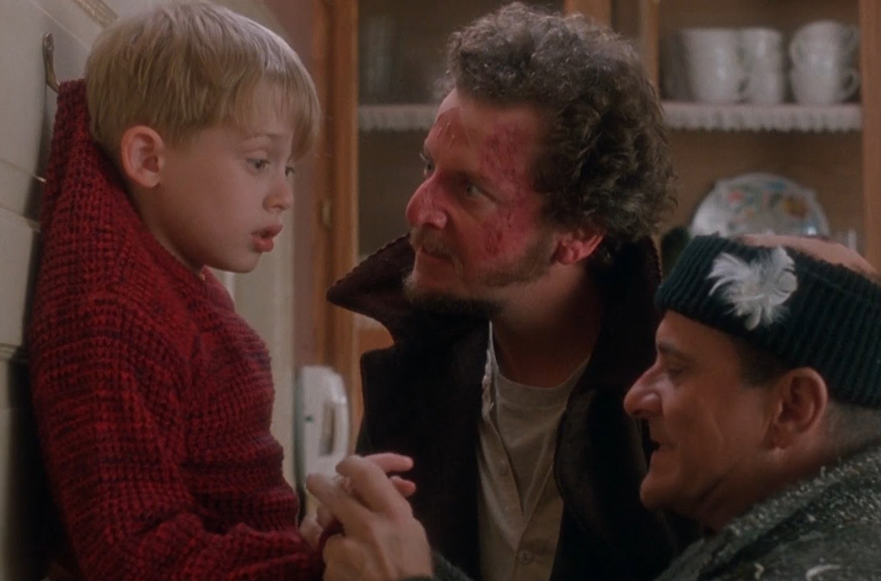
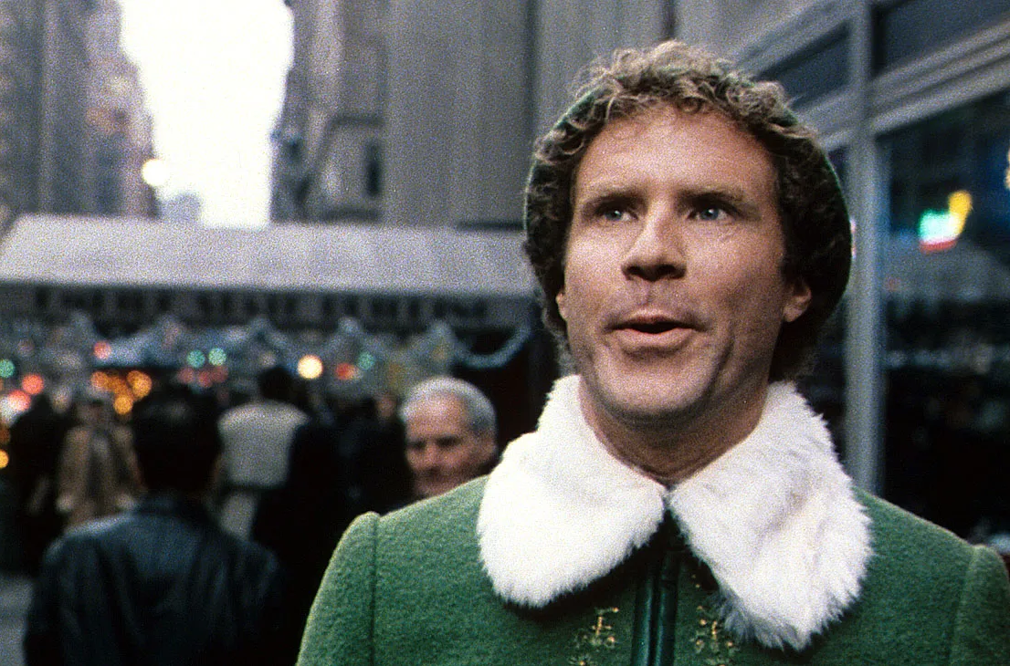
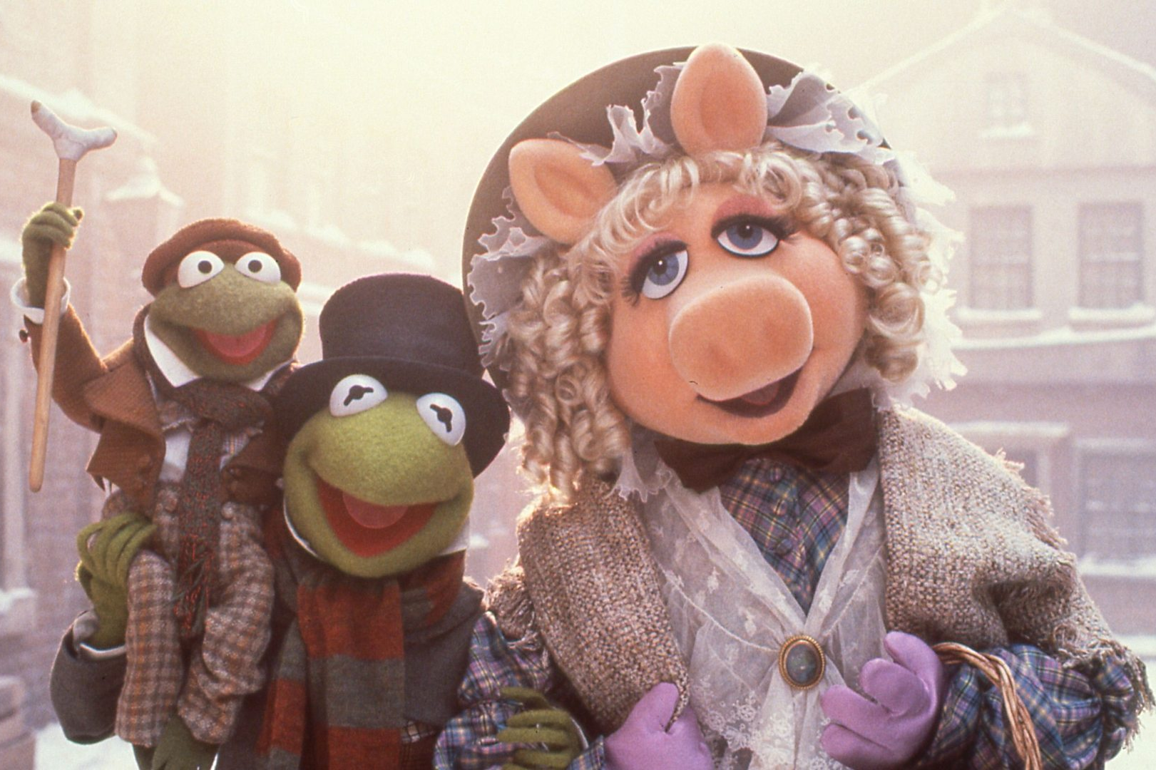
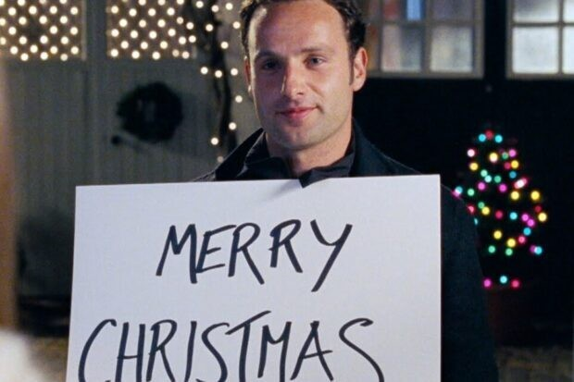
Brands can tap into seasonal nostalgia too
Visiting the cinema is a core part of the Christmas-festivities, with re-releases of films over 20 years old attracting large audiences in this time. Being connected to cinema during this time allows you to remain relevant during the busy period and maximise reach.
Home Alone
2026 Admissions
433k
Elf
2026 Admissions
359k
“I enjoy watching festive films with my family at Christmas”
66% AGREE / INDEX: 116
Muppets Christmas Carol
2026 Admissions
183k
Love Actually
2026 Admissions
82k
Source: TGI GB June 2026. Target: Cinemagoers who have children in the household who have been to the cinema in the last week

Slide 23
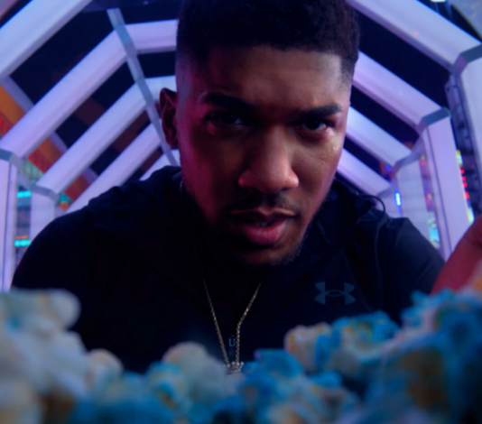
Cut through the clutter
JD Sports case study
JD Sports wanted to cut through with its young and diverse audience and reach them away from the clutter and distraction of online/social media environments
Collaborating with DCM Studios, two branded idents were created using footage from the original brand ad & 120” copy was used in cinemas closest to JD Sport’s top-performing stores
Recall of the ‘King of Games’ ad peaked at 70% for cinemagoers, an uplift of +17% vs. control
Intent to act having been exposed to the ad in cinema was above 80% across all creative routes
Source: JD Sports Campaign Effectiveness Study (2023)

Slide 24
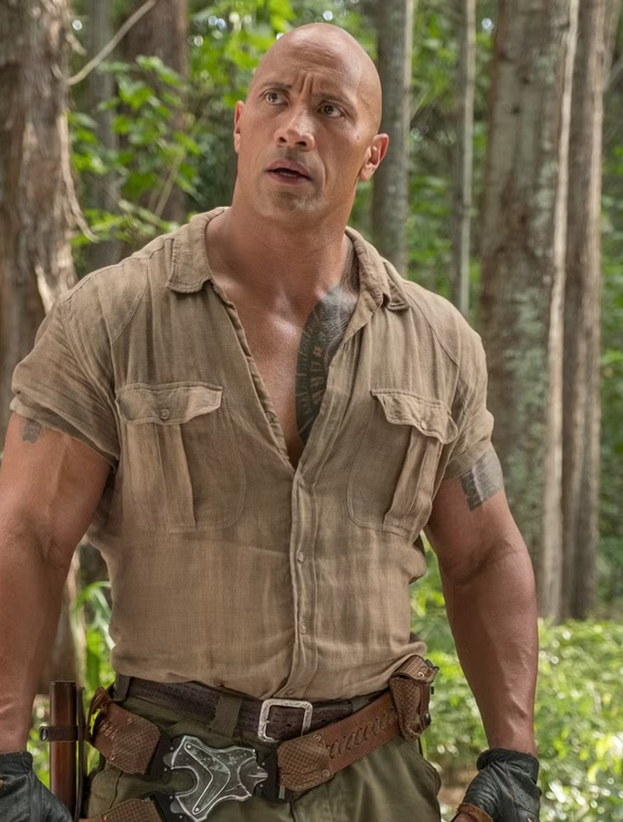
04.
Leverage cinemagoers spending power

Slide 25
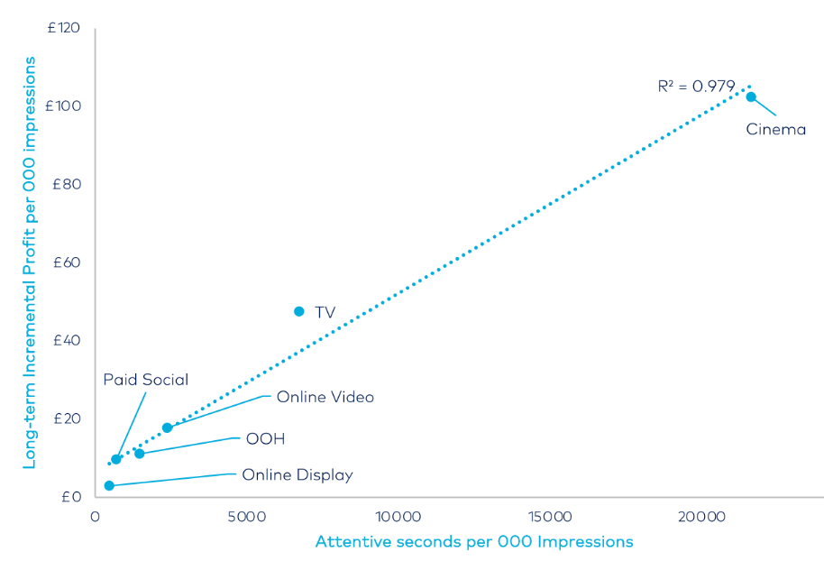
Cinema delivers ROI and strongest incremental profit per 000 impressions
For
every £1 invested…
Cinema ROI = £2.56
Source: Thinkbox Profit Ability 2 & Lumen/Ebiquity

Slide 26
Cinema boosts how much audiences are wanting to pay for a brand, rating them as more premium vs other platforms
% Agree that platform advertising is premium
Cinema delivers price premium +10% above the average optimal price point
Cinema 80%
Live TV 69%
Online Video 64%
BVOD 63%
Social Media 58%
Source: DCM/everyday people 2025. Base: 150 UK adults per media cell. Price sensitivity meter output for Tixe as mobile network brand. *Statistically significant difference vs. all media except for TV and Video Sharing at 95% confidence interval
TGI GB 2026. Cinemagoers who typically go at Christmas time.

Slide 27
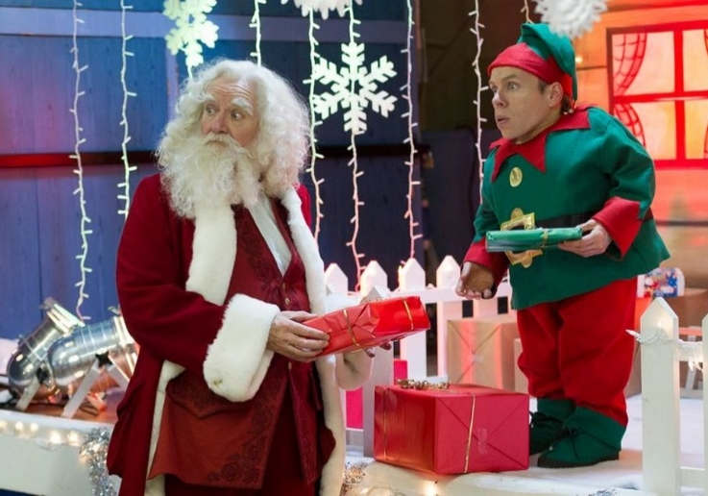
So, brands should leverage cinemagoers spending power
Regular & heavy cinemagoers (who profile more ABC1) are more likely to agree they intend to spend more than usual across key categories this Christmas.
Likelihood to spend more than usual this Christmas on gifts
Cinemagoing families are +30% more likely to agree they like to splash out at Christmas
Source: TGI GB June 2026 Target: Heavy cinemagoers, cinemagoers, non-cinemagoers. Index vs. average GB adult. Cinemagoers who have children in the HH.

Slide 28

Maximise spending power
Ernest Jones case study
Ernest Jones wanted to promote its luxury associations on a wider national level, looking at driving mass reach & sales but with a proximity focus to support its key outlets.
Using DCM’s Cinemapper planning tool, Ernest Jones’ 30” copy ran in cinemas within a 20-minute drive of a store. A bespoke 5” end-frame was also used to highlight the stores’ close proximity.
+39% uplift in those who said they would consider shopping at Ernest Jones
The selected stores saw a 9% increase in attributed sales vs. 2019, outperforming other Ernest Jones’ outlets by 3%.
Source: Ernest Jones Campaign Effectiveness Study (2019)

Slide 29
Dial up social
connection
with cinema
Access cinematic
cultural moments
Cut through the Christmas clutter
Leverage cinemagoers spending power
95% agree that spending time with family is the most important aspect of Xmas
66% agree they enjoy the build-up leading up to a film release
TV delivers nearly 2x more advertising time compared to cinema, meaning there’s less ad clutter to cut-through in the cinema
Cinema delivers the highest price perceptions vs other channels
90% of cinemagoers who go at Xmas go with friends or family
Cinema offers the most plannable route, with the next cultural moment being DunesDay
We’re forecasting 13.3m admissions for Dec 2026, which is higher than the monthly avg.
Brands should leverage spending power, with heavy cinemagoers being 76% more likely to spend more than usual this Xmas
60% agree “I feel left out if my friends are talking about a film I haven't seen”
Running in the premium positions of cinema’s biggest blockbusters maximises cultural relevance by 55%
With 5.2m admissions post-Xmas, there’s opportunity to maximise reach
Across Xmas campaigns, Exposure to the ad in the cinema improves
purchase intent by +13%

Slide 30

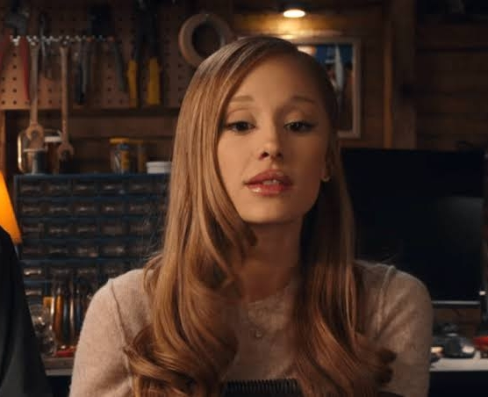

13
HP+CH TVRS
6
HP+CH TVRS
8
HP+CH TVRS
Avengers: Doomsday 18 Dec 2026
Jumanji Open World 23 Dec 2026
Dune Part 3 18 Dec 2026
6
HP+CH TVRS
6
HP+CH TVRS
5
HP+CH TVRS
The Hunger Games: Sunrise on the Reaping 20 Nov 2026
Focker-In-Law 25 Nov 2026
The Cat in the Hat 6 Nov 2026

Slide 31


18
16-34 TVRS
12
16-34 TVRS
10
16-34 TVRS
Avengers: Doomsday 18 Dec 2026
Jumanji Open World 23 Dec 2026
Dune Part 3 18 Dec 2026
8
16-34 TVRS
4
16-34 TVRS
4
16-34 TVRS
The Hunger Games: Sunrise on the Reaping 20 Nov 2026
Verity 2 Oct 2026
Digger 2 Oct 2026

