Slide 1
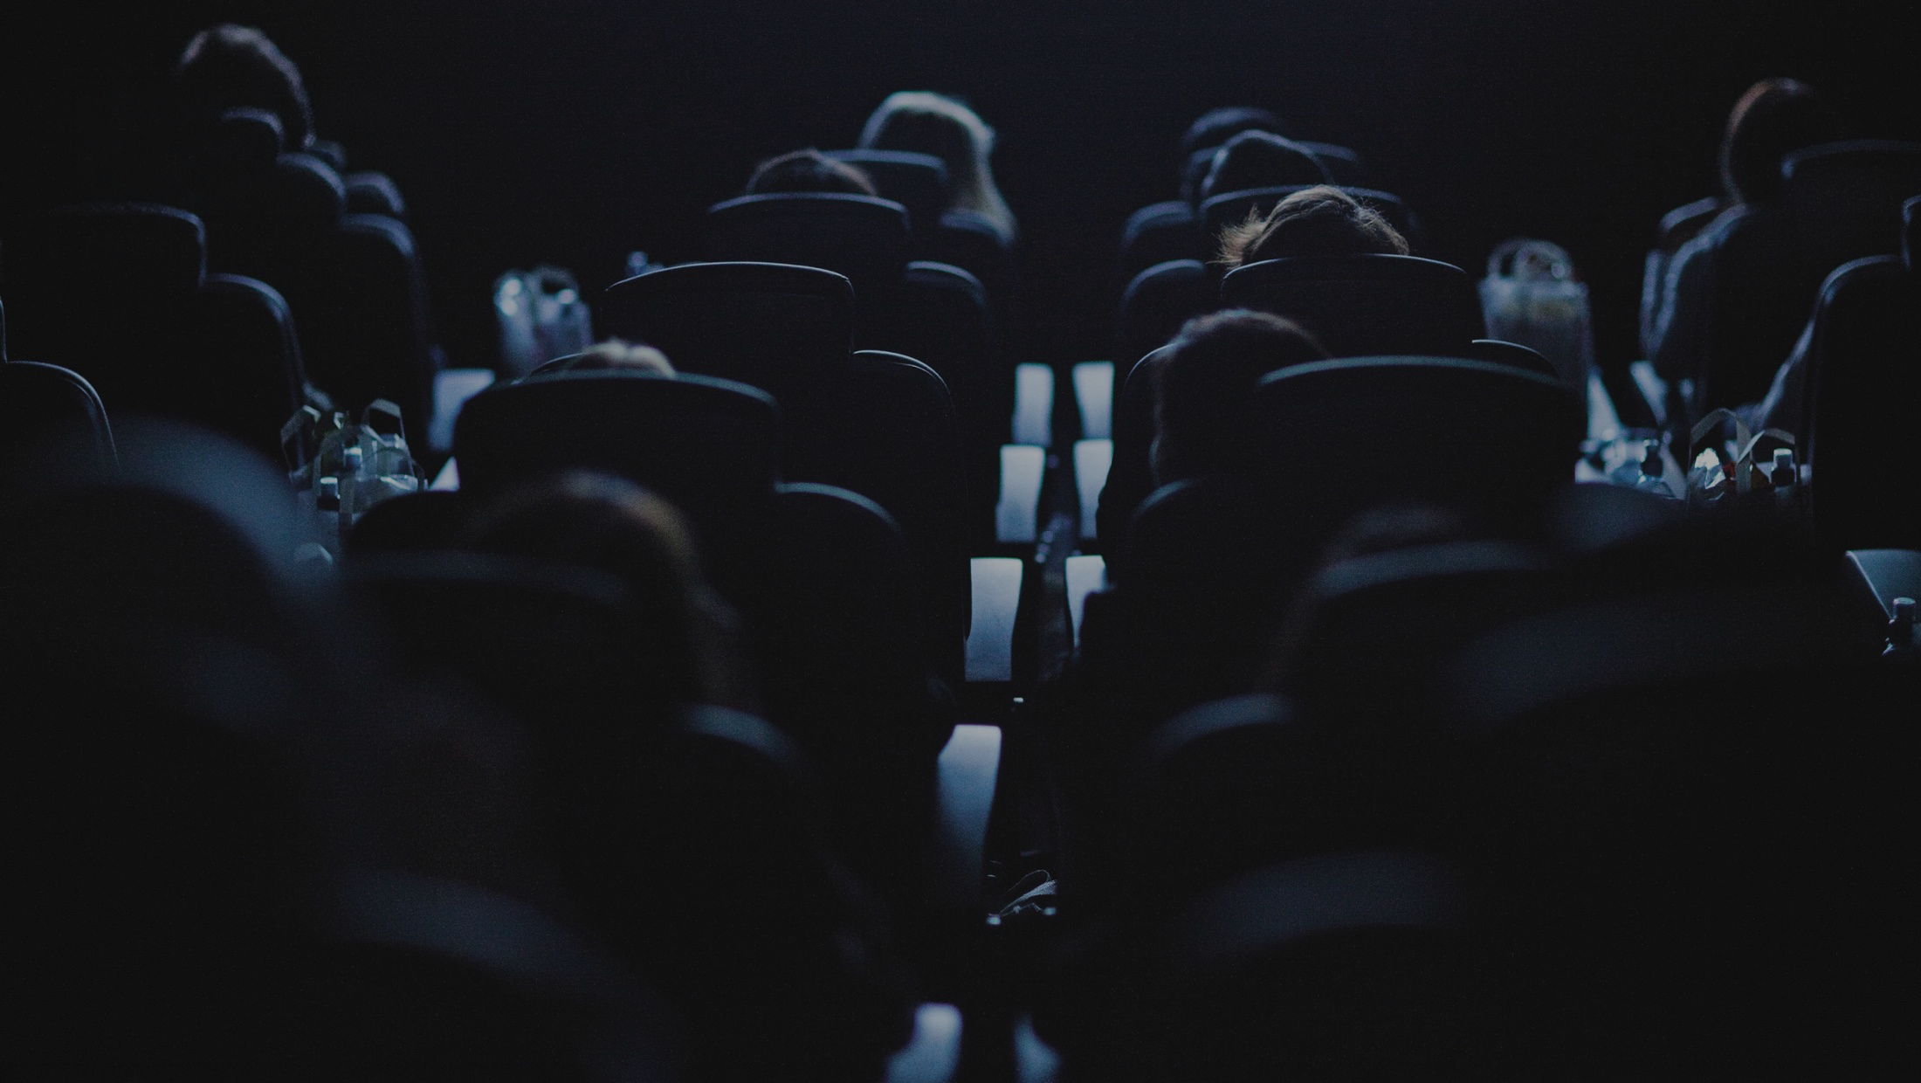

Maximising cultural power with cinema
DCM x everyday people research findings
Notes:
This year we have worked with independent research consultancy Everday Peopleto investigate the cultural power of cinema – both for audiences and the communities in which cinemas are located, but also the role this can play for brands when cinema is part of the wider AV mix.

Slide 2
In the era of ‘social’ media and post-covid, people are spending more time alone
Time spent alone has increased significantly since 2014 – most notably for young adults (16-34) which as increased by 47% in the last decade
Time spent alone since 2014 has increased by:
All Adults
+29%
16-34s
+47%
Mean hours per day spent alone
Source: IPA TouchPoints 2014-2023
Notes:
When our research team started out working on this with Burst Your Bubble, one of the key starting points was to look at what’s happening in wider culture and society.
Looking at the IPA TouchPoints data across the last ten years, there’s a quite sobering piece of data that we found
The amount of time 16-34 year olds are spending alone has been increasing steadily since 2014, from an average of 4.55 hrs a day to 6.67 hrs in 2023. That’s an increase of 47%, which outpaces the all adult growth of 29%.
We can see that covid accelerated this growth and it hasn’t returned to pre-pandemic levels.
What’s even more worrying is that it suggests that the traditional lifestyle drivers of spending time alone is broken. We naturally would expect people to spend more time alone as they get older, but young people are now spending as much time on their own as the adult population as a whole.
What ae some of the outcomes of this? Well…

Slide 3
There is also a sense of disconnection and distance in society too
Again, a pattern particularly seen among the young adult (16-34) demographic with
over half agreeing there’s distance from other people and ‘no sense of community anymore’.
51%
(all ads 47%)
Feel disconnected from
the world around me
56%
(all ads 55%)
There is no sense
of community anymore
60%
(all ads 55%)
Feel distant from
other people
Source: DCM/everyday people | Base: UK Adults 16-54 (n=1,020), 16-34 (n=479)
Notes:
Spending more time alone is also driving an increased sense of disconnection from others.
In our survey we found that half of 16-34s say they fee disconnected from the world around them, that the ‘sense of community’ isn’t what it was and six in 10 agree they ‘feel distant from other people’
Now there are a lot of reasons potentially driving this outlook – both short-term context from the last few months but also longer term trends that have led to this feeling.
While it may all sound a little troubling and negative, people actually aren’t necessarily happy about spending more time alone and not feeling this connection with others…

Slide 4
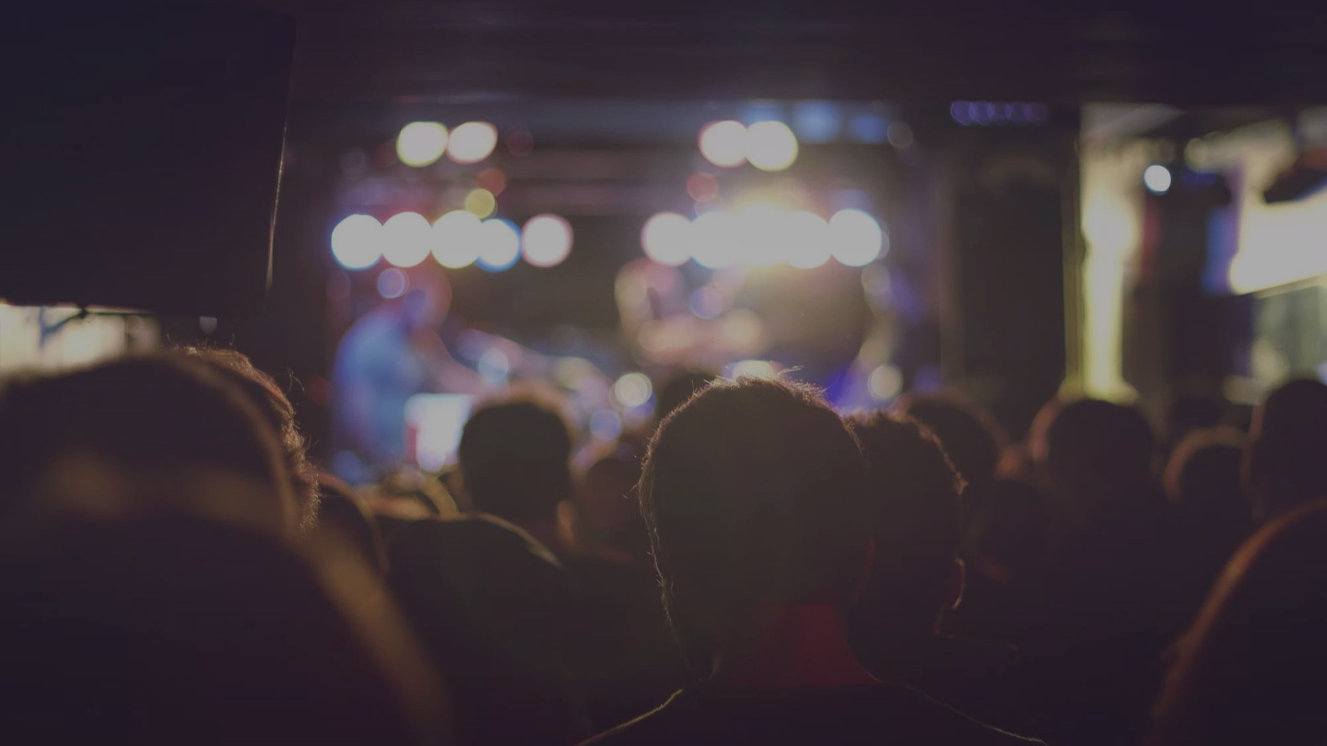
73%
(All ads 71%)
Agree that events that bring people together are more important now than ever
Source: DCM/everyday people | Base: UK Adults 16-54 (n=1,020), 16-34 (n=479)
Notes:
We also found in the research – both in focus groups we ran and the survey – that there remains a strong need for social assurance.
We are after all social beings who are programmed to be together. We all crave connection. Which manifests in the need to do things that bring people together. but it needs to be more tangible. It appears that the digital ‘experience’ and ‘communities’ that we may spend time engaging with don’t cut it in the same way, as in person, real world connection.
We need and want more shared experiences, and that’s where Cinema can really excel and provide this for people

Slide 5

The shared nature of cinemagoing makes it more of an event than just a ‘channel’
Over three fifths of cinemagoers agree their visit is a social occasion that’s about more than just the film – its event for people where brands are part of the experience.
% Net agree
62%
Going to the cinema is
about much more than the film – it’s a social occasion
71%
Being part of a big audience enhances the experience
62%
Like to get to the cinema
in good time to see
the ads & trailers
60%
Enjoy talking about
the ads with other
people
Source: DCM/everyday people | Base: Cinema goers last 4 weeks 16-54 (n=884)
Notes:
When we talked to people in the focus groups, it became clear that people very much see cinema as an event – they talk about it akin to going to gigs, theatre, live sport, the pub etc. – it’s not just a media channel like TV, radio etc.
Physical shared experiences help reduce feelings of isolation and Cinema is well placed to always deliver that collective experience, and an environment which is set up for delivering ‘emotional contagion’ – the idea that we are all engaging and reacting to the same thing at the same time, and seeing each other react.
[BUILD] Why does this matter in an advertising context and for brands? Well, we know that compared to other media audiences are far more receptive to advertising in cinema. We’ve seen it in previous research and see it again here, the ads and trailers are part of the cinema experience, it forms one of the rituals of going to the cinema.
Importantly for brands, the social collective environment of the cinema also provides a context in which people also enjoy talking about the ads with the other people they’ve gone with – and that’s crucially important at key times when you’re launching new campaigns or trying to land a new brand/product.
Its particularly powerful and unique when you consider where a lot of AV impacts are now being delivered…

Slide 6
Maximise shared viewing with cinema
As many other AV experiences are now watched alone, cinema continues to bring people together and provide brands with a co-viewing environment for their ad
% of viewing that is co-viewing
Source: Barb / TRP / 2023 / All devices + DCM, 2024 YTD
Notes:
Data released by Thinkbox recently shows the challenge facing planners and brands today – increasingly AV impacts are being delivered 1-to-1, rather than in 1-to-many environments. With the shift to Youtube (and other online/socal video) ads are increasingly being viewed solus rather than in co-viewing environments.
About half of your TV impacts are co-viewing experiences within the households but there’s still a lot being delivered to one person.
This is where cinema has a unique role to play within the AV mix - It is almost impossible to go to the cinema and for it not be a collective experience – 98% of showings are a shared experience. So adding cinema to your AV plans, ensures that you’re re-balancing ‘co-viewing’ within the mix.
Why does this matter?

Slide 7
Everything signals
Investing in a premium, shared experience channel such as cinema helps signal to the audience that your brand is also high quality and can also help validate price premium too for higher end products.
Fitness signalling
Social signalling
Honest signalling
Production values, big screens, premium content etc. signal financial strength and success
for brands.
Maximising perceptions
of fame and ‘common knowledge’ about brands.
The power of brands
making a public promise
(as opposed to a hyper personalised one) signals
trust and fame.
Source: Nielsen AdIntel. Top 100 Multi-media advertisers.
Notes:
Well how we as a consumers make decisions about ads and brands is based on the concept of ‘signalling’ – essentially what the context in which we encounter brands says (signals) about them and their stature.
In the context of this project we’re talking about signalling in terms of Fitness (so trust financial strength of brands) and Social signalling (brand fame, common knowledge about brands and what they offer and stand for)
From a signalling perspective, what do these big collective viewing moments give us?

Slide 8
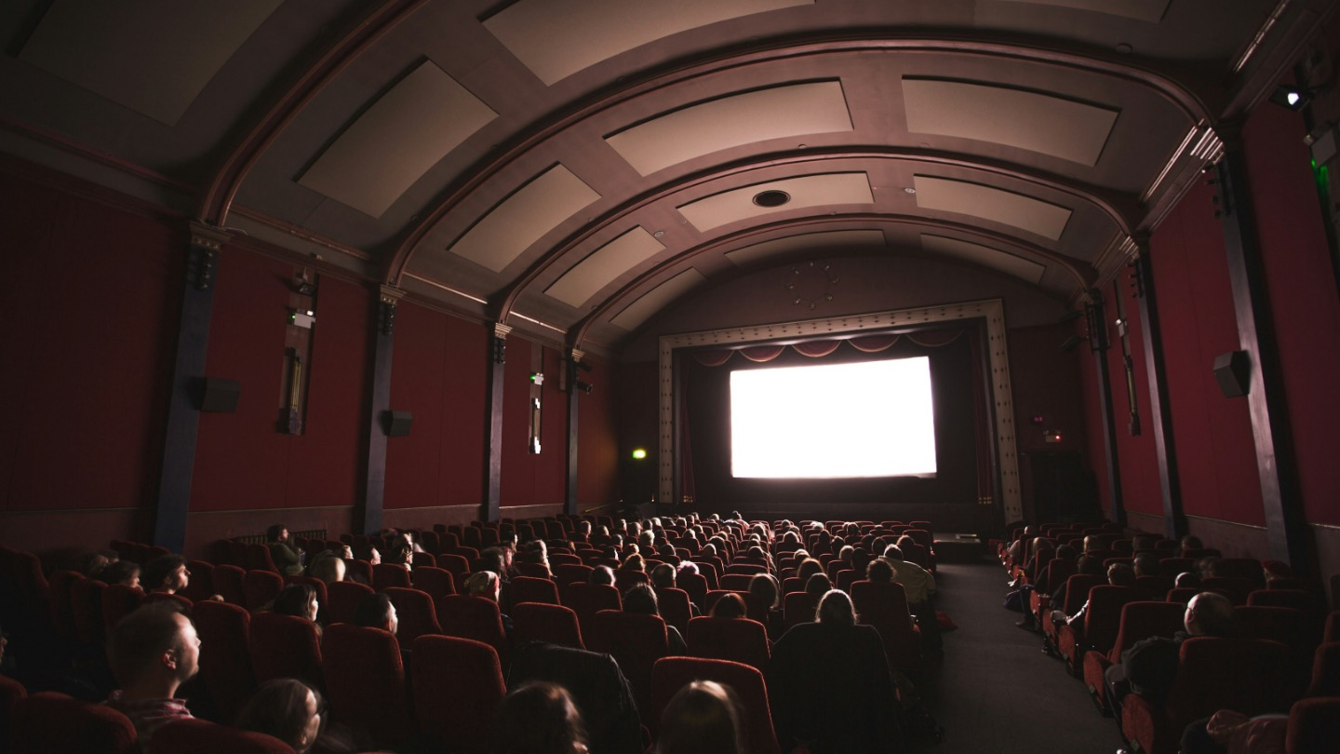
73%
Of the top 100 advertisers
have used cinema in
the last 12 months
Source: Nielsen AdIntel. Top 100 Multi-media advertisers.
Notes:
They see your brand in the company of other well established, trust, high stature brands
A key part of signalling is the idea of ‘the company you keep’ and better company than appearing alongside the majority of the biggest brands around in a premium, high quality, co-viewing environment

Slide 9

Fitness
“I think for a brand to be advertising at the cinema,
it's not going to be cheap to do so. I think it's only ever big
brands are the ones that can afford it…”
Male, 16-34
Social
“…It makes me think that lots of people must be buying
or using their product because I think that just comes hand
in hand with the brands that are able to advertise at the cinema.”
Male, 16-34

Slide 10
Maximise social and fitness signals with Cinema
Research from Everyday People and EssenceMediacom shows how cinema advertising excels when it comes to deliver strong ‘social’ and ‘fitness’ signals for brands for the 16-34 audience.
Social Signal
Fitness Signal
Source: Everyday People / EssenceMediacom, January 2024
Notes:
And that’s why when Everday People worked with EssenceMediacom earlier this year on a comprehensive signalling study looking at all channels
The new results showed how TV and Cinema still provide the strongest fitness and social signals for advertising at an aggregated level. This chart plots the results for 16-34s and as you can see cinema outperforms TV on ‘fitness signals’ to provide the strongest environment on that front for brands.
Interestingly, you’ll also see that social media and online video perform relatively poorly for social signalling. Everday People’s hypothesis for this is that its often user-generated content and poor quality in a lot of these spaces, and with perception of a lower entry cost for advertisers, it therefore delivers weak fitness signals for advertising brands that appear in that context.

Slide 11
Maximise cultural power with cinema
Being exposed to your ad in the premium, shared environment of cinema helps drive cultural values
of your brand including associations with community, as well being able to drive fame and likeability.
+50%
+106%
+37%
uplift in association with community (bringing people together, inclusive)
uplift in association with universalism (broad minded,
social justice etc)
uplift for 'If I use this brand, most people will think I have made a good choice’
+26%
+12%
+21%
uplift for 'everyone
likes this brand’
uplift for 'everyone
knows this brand’
uplift on 'High quality
products and services’
Source: DCM/everyday people May-June 2024. Based on 5 recent campaigns - automotive, gaming, entertainment & leisure, retail, telecoms brands
Notes:
So to put this all into some real world context and give you examples of the benefits of having your brands and ads seen in the cinema environment we used Burst Your Bubble’s signal framework to measure the effectiveness of cinema across 5 recent campaigns – all from different categories.
As you’ll see here we’ve seen that cinema delivers both positive cultural and commercial impact for brands
Advertising in the cinema drives perceptions of a brand being community orientated (‘bringing people together’), as well as delivering uplifts in ‘social assurance’ (perception of the brand as a ’good choice’), brand fame metrics (everyone knows and likes this brand) and importantly driving quality metrics too.

Slide 12
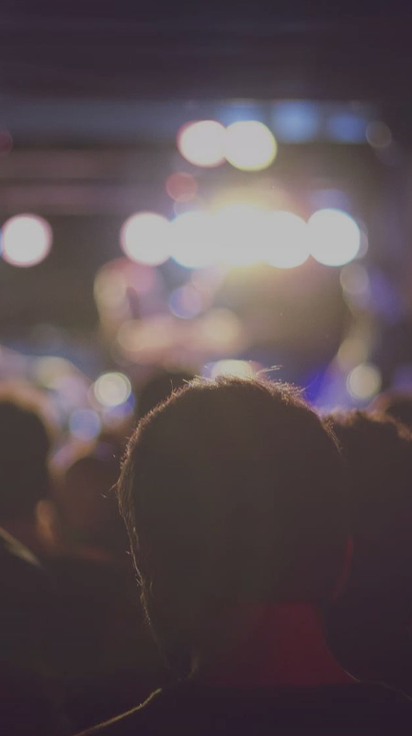
The cultural power of cinema: summary
1
2
People have been spending increasing amount of time alone and we also see this in media planning/delivery with more impacts being delivered in solus environments.
Cinema brings people together and as a ‘shared experience’ is uniquely placed to ensure important ‘co-viewing’ impacts remains well represented in your AV mix.
3
Brands are utilise this to maximise their own cultural power – cinema delivers strong social and fitness signals that helps drive trust, stature, brand fame and quality metrics.

