Slide 1
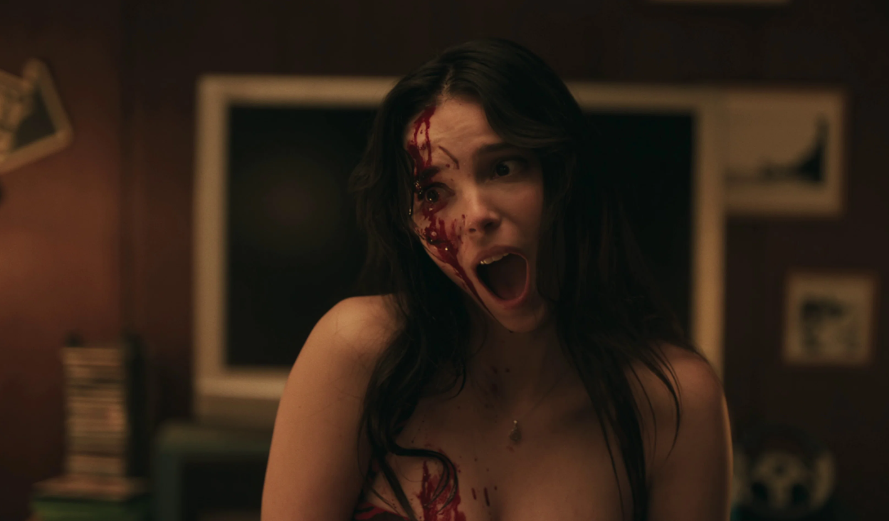
The Horror Fandom
The rise of the horror community and how brands can benefit from this highly engaged audience.

Slide 2
Struggling to efficiently maximise young adult reach?
Fighting to stay culturally relevant?
Looking to improve brand appeal?
Horror is a big pull for young audiences
Horror delivers buzzy cultural moments
Cinema delivers positive brand outcomes

Slide 3
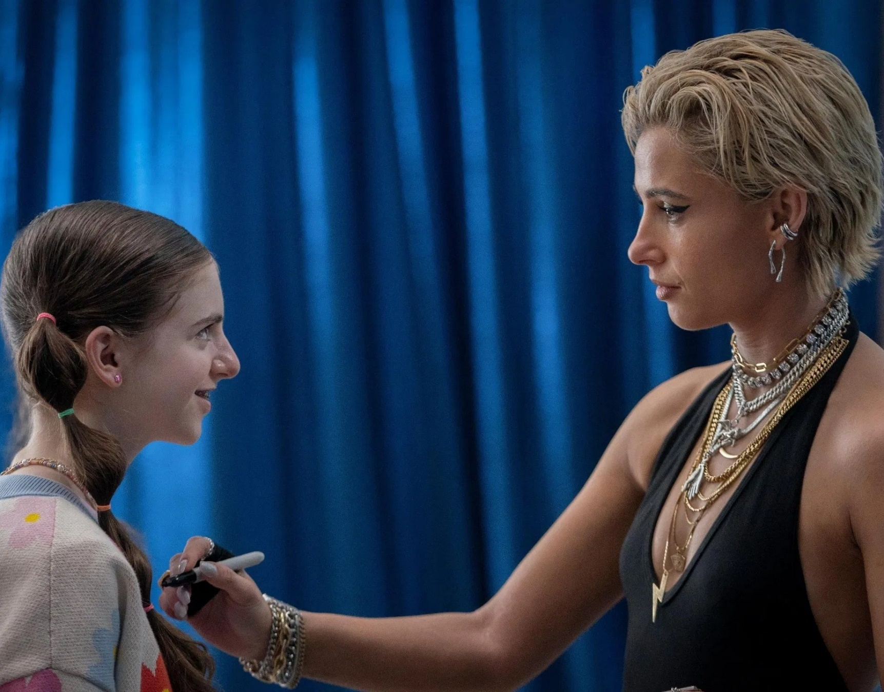

+265%
Horror’s share of DCM cinema admissions has seen huge growth over the last ten years – now accounting for 8% of admissions (vs. 2% in 2015)
3.3m
Horror fandom is incredibly active on Reddit, r/horror has over 3.3 million members and is a core digital space for horror fans to interact
The horror genre fandom has grown significantly in GB – fanship is up 66% since 2015 when only 2.5m said horror was their favourite genre.
Sources: TGI GB July 2025 vs July 2015 / DCM Admissions / Reddit

Slide 4
Horror is the most efficient genre for 16-34s
Based on 2024 releases, almost 6 in 10 of those watching horror films at the cinema were aged 16-34
16-34% Profile
GB Population 16-34 Profile
Based on 2024 film releases with demographic profiles collected via CAA Film Monitor survey

Slide 5
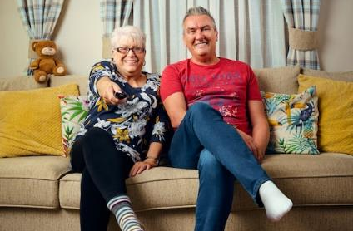
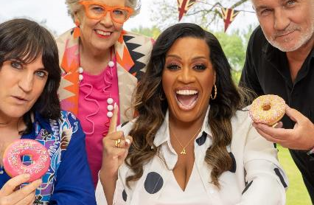
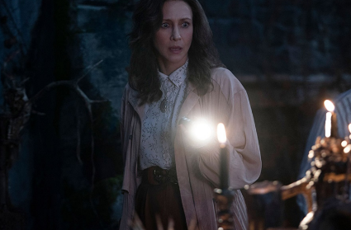
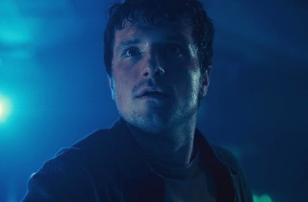

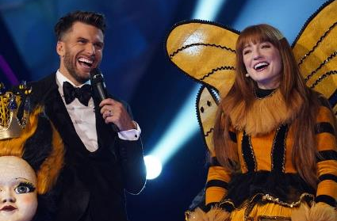
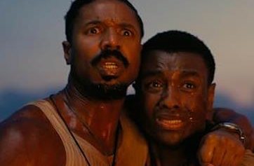
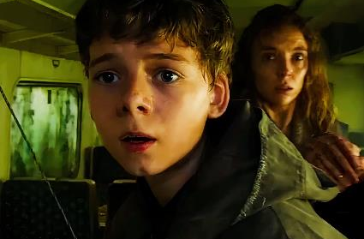
Cinema connects brands with cultural moments
Cinema is integral for brands looking to boost their relevance and be seen alongside peak entertainment moments
3 TVRs
6 TVRs
7 TVRs
5 TVRs
Gogglebox
The Great British Bake Off
The Conjuring: The Devil Made Me Do It
Five Nights at Freddie’s
6 TVRs
4 TVRs
7 TVRs
6 TVRs
Love Island
The Masked Singer
Sinners
28 Years Later
Source: DCM Planner. Film Monitor 2024 / 2025. TVRs based on 16-34 adults. BARB via Adwanted Connected, 2024. Top rated episode per TV series
Notes:
Gogglebox, GBBO, Love Island, Masked Singer, The Conjuring, Five Nights at Freddies, Sinners & 28 Years Later

Slide 6

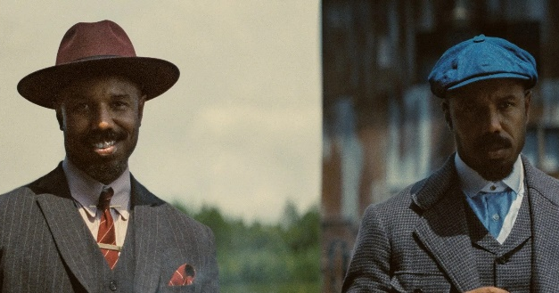
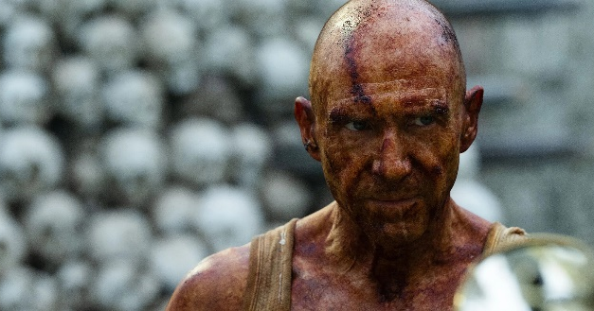
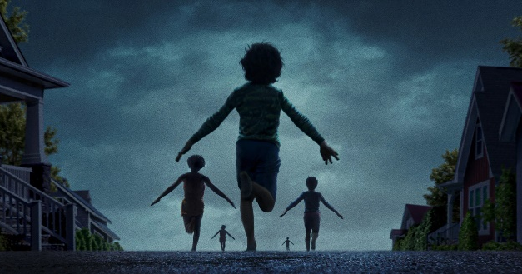

Horror = a big driver of cultural conversation
Horror films are consistently some of the most talked-about, with an online fandom that leans into the viral moments that help fuel buzz and make these films ‘must sees’ at the cinema.
Longlegs delivered a marketing masterclass. Creating huge buzz after debuting the trailer mere weeks before release, it delivered 3x more admissions than originally forecast
Sinners became the biggest original film since Inception (2010) in the US, and successfully out-performed vs. forecasts here in the UK, delivering 7 16-34 Adult TVRs
With 140m views, 28 Years Later had one of the most-watched horror trailers of all time, and the film’s surprising ending certainly got the online fandom talking…
Weapons created significant buzz, becoming the most recent ‘must see’ title for the horror fandom and is on track to deliver 2x more admissions than originally forecast.

Slide 7
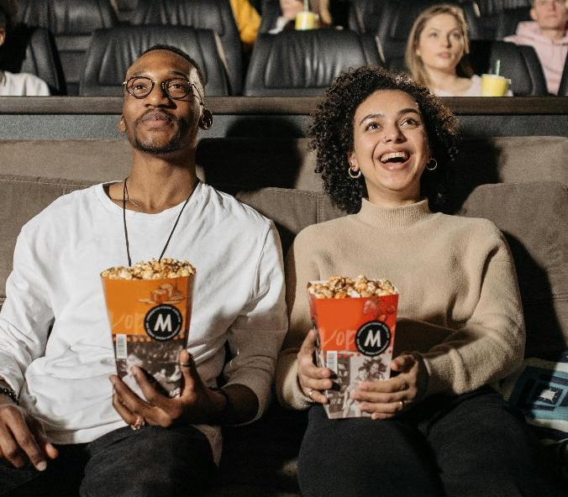
Horror drives early excitement & co-viewing
Horror is ideal for brands looking to connect with audiences who value shared cultural moments and want to be part of the ‘opening weekend’ moment.
39% more likely to go in groups of 6+
23% more likely to be heavy cinemagoers
23% more likely to watch on opening weekend
“Cinema is a great way to spend quality time with family & friends”
Source: FAME 2024. Target: 16-34 cinemagoers who enjoy watching horrors. Index vs avg. GB cinemagoer.

Slide 8

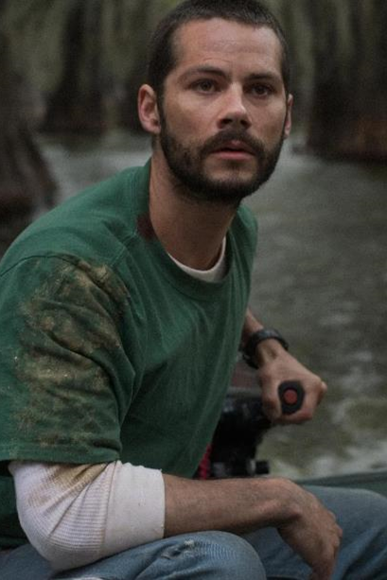
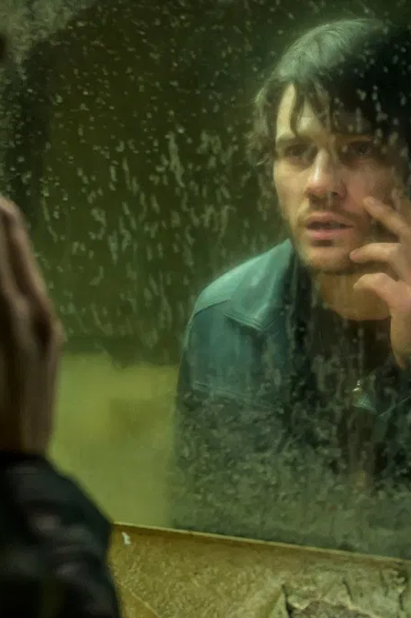
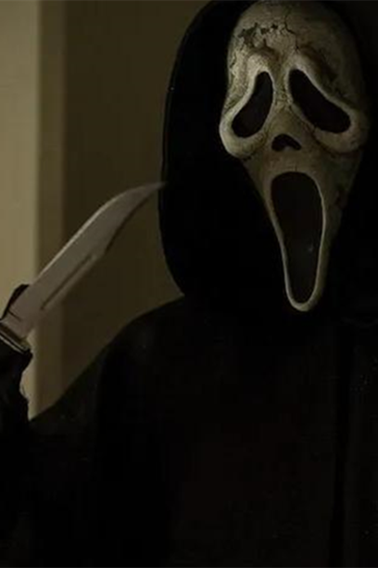
The horror hits will keep on coming…
Align your upcoming campaigns with horror blockbusters that are forecasted to deliver strong TVRs
28 Years Later: The Bone Temple
Send Help
Return to Silent Hill
Scream 7
16 Jan 2026
1.2m admissions
30 Jan 2026
432k admissions
23 Jan 2026
300k admissions
27 Feb 2026
804k admissions
Source: DCM Planner

Slide 9
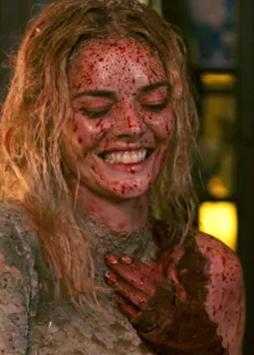
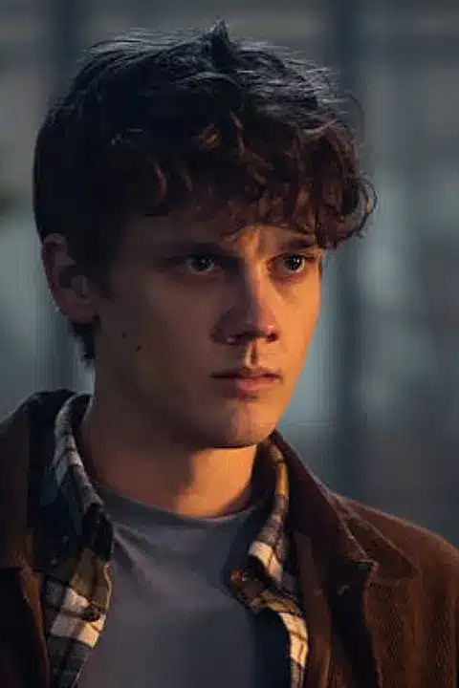
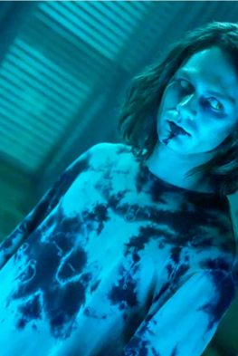

Horror is here to stay with a strong 2026 slate too
Brands looking to excite and engage horror fandom should tap into the upcoming cultural moments throughout 2026
Ready Or Not 2: Here I Come
Evil Dead Burn
Insidious
10 Apr 2026
400k admissions
24 July 2026
450k admissions
21 July 2026
650k admissions
Source: DCM Planner

Slide 10
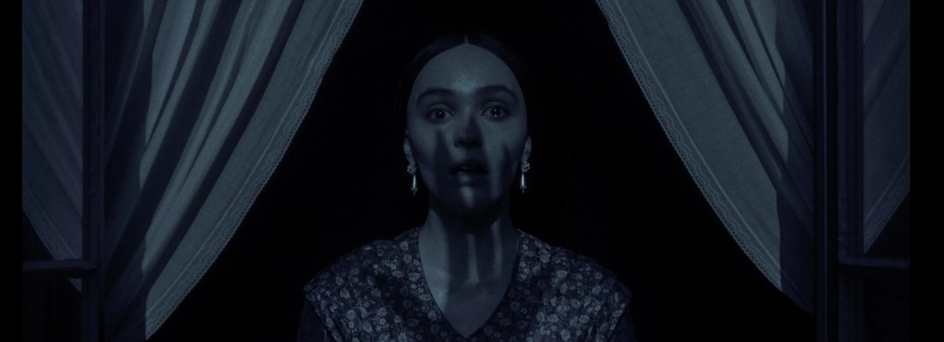
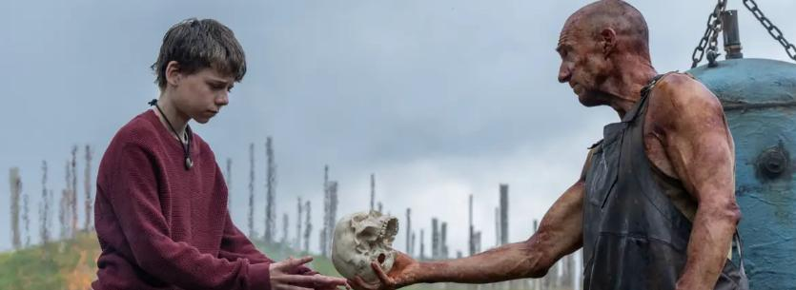
Brands should not fear the genre
Over 85% of cinemagoers agree there are no negative connotations around brands that advertise in horror films. Audiences are excited about watching the film, so it won’t negatively impact perceptions of your brand.
“I don't feel negatively towards
a brand if they are advertised before a horror film at the cinema”
“When I watch adverts before horror films at the cinema, I don’t associate the brands with the content of the film”
Source: FAME 2024. Statements target: All cinemagoers. Happy/Excited mood target: Those who would consider themselves fans of horror.

Slide 11

Cinema delivers when targeting young adults
Data from the cinema effectiveness databank evidences that young adults seeing your campaign on the big screen drives significant uplifts on key campaign and brand metrics.
Recall
Perceptions
Recommendation
Source: Meta-analysis of 27 cinema campaigns all targeting 16-34s. Index represents average uplifts seen from ‘no exposure to ad in cinema’ vs. ‘exposure to ad in cinema

Slide 12
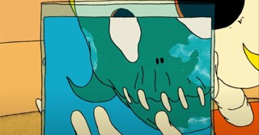
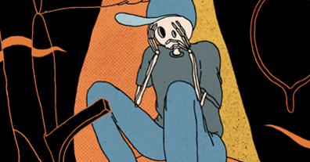
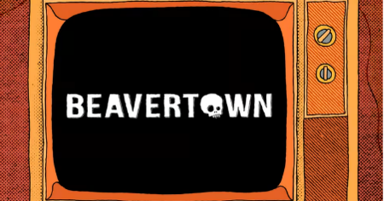
Case study: Beavertown
How aligning with the horror genre helped drive brand appeal, difference and consideration
Beavertown aimed to build greater association with Halloween with its 180” Flightmare creative and ultimately drive impact among 18+ adults in market for premium beer.
Launching at the start of October, Beavertown bought the Gold Spot in horror titles
A perfect contextual match for the beer brand to associate with the genre that would draw in audiences around Halloween.
Aligning with the horror genre delivered positive outcomes for Beavertown:
+27% increase in brand consideration
+50% increase in agreement that Beavertown ‘is a brand that does things differently’

Slide 13
Struggling to efficiently maximise young adult reach?
Fighting to stay culturally relevant?
Looking to improve brand appeal?
Horror is a big pull for young audiences
Horror delivers buzzy cultural moments
Cinema delivers positive brand outcomes

Slide 14
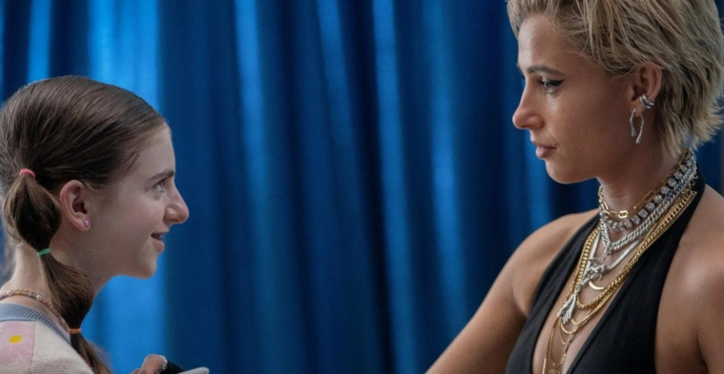
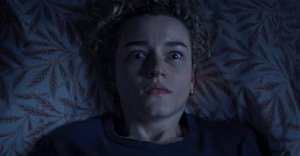
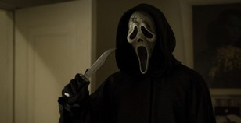
Horror: how to access a highly engaged audience
Cinema can help brands achieve key objectives with culturally relevant horror titles:
Horror is a big pull for young audiences
Horror delivers buzzy cultural moments
Cinema delivers positive brand outcomes
The horror fandom has significantly grown in the last decade (+66%).
It’s the most efficient genre for 16-34s
Horror films deliver scale similar to peak TV shows (Love Island 6 TVRs vs Sinners 7 TVRs)
Horror films create viral moments that fuel the online buzz & create unmissable culturally relevant experiences.
Horror drives excitement & co-viewing, with fans being +23% more likely to watch on opening weekend.
Cinema can drive significant improvements in metrics like ad recall (+49%), brand perceptions (+24%) and product recommendation (+38%)
Success: Beavertown saw a +50% increase in agreement that Beavertown ‘is a brand that does things differently’

