Slide 1
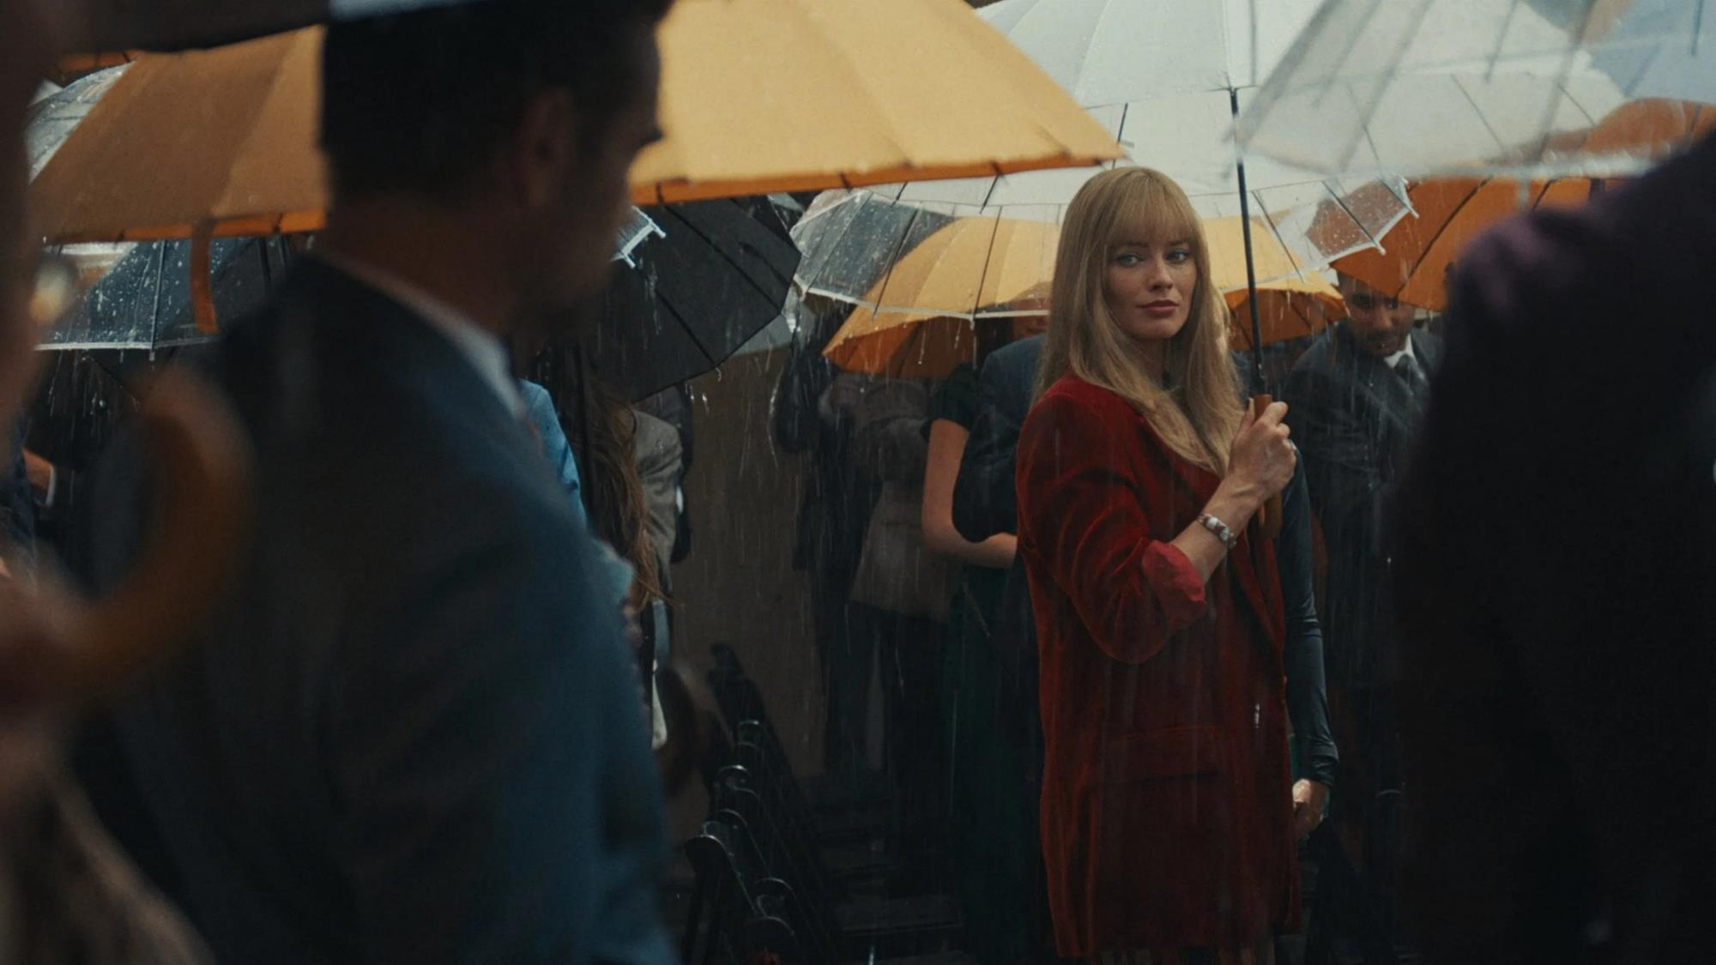
The ABC1 Audience
How cinema engages affluent adults, drives value perceptions and connects brands with cultural moments.

Slide 2
Want to engage affluent adults?
Want to drive quality & premium perceptions?
Want your brand to be culturally resonant?
Cinema delivers a valuable ABC1 audience
Cinema makes your brand feel worth more
Cinema connects brands & cultural moments

Slide 3
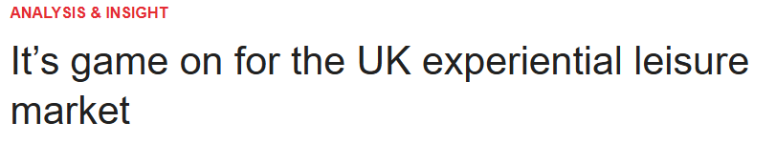
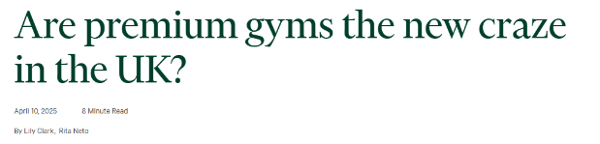
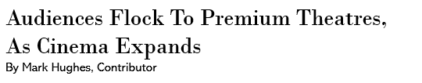
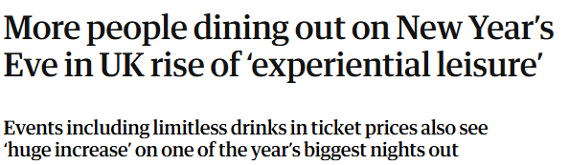
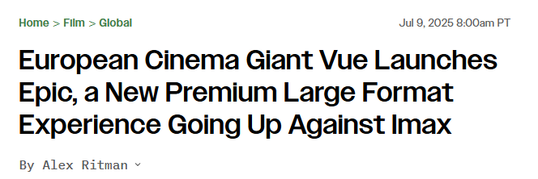
There’s an appetite for premium leisure experiences
Consumers are prioritising quality out-of-home experiences like premium gyms, high quality pubs and luxury cinemas, driven by a desire for making ‘going out’ worth it and a quality experience.
“I would pay more for an enhanced viewing experience”
63%
“An IMAX cinema is the best place to watch films”
56%
“I value going to the cinema above other leisure activities”
51%
Source: FAME 2024. Statements: ABC1 Cinemagoers who have visited the cinema in the last week. % all agree. In order top down: 63%, 56%, 51%. Index vs avg. GB adult

Slide 4

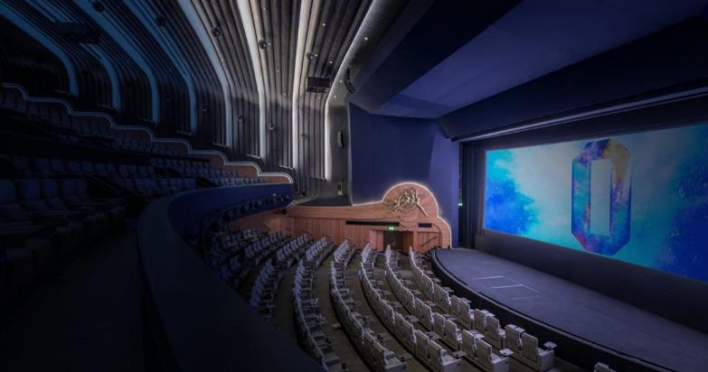

Cinema is high quality in experience and in content
Brands can tap into this, taking advantage of the premium context to boost their own perceptions of premium and quality.
“You can’t replicate the cinema experience on TV or mobile”
Award-worthy entertainment ultimately elevates audience impressions, driving premium perceptions of the cinema experience
Cinemas continue to enhance tech and overall experience by adding restaurants, bars and family activities…cinema is about more than just the big screen!
“I am more likely to go see a film at the cinema if it has been talked about as an awards contender”
Source: FAME 2024. Target: ABC1 and been to the cinema in the last week. Statements are above 60% All Agree.

Slide 5
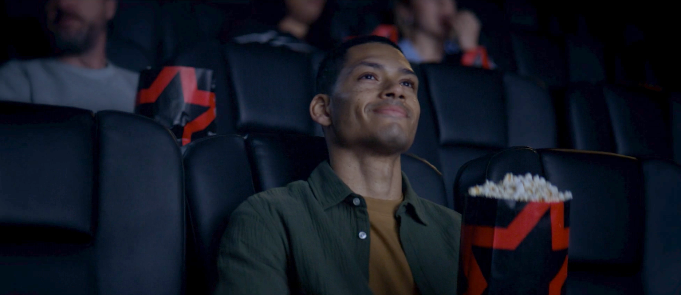
Cinema helps land premium perceptions
Cinema advertising is perceived as the most premium compared to other channels, and brands have already benefitted from accessing the quality environment of cinema to drive key perceptions.
Sky wanted to shift premium perceptions by aligning its TV with the big screen, inspiring the tagline, "Like the cinema, but in a TV”, running across Premium Large Format showings and in Cineworld Superscreens.
Exposure to the cinema campaign delivered +20% uplift in agreement that it ‘has quality picture/sound' showing how valuable cinema can be for maximising brand perceptions.
“The advertising is premium…” top 3 scores indexed vs cinema
Sky Glass: case study
Source: DCM / Sky Glass Conducted by; Differentology, 2024
Uplifts are control (unexposed to ad) vs test (exposed to ad). Premium Source: FAME, All Cinemagoers 15+

Slide 6
Cinema delivers an affluent & valuable audience
Frequent cinemagoers profile younger, have higher income, and are more likely to have children in the HH, so brands should utilise cinema as a medium to maximise reach among these incredibly valuable audiences.
    GB population
    Cinemagoers
    Heavy Cinemagoers
    ABC1
58%
66%
69%
    Have children in HH
29%
40%
44%
    16-34
30%
41%
43%
    >£50K
    HH Income
23%
32%
33%
Source: TGI GB Aug 2025. Target: Cinemagoers who have been in the last week & Heavy Cinemagoers

Slide 7
Brands should capitalise on cinemagoers potential spending power
Affluent cinemagoers are significantly more likely to be in market for key products and intend to spend more for quality
“I spend a lot of money on toiletries and
cosmetics for personal use”
(Index: 189)
“I buy new products before
most of my friends”
(Index: 224)
“I spend a lot on clothes”
(Index: 218)
“I'm always looking for new ideas to improve my home”
(Index: 152)
“I tend to spend money without thinking”
(Index: 145)
“I spend a lot of money on my pet (e.g. on good quality food, health products, toys, accessories”
(Index: 189)
More likely to be interested in innovations in cosmetics
(Index: 211)
6 in 10
Source: TGI GB July 2025 Target: Heavy cinemagoers who are ABC1. Index vs. average GB adult

Slide 8


Cinema makes your brand feel worth more
Cinema signals quality and premium, and therefore people’s perceptions of the products advertising on the big screen reflect this too.
Habitat aimed to raise perceptions of the breadth and quality of its range to ultimately to drive consideration.
Seeing the ad in cinema helped deliver a significant +43% uplift on ‘Habitat is good value for money’.
Almost 6 in 10 said they would consider shopping at Habitat, with cinemagoers 42% more likely vs. those not exposed to the ad in cinema.
Cinema drives perceived brand value
Cinema delivers a +10% higher price premium vs. the all-channel average for a mobile network brand
Habitat: case study
+10%
Sources: Habitat research conducted by Differentology. Maximising Price conducted by DCM/everyday people 2025.

Slide 9






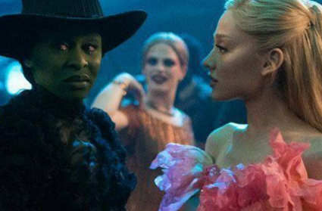


Cinema connects brands with cultural moments
Cinema is integral for brands looking to boost their relevance and be seen alongside peak entertainment moments
Weapons
Top Gun Maverick
Conclave
Avatar Way of Water
Dune Part 2
Everything Everywhere All At Once
Wicked
Oppenheimer

Slide 10





And cultural moments boost reach & memorability
Using cinema, Range Rover was able to significantly improve their luxury perceptions and intent to purchase, by association with ABC1 indexing cultural moments.
Range Rover used cinema to reach affluent adults to increase brand affinity and align itself with cultural moments, so it cherry-picked Gold & Silver Spots in multiple ABC1 skewing films.
The cinema ad improved perceptions surrounding ‘uniqueness’, ‘desirability’ and ‘luxury’ and overall impressions by +25%.
Just under 1 in 5 Test respondents agreed they are intending on purchasing a Range Rover Sport.
Range Rover: case study
Avatar Way of Water
Source: DCM / Range Rover. Conducted by: Differentology May 2025. Results base 35+. Uplifts seen from Control (unexposed to cinema ad) vs Test (exposed to cinema ad)

Slide 11



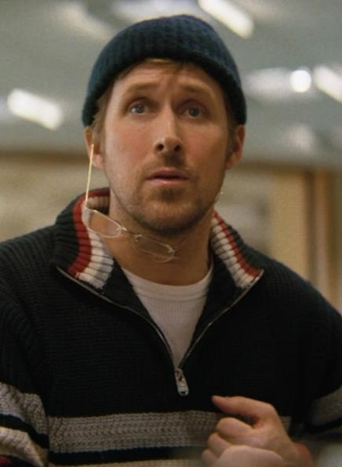

Q1 is always strong for ABC1 titles
Brands looking to excite their audiences during cultural moments should utilise our strong 2026 slate
75% ABC1
68% ABC1
67% ABC1
60% ABC1
Wuthering Heights
28 Years Later: The Bone Temple
The Bride!
Project Hail Mary
13 Feb 2026 / 1m admissions
16 January 2026 / 1m admissions
6 March 2026 / 696k admissions
20 March 2026 / 1.1m admissions
Source: DCM Planner

Slide 12
Want to engage affluent adults?
Want to drive quality & premium perceptions?
Want your brand to be culturally resonant?
Cinema delivers a valuable ABC1 audience
Cinema makes your brand feel worth more
Cinema connects brands & cultural moments

Slide 13
Cinema provides audiences and brands with a premium experience
Consumers are prioritising premium out-of-home experiences and cinema provides them quality content and experiences, which ultimately drives reach, memorability and value perceptions.
Cinema delivers a valuable ABC1 audience
Cinema makes your brand feel worth more
Cinema connects brands & cultural moments
There’s an appetite for OOH premium leisure experiences
Audiences are drawn in by premium atmosphere and high-quality content it offers.
Success: cinema delivered +20% uplift in agreement that it ‘has quality picture/sound'
Frequent cinemagoers profile younger with more income and have children in the HH.
Heavy cinemagoers profile more ABC1, so are more likely to agree they intend to spend more on higher quality products
Success: cinema delivered 43% uplift in perceptions for ‘good value for money’
Films start the cultural convo, so cinema is integral for brands looking to boost their cultural relevance.
Brands looking to excite their audiences during cultural moments should utilise our strong 2026 slate
Success: Cinema improves perceptions surrounding ‘desirability’ ‘luxury’ and ‘uniqueness’ by +25%.

