Slide 1

South Asian Cinema
How cinema remains an untapped opportunity for brands to authentically build connection with the South Asian community

Slide 2
The British South Asian community
3.3M
2 in 5
50:50
The South Asian population in Great Britain has grown significantly – up by 20% over the last 5 years
Agree they ‘prefer to buy brands which emphasise inclusion & diversity in their ads.’
Significantly higher (+41%) than the GB average
Opinion is split on whether brands are better at authentically recognising occasions such as Ramadan and Eid now
Sources: IPA TouchPoints 2024 (Indian, Bangladeshi and Pakistani). DCM & Old Salt 2025 research. GB TGI February 2025

Slide 3

More positive about advertising in cinema
South Asian cinemagoers are significantly more likely to feel positively about ads at the cinema than most other AV platforms (+15% vs other AV platforms)
Source: DCM/Old Salt. How would you describe your attitude towards the advertising in each of the following places? (Very & Slightly Positive scores). Base: South Asian cinemagoers n=302

Slide 4
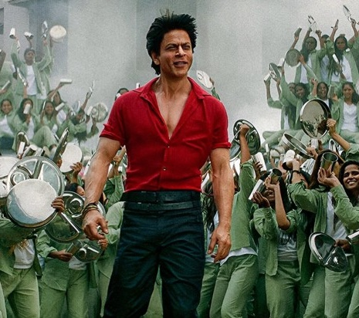

2.2M
Have been to the cinema in the last 12 months
23%
More likely to be heavy cinemagoers, who go at least once a month
82%
of the South Asian population are cinemagoers
Sources: IPA TouchPoints 2024 (Indian, Bangladeshi and Pakistani) + GB TGI February 2025

Slide 5
The South Asian cinema audience
50/50 Gender split. While it will vary slightly by title, there’s no overall gender bias to cinemagoing
Over-index younger. 46% of those who have been in the last year are aged 15-24
Cinema allows you to engage with the younger, affluent-skewing part of the community
Over-index as more affluent. 11% more likely to ABC1 and 18% more likely AB vs. average South Asian adult
1 in 4 have household income >£75,000, over-indexing by 19% vs. the average South Asian adult
Source: GB TGI February 2025

Slide 6


60%
More South Asian films released at cinema than 5 years ago
64%
South Asian films are more popular than ever
63%
Quality of the films has improved in last 5 years
57%
More South Asian films I feel I must see at the cinema now
Source: DCM/Old Salt, Jan 2025. Base: South Asian cinemagoers n=302
Notes:
3 in 5 feel the quality and quantity of south Asian cinema releases has improved

Slide 7
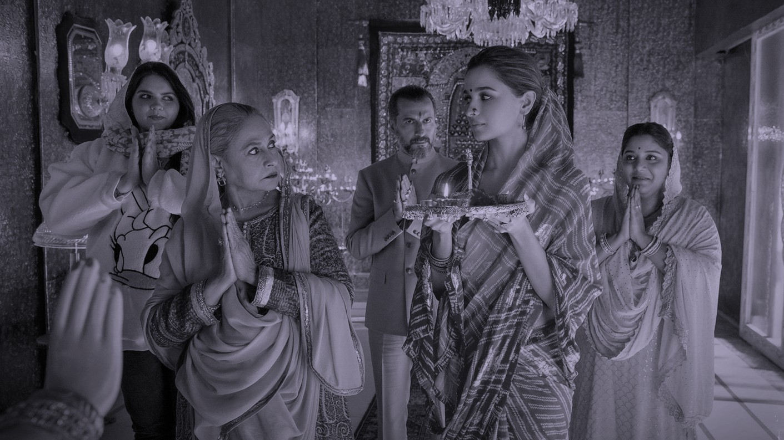
1 in 2
South Asian cinemagoers are watching more South Asian films at the cinema now than ever before
DCM & Old Salt. Base: South Asian cinemagoers n=302

Slide 8
South Asian Cinema has seen significant box office growth
Box office success of South Asian titles has accelerated in recent years
Source: Comscore Movies

Slide 9
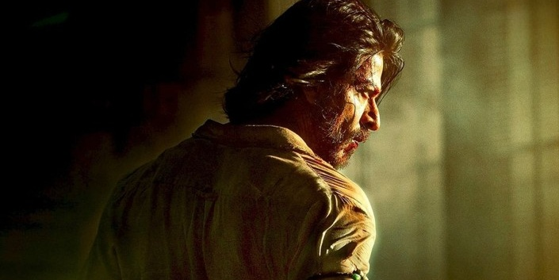


South Asian cinema = real blockbuster cinema
South Asian Cinema may not be entirely what you think.
Increasingly, the biggest South Asian releases are huge, big budget, action thrillers – think Top Gun Maverick and the John Wick and Mission Impossible franchises.
The ‘YRF Spy Universe’ has become one of the biggest properties – delivering the most popular South Asian film of all time in the UK with Pathaan (600k DCM admissions), as well as other hits in War and Tiger 3.

Slide 10
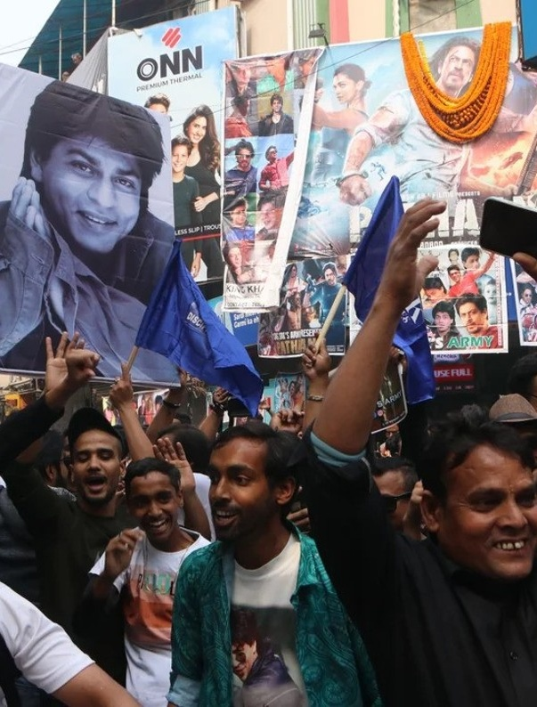

South Asian cinema delivers real ‘event’ moments
Films are typically released in multiple languages – e.g., Hindi, Telugu, Tamil – to cater for all audiences.
Based on recent biggest releases, the average length of South Asian titles is 164 minutes – with films typically having a 5–10 minute interlude too, so the film is very much the centrepiece of the social ‘out of home’ occasion.
Soundtracks are a big promotional tool for South Asian Cinema as they come out in advance and are key in creating interest around titles and driving opening night/weekend audiences

Slide 11
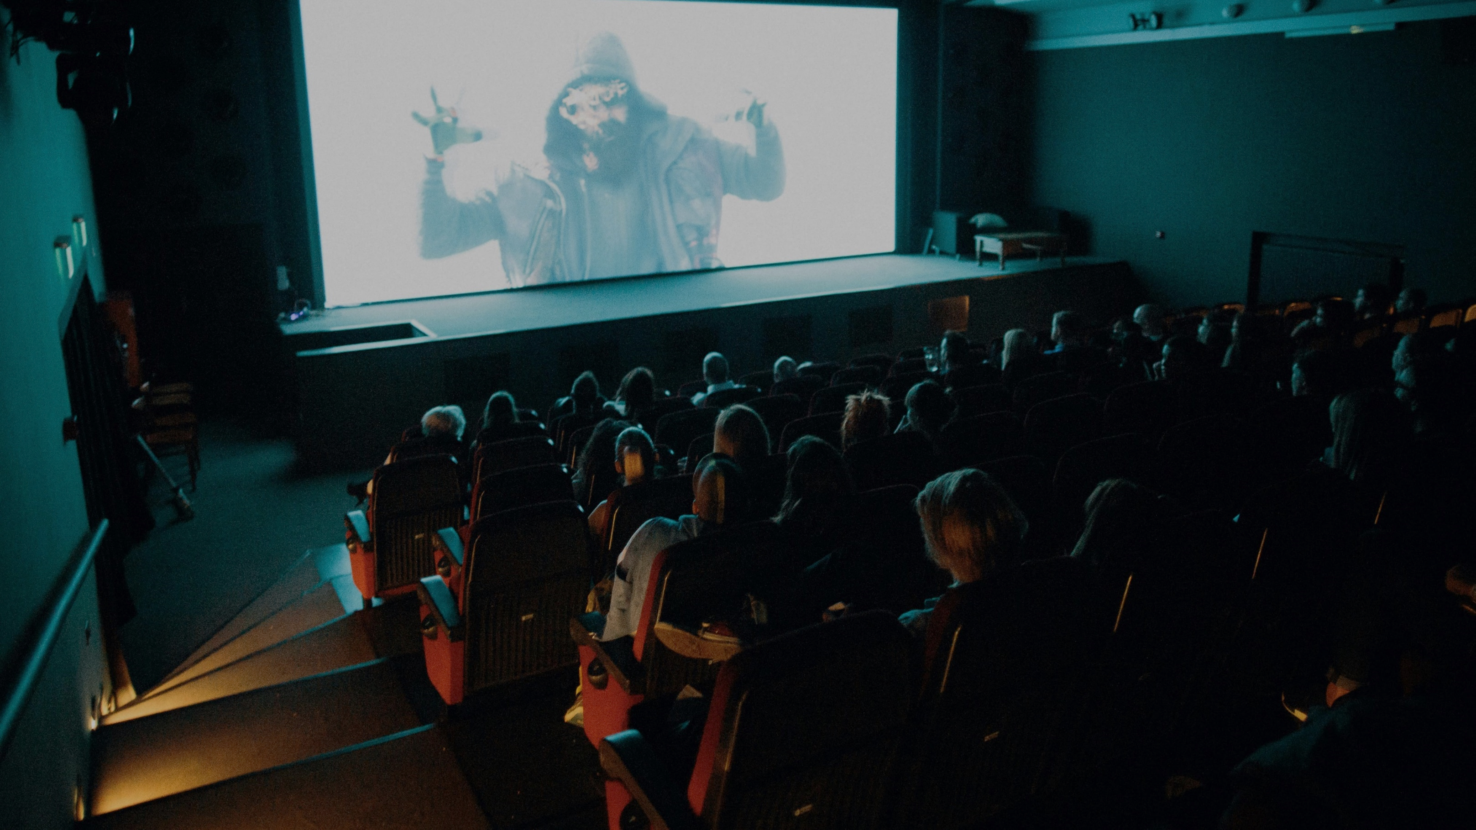
“I love the vibe of the cinema, where everyone collectively comes to watch a movie…with a massive screen and snacks to eat, I love hearing everyone's reactions to scenes…it feels like the film is real when people around me are reacting”
Female, 24
“I love to watch an action movie…it's all about escapism…when the hero acts to save the day, fights with the villains and stop the carnage from escalating”
Male, 47
Notes:
Photo by Bence Szemerey: https://www.pexels.com/photo/people-watching-movie-on-a-cinema-7513460/

Slide 12
Cinema is all about the big screen shared experience
Top 5 reasons for going to the cinema
Shared experience
2 in 3 South Asian cinemagoers visit with family
Over 1 in 2 South Asian cinemagoers visit with friends, with 1 in 5 going in large groups (5+)
Source: DCM/Old Salt. Base: South Asian cinemagoers n=302
Notes:
68% visit with family, 56% visit with friends, 18% visit with a large group of friends (5 or more)

Slide 13
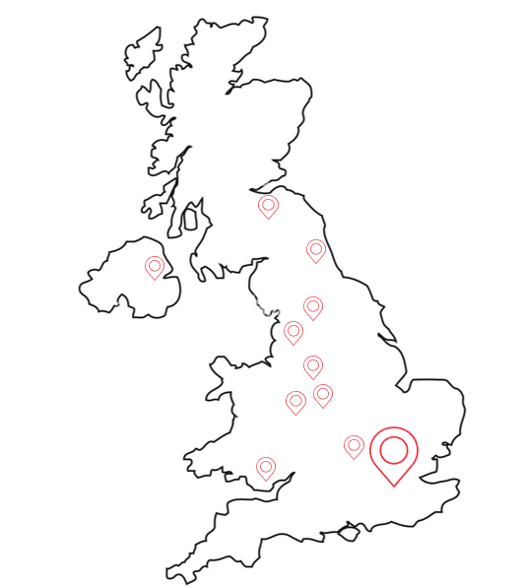
Connect with communities
London
The top 20 sites account for 66% of all South Asian film admissions
50% of South Asian film admissions have been delivered in London cinemas - including Ilford, Hounslow, Greenwich, South Ruislip, Romford, Feltham, Wembley, Stratford and Harrow
Central
13% of South Asian film admissions have been delivered across Central with popular cinemas in Birmingham, Coventry and Leicester
Anglia
8% of all South Asian film admissions have been delivered in Anglia, with key sites including Milton Keynes and South Ruislip
Source: DCM, YTD admissions

Slide 14


Actors are a big draw for South Asian cinema
With 6 in 10 South Asian cinemagoers agreeing that if their ‘favourite actors are in a South Asian film I have to watch it’ it’s clear that star pull is incredibly influential when it comes to the success of South Asian titles.
Most notable is the box office draw of the ‘Three Khans’ - Shah Rukh Khan, Salman Khan and Aamir Khan – considered the most successful movie stars in Indian cinema.
73%
‘I usually look at the cast when deciding whether to watch a South Asian film’
Source: DCM/Old Salt. Base: South Asian cinemagoers n=302

Slide 15
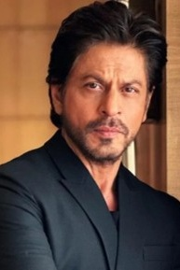





The most popular South Asian cinema stars
Top 6 – Talent enjoy watching in films/ films directed by
Shah Rukh Khan
Salman Khan
Aamir Khan
Deepika Padukone
Ranveer Singh
Alia Bhatt
Source: DCM/Old Salt. . Base: South Asian cinemagoers n=302

Slide 16




Highly anticipated titles of 2025
Housefull 5. India’s biggest comedy franchise is back
War 2. The next installment within the popular ‘YRF Spy Universe’
Baaghi 4. Another popular action thriller series returns
Source: DCM/Old Salt. . Base: South Asian cinemagoers n=302

Slide 17
2024 South Asian cinema admissions
Admissions typically see a spike around key holidays including Eid, Diwali and because of films being released in India to coincide with Republic Day (Jan) and Independence Day (August)
Diwali
Eid
Source: DCM, 2024 Admissions. Dotted line = average month.
Notes:
68% visit with family, 56% visit with friends, 18% visit with a large group of friends (5 or more)

Slide 18
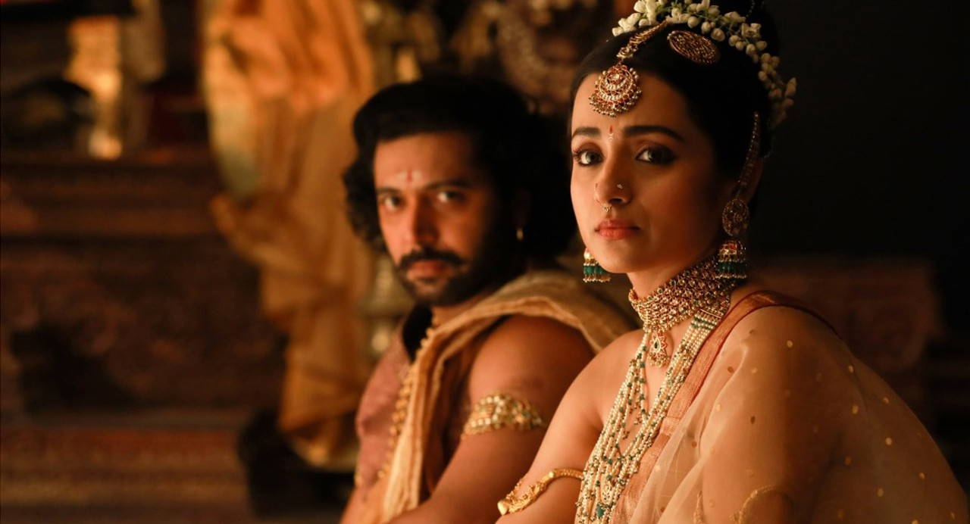

The
Opportunity

Slide 19
Connect with South Asian cinemagoers by owning the Gold Spot & cinema foyer for South Asian releases

Slide 20
The Gold Spot
The Gold Spot is the last commercial message after the trailers and sits, on average, six minutes away from any other advertising.
7
Gold spot
+ 60% rate card
1
DCM Opening ident
2
Brand ads
3
Bronze spots
4
DCM closing ident
5
Silver spot
6
Film trailers
8
Film
This 60” spot offers incredible standout, positioning your brand up close to the main event as anticipation and attention is at its highest.

Slide 21
The plan
60” Gold Spot across all South Asian cinema releases for 12 months.
Constant cinema foyer presence in 12 key locations
Position | 60" CPT Ratecard | Premium CPT | Admissions | STV Ratecard | Gross Costs @ 40% Discount | DOOH Foyer Annual always on | Total Gross Cost
Gold | £160 | £256 | 3,400,000 | £870,400 | £522,240 | £70,200 | £592,440
Please note admissions forecast is correct as of presentation date and based on 3-year average
Final admission and OOH number to be confirmed upon approval

