Slide 1


Cinema: A Family Favourite
Digital Cinema Media x REDC

Slide 2
DCM x REDC research: Objectives & Methodology
Online survey conducted in September 2025 among c.1,300 parents of children aged 6 to 15
Family experiences
CGF: (Cinemagoing families) n=1,101
Parent of child/children aged 6 to 15
Have been to the cinema as a family in the past 12 months
  n=1,054 children answered a 5-minute section of the survey
Understand where cinema sits within the wider range of paid for family activities
Identify what appeals most to families about cinema (environment and content)
Understand purchasing behaviour and the influence of kids/advertising
Non-CGF: (Non-cinemagoing families) n=195
Parent of child/children aged 6 to 15
Have not been to the cinema as a family in the past 12 months

Slide 3

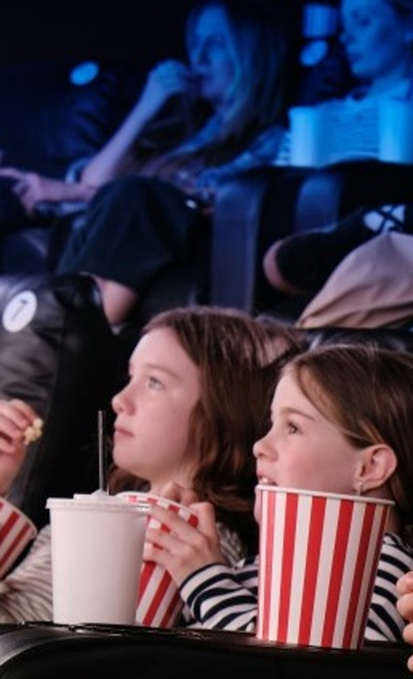




Swimming & cinema are the top paid family activities
We asked families about their experiences with 12 paid-for activities, and these were the top 5 most frequently done
1. Swimming
2. Cinema
3. Soft play
4. Live events
5. Theme parks/ attractions
How often do you do the following activities that have an entry fee as a family with your children/child? Base: All cinemagoing families (n=1,101)

Slide 4

Cinemagoing families do significantly more paid for family activities
Online survey conducted in September 2025 among c.1,300 parents of children aged 6 to 15
Paid activity frequency: At least once a month - Average
3.5
Cinemagoing families
1.3
Non-cinemagoing families
How often do you do the following activities that have an entry fee as a family with your children/child?. Base: All cinemagoing families (n=1,101), All non-cinemagoer families (n=195)

Slide 5
Cinemagoing families are more affluent & city-based
Average income, likelihood to be ABC1, and urban-based are all significantly higher for cinemagoing families.
Average HH income
HH SEG - %
Currently live… - %
Cinemagoing families
£80,000
▲
▲
56 | 34 | 10
Urban | Suburban | Rural
▲
ABC1 C2DE
Non-cinemagoing families
£56,100
▲
40 | 48 | 12
Urban | Suburban | Rural
▲
ABC1 C2DE
▲/▼ Significantly higher/lower than other group @95%
Base: All cinemagoing families (n=1,101), All non-cinemagoing families (n=195)

Slide 6
For all families, quality time & enjoyment for all are key in activity decision-making
Suitability for the whole family and value for money are also important considerations
MaxDiff – Importance of elements when deciding on a family activity - % (All respondents)
Top 5
Imagine you are deciding what activity to do as a family. […] Which of the following are most and least important to you? Base: All families (n=1,296)

Slide 7
Cinema delivers strongly against the most important factors for families
MaxDiff vs Cinema performance - % (Cinemagoer families)
+
Importance when choosing family activity*
-
Cinema performance (strongly agree score)
A2. When thinking about [cinema], how much do you agree, or disagree, with each of the following statements? Base: All cinemagoing families (n=1,101)

Slide 8






Cinema is the top consideration all year round - well ahead of other options
Likelihood (very/somewhat likely) to go to the cinema by seasonal event (cinemagoing families)
#1 89%
#1 87%
#1 84%
October
half-term
February
half-term
May
half-term
Christmas holidays
Easter holidays
Summer holidays
86%
#1.
85%
#1.
85%
#1.
Now thinking about specific times of year… How likely, or unlikely, are you to choose the following activities to do as a family during [seasonal event]? / Base: All cinemagoing families (n=1,101)

Slide 9

In their own words, cinemagoing families describe a very deep bond with cinema
“
“
Cinema means a night out where we are all off our phones, sat together watching a film and we can snack and laugh and share our thoughts after.
It's a fun day out for all as standalone activity or as part of a whole day of shopping/eating out. Cinema is a great place to go, rain or shine for some escapism.
“
“
“
“
Cinema means a lot to my family. It's the one time we get to come out together and spend time without any interruption.
For my family, cinema isn't just about watching movies it's a shared ritual. It's the way we gather, press pause on the chaos of daily life, and dive into a story together.
“
“
“
Cinema is like a magic window where family can share exciting stories, laugh together, and feel like they are on an adventure without ever leaving their seats.
“
It's an activity that all the family enjoy, a nice half term treat which allows the children to bond.
“
“
In your own words, please describe what cinema means to your family. Base: All cinemagoing families (n=1,101)

Slide 10
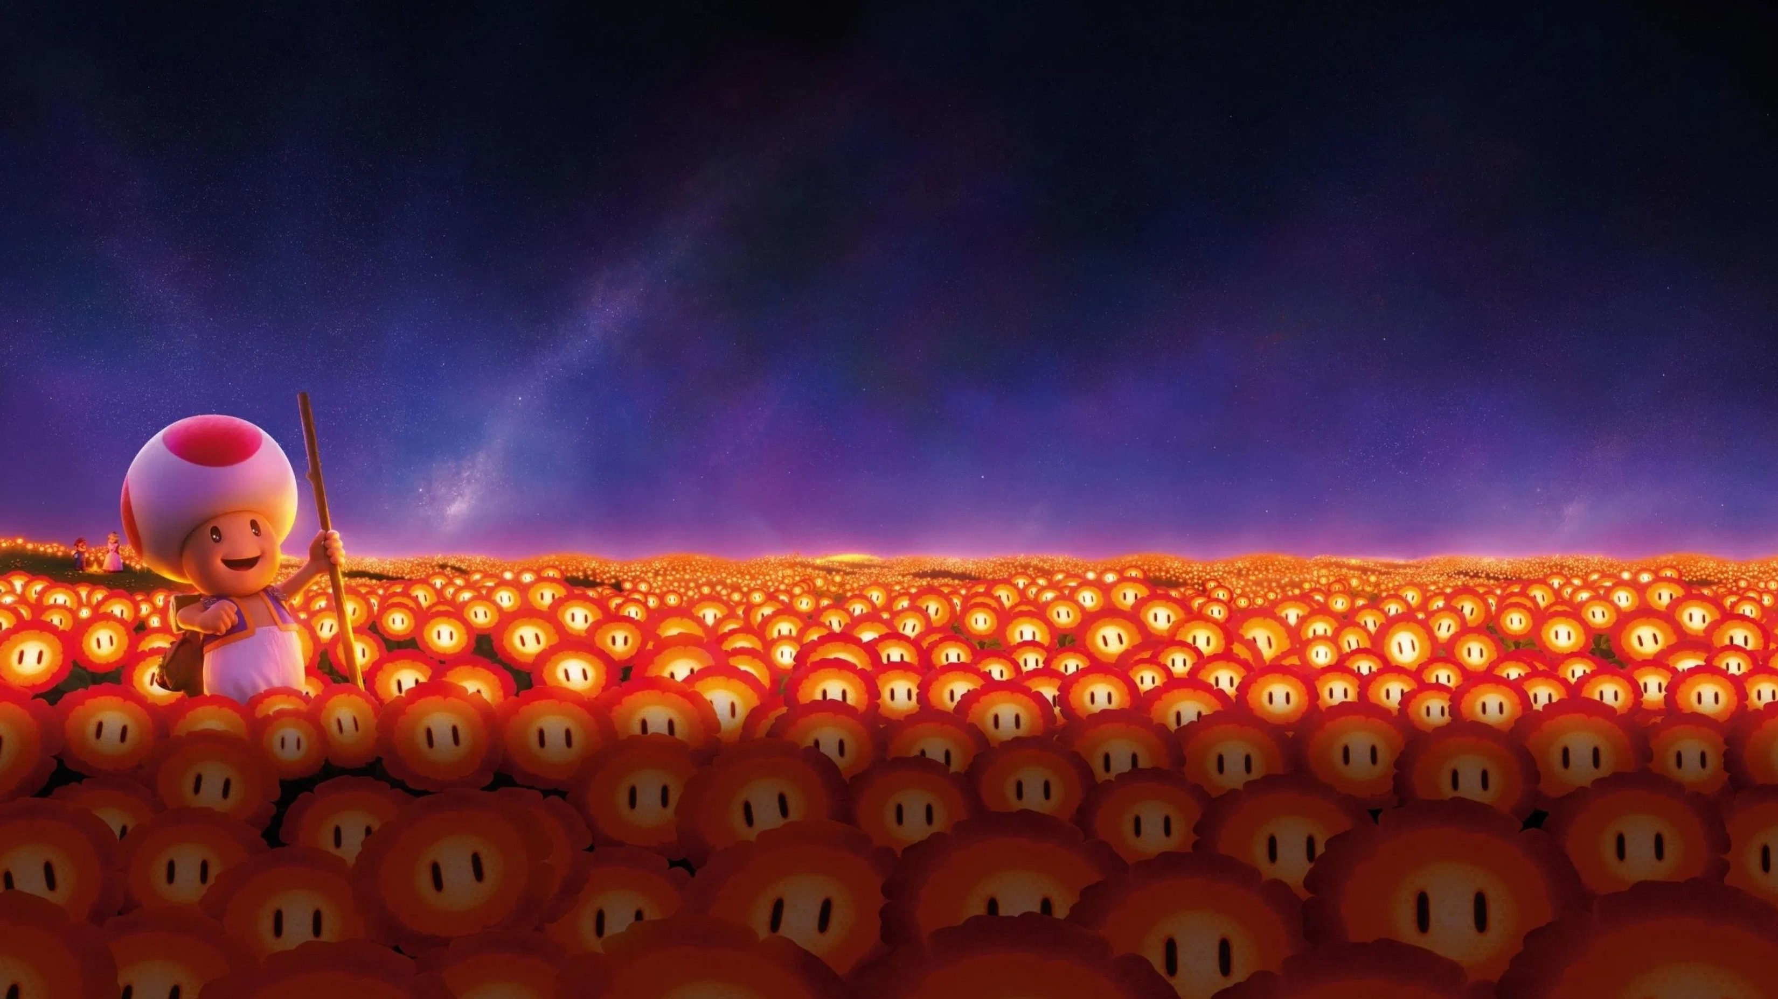
Over 8 in 10 agree that a trip to the cinema as a family always feels special (85%)
Base: All cinemagoing families (n=1,101). Strongly/somewhat agree.
Notes:
No significant differences @95% between CGF Child profile

Slide 11

Cinema is highly valued by parents
88%
Cinema is a relaxing way to spend time together as a family
87%
Watching a film in the cinema is more immersive than watching at home
86%
We can focus better on a film in the cinema than at home
(Strongly/ somewhat agree)
How strongly do you agree, or disagree, with each of the following statements? Base: All cinemagoing families (n=1,101)
Notes:
No significant differences @95% between CGF Child profile

Slide 12
Families are set to be well served by popular franchises in 2026-27
Popular franchises returning in 2026 will drive significant growth in family admissions YOY
Franchises / Characters Enjoy - % (Cinemagoing Families)
▲
▲
▲
▲
Boys |  |  | Girls | Girls |  | 6-10 | Boys | Girls
▲
▲
Summer 2026 | Summer 2026 | Summer 2027 | Summer 2026 | Winter 2027 | Summer 2026 | Spring 2026
▲/▼ Significantly higher/lower than other group @95%
Which franchises or characters does CHILD(REN) AGE enjoy? Please select up to 3. Base: All cinemagoing families (n=1,101)
Notes:
Recent release Lilo & Stitch felt like it was everywhere and was box office hit, but ranks 10th (of 13)
Shrek – ranks 3, last release was 2010, next not until 2027
Longer term 2027 releases: Shrek, frozen, sonic, Ice Age, Bluey
RELEASE DATES
Spiderman: 31st July 2026
Minions / Despicable Me: Summer 2026 (DM4 was 12th July 2024)
Shrek: 30 Jun 2027 (delayed from Dec 2026) – Shrek 4 was in 2010
Moana 2: 29 November 2024
Frozen: 24 November 2027 (Frozen 2 was 2019)
Toy Story: 19 June 2026 (TS4 was 2019)
Super Mario: 3 April 2026 (last one was 2023)
Sonic: 19 March 2027 (last was 2024)
Sponge Bob: 26 December 2025 (last was 2015)
Lilo & Stitch: 21 May 2025
Ice Age: 5 feb 2027 (last was 2016)
Bluey: 6 august 2027
Zootropolis: 28 November 2025 (first was 2016)

Slide 13





When asked directly, the kids confirmed the top 3
However, Toy Story and Super Mario – both with new films coming in 2026 - moved up the hierarchy
Top 5 Franchises Love / Like - % (All cinemagoing families and cinemagoing children)
Kids ranking | #1 | #2 | #3 | #4 | #5
Kids Rating | 74% | 72% | 71% | 71% | 70%
Parent Ranking | #2 | #3 | #1 | #6 | #7
How much do you like each of the following characters and franchises? – 5 Point answer scale. Base: All cinemagoing families (n=1,101), All cinemagoing children who took part in the survey (n=1,054)
Notes:
13 in the list

Slide 14

83% of cinemagoing families agree watching the ads & trailers is part of the cinema experience
A5. Now thinking about the cinema as a family activity more particularly… How strongly do you agree, or disagree, with each of the following statements? / Base: All cinemagoing families (n=1,101)
Notes:
Philip Oroni For Unsplash+
Ads/trailer integral part of cinema experience

Slide 15
Cinema perceived as higher quality & safer
Relative to other platforms, the vast majority of cinemagoing parents perceive cinema – and the advertising shown – as higher quality and safe for their children.
81%
71%
65%
67%
Cinema offers
higher quality ads
than other platforms
Cinema offers
higher quality films
than other platforms
Less concerned about content my kids see at the cinema vs other platforms
Less concerned about
ads my kids see at the cinema vs other platforms
Now thinking about the cinema vs other platforms in the context of a family activity… How strongly do you agree, or disagree, with each of the following statements? / Base: All cinemagoing families (n=1,101)
Notes:
No significant differences @95% between CGF Child profile

Slide 16
Cinemagoing families are significantly more likely to be in the market
With more disposable income, cinemagoing families are unsurprisingly more likely to be in market across an array of product categories from holidays and tech to a new car.
Purchase categories – Likely to purchase in the next year: Very/somewhat likely - %
+37% | +29% | +42% | +21% | +65%
▲
▲
▲
▲
▲
▲/▼ Significantly higher/lower than other group @95%
Thinking about the following categories, how likely are you to buy something from each one in the next 12 months? Base: All cinemagoing families (n=1,101), All non-cinemagoing families (n=195)

Slide 17
Tap into families with stronger purchasing power with cinema
Holiday Spend
(yearly average)
Grocery Spend
(monthly average)
£2,800 [+33%]
£2,100
£517 [+14%]
£454
Cinemagoing families
Non-cinemagoing families
Thinking about holidays (e.g. train or plane tickets and accommodation, or package holidays), approximately how much do you spend per year? Thinking about supermarket grocery spend, approximately how much do you spend per month? / Base: All cinemagoing families (n=1,101), All non-cinemagoing families (n=195)

Slide 18
Children in cinemagoing families have a bigger influence on purchases
Significantly higher than non-cinemagoing families in most categories
Purchase categories – Child influence: Decisive/strong influence – % (All respondents)
+16% | +26% | +44% | +35% | +40% | +28% | +25%
▲
▲
▲
▲
▲/▼ Significantly higher/lower than other group @95%
How much influence does/do your child/children usually have on your purchasing decisions in each of the following? Base: All cinemagoing families (n=1,101), All non-cinemagoing families (n=195)

Slide 19
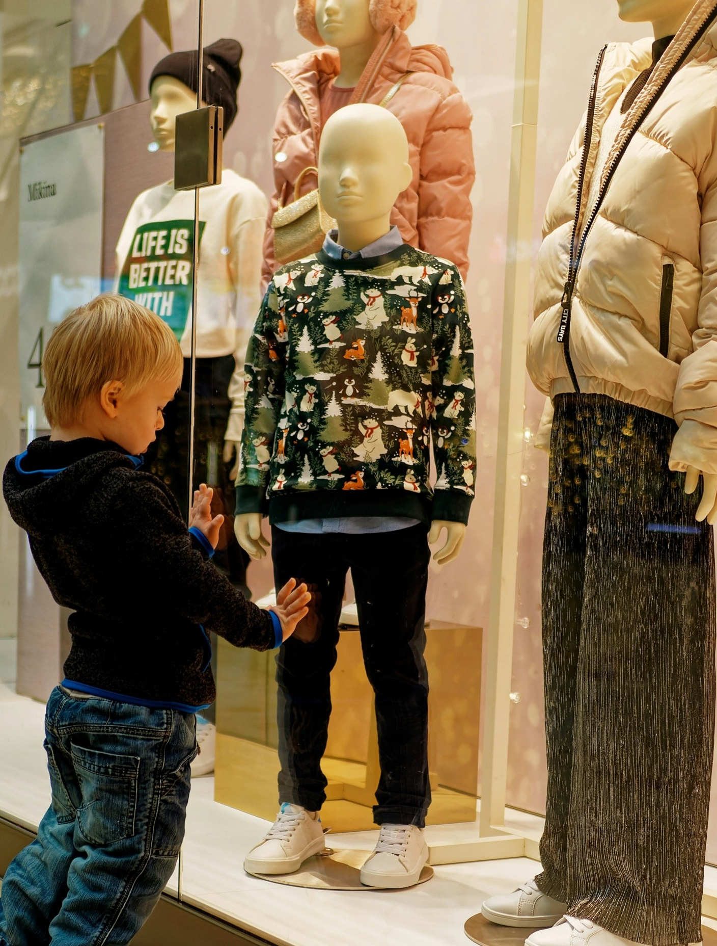
Pester power is alive and well!
70%
of children told us they had asked for something they’d seen advertised at the cinema
and
▲
Child aged 6-10 significantly higher than aged 11+
71%
of parents said they usually buy as a result
▲
CGF child aged 6-10 significantly higher than 11+
▲/▼ Significantly higher than other group @ 95%
Have you ever asked for something you saw in an ad at the cinema? / Has your child ever asked you for something they saw advertised at the cinema? Base: All cinemagoing families (n=1,101)
Notes:
Photo by Pavol Štugel on Unsplash

Slide 20
Implications for brands
Cinema remains a favourite activity for families, and provides brands with an increasingly unique opportunity to reach parent(s) and children together
Cinema remains a family favourite
Engage higher-income families
Reach them in a special, engaged moment
Despite an array of paid-for leisure activities, cinema remains a family favourite because it’s ability to deliver an array of family needs – it’s particularly top of mind across the key school holiday periods.
Cinemagoing families are typically higher income households who have more disposable income.
They are more likely to be in market – and spend more – across an array of product categories.
Cinema allows brands to reach families away from the hectic day-to-day, in an engaged moment that they really value because of the ‘together time’.
A big opportunity for brands to tap into ‘pester power’ in a high quality, safe environment.

Slide 21
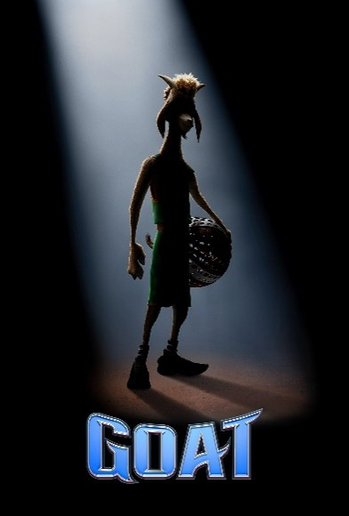

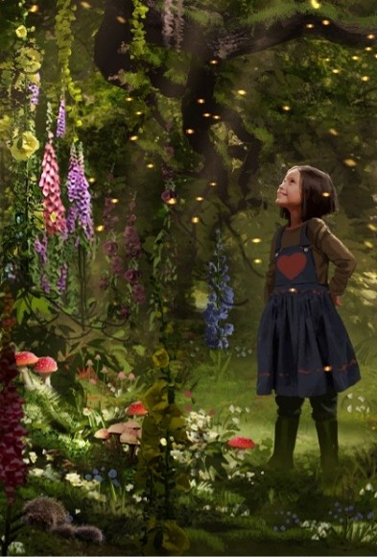







Families and brands are spoilt for choice in 2026
Goat
13 February
Hoppers
6 March
Magic Faraway Tree
27 March
Super Mario Bros Galaxy Movie
3 April
Toy Story 5
19 June
Minions 3
1 July
Paw Patrol: The Dino Movie
31 July
The Cat in the Hat
7 November
Hexed
27 November
Angry Birds 3
23 December

Slide 22

To my family, cinema isn't just about watching movies, it’s about togetherness and the memories. It’s a place where we pause from our busy lives, sit side by side and get lost in a story that makes us laugh, cry or dream together
“
”

