Slide 1
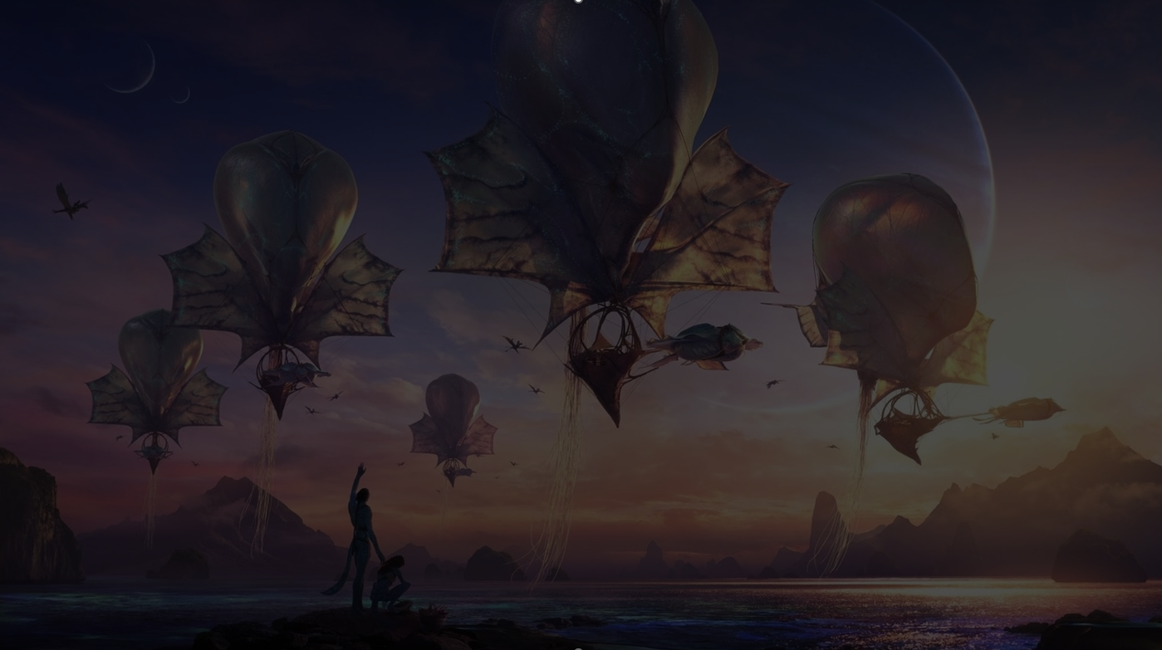
“Gen C?”
Cinema & 16-34s
Cinema’s role in engaging 16-34s and maximising advertising impact

Slide 2
16-34s are facing increasing worries and anxiety over their busy day-to-day lives
16-34s are…
+67%
+63%
+36%
+30%
More likely to worry about work during my leisure time.
More likely to find it difficult to balance work, children and social life.
More likely to try to avoid the news as it makes me too anxious.
More likely to worry a lot about myself
Source: GB TGI May 2025. All 16-34s indexed against all GB Adults

Slide 3
This is reflected in their busy media habits, full of distraction and usage across multiple channels
92% of Gen Z double screen whilst watching TV
“I don’t have the attention span to watch a whole film (on TV) without losing track on my phone”
“If I’m ‘watching’ a film on TV I have to be able to scroll TikTok whilst watching”
Source: GB TGI May 2025. Quotes from Ladnation Survey 2024

Slide 4


Cinema is a moment of escapism & comfort
“I’d say that going to the cinema feels like you get away from the outside world for a few hours, when you’re inside that screen room it’s like a cosy blanket.”
% 16-34s agree
65%
64%
61%
I get completely absorbed into the story when I watch a film at the cinema.
Cinema allows me to have some well-needed time out from day-to-day life.
A trip to the cinema lets me escape from everyday life
Data Source: FAME 2024, Cinemagoers 16-34. Quote source: Ladbible, Ladnation Survey 2024

Slide 5
As a result of this, 16-34s feel more positive at the cinema than when using any other media
Cinema ensures audiences are in the most positive mindset to be exposed to advertising
Source: IPA TouchPoints 2024. Good mood = 7+ on ten-point scale. 15-34 resp. only.

Slide 6
16-34s have a deeper connection with cinema with the big screen having huge cultural significance
of 16-34s have visited the cinema in the last 12 months
Culture Centric
63%
(i. 123)
“I love the hype around big film releases at the cinema” (62% agree, Index: 116)
Promotes FOMO
“I feel left out if my friends are talking about a film I haven't seen” (52% agree, Index: 129)
+66%
More likely to be heavy cinemagoers
of 16-45s have visited the cinema in the last 12 months
Social Interaction
“I love sharing my recommendations on films I have seen” (61% agree, Index: 116)
More likely to consider themselves ‘Film enthusiasts’ or ‘film buffs’
+25%
Trend & Styles
of 16-45s have visited the cinema in the last 12 months
“Movies give me ideas about style, fashion and music” (55% agree, Index: 123)
Sources: GB TGI May 2025 (16-34s vs All Ads) and FAME 2024 (16-34 cinemagoers, Index vs. All cinemagoers)

Slide 7
16-34s lure by excitement of new releases
Young adults are significantly more likely than older adults to go during a film’s opening weekend
Source: FAME 2024. Based on Adults 16+, Index vs. Cinemagoers 16+

Slide 8
Whilst they are also becoming increasingly less interested in traditional TV
-85% Decline in Traditional TV viewing in last 15 years
25
20
15
10
5
0
Source: BARB

Slide 9
Digital media has great reach but its effectiveness for delivering advertising is hindered
Weekly Media Channel Usage (Hrs) – 16-34s
Intrusive
“It feels like ads are everywhere now and you can’t escape them. Every app has a lineup of ads waiting for you as soon as you open it. I think it’s changed what social media was supposed to be about, which was connecting with others and having a good time.”
Female, Age 24
Less Trusted
Online advertising is seen as significantly less trustworthy than cinema amongst 16-45 cinemagoers.
Sources: TGI Media Usage. Downweighted based on BARB TV viewing data. Dentsu. The Gen Z Effect, FAME 2024

Slide 10
Cinema offers advertisers an opportunity to gain great incremental reach
Cinema maximises
16-34 reach
by +6pts
Source: DCM AV Reach Maximiser, powered by IPA Touchpoints 2024 Channel Planner Data
Notes:
Something we’re very confident of is the effectiveness of cinema to be able to deliver cost efficient incremental reach within the AV mix.
Using various tools and models, we’re able to forecast AV campaigns that can deliver significantly greater uplift when compared against AV plans that have excluded cinema.
The chart on the left shows a typical heavyweight AV mix working to a total budget of £2.6m, with the inclusion of only TV, VOD, and OLV.
On the right, you’ll see the addition of cinema into the mix, while keeping the total budget the same, we can deliver an uplift of 3 percentage points vs. Housepersons with Children, and 11 percentage points vs. 16-34s.
It’s worth noting, if you wanted to achieve these uplifts in linear TV alone, you’d expect to need to increase your budget by millions of pounds, but also worth noting your frequency against heavy TV viewers would exceed diminishing returns.

Slide 11
Cinema delivers unrivalled attention
A far greater proportion of your ad – 24 seconds of a 30” and 48 seconds of a 60” - will be watched in cinema
Lumen norms
Source: Lumen Attention Research Channel Benchmarks
Notes:
As you can see Cinema is really the stand out media when it comes to driving engagement – on average 24 seconds of a 30” ad are watched, and 48 seconds of a 60”. The level of attention provided by exposure to the ad in cinema far surpasses what is achievable in other formats and really allows for deep engagement with the brand and the message.
By comparison TV on average delivers a solid 15.5 seconds attention to a 30” ad, and there’s a decreasing tail of attention available across other formats e.g. 4 seconds of a 15-20” bumper on YouTube and 1-1..5 seconds attention paid to Facebook and Instagram Infeed advertising.

Slide 12
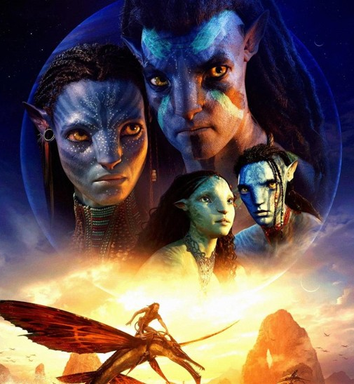
Upcoming cinematic cultural moments for reaching the 16-34 audience
 | Industry Admissions | 16-34 TVRs
Avatar: Fire And Ash December 2025 | 6.3m | 19
Wicked Part II November 2025 | 6.3m | 16
Untitled Super Mario Bros Sequel April 2026 | 4.4m | 11
The Mandalorian & Grogu May 2026 | 3.1m | 8
Zootropolis 2 November 2025 | 3.0m | 8
The Conjuring: Last Rites September 2025 | 1.2m | 6
The Housemaid December 2025 | 1.3m | 6
One Battle After Another September 2025 | 1.3m | 4
Hoppers March 2026 | 1.5m | 4
28 Years Later: The Bone Temple January 2026 | 1.3m | 4
Source: DCM. Based on industry admissions forecasts and comparative film profiles

Slide 13
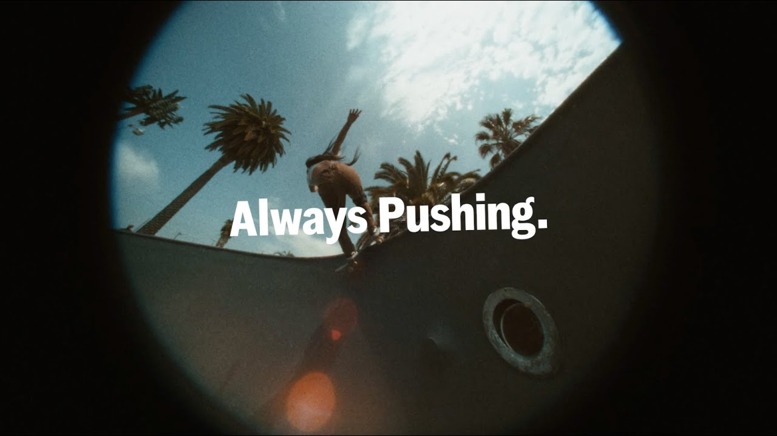
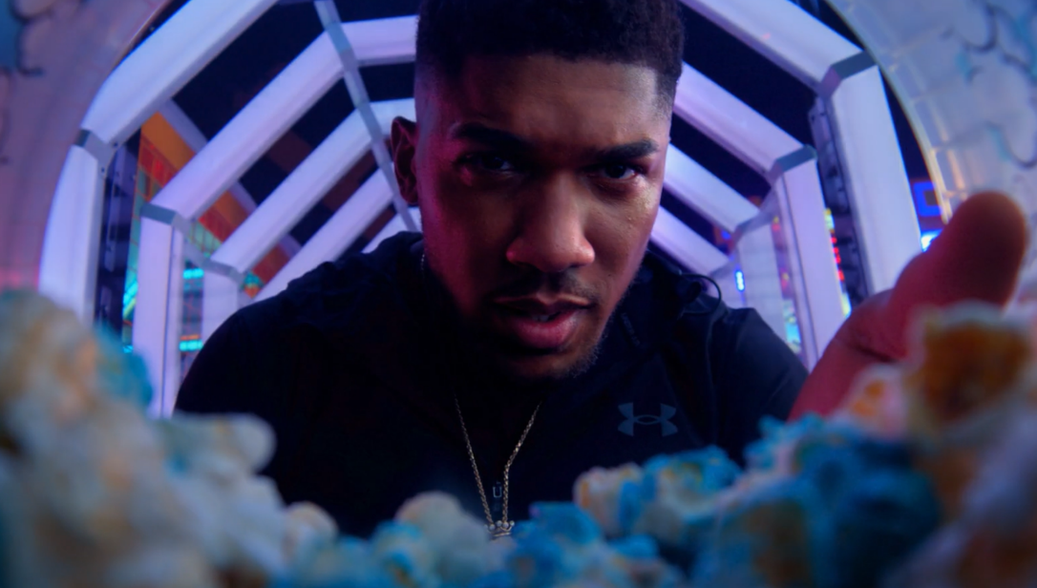


Cinema is a proven media for driving impact amongst the 16-34 audience
Always Pushing
King of the Game
Background: Vans felt the brand was no longer top of mind, with no clarity on what the brand stood for. Vans realised that they needed to enhance their relevancy through elevated storytelling to appeal to young audiences.
Plan: Vans showcased a hero 60” copy in cinema – buying into 16-34 skewing films - to build an emotional connection with this audience.
Results:
Around half of exposed cinemagoers agreed they were very likely to consider Vans, a significant +48% uplift from those not exposed to the ad in cinema
The campaign saw a +88% significant uplift in agreeing that Vans is ‘for people like me’.
Background: JD Sports wanted to cut through with its young and diverse audience and reach them away from the clutter and distraction of online/social media environments.
Plan: Collaborating with DCM Studios, two idents were created from the original brand ad. 30” copy was used throughout the campaign, but JD Sports also used DCM’s proximity planning tool Cinemapper tool, to run 120” copy in cinemas closest to top-performing stores.
Results:
Recall of the ‘King of Games’ ad peaked at 70% for cinemagoers, an uplift of +17% vs. control and well ahead of DCM benchmarks (48%)
Intent to act having been exposed to the ad in cinema was above 80% across all creative routes.

