Slide 1
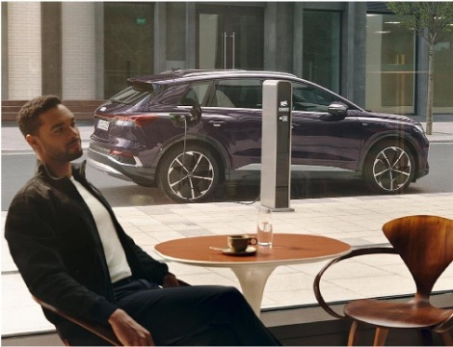
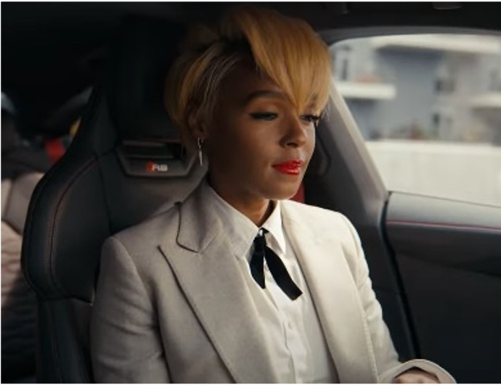

Audi
Background
Preparing for the 2030 ban on the sale of new petrol and diesel cars in the UK, Audi wanted to be on the front foot and establish its credentials as a leader in electric vehicles by promoting both the Q4 e-tron and e-tron GT models.
Plan
Audi ran three pieces of copy across its two Gold Spot selections – The King’s Man and The Matrix: Resurrections.
Results
Cinema helped deliver increases in awareness for both models (Q4 e-tron and e-tron GT) featured across the campaign, with an average uplift of 14% vs control
Cinema exposed group are +32% more likely to be ‘extremely likely’ to consider Audi if they were buying an electric car
Source: DCM / Audi
Conducted by: Differentology, Dec 2021. Base: ABC1 Adults
Notes:
Source: DCM / Audi
Conducted by: Differentology, Dec 2021. Base: ABC1 Adults

Slide 2
Audi
Media agency | Target | Buying route | Copy length
PHD | ABC1 Adults | Gold Spots | 3 x 60”
Q4 e-tron and e-tron GT
Background
As the automotive industry begins to prepare for the 2030 ban on the sale of new petrol and diesel cars in the UK, Audi wanted to be on the front foot and establish its credentials as a leader in the electric vehicle market. The aim of the campaign – promoting both the Q4 e-tron and e-tron GT models – was to drive awareness and desire of Audi and ultimately increasing consideration for its electric vehicles.
Plan
With the cinema burst starting just days before Christmas, Audi wanted to maximise relevance and so decided to run three pieces of copy across its two Gold Spot selections – The King’s Man and The Matrix: Resurrections.
The Q4 e-tron ad (starring Rege-Jean Page) was seen by those who went to see The King’s Man; while those who went to see The Matrix: Resurrections in the lead up to Christmas saw the e-tron GT Christmas copy. This was then switched out post-Christmas to the Janelle Monae-starring e-tron GT ad.
Results
Using cinema to engage an affluent audience with its range of electric vehicles worked successfully for Audi in driving key campaign metrics:
Increased awareness of new models
Cinema helped deliver increases in awareness for both models (Q4 e-tron and e-tron GT) featured across the campaign, with an average uplift of 14% vs control.
Improved consideration
Cinema exposed group are +32% more likely than control to be ‘extremely likely’ to consider Audi if they were buying an electric car.
Source: DCM / Audi
Conducted by: Differentology, Dec 2021. Base: ABC1 Adults
Notes:
Source: DCM / Audi
Conducted by: Differentology, Dec 2021. Base: ABC1 Adults

