Slide 1
Virgin trains
VIRGIN Trains
Cinemapper
Cinemapper
Background
Having a very specific site footprint of railway stations, Digital Cinema Media (DCM) created a new bespoke Audience Guaranteed Package (AGP) to enable Virgin Trains to get as close as possible to its target audience along its own footprint of railway stations.
Idea
Using Cinemapper, DCM’s proximity planning tool, DCM tracked all Virgin train stations that were within a 20 minute drive time of a DCM cinema. 42 out of 43 Virgin train stations were covered – a 98% reach, with the whole campaign reaching a total of 1.7m DCM admissions. Providing flexibility in this way allowed Virgin Trains to target a relevant audience locally, yet on a national scale.

Slide 2
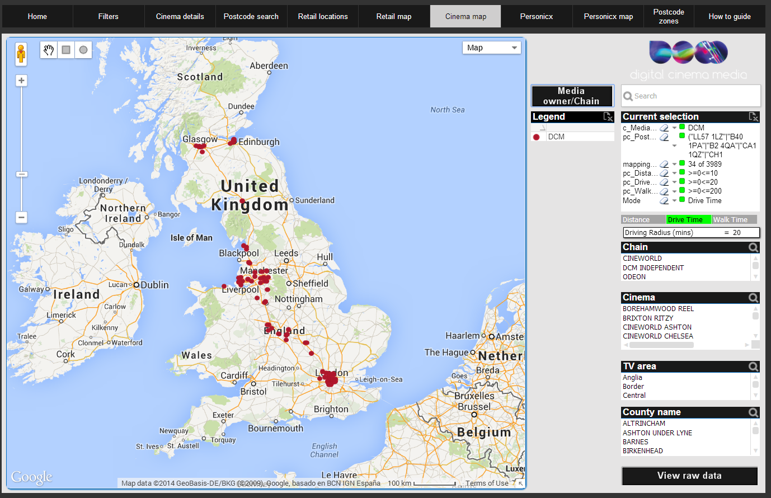
Virgin trains
Cinema site matches: mapped
Cinemapper
Virgin Train stations within 20 minute drive time of a cinema – Total DCM
Source:CineMapper. Distance used: 20 minute drive time from a DCM cinema. Postcode list supplied. Accurate as at 14/08/14. Data subject to change.

Slide 3
Virgin trains
VIRGIN Trains summary
Cinemapper
Cinemapper
20 mins Drive time (distance mapped)
42 Virgin train stations covered by DCM cinemas
133 DCM cinemas required for booking
1.7m DCM average weekly admissions

