Slide 1
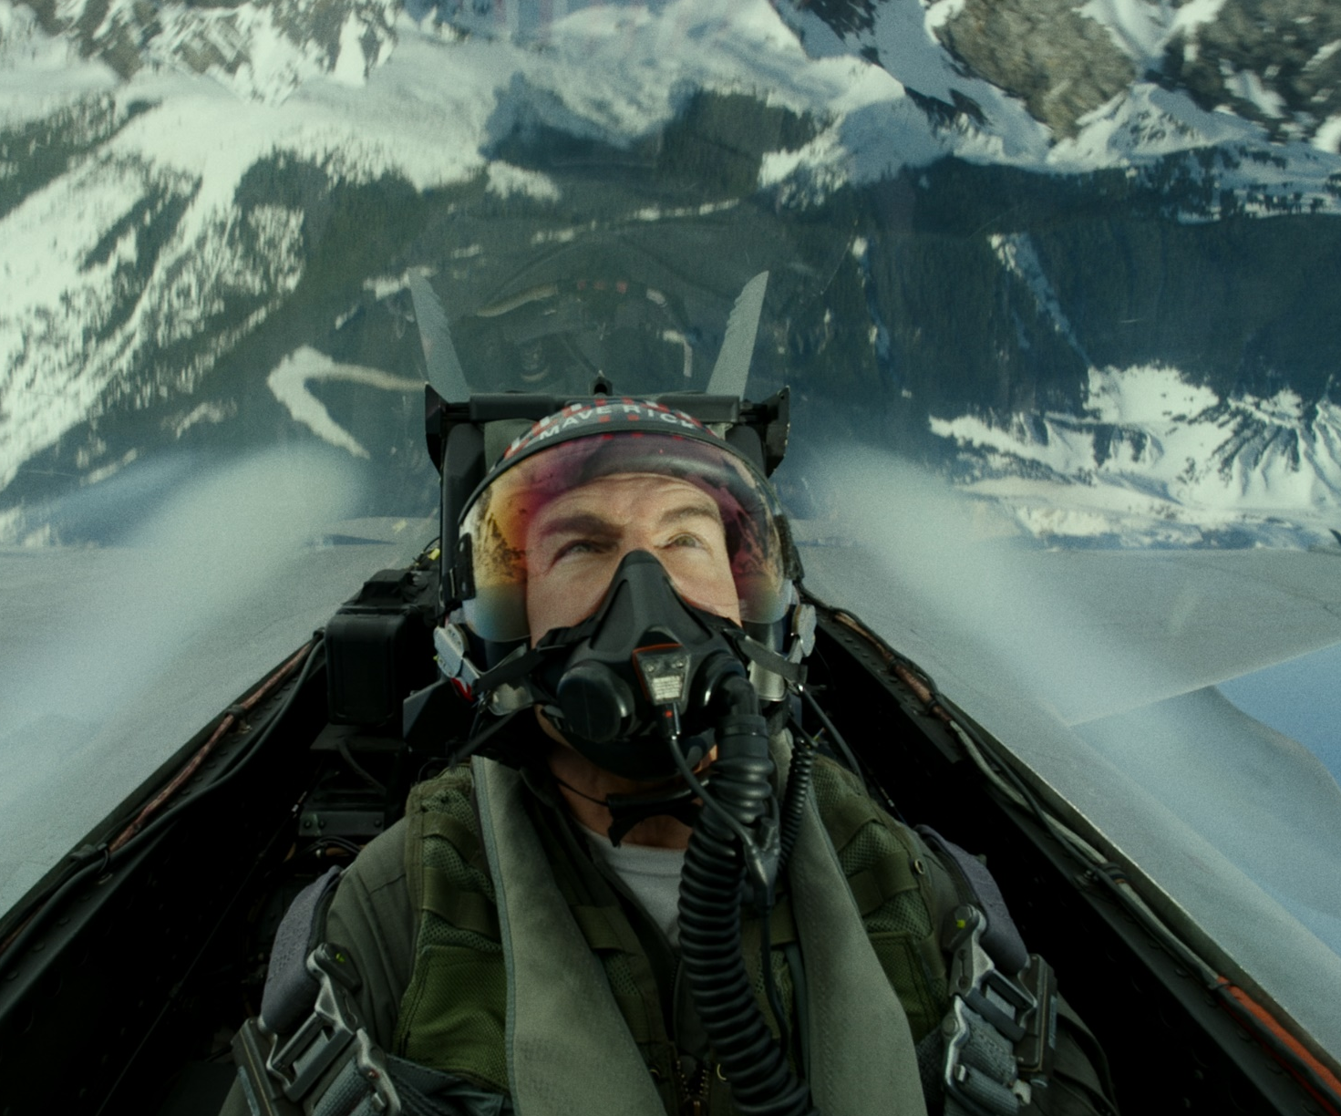
Top Gun: Maverick
Fly back into the Danger Zone!
Release Date
25 May 2022
Cast
Tom Cruise, Miles Teller, Jennifer Connelly
Director
Joseph Kosinski (Tron: Legacy, Oblivion)
Recommended if you like
Top Gun
Reasons to buy into
Tom Cruise an his particular brand of do-it-yourself Hollywood action cinema has proved a box office phenomenon, and his return to a classic 80s movie looks set to soar.
Key audience info
16-34 Men index: 278
Est. DCM admissions
1.9m
Pete ‘Maverick’ Mitchell, now a flight instructor at the Top Gun academy, trains the next generation of fighter pilots while searching for new meaning in his life. A sequel to the 1986 classic, Top Gun.
Plan your campaign

