Slide 1
Ticket to paradise
Two modern Hollywood greats re-unite for a fabulous new rom-com
Julia Roberts and George Clooney are genuine Hollywood royalty, having starred in some of the most famous films of the last 30 years. In Ticket To Paradise they are re-united for the first time since Ocean’s 12, playing a divorced couple that teams up and travels to Bali to stop their daughter from making the same mistake they think they made 25 years ago. After the success of April’s The Lost City, the romantic comedy is back on the big screen in a big way, so any brand looking to reach upmarket women this September and October, look no further than Ticket To Paradise.
CAST
Julia Roberts, George Clooney, Kaitlyn Dever, Billie Lourd
KEY STATS
Romantic comedies are a popular genre in film, bringing in a number of audiences all coming together to experience the laughter and nostalgia that it holds. 30% of all cinemagoers state that rom-coms are their favourite film type, where specifically ABC1 women are 62% more likely than the avg. UK adult to agree that rom-coms are their favourite film type². Overall, the harmony of this nation-loved genre combined with a strong cast list will be major factors in the success of this film.
George Clooney has won 2 Academy Awards, 1 BAFTA and 4 Golden Globe Awards over his career. Similarly, Julia Roberts has won 1 Academy Award, 1 BAFTA, 1 Critics Choice Movie Award, 1 Screen Actors Guild Award and 3 Golden Globe Awards – highlighting the success of both these actors in the industry over the past 20 years.
EST. INDUSTRY ADMISSIONS
818k
Source: CAA C+F Planner of Industry figures and using comparative film information.
2. TGI GB June 2022. target: ABC1 Women who are cinemagoers. Index vs the avg. UK adult
RELEASE DATE: 16 SEPTEMBER 2022

Slide 2
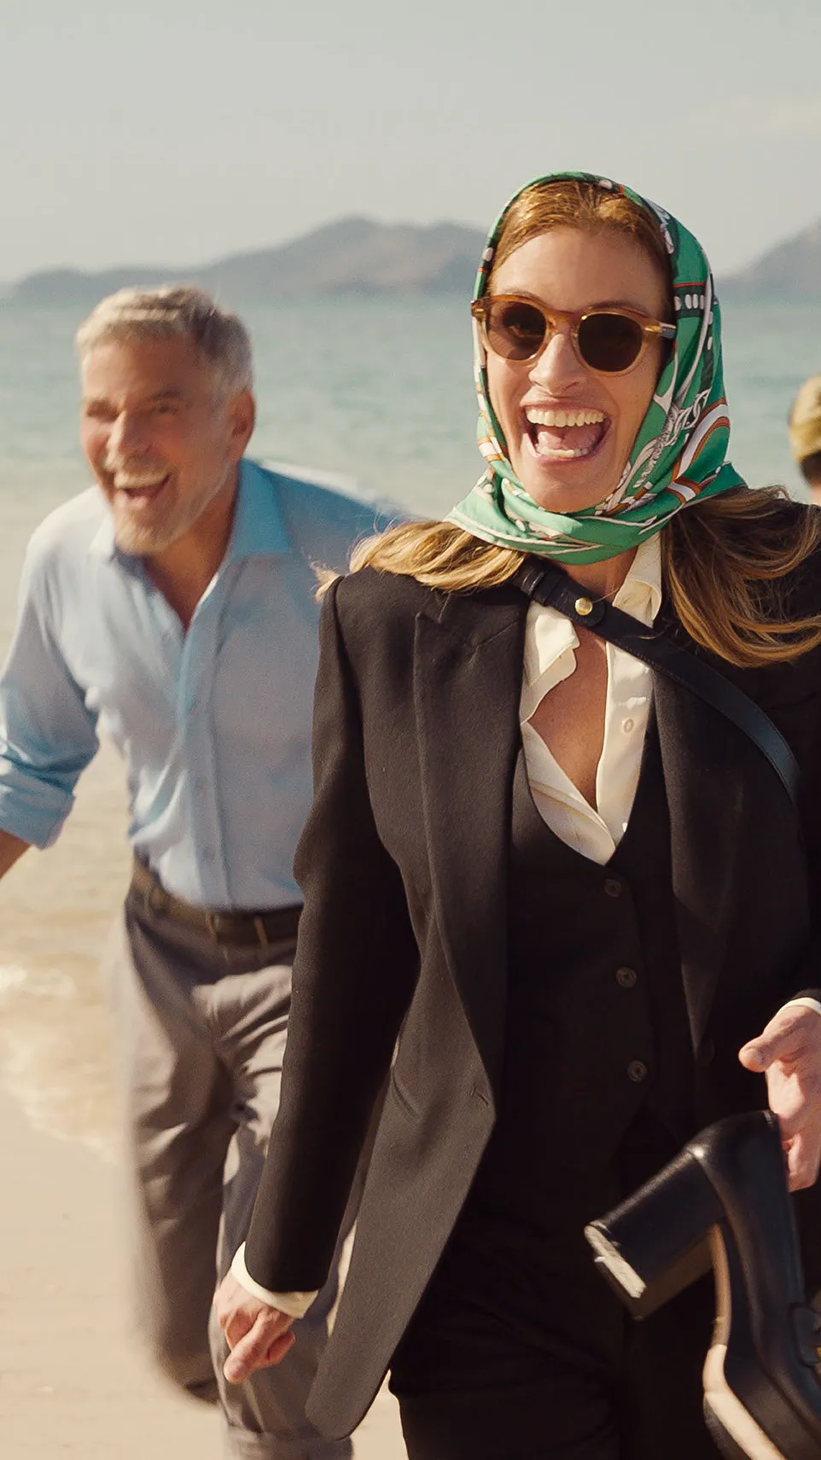
Ticket to paradise
A divorced couple that teams up and travels to Bali to stop their daughter from making the same mistake they think they made 25 years ago. Featuring big names including Julia Roberts, George Clooney, Billie Lourd and Kaitlyn Dever.
 | REACH | IMPACTS | TVRs
Adults 16+ | 1.5% | 787,024 | 1.6
ABC1 Adults | 1.9% | 542,177 | 2.0
ABC1 Women | 2.0% | 284,005 | 2.1
ABC1 Men | 1.8% | 258,172 | 1.9
ABC1 Housewives | 1.9% | 400,502 | 2.0
RELEASE DATE 16 SEPTEMBER 2022
Source: CAA C+F Planner of Industry figures and using comparative film information.

Slide 3
Ticket to paradise will attract ABC1 FEMALES
Using the comparative film profile for an average rom-com audience, we can predict strong figures for Ticket To Paradise for ABC1 Females
Source: CAA Film Monitor . Aggregate rom-com profiles based on The Intern, How To Be Single & Bridget Jones’s Baby

Slide 4
Heavy cinemagoing AFFLUENT females: in market for clothes and cosmetic products
ABC1 females who frequently go to the cinema enjoy spending money on accessories, cosmetic products and good quality clothing
73%
‘I tend to buy brands I trust when I shop online’
They are also 76% more likely to agree that they trust the advertising they see in the cinema¹
52%
Agree they ‘really enjoy shopping for clothes’²
ABC1 Female CINEMAGOERS
93%
more likely to agree that they buy new products before most of their friends²
5 in 10
Buy Clothing & Toiletries/Cosmetic products as Christmas gifts²
75%
‘Sometimes I treat myself to something I don't need’²
2x
More likely to be heavy spenders on skincare and cosmetic products²
Source: 1 IPA Touchpoints 2021. Target: ABC1 females who frequently visit the cinema. Index vs the average UK adult
2 TGI GB 2022. Target: ABC1 females who are cinemagoers. Index vs avg. UK adult

Slide 5
Heavy cinemagoing AFFLUENT females: in market for tech
ABC1 females who frequently go to the cinema enjoy spending money on up-to-date tech products.
2x
More likely to agree that advertising is a key influencer in buying their household appliances/products if they are heavy cinemagoers
53%
Agree that they like innovative household appliances and devices
^{(Index: 116)}
ABC1 Female CINEMAGOERS
50%
‘I try to keep up with developments in technology’
^{(Index: 129)}
66%
‘As we return to a more normal life, my monthly expenditure has increased significantly’
^{(Index: 109)}
Source: TGI GB 2022. Target: ABC1 females who are cinemagoers. Index vs avg. UK adult unless otherwise stated

Slide 6
Heavy cinemagoing AFFLUENT females: in market for good quality products
ABC1 females who frequently go to the cinema enjoy spending money on good quality drinks, food & gifts.
39% more likely to consume an alcoholic drink at least once a week if they are heavy cinemagoers
58% agree its worth paying extra for good quality drinks
ABC1 Female CINEMAGOERS
£438
Spent on Christmas present purchases
£61 more than the avg. UK adult
2x
More likely to spend more than £150 per week on food, drink & groceries online or in-store
57%
Agree that advertising is a key influencer in buying their food, drink or household products
59%
More likely to buy drinks around their visit to the cinema or theatre etc
Source: TGI GB 2022. Target: ABC1 females who are cinemagoers. Index vs avg. UK adult unless otherwise stated

Slide 7
THANK YOU TO ALL THE TOP SPENDERS WHO BOUGHT IN PREVIOUS ROM-COMS
Source: DCM Planner 2018-2022

Slide 8
Affluent females feel more positive towards adverts in the cinema
ABC1 females who are heavy cinemagoers more likely to enjoy, trust and pay more attention to adverts in the cinema compared to the average UK adult.
3x
More likely to agree that they pay the most attention to cinema ads compared to other platforms (TV, Internet, Radio, Podcasts)
64%
‘I get to the cinema in time to specifically watch the adverts and trailers’
^{(Index: 176)}
2x
More likely to agree that they ‘enjoy seeing films in the cinema more than on TV’
64%
Agree they are less distracted watching adverts in the cinema compared to any other media
(Index: 118)
50%
‘I feel left out if my friends are talking about a film I haven’t seen’
(Index: 123)
70%
‘A trip to the cinema lets me escape from everyday life’
(Index: 110)
Source: TGI GB June 2022 & TGI GB June 2022 Multibased with FAME 2021. Target: ABC1 females who are heavy cinemagoers Index vs avg. UK adult

Slide 9
Your advertising can ALSO have instant impact
98% OF DCM CINEMAS ARE WITHIN ONE MILE OF A RETAIL LOCATION
Cinema is typically part of a wider trip, so you can reach mainshoppers before they go to a shop either online or in-store
After watching a film, heavy cinemagoers are more likely to…
Source: FAME 2021. Activities do immediately after / on same day as cinema visit. Target: ABC1 mainshoppers who are heavy cinemagoers. Index vs. average GB adult
Notes:
So we can infer that even though men will be prioritising the world cup, they are also more likely to watch new releases in the first two weeks and with the plethora of films we have coming out at the end of the year, brands will be able to access them in the right way.

Slide 10
Despite the cost-of-living crisis, there are positive signs for continued consumer spending
Although 86% of people across the UK are concerned about the impact of the increase in cost-of-living, consumer spending remains strong
Most consumers still plan to treat themselves and prioritise getting out and about…
Despite the impact of the increasing cost-of-living…
52%
Intend to maintain or increase their spending in trips to the cinema
+17%
Brands who boosted their investment saw a 17% increase in incremental sales.
Increased media spend therefore pays off during times of economic uncertainty
Sources: Kinetic: ‘New Data Shows Positive Signs in the Lead up To Christmas Despite Cost of Living Increases’ / Alfresco Life with Toluna Survey

