Slide 1
THE SUICIDE SQUAD
Notes:
Statements or numbers on this slide should be short and concise

Slide 2
The suicide squad
DC get another bite of the cherry for their famous anti-heroes
In one of the more interesting behind the scenes stories of the summer, Guardians Of The Galaxy 1 & 2 filmmaker James Gunn takes on a major DC Comics film before returning to direct Guardians Of The Galaxy 3. In this new adventure supervillains Harley Quinn, Bloodsport, Peacemaker and a collection of nutty cons at Belle Reve prison join the super-secret, super-shady Task Force X as they are dropped off at the remote, enemy-infused island of Corto Maltese. It should be an exciting, irreverent treat and ideal for brands looking to reach 16-34 men this summer.
CAST
Margot Robbie, Viola Davis, Idris Elba, John Cena, Taika Waititi, Sylvester Stallone
KEY STATS
2016’s Suicide Squad delivered over 3.1m DCM admissions, making it one of the biggest films of the year
It also delivered 21 16-34 male TVRs and 15 16-34 adult TVRs
EST. INDUSTRY ADMISSIONS
1.5m
REACH / IMPACTS / TVRs³
All adults (16+): 2.8% / 1.4m / 2.9
16-34 adults: 7.12% / 1.2m / 7.4
16-34 men: 9.54% / 790k / 10.1
Sources: 1. IBOE 2. CAA Film Monitor 3. Industry figures.
RELEASE DATE: 30 JULY 2021

Slide 3
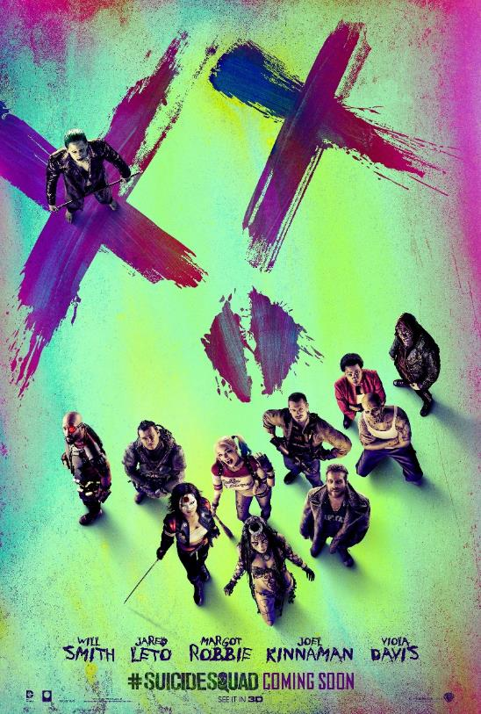
SUICIDE SQUAD IS A BIG DRAW FOR 16-34S
75% of Suicide Squad’s cinema audience were 16-34s – the highest proportion of 16-34s for any blockbuster in the last 5 years. We expect strong delivery of 16-34 Ads & 16-34 Male audiences once again with the new instalment.
SUICIDE SQUAD (2016)
75%16-34
Source: Profile data from Kantar Film Monitor survey. TVR build based on industry admissions

Slide 4
SNAPSHOT: DC FANS
The Suicide Squad audience will be an ideal match for brands in the tech, gaming, sports clothing and men’s personal care/toiletries categories.
TECHNOLOGY
GAMING
CLOTHING & PERSONAL CARE
INTEND TO PURCHASE A NEW SMARTPHONE
154
INTEND TO PURCHASE A GAMES CONSOLE
235
USE AFTERSHAVE/EAU DE TOILETTE
138
LOVE TO BUY NEW GADGETS & APPLIANCES
134
LIKE TO KEEP UP WITH LATEST DEVELOPMENTS IN GAMNG INDUSTRY
169
BOUGHT SPORTS CLOTHING IN L12M
132
INTEND TO PURCHASE NEW LAPTOP/NOTEBOOK
134
FAVOURITE PASTIME IS PLAYING VIDEO GAMES
165
HEAVY SKINCARE SPENDERS
131
159
126
I LIKE INNOVATIVE HOUSEHOLD DEVICES
125
USED SMARTPHONE FOR GAMING
BOUGHT SPORTS SHOES/TRAINERS
IN L12M
TRY TO KEEP UP WITH DEVELOPMENTS IN TECH
123
REGULAR GAMER
(>= 3-4 DAYS A WEEK)
151
I SPEND A LOT ON CLOTHES
112
Source: GB TGI May 2021, DC: Fans of the franchise.
Indexes vs. average GB adult

