Slide 1
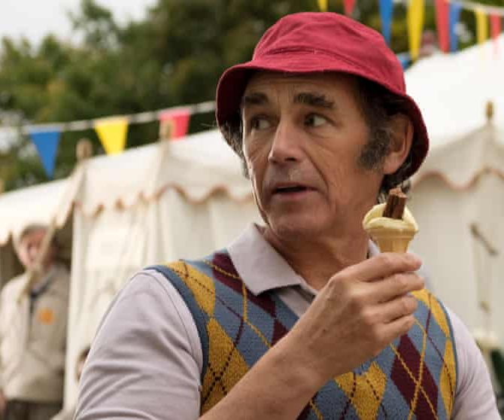
The Phantom of the Open
An unbelievable true story!
Release Date
15 April
Cast
Mark Rylance, Sally Hawkins, Rhys Ifans
Director
Craig Roberts (Eternal Beauty)
Recommended if you like
Fisherman’s Friends
Reasons to buy into
The film adaptation of this uniquely British story has received strong acclaim from festival audiences.
Key audience info
ABC1 Adults Index: 270
Est. DCM admissions
590k
The story of golfer Maurice Flitcroft, whose performance at the 1976 British Open Golf Championship made him a legend.
Plan your campaign

