Slide 1
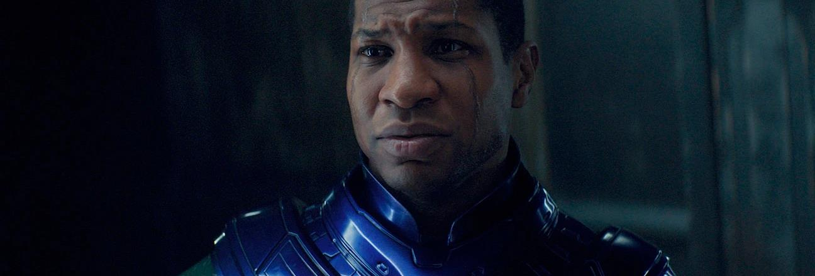
MARVEL CINEMATIC UNIVERSE
The upcoming releases from cinema’s biggest franchise

Slide 2
MARVEL CINEMATIC UNIVERSE:
THE BIGGEST CINEMA
FRANCHISE OF ALL TIME
TAKING OVER £1BN AT
THE UK BOX OFFICE ALONE
Source: IBOE

Slide 3
Fans of the mcu are more likely to be young, male and ABC1.
Marvel films should be an attractive proposition for any brands wanting to engage with a young male audience
Source: GB TGI October 2022 – Fans of Marvel franchise and are cinemagoers

Slide 4
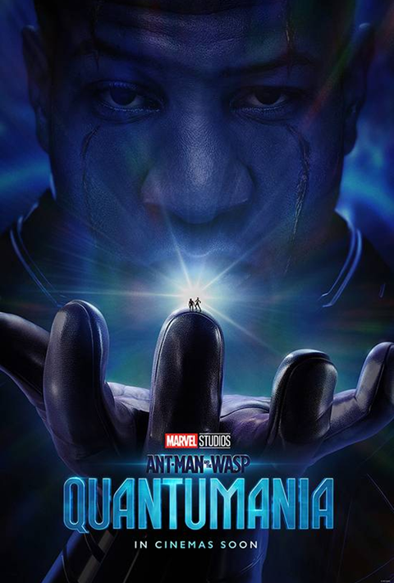


marvel phase 5: 2023 cinema releases
After a year of mostly introducing new characters to the MCU, Marvel’s 2023 focuses on sequels starring well-established characters
Ant Man And The Wasp: Quantumania
17 Feb 2023
Guardians Of The Galaxy Vol. 3
5 May 2023
The Marvels
28 July 2023
Source: DCM Planner

Slide 5
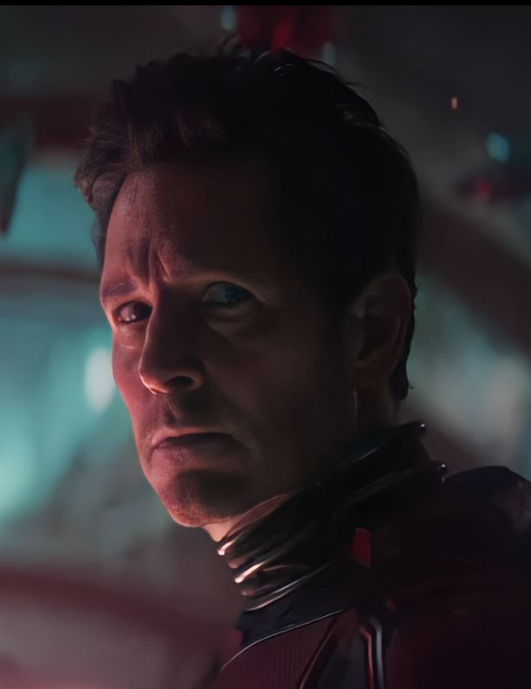
Ant-man and the wasp: quantUmania
The first film to kick-off Marvel Cinematic Universe’s (MCU) Phase 5
RELEASE DATE | EST. INDUSTRY ADMISSIONS | GENRE | HFSS BRANDS | ALCOHOL/GAMBLING BRANDS
17 February 2023 | 2.7m | Superhero | Yes | No
SYNOPSIS
Ant-Man and the Wasp, along with Hank Pym and Janet Van Dyne, end up in the Quantum Realm. Interacting with strange creatures they will embark on an adventure that goes beyond the limits of what they thought was possible...
CAST
Paul Rudd, Evangeline Lilly, Jonathan Majors, Michelle Pfeiffer, Michael Douglas and Bill Murray
THE DCM TAKE
Ant-Man and the Wasp: Quantumania has the honour of kickstarting Marvel’s next significant phase of titles in its cinematic universe, with Marvel boss Kevin Feige saying the film will be a “direct line into Phase 5 and Kang Dynasty” (the next Avengers film due out in 2025). Viewers of the Disney+ series Loki will have met him briefly already but Ant-Man and the Wasp: Quantumania will be the first big screen appearance of the new Marvel ‘big bad’ Kang, played by Jonathan Majors. We expect this to stimulate desire among Marvel fans to see this title more than the previous Ant-Man films, which have never played too heavily into the over-arching MCU. Brands looking for a strong 16-34 / 16-34 male-skewing audience need not look any further than this, the first superhero blockbuster of the year.
 | Adults (16+) | 16-34 Ads | 16-34 Men | ABC1 Ads | ABC1 Men
REACH | 4.07% | 7.6% | 10.7% | 4.5% | 6.3%
IMPACTS | 2.2m | 1.3m | 982k | 1.3m | 959k
TVRS | 5 | 9 | 12 | 5 | 7
Source: DCM Planner, based on industry admissions

Slide 6
Ant-Man and the Wasp: Quantumania WILL DELIVER A YOUNG MALE AUDIENCE
Based on current forecasts we estimate that Ant-Man And The Wasp: Quantumania will deliver 12 16-34 Men TVRs
Source: CAA C+F Planner. Predicted industry admissions.

Slide 7
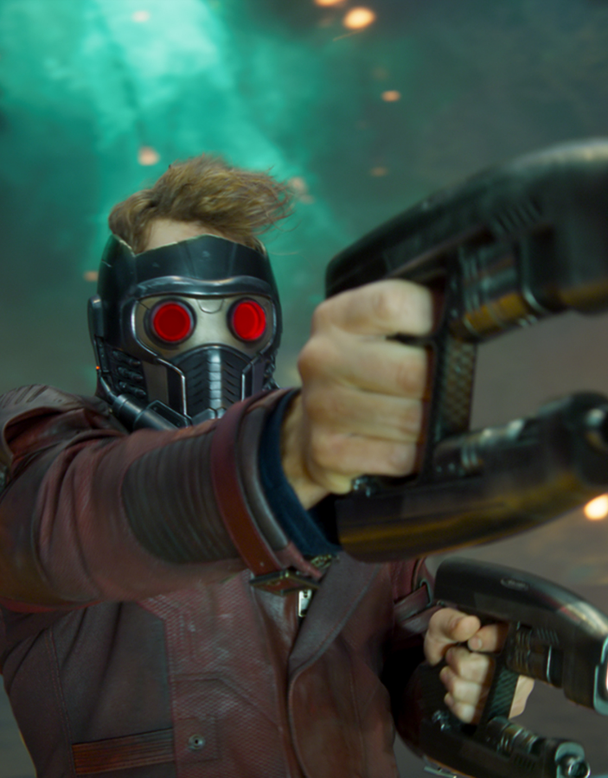
Guardians Of The galaxy Vol. 3
The fan favourites return for another adventure
RELEASE DATE | EST. INDUSTRY ADMISSIONS | GENRE | HFSS BRANDS | ALCOHOL/GAMBLING BRANDS
5 May 2023 | 5m | Superhero | Yes | No
SYNOPSIS
Still reeling from the loss of Gamora, Peter Quill rallies his team to defend the universe and one of their own - a mission that could mean the end of the Guardians if not successful.
CAST
Chris Pratt, Zoe Saldana, Karen Gillan, Bradley Cooper, Dave Bautista, Will Poulter
THE DCM TAKE
Coming off the back of the team’s appearance in Thor: Love and Thunder Vol. 3 sees the team re-unite under the vision of director James Gunn for one last film (before he jumps ship to DC) so expectations are high for an epic conclusion to this iteration of the Guardians of the Galaxy. The popularity of these characters was particularly seen with the release of Vol. 2 growing its box office by 42% here in the UK compared to Vol 1.
We expect this long-awaited follow-up to perform as well as the previous film, with it forecast to deliver 5m industry admissions and 16 16-34 TVRs – the highest forecast for this demo of any film in 2023. This makes it a must-have on the AV plan for any brands keen to reach and engage this audience in the late Spring.
 | Adults (16+) | 16-34 Ads | 16-34 Men | ABC1 Ads | ABC1 Men
REACH | 7.2% | 13% | 15% | 8.4% | 8.8%
IMPACTS | 4.2m | 2.4m | 1.4m | 2.6m | 1.4m
TVRS | 9 | 16 | 19 | 10 | 11
Source: DCM Planner, based on industry admissions

Slide 8
Guardians of the galaxy vol. 3 WILL DELIVER A YOUNG MALE AUDIENCE
Based on current forecasts we estimate that Guardians Of The Galaxy Vol. 3 will deliver 19 16-34 Men TVRs
Source: CAA C+F Planner. Predicted industry admissions.

Slide 9

THE MARVELS
Bringing together Captain Marvel, Monica Rambeau and Ms Marvel for the first time
RELEASE DATE | EST. INDUSTRY ADMISSIONS | GENRE | HFSS BRANDS | ALCOHOL/GAMBLING BRANDS
28 Jul 2023 | 3.8m | Superhero | Yes | No
SYNOPSIS
Carol Danvers, Monica Rambeau, and Kamala Khan begin swapping places with each other every time they use their powers and must team-up to figure out why.
CAST
Brie Larson, Teyonah Parris, Iman Vellani, Samuel L. Jackson, Zawe Ashton
THE DCM TAKE
Wrapping together events from recent Disney+ series including Wandavision and Ms Marvel, The Marvels will pick up right after the post-credits scene of the latter series. Reports from the D23 expo last Autumn say the first footage of the film was “aggressively fun”. Helmed by Nia DaCosta, who superbly directed Candyman (2021), the director becomes the first black woman and youngest person to ever to direct a MCU movie.
The first Captain Marvel remains in the top 10 most successful Marvel films at the UK box Office (£39m), outgrossing the likes of Thor: Love and Thunder, so this second film has a strong base to build from. The Marvels will be one of the most efficient 16-34 blockbusters of the year, forecast to have a 53% 16-34 profile and deliver 13 16-34 TVRs across its run.
 | Adults (16+) | 16-34 Ads | 16-34 Men | ABC1 Ads | ABC1 Men
REACH | 5.6% | 11% | 13% | 7% | 8%
IMPACTS | 3.1m | 2m | 1.2m | 2.1m | 1.2m
TVRS | 6 | 13 | 16 | 8 | 9
Source: DCM Planner, based on industry admissions

Slide 10
The marvels WILL DELIVER A YOUNG MALE AUDIENCE
Based on current forecasts we estimate that The Marvels will deliver 13 16-34 Adult TVRs and 16 16-34 Men TVRs
Source: CAA C+F Planner. Predicted industry admissions.

Slide 11
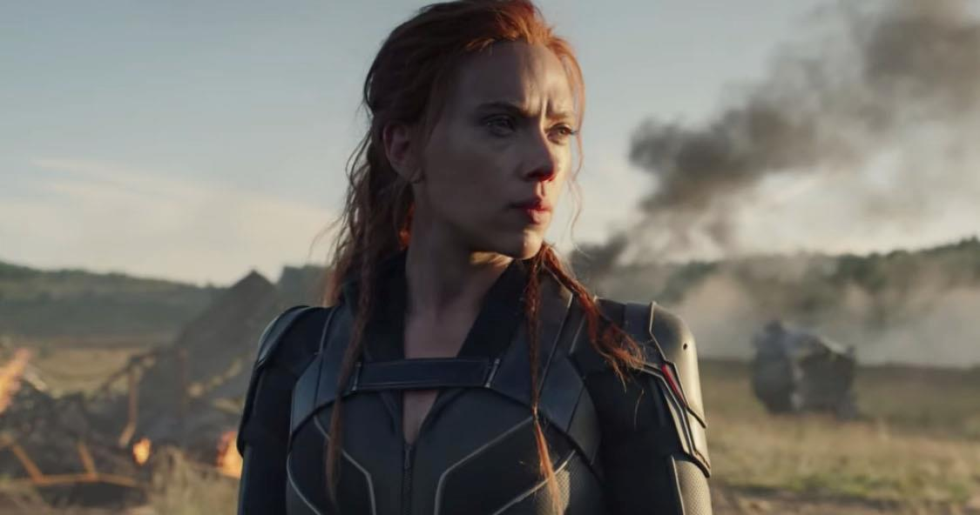
THE MARVEL AUDIENCE IS A PERFECT MATCH FOR GAMING & TECH BRANDS
Marvel fans: Gaming & Tech insights
CONSOLE GAMERS
Index: 158
“LOVE TO BUY NEW GADGETS & APPLIANCES”
Index: 131
INTEND TO PURCHASE: LAPTOP/TABLET
Index: 123
“MY FAVE PASTTIME IS PLAYING VIDEO GAMES”
Index: 150
“TRY TO KEEP UP WITH TECH DEVELOPMENTS”
Index: 116
INTEND TO PURCHASE: SMARTPHONE
Index: 133
INTEND TO PURCHASE: GAMES CONSOLE
Index: 203
“I LIKE INNOVATIVE H/HOLD DEVICES”
Index: 123
INTEND TO PURCHASE: HOME OR PERSONAL SMART TECH
Index: 151
Source: TGI GB Oct 2022, Fans of the Marvel film franchise.
Indexes vs average GB adult (15+)

Slide 12
AUDIENCE SNAPSHOTS: MARVEL FANS
Category insights
MOTORS
FOOD
RETAIL
“I LIKE INNOVATIVE CARS”
Index: 148
“I LIKE TO TRY NEW RECIPES”
Index: 118
VISITED MAJOR
SHOPPING CENTRES
Index: 133
INTEND TO BUY CAR IN NEXT
24 MONTHS
Index: 127
“I LIKE TO EAT TAKEAWAY MEALS”
Index: 126
£491 AMOUNT SPENT ON ONLINE SHOPPING IN PAST YEAR
Nearly £100 more than avg. UK adult
INTEND TO BUY – NEW (NOT SECONDHAND)
Index: 143
SPLASHING OUT AT A RESTAURANT
Index: 120
“BUY NEW PRODUCTS BEFORE MOST OF MY FRIENDS”
Index: 179
Source: TGI GB Oct 2022, Film Franchise Fans – Marvel who are heavy cinemagoers Index vs GB average

Slide 13
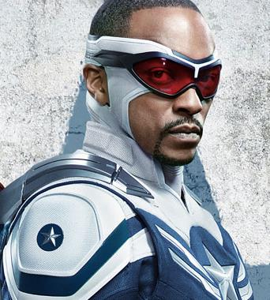

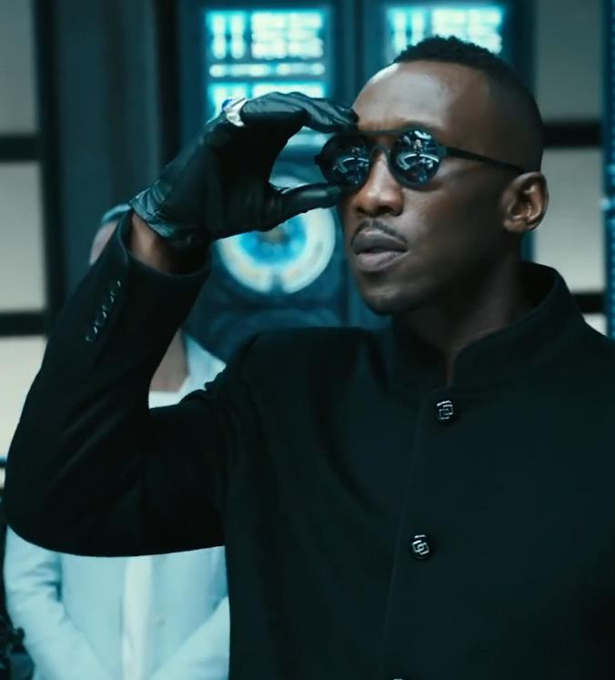
marvel phase 6: 2024 cinema releases
2024 ushers in a new big-screen era for the MCU with the first leading appearances of Anthony Mackie as Captain America and Mahershala Ali as Blade, and the introduction of the anti-hero Thunderbolts team led by Florence Pugh and Sebastian Stan.
Captain America New World Order
Thunderbolts
Blade
3 May 2024
26 July 2024
6 September 2024

