Slide 1
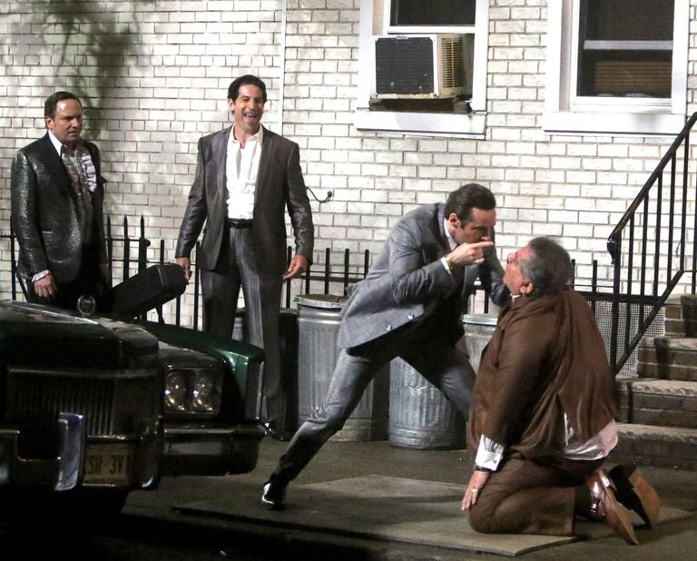
The Many Saints of Newark
A television classic debuts on the big screen!
Release Date
22 October 2021
Cast
Alessandro Nivola, Leslie Odom Jr., Jon Bernthal
Director
Alan Taylor (Thor: The Dark World, Terminator: Genisys)
Recommended if you like
Black Mass, Legend
Reasons to buy into
The Sopranos is one of television’s most beloved and critically-acclaimed shows, and this prequel film features an all-star cast set to play younger version of the original players.
Key audience info
ABC1 Men Index: 155
Est. DCM admissions
233k
A look at the formative years of New Jersey gangster, Tony Soprano.
Plan your campaign

