Slide 1
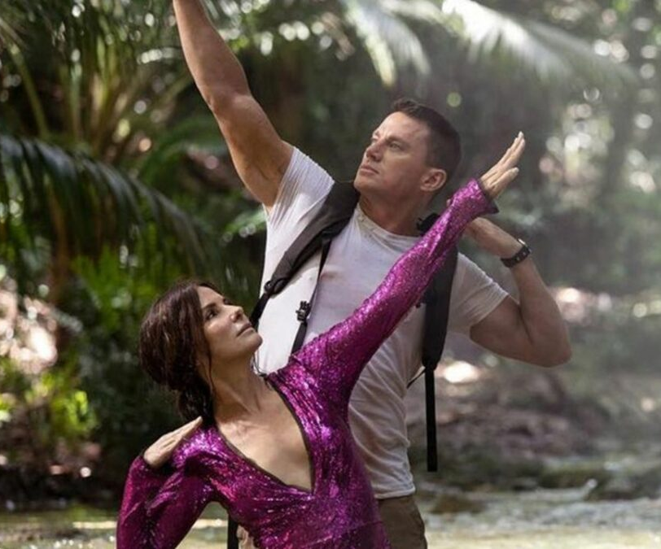
The Lost City
Star-studded jungle hijinks
Release Date
25 March
Cast
Sandra Bullock, Channing Tatum, Brad Pitt
Director
Aaron Nee, Adam Nee (Band of Robbers)
Recommended if you like
Ocean’s 8
Reasons to buy into
This original action comedy features an incredible array of Hollywood’s top talent.
Key audience info
18-34 Women Index: 215
Est. DCM admissions
590k
A reclusive romance novelist on a book tour with her cover model is swept up in a kidnapping attempt that lands them both in a cutthroat jungle adventure.
Plan your campaign

