Slide 1
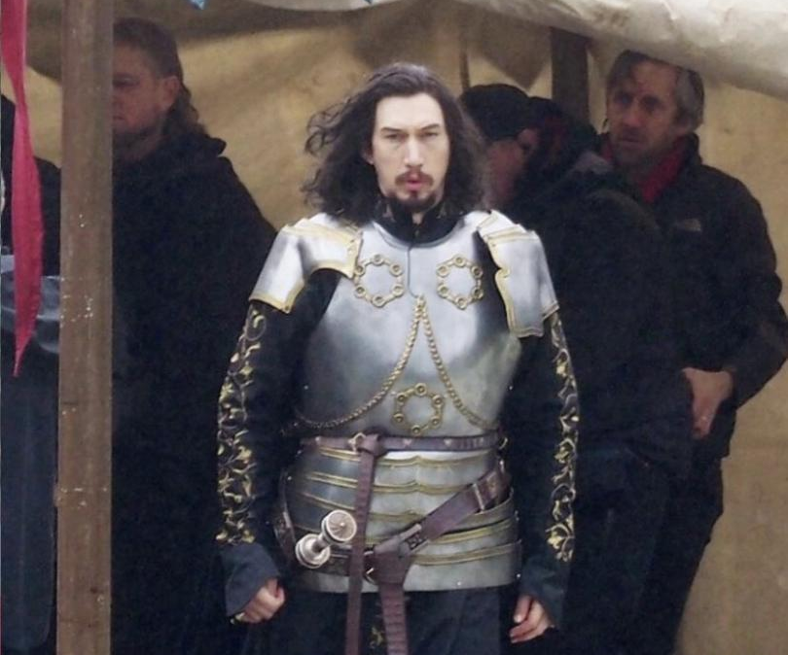
The last duel
A cinematic visionary returns
Release Date
15 October 2021
Cast
Adam Driver, Jodie Comer, Matt Damon
Director
Ridley Scott (The Martian, Alien Covenant)
Recommended if you like
The Revenant
Reasons to buy into
The Last Duel marks legendary director Ridley Scott’s return to cinema after 2017’s All the Money in the World, working from a script by Ben Affleck and Matt Damon
Key audience info
ABC1 Adults Index: 137
Est. DCM admissions
709k
King Charles VI challenges a young knight to a duel to settle a dispute.
Plan your campaign

