Slide 1
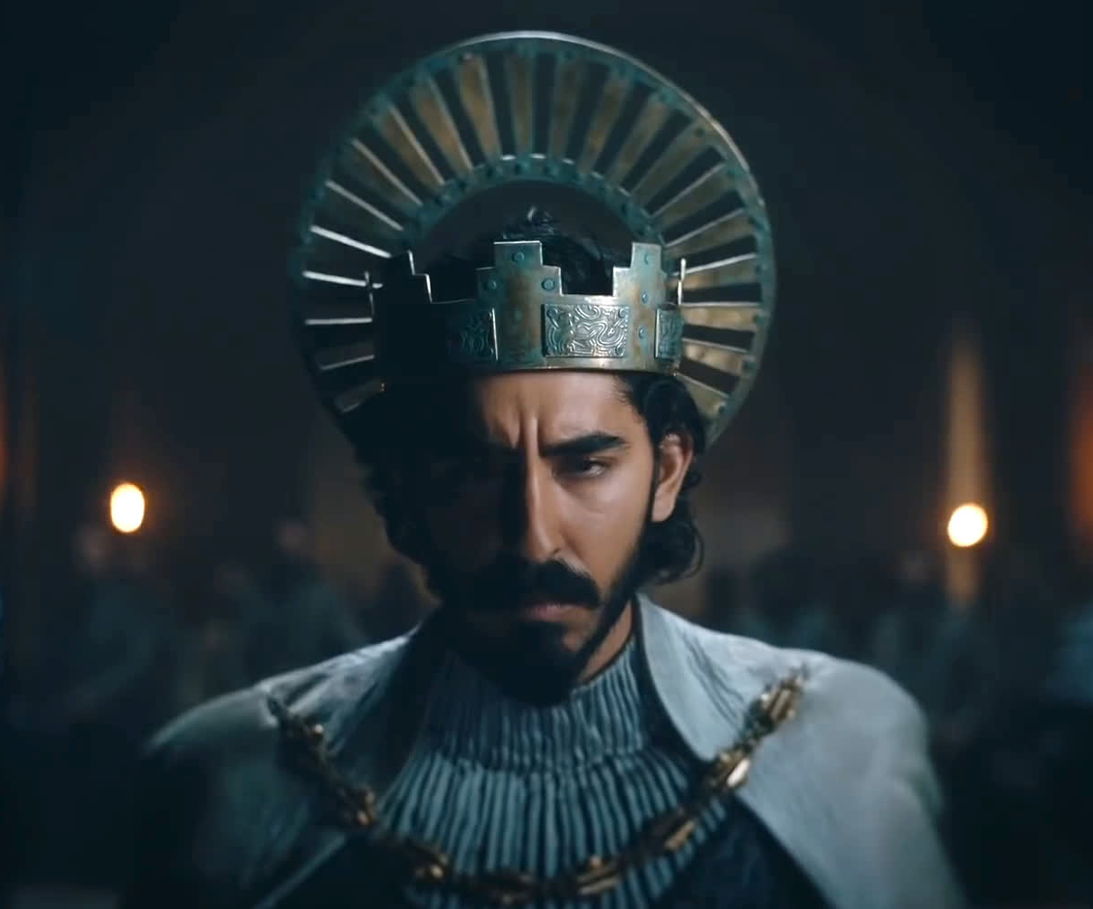
The green Knight
An legend reborn
Release Date
6 August 2021
Cast
Dev Patel, Alicia Vikander, Joel Edgerton
Director
David Lowrey (Pete’s Dragon, A Ghost Story, The Old Man and The Gun)
Recommended if you like
Midsommar
Reasons to buy into
The latest from blockbusting arthouse studio A24 (Midsommar, Hereditary, The Farewell), this moody, fantastical journey stars Dev Patel as a knight tasked with a dangerous journey into the unknown.
Key audience info
ABC1 Adults Index: 136
Est. DCM admissions
23k
A fantasy re-telling of Sir Gawain and the Green Knight, a medieval legend from the times of King Arthur.
Plan your campaign

