Slide 1
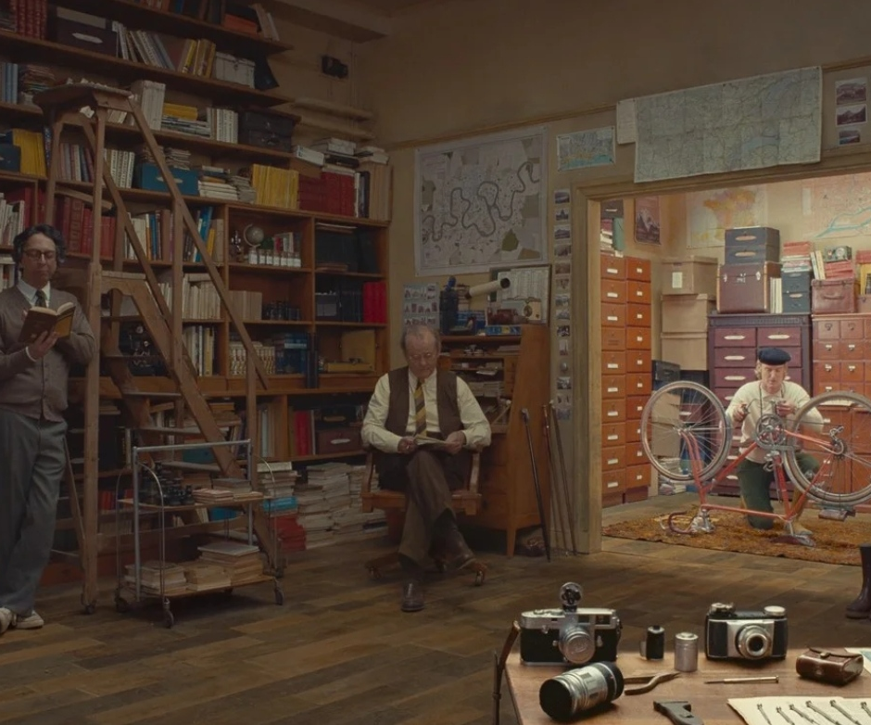
The French Dispatch
A quirky new journey from a cinematic master!
Release Date
22 October 2021
Cast
Timothee Chalamet, Elisabeth Moss, Frances McDormand
Director
Wes Adnerson (Isle of Dogs, The Grand Budapest Hotel)
Recommended if you like
The Grand Budapest Hotel
Reasons to buy into
Wes Anderson is a singular voice in cinema, with his instantly-recognizable aesthetic and keen eye for ensemble casts. His films have grossed over $500 million worldwide.
Key audience info
ABC1 Adults Index:
Est. DCM admissions
k
A love letter to journalists, set in an outpost of an American newspaper in a fictional twentieth-century French city that brings to life a collection of stories published in ‘The French Dispatch Magazine’.
Plan your campaign

