Slide 1
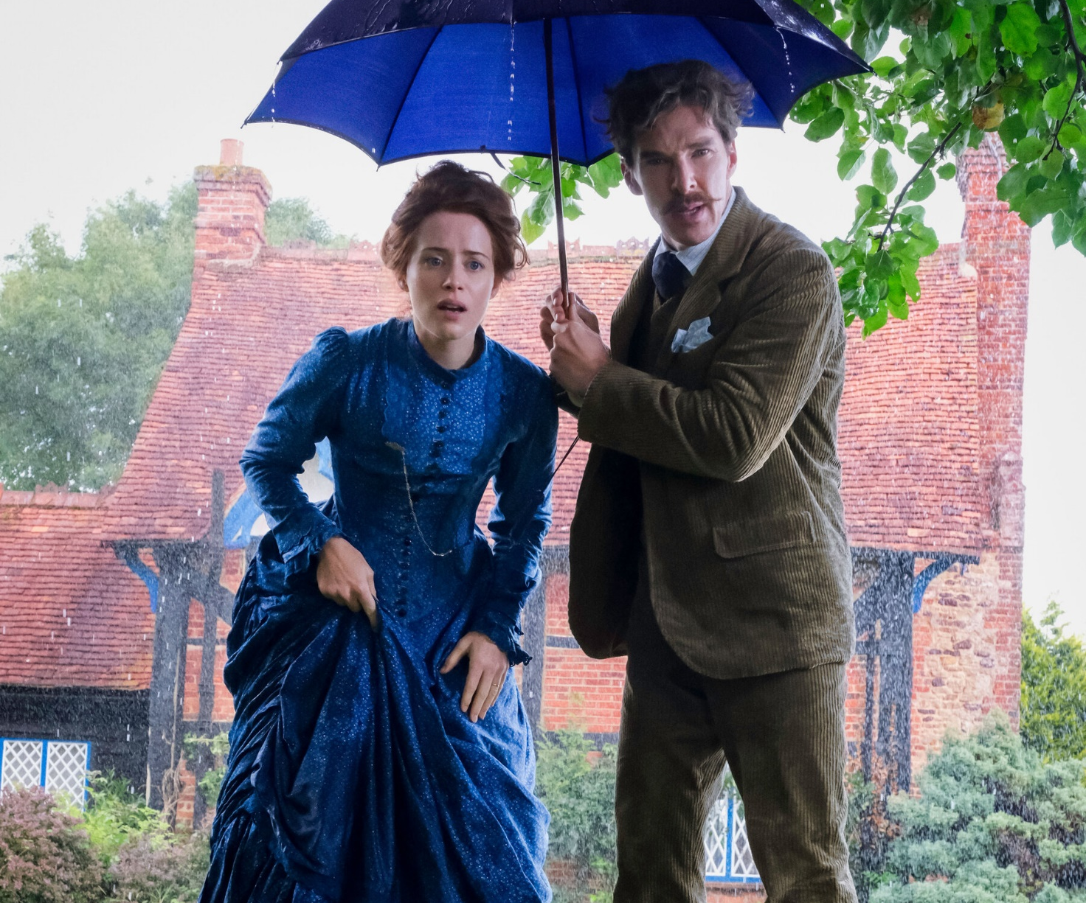
The Electrical Life of Louis Wain
A curious true story
Release Date
1 January
Cast
Benedict Cumberbatch, Claire Foy, Andrea Riseborough
Director
Will Sharpe (Black Pond)
Recommended if you like
The Aeronauts
Reasons to buy into
Benedict Cumberbatch and Claire Foy lead a winning British cast in this charming drama that has received rapturous early
Key audience info
ABC1 Adults Index: 166
Est. DCM admissions
272k
English artist Louis Wain rises to prominence at the end of the 19th century for his surreal cat paintings that seemed to reflect his declining sanity.
Plan your campaign

