Slide 1
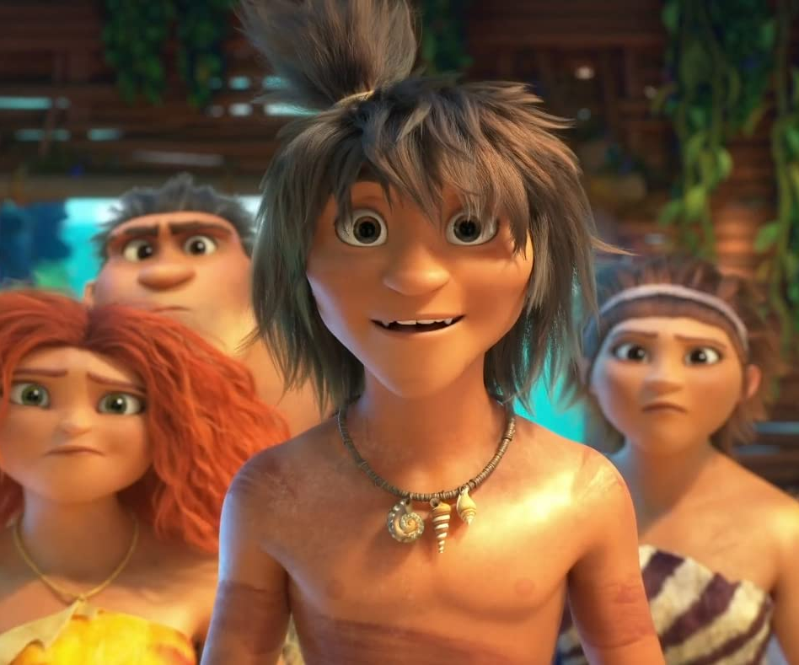
The Croods 2: A New Age
The pre-historic family is back!
Release Date
16 July 2021
Cast
Nicolas Cage, Emma Stone, Ryan Reynolds
Director
Joel Crawford (Feature Debut)
Recommended if you like
The LEGO Movie 2, Trolls
Reasons to buy into
The first Croods was released in 2013 and grossed a stunning £27 million at the UK box office and almost $600 million worldwide – this sequel is already a massively successful film in other regions.
Key audience info
HW w/Kids Index: 127
Est. DCM admissions
935k
The prehistoric family are challenged by a rival family, The Bettermans, who claim to be more evolved.
Plan your campaign

