Slide 1
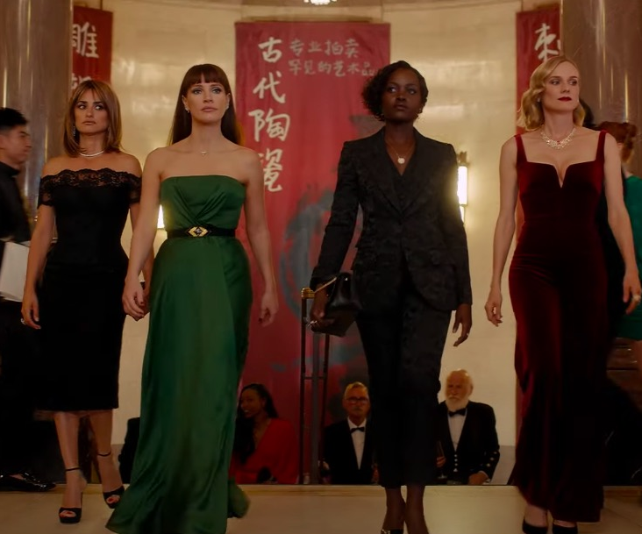
The 355
An original action thriller!
Release Date
7 January
Cast
Jessica Chastain, Lupita Nyong’o, Diane Kruger
Director
Simon Kinberg (Dark Phoenix)
Recommended if you like
Ocean’s 8
Reasons to buy into
With a stacked cast, this new action film promises the fun of the all-women Ocean’s 8 with the gritty, high-octane thrills of Atomic Blonde.
Key audience info
16-34 Adults Index: 185
Est. DCM admissions
406k
When a top-secret weapon falls into enemy hands, a wild card CIA agent assembles a team of international agents for a mission to retrieve it.
Plan your campaign

