Slide 1
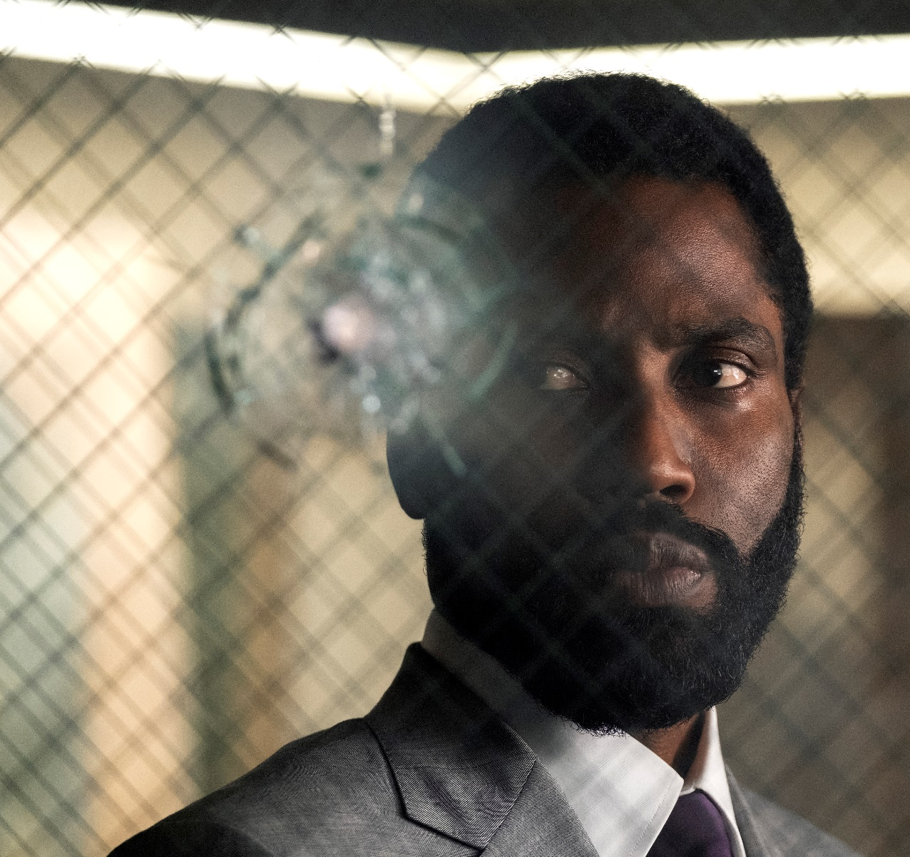
tenet
A brand new original blockbuster from Christopher Nolan
One of blockbuster cinema’s very best directors, Christopher Nolan (Dunkirk, Inception,
The Dark Knight Trilogy) returns for another huge original project clouded in secrecy with a prime summer release date. BlacKkKlansman star John David Washington takes the lead in a globe-trotting, time-travelling, espionage thriller, supported by Batman-to-be Robert Pattinson, Elizabeth Debicki (Widows) and of course Nolan stalwart Michael Caine. It’s set to be the best action film of the summer and may give a certain Mr. Bond a run for his money.
CAST
John David Washington, Robert Pattinson, Elizabeth Debicki, Michael Caine
KEY STATS
Christopher Nolan makes the most critically acclaimed blockbusters – his last five films have cumulatively grossed over £218m¹ at the UK box office and have won 10 Academy Awards
Consistent male audience – on average, Nolan’s last five films profiled 63% male
(128 index)²
EST. DCM ADMISSIONS
1.7m
Source: 1. IBOE. 2. Kantar TNS Film Monitor database. 3. CAA C+F Planner – using comparative film information.
RELEASE DATE: 26 AUGUST 2020

Slide 2
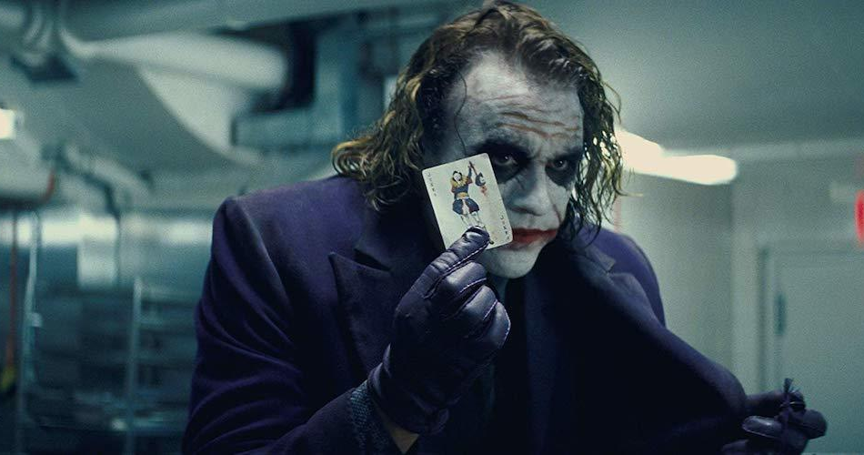
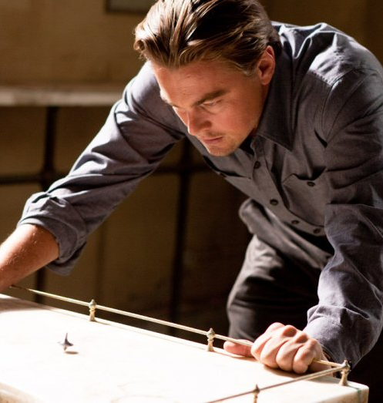


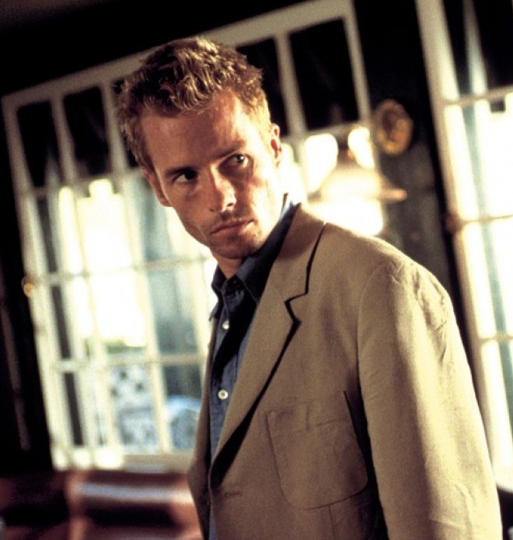

CHRISTOPHER NOLAN
Tenet marks the return of one of cinema’s most ambitious directors ever, the man behind The Dark Knight Trilogy, Inception, Interstellar and Dunkirk

Slide 3
Tenet is predicted to attract an affluent male audience
Nolan’s latest film is predicted to be the highest profiling blockbuster for ABC1 Men in 2020 – a brilliant fit for any brands looking
to reach and impact this key buying audience.
16-34 adults
38%
Index 130
Women (16+)
59%
Index 129
Index line 100
ABC1 (16+)
67%
Index 138
Source: Kantar TNS Film Monitor. Index based on spit in UK population.

