Slide 1
SUNDANCE FILM FESTIVAL
2021

Slide 2
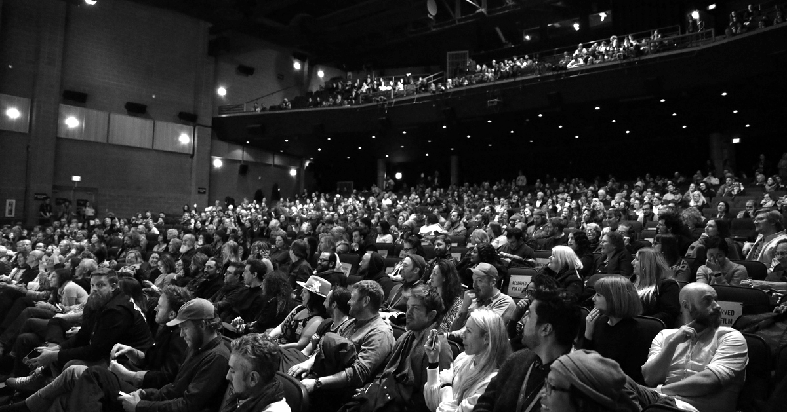
SUNDANCE FILM FESTIVAL
The Sundance Film Festival stands as the largest and most influential celebration of independent film in the world.
Every year in Utah, it draws crowds and artists from all over the world, with one aim; to support and celebrate exciting stories from established and emerging independent artists.

Slide 3
2021 Sundance Film Festival: OFFICIAL SELECTIONS
44
COUNTRIES REPRESENTED ACROSS FESTIVAL PROGRAM
27
COUNTRIES REPRESENTED IN SHORT FILM
39
FIRST TIME FEATURE FILMMAKERS
25
FIRST TIME FEATURE FILMMAKERS IN COMPETITION
77
FEMALE FEATURE AND SHORT FILMMAKERS
80
BIPOC FEATURE AND SHORT FILMMAKERS
69
PROJECTS DIRECTED BY WOMEN, 49% TOTAL
71
PROJECTS DIRECTED BY BIPOC ARTISTS, 50% TOTAL
14 PROJECTS SUPPORTED BY THE SUNDANCE INSTITUTE ARTIST PROGRAMS

Slide 4
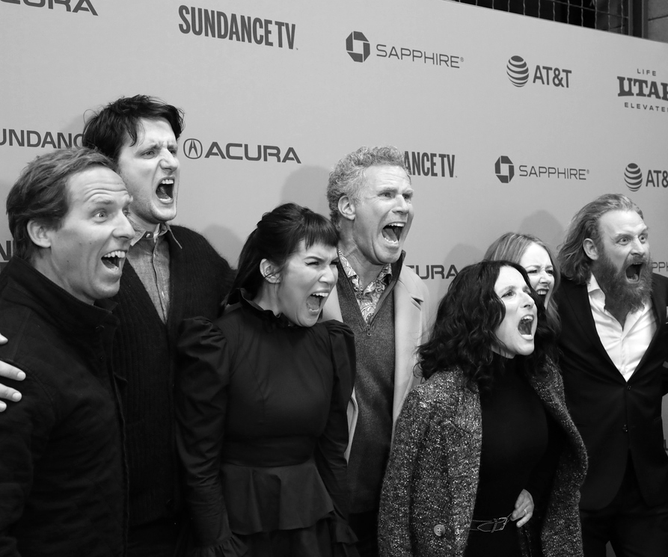
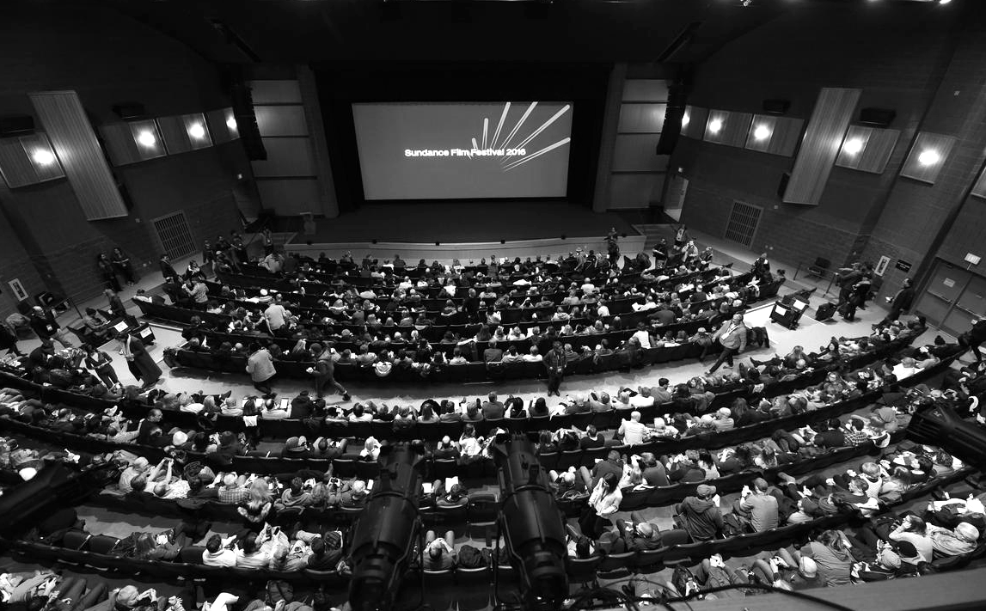
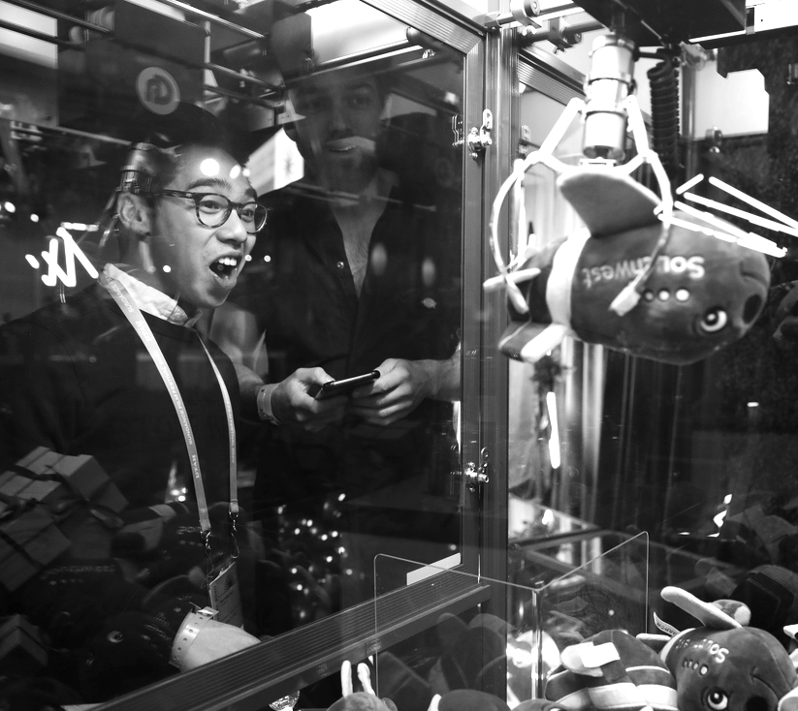
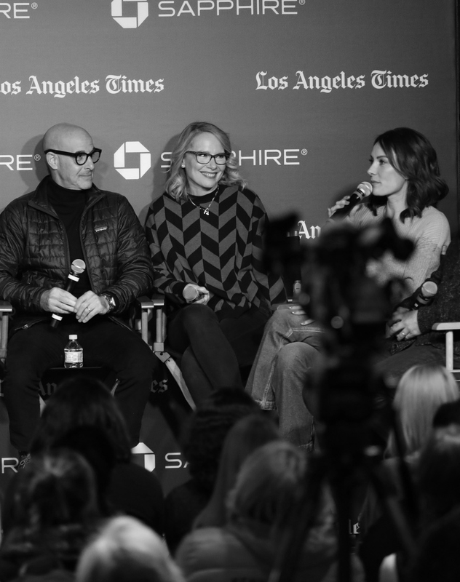
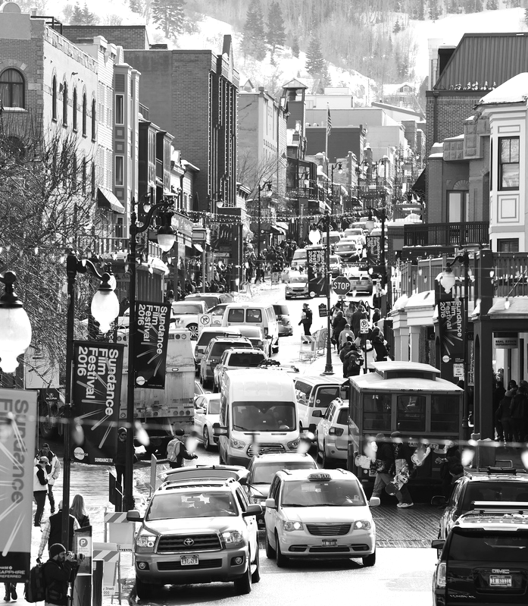

Slide 5
SUNDANCE FILM FESTIVAL: LONDON

Slide 6
SUNDANCE FILM FESTIVAL: LONDON
After a year of shuttered cinemas, and an ever-moving film slate, we are excited to welcome audiences back to London’s first in-venue film festival in over a year, Sundance Film Festival: London.
Partners have the unique opportunity to play a role in welcoming audiences back through cinema doors, to celebrate film, diversity and the craft of storytelling.
From online activation, in theatre experiential and new possibilities such as pop-up cinema events this year, even more than most is set to be electric.

Slide 7
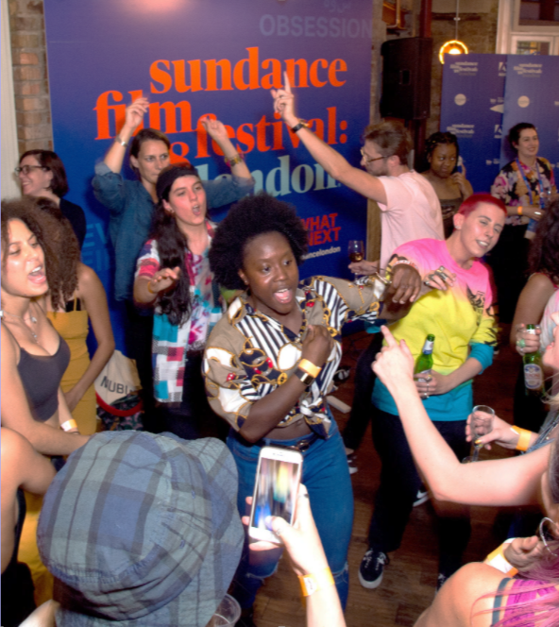
HOW IT WORKS
Returning for its sixth year, Sundance Film Festival: London will take place 29th July - 1st Aug at the West Ends Picturehouse Central.
12 hand-selected Sundance titles will be previewed to UK audiences, supported by a diverse program of panels, shorts, Q&A’s and workshops.
This year, centering around our values of accessibility and inclusion, we are excited to announce that a select program will be extended to 40 additional sites nationwide.
A feast of independent film awaits eager audiences and brand partners…

Slide 8
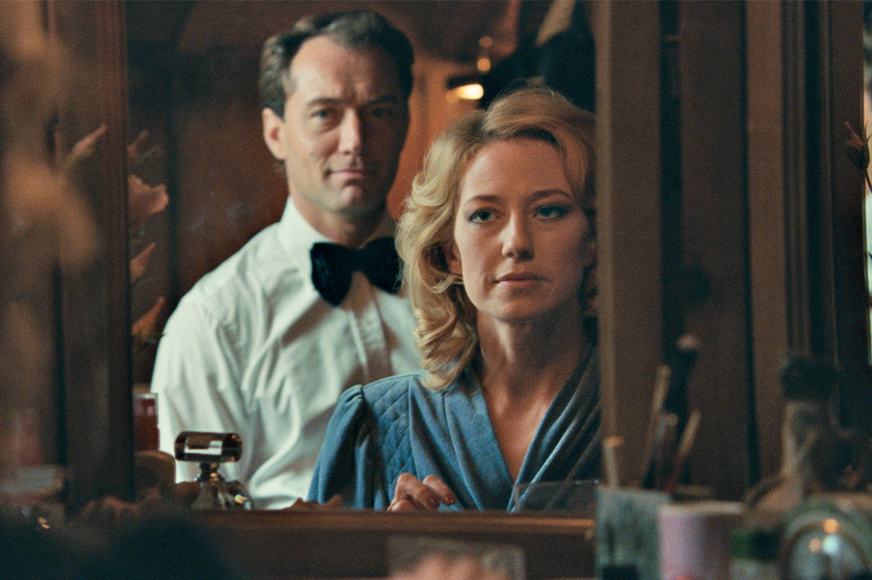
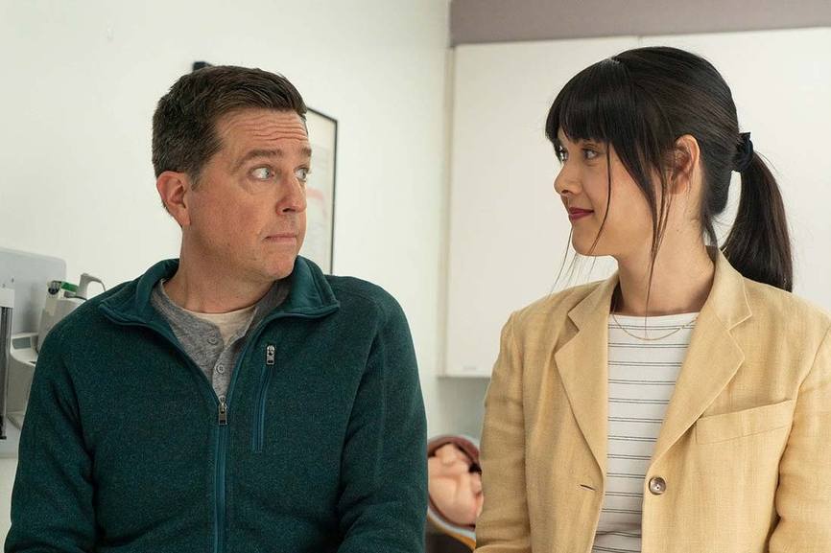
THE PROGRAMME
Confirmed so far for 2021:
Mass
The Nest
Human Factors
Together Together
Zola
Sparks Brother
Writing with Fire
Misha and the Wolves
The Nest
Together Together

Slide 9
SUNDANCE FILM FESTIVAL: PARTNER OPPS

Slide 10
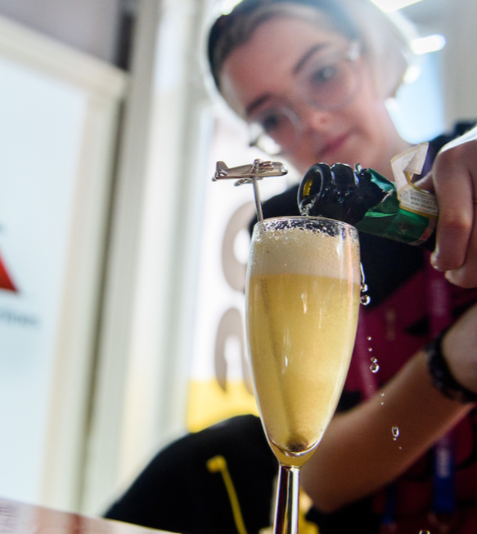
2021 sees Adobe reprise their role as Presenting Partner. There are still a number of supporting tiers available:
Lead Partners
Alcohol Partners
Supporting Partners
Experiential Partners
Lead & Alcohol partners will enjoy exclusivity across their brand verticals
We remain committed to integrating brands into the overall Sundance Film Festival: London experience in as bespoke a manner as possible, being flexible with assets and activations in order to suit brand campaign strategy and briefs.

Slide 11
SUNDANCE FILM FESTIVAL
PRE PROMOTIONAL EXPOSURE
In the weeks running up to the festival - logo exposure will be available across all festival promotional assets, as well as editorial led opportunities across Picturehouse assets.
On-Screen - Logo inclusion on Festival trailer across the Picturehouse estate
In Venue - Logo inclusion on promotional assets eg. posters and digi screens
Social - Bespoke brand led posts across Picturehouse channels
Email - Bespoke brand led emails to Picturehouse database
Online - Logo inclusion on Festival URL and brand hub creation

Slide 12
SUNDANCE FILM FESTIVAL
PARTNER ACTIVATION OPPORTUNITIES
Deeply connect with storytellers, creators and talent to further solidify your brand as one committed to the creative community with a Festival sponsorship. Sponsors have the opportunity to:
Gain large-scale logo optics across Festival materials, cementing your brand as a leader to creative community and providing a unique way to showcase your products
Develop and program custom activations to reach filmmakers, industry and Festivalgoers alike
Host events for key executives, guests and important clients/customers, delivering a once-in-a-lifetime experience
Develop experiential moments across venues to deliver product led experiences.

Slide 13
Sundance Film Festival: CASE STUDIES

Slide 14
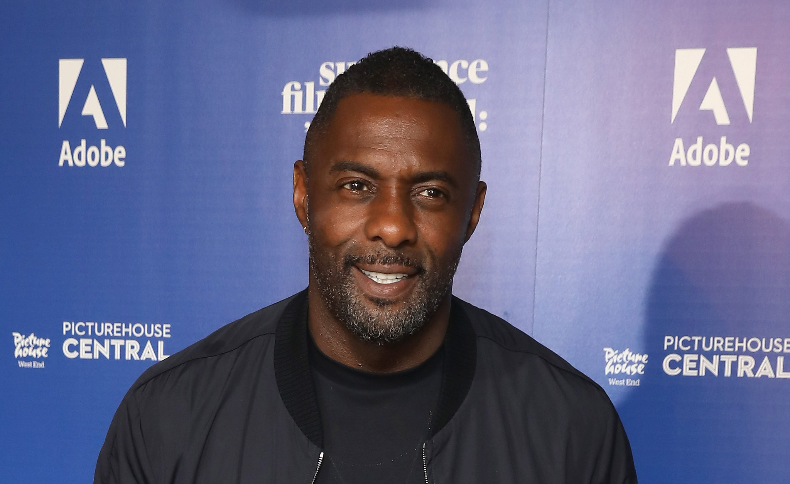
ADOBE
Adobe wanted to further establish itself as an industry leader whilst engaging the next generation of video editors.
They launched a highly visible, multi touchpoint campaign taking over the members bar, hosting screenings for the emerging filmmaker audience and editing workshops.

Slide 15
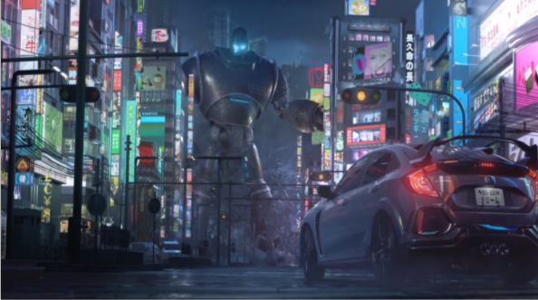
HONDA
Building on its long term brand association with film Channel 4, DCM and Picturehouse worked with Honda to bring it’s ‘Dream Makers’ creative to audiences during the promotional and live periods of the festival in 2019.

Slide 16
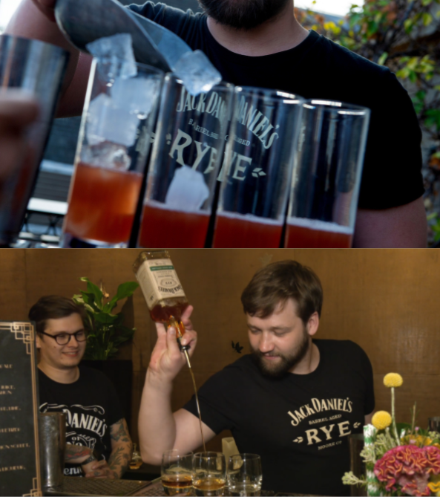
JACK DANIELS
Jack Daniels wanted to engage with the Sundance audience and influencers to drive awareness of their NPD Jack Rye.
Jack Daniels provided film themed whiskey cocktails for all Sundance London events. They also took over the roof terrace renaming the area ‘The Rye Members Terrace’. Positioning a branded bar on the terrace they also treated customers to free whiskey tasting sessions that were promoted as part of the official festival programme.

Slide 17
Sundance Film Festival: LONDON AUDIENCE

Slide 18
AUDIENCE AND DEMOGRAPHICS*
The Festival draws a tastemaker audience, comprised of cinephiles, industry leaders, art lovers and more to be among the first to discover the groundbreaking voices.
AGE
40% 14 - 34
32% 35-54
29% 55+
GENDER
49% Female
51% Male
SOC.EC
78% ABC1
38% > £60k
Source: IPA TouchPoints 2019 & TGI
Picturehouse = Cinema most visited last 12 months
Index vs. average UK adult

Slide 19
LIFESTYLE & ATTITUDES
Love a good tipple!
47% say it’s worth paying more for good quality beer (123)
…and 40% feel the same about a quality wine! (120)
Well travelled
54% are passionate about travelling (121)
82% plan on holiday/a short break in next 12 months. (127)
Progressive & ethically minded
Want to know where products are sourced, concerned about climate change and
prepared to make lifestyle comprises
to benefit the environment
Love the arts and culture
37% regularly visit a museum (126)
24% regularly visit the theatre (115)
34% regularly visit an art gallery (125)
Affluent, upmarket audience
43% AB / 78% ABC1
16% Senior director/Professional
(e.g. doctor/solicitor)
14% Household income >£100k
Source: IPA TouchPoints 2019
Target: Visited Picturehouse in last 12 months
1: Life event planned in next 12 months. 2: at least once every 3 months

Slide 20
THANK YOU

